Slide 1
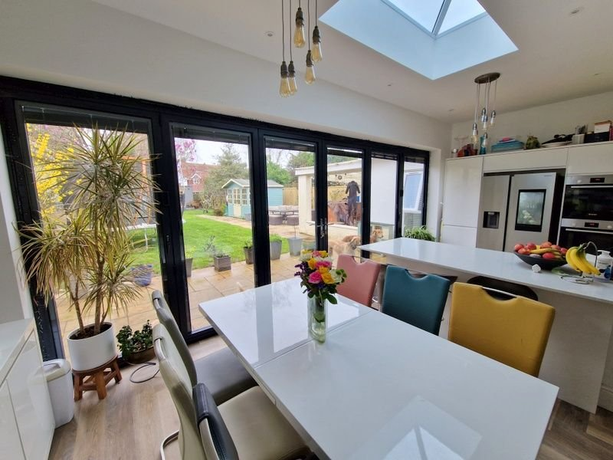
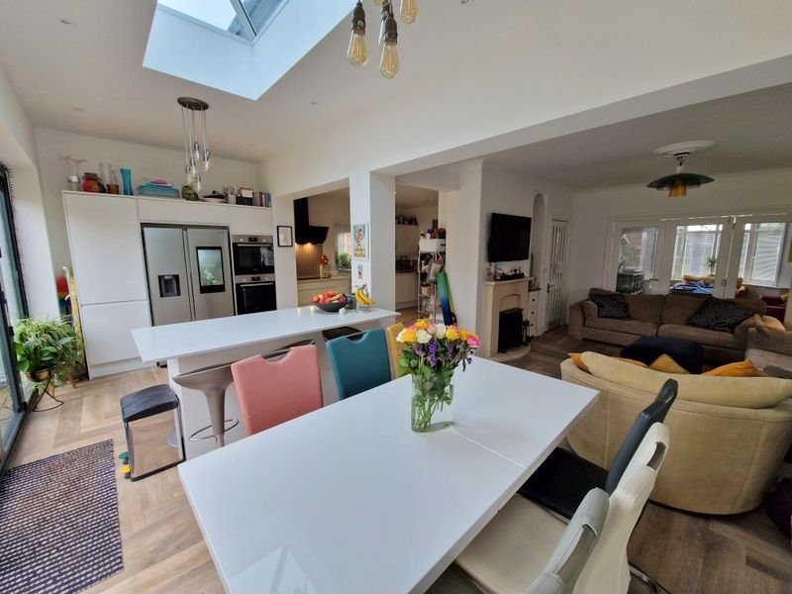
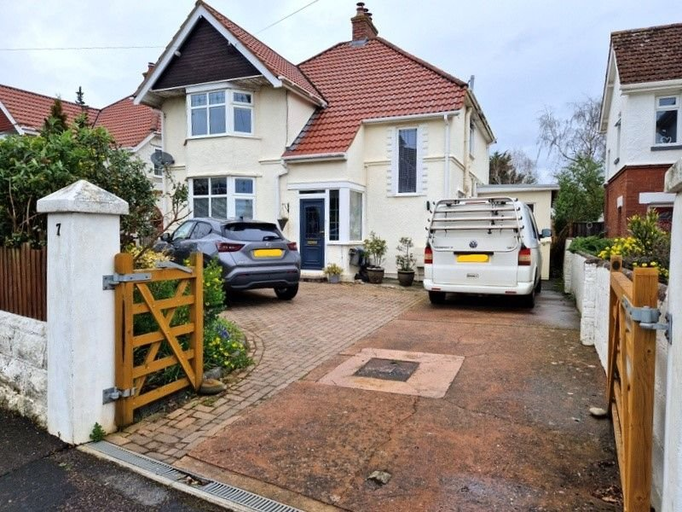
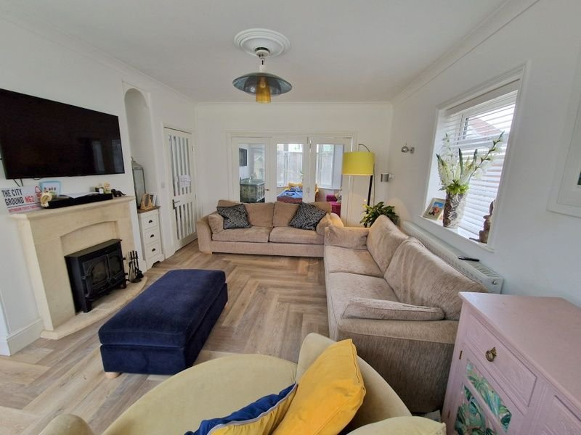
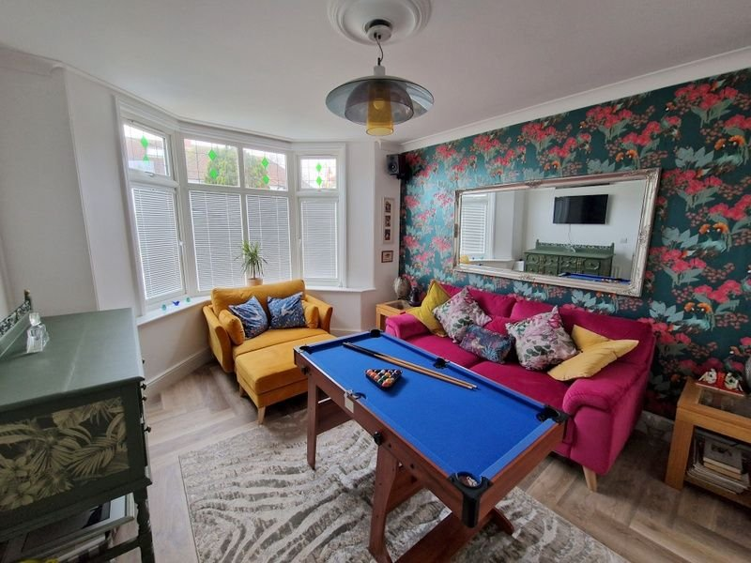
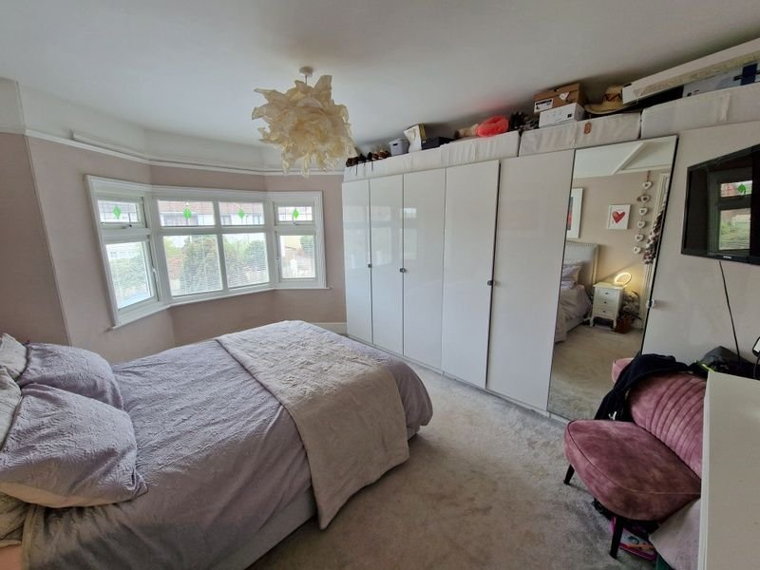
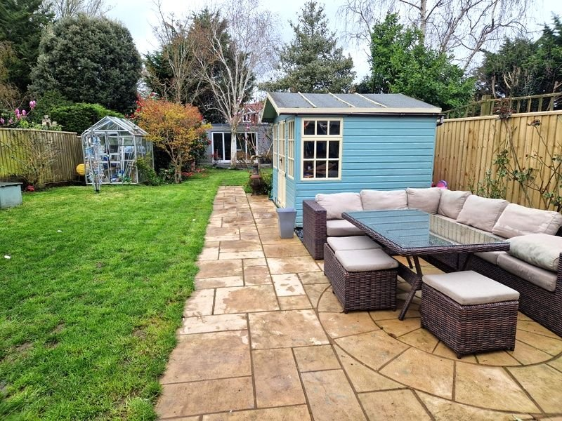
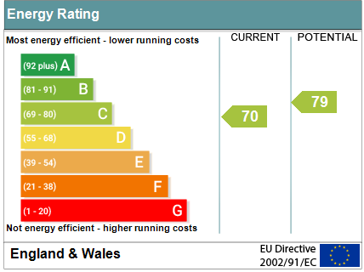
www.pennys.net
7 Barnfield Avenue, Exmouth, EX8 2QE
GUIDE PRICE £650,000
TENURE Freehold
A Significantly Extended Detached House Standing In Large Gardens With Cabin/Studio, Ample Off-Road Parking And Located In A Desirable And Convenient Location
Reception Hall • Sitting Room • Living Room •
Stunning Kitchen/Breakfast/Dining Room • Utility Room •
Ground Floor Bedroom Four/Office • Three First Floor Bedrooms • Spacious Bathroom Suite • Gas Central Heating & Double Glazed Windows • Fantastic Family Home •
Viewing Advised •
Pennys Estate Agents Limited for themselves and for the vendor of this property whose agents they are give notice that:- (1) These particulars do not constitute any part of an offer or a contract. (2) All statements contained in these particulars are made without responsibility on the part of Pennys Estate Agents Limited. (3) None of the statements contained in these particulars are to be relied upon as a statement or representation of fact. (4) Any intending purchaser must satisfy himself/herself by inspection or otherwise as to the correctness of each of the statements contained in these particulars. (5) The vendor does not make or give and neither do Pennys Estate Agents Limited nor any person in their employment has any authority to make or give any representation or warranty whatever in relation to this property.
PENNYS ESTATE AGENTS
2 Rolle House, Rolle Street, Exmouth, Devon, EX8 2SN
Tel: 01395 264111 EMail: help@pennys.net

Slide 2
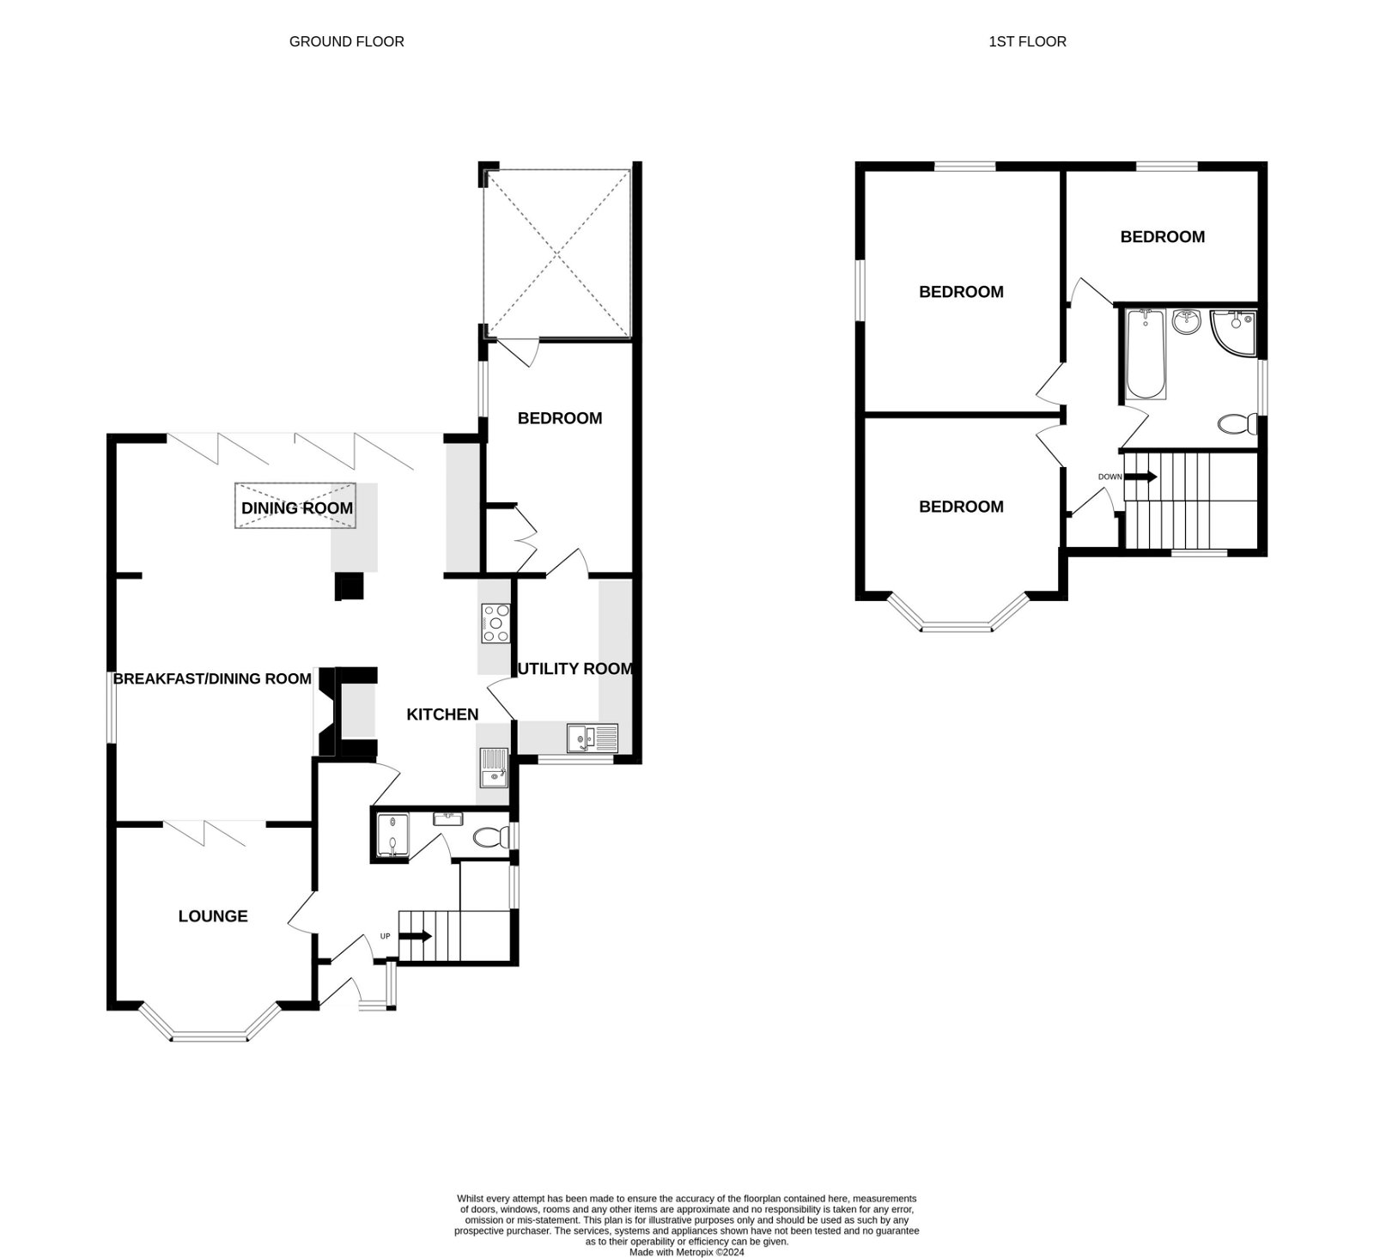
7 Barnfield Avenue, Exmouth, EX8 2QE
THE ACCOMMODATION COMPRISES: Double glazed front door to: ENTRANCE PORCH: Tiled floor; double glazed window; inner glass panelled door to: RECEPTION HALL: Radiator; picture rail; stairs to first floor landing with access to good size understairs cupboard; double glazed window; radiator. CLOAKROOM/WC: Space saver wash hand basin; WC; part tiled walls; chrome heated towel rail; window with pattern glass. SITTING ROOM: 4.39m x 3.68m (14'5" x 12'1") into double glazed bay window to front aspect; television point; radiator; glass triple doors to: OPEN PLAN LIVING ROOM/KITCHEN/DINING/BREAKFAST ROOM: LIVING ROOM: 4.57m x 3.86m (15'0" x 12'8") Stone fireplace housing wood burner stove; television point; radiator; double glazed window to side aspect. KITCHEN/BREAKFAST/DINING ROOM: 7.01m x 6.71m (23'0" x 22'0") maximum overall measurement. A stunning open plan area with full width Bi-folding doors to rear garden; roof lantern window over dining area; LED ceiling spotlighting and down lighters over dining area. High quality kitchen with quartz worktop surfaces including bar area with wine cooler and cupboards beneath; Bosch double oven, induction hob with fold-up extractor hood over with light; sink unit with integrated drainer; wall mounted cupboards including space for microwave; underfloor heating. UTILITY ROOM: 3.33m x 2.01m (10'11" x 6'7") Worktop surfaces with cupboards, drawer units, plumbing for an automatic washing machine and tumble dryer space beneath; inset one and a quarter bowl sink unit with hose style mixer tap; wall mounted cupboards; double glazed window to front aspect; radiator; door to: GROUND FLOOR BEDROOM FOUR/OFFICE: 4.24m x 2.72m (13'11" x 8'11") Double glazed window and door to rear garden; television point; fitted wardrobe. FIRST FLOOR LANDING: Double glazed window; access to roof space; linen cupboard. BEDROOM ONE: 4.37m x 3.48m (14'4" x 11'5") Double glazed bay window to front aspect; radiator; television point; picture rail. BEDROOM TWO: 4.55m x 3.68m (14'11" x 12'1") Double glazed window to side and rear aspect; picture rail; television point; radiator. BEDROOM THREE: 3.58m x 2.44m (11'9" x 8'0") Double glazed window to rear aspect; radiator. BATHROOM/SHOWER ROOM/WC: 2.57m x 2.54m (8'5" x 8'4") Bath; shower cubicle; WC with push button flush; chrome heated towel rail; two double glazed windows with pattern glass; attractive tiling to splash prone areas; mirror fronted medicine cabinet.
OUTSIDE: Double wooden gates to driveway plus block paved additional parking area, well stocked flower and shrub beds, side gates and pathway to rear garden. The rear garden is a super feature to the property being of good size level lawn garden, patio sun terrace area, variety of mature trees & shrubs, covered area (ideal for hot tub with power and light) summer house and green house. CABIN: 4.7m x 3.89m (15'5" x 12'9") Sliding double glazed doors; double glazed window; insulated LED lighting.
FLOOR PLAN:

