Slide 1
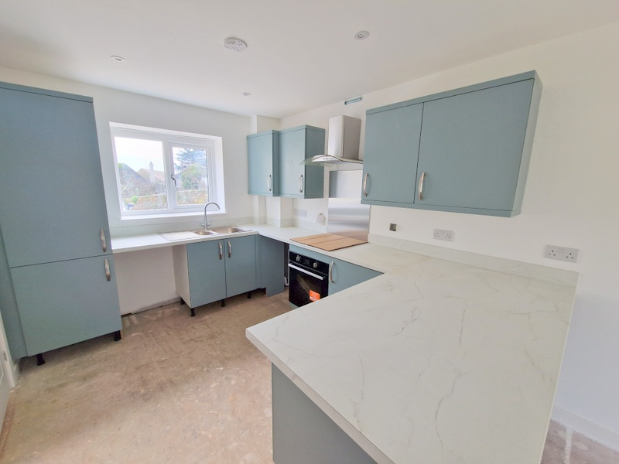
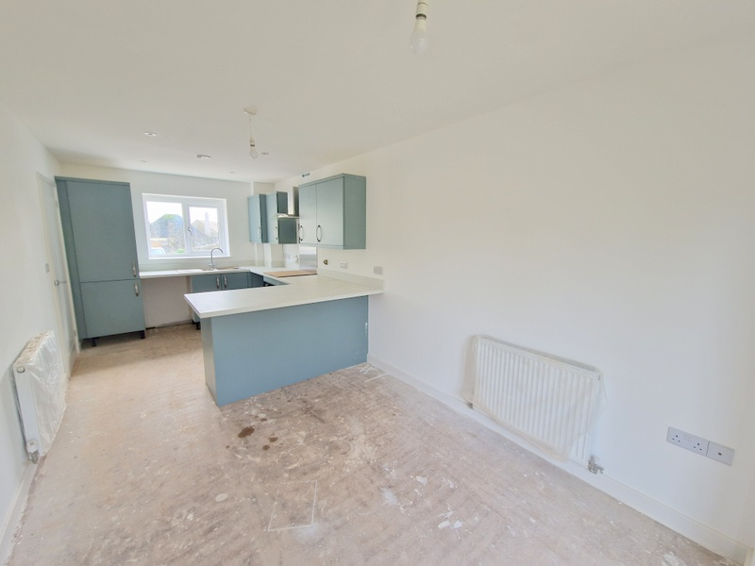
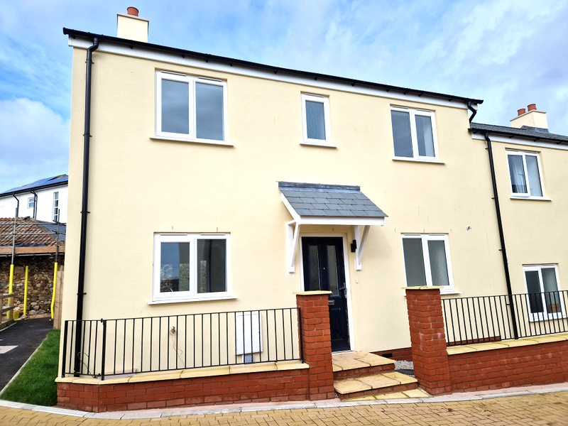
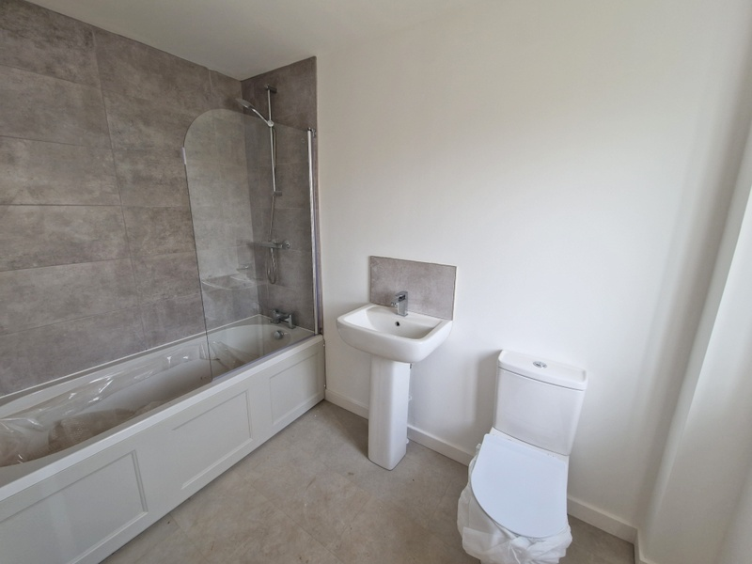
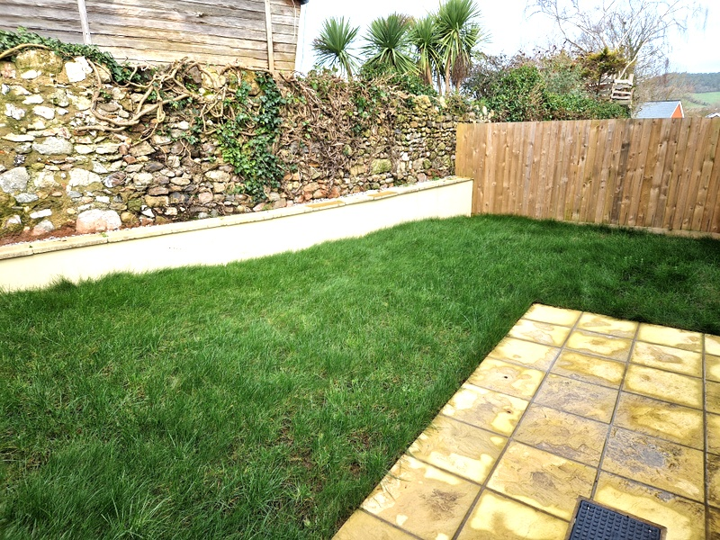
www.pennys.net
Plot 1, Driftwood, Fore Street, Seaton, EX12 2AD
GUIDE PRICE £325,000
TENURE Freehold
A Brand New Three Bedroom Semi Detached House With Parking And Gardens Situated In A Convenient Location Close To The Town Centre And Beach
Lounge • Quality Open Plan Kitchen/Dining Room •
Ground Floor Cloakroom/WC • Three Bedrooms Master with En-Suite •
Family Bathroom/WC • Available For Reservation Now •
10 Year Warranty • Viewing Recommended •
Pennys Estate Agents Limited for themselves and for the vendor of this property whose agents they are give notice that:- (1) These particulars do not constitute any part of an offer or a contract. (2) All statements contained in these particulars are made without responsibility on the part of Pennys Estate Agents Limited. (3) None of the statements contained in these particulars are to be relied upon as a statement or representation of fact. (4) Any intending purchaser must satisfy himself/herself by inspection or otherwise as to the correctness of each of the statements contained in these particulars. (5) The vendor does not make or give and neither do Pennys Estate Agents Limited nor any person in their employment has any authority to make or give any representation or warranty whatever in relation to this property.
PENNYS ESTATE AGENTS
2 Rolle House, Rolle Street, Exmouth, Devon, EX8 2SN
Tel: 01395 264111 EMail: help@pennys.net

Slide 2
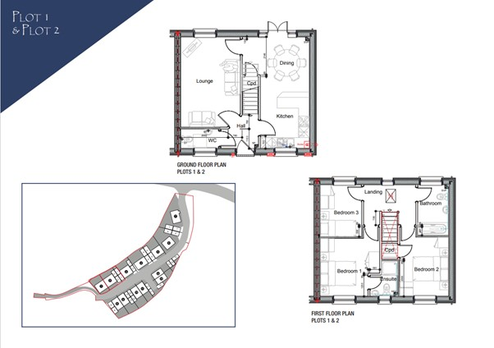
Plot 1 Driftwood, Fore Street,Seaton, EX12 2AD
THE ACCOMMODATION COMPRISES: Entrance Canopy with front door to: RECEPTION HALL: Stairs rising to first floor. CLOAKROOM/WC: KITCHEN/DINING ROOM: 6.27m x 3.81m (20'7" x 12'6") narrowing to 9' Fitted with a stylish contemporary kitchen with built in appliances; uPVC double glazed doors to rear garden. LOUNGE: 5.05m x 3.15m (16'7" x 10'4") FIRST FLOOR LANDING: BEDROOM ONE: 3.35m x 3.23m (11'0" x 10'7") plus door recess EN-SUITE SHOWER ROOM/WC: BEDROOM TWO: 3.3m x 2.74m (10'10" x 9'0") BEDROOM THREE: 2.9m x 2.34m (9'6" x 7'8") BATHROOM/WC: 2.92m x 1.7m (9'7" x 5'7") OUTSIDE: Parking and enclosed rear garden with patio and lawn.

