Slide 1
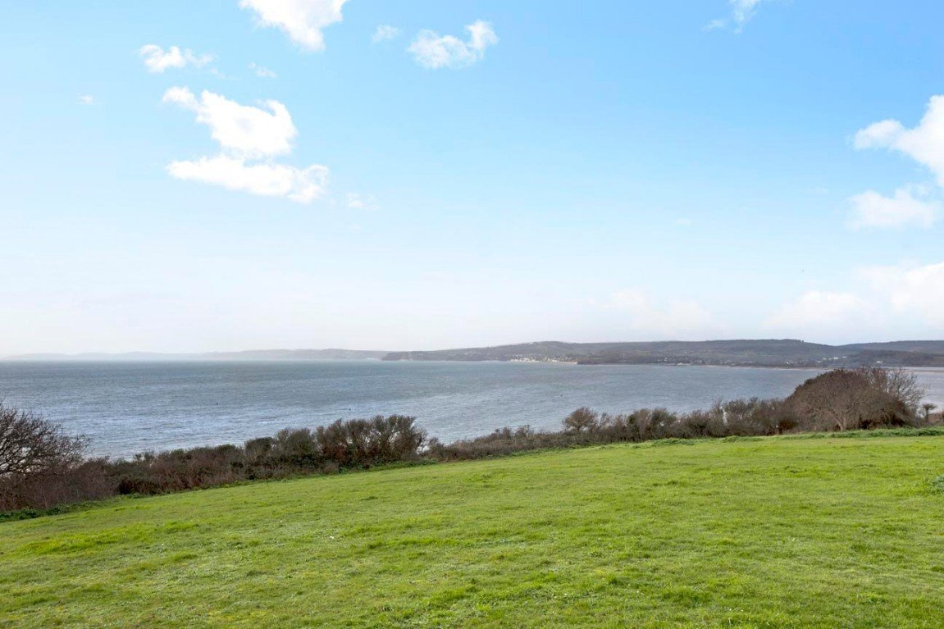
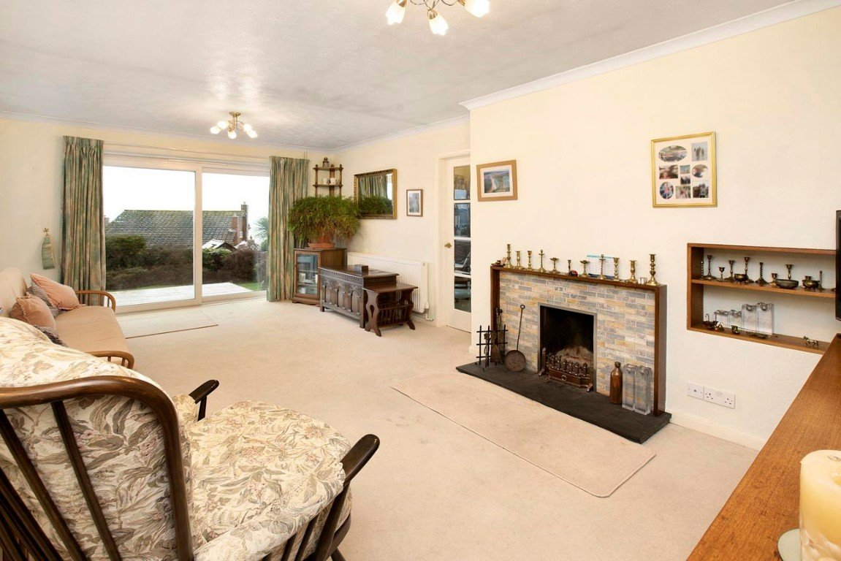
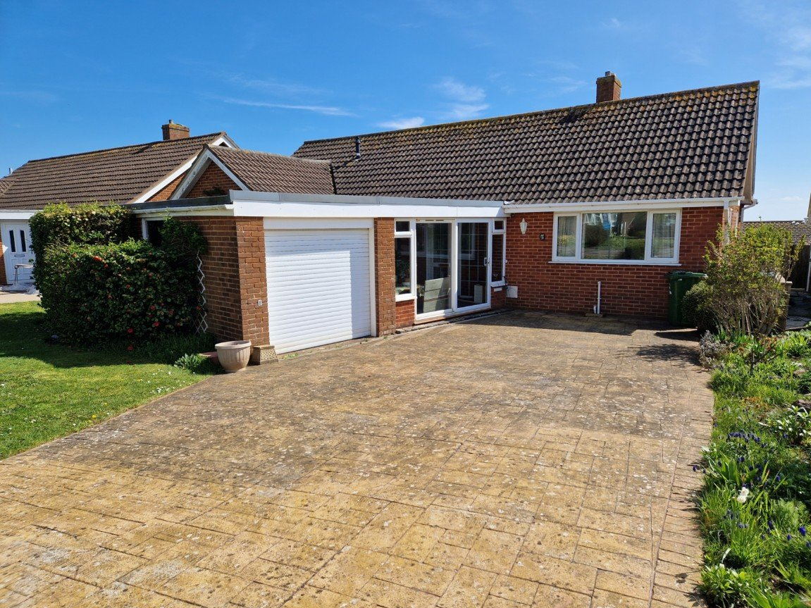
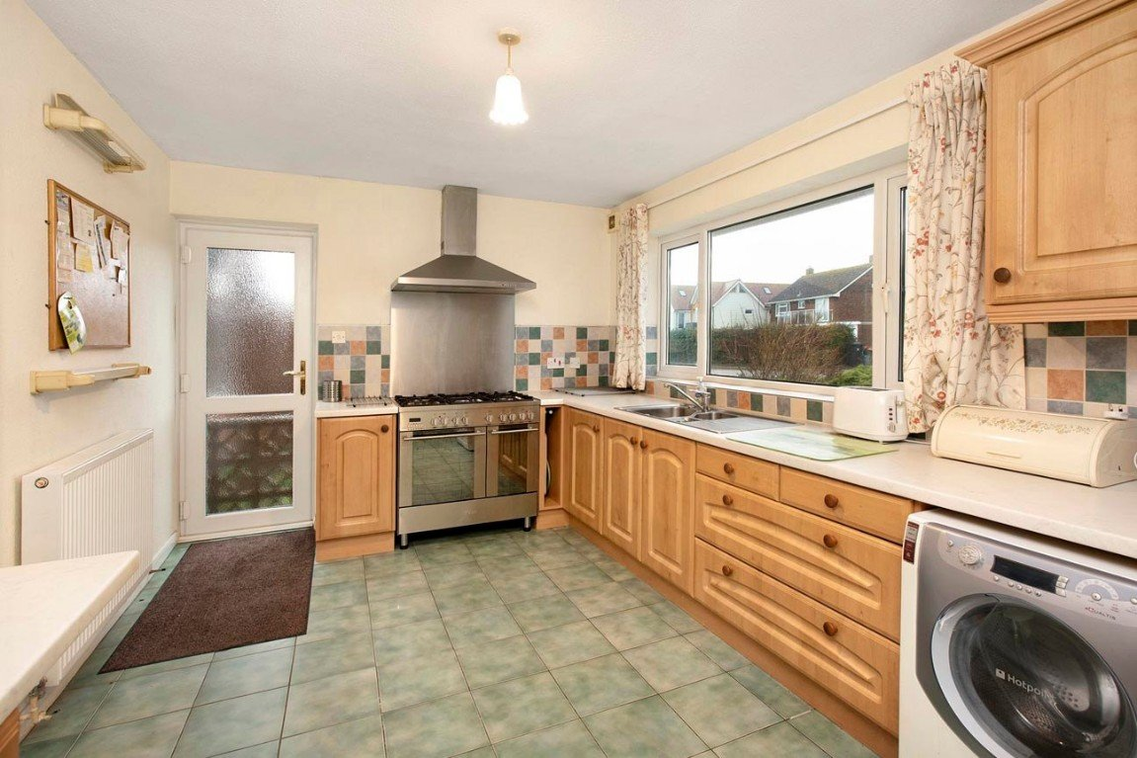
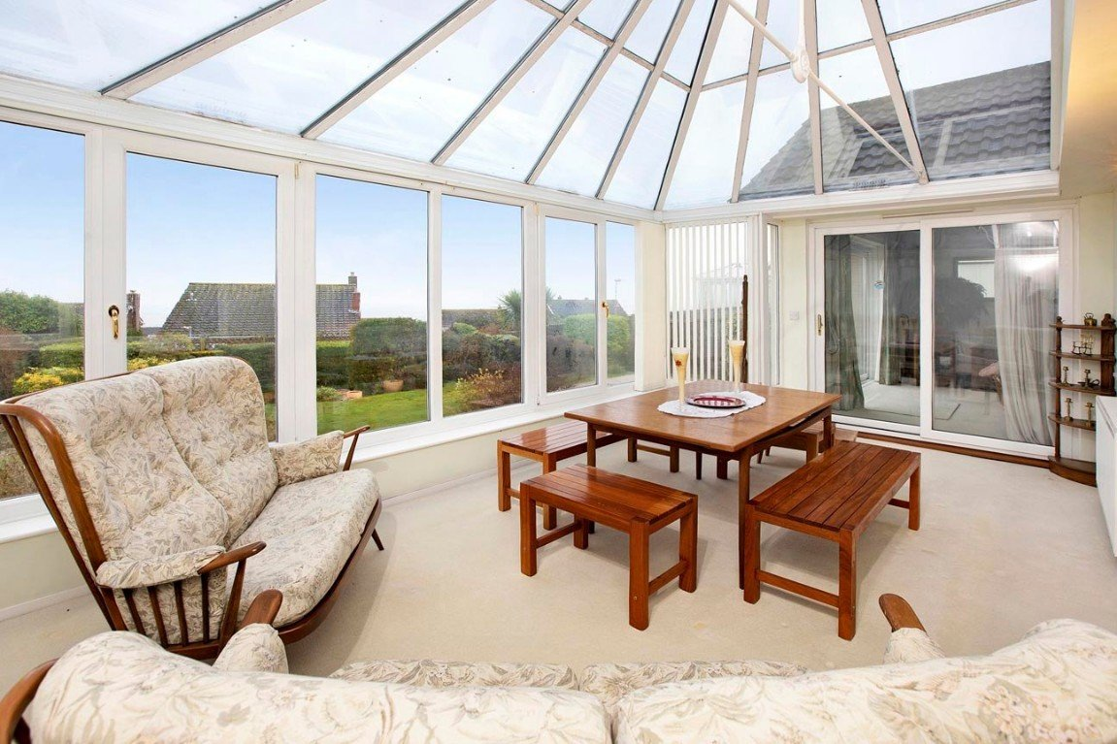
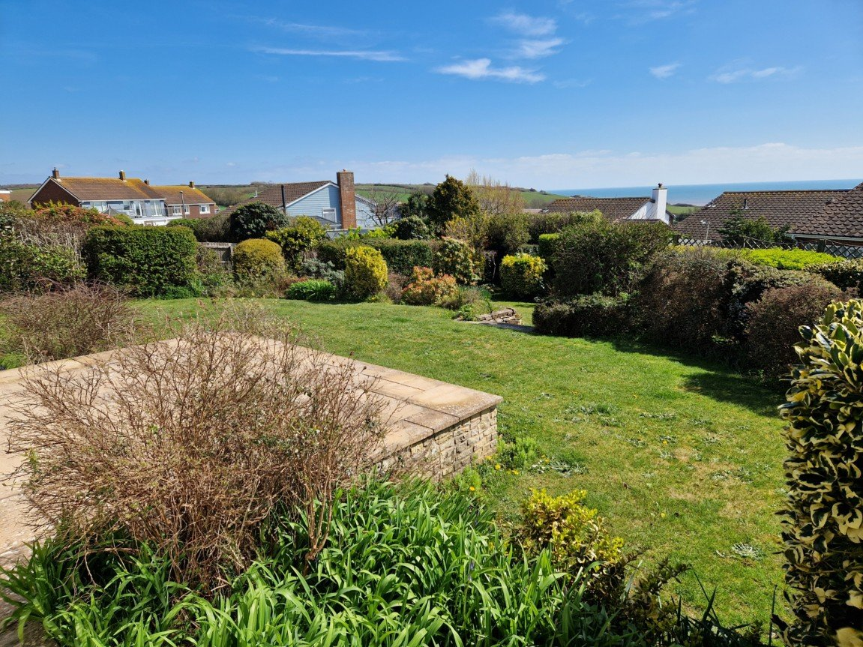
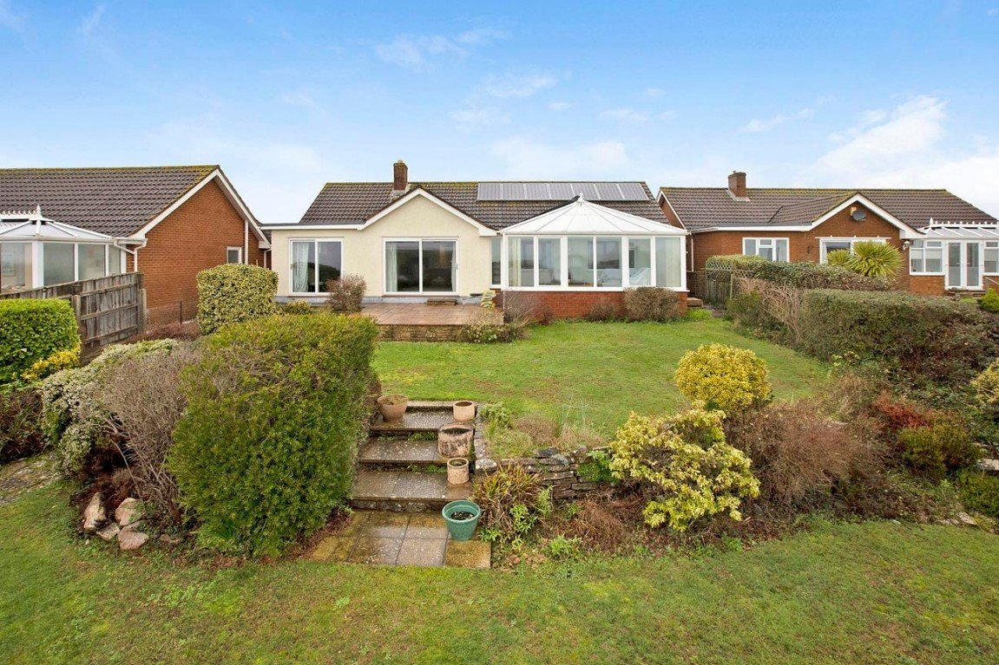
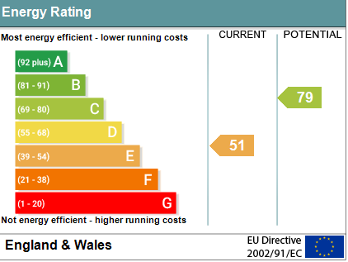
www.pennys.net
28 Foxholes Hill, Exmouth, EX8 2DQ
GUIDE PRICE
£749,000
TENURE Freehold
An Extremely Spacious Detached Bungalow Enjoying An Enviable Position In One Of Exmouth’s Most Desirable Locations With Views Across Surrounding Countryside Towards The Sea And South Devon Coastline Offered For Sale With No Onward Chain
Large Entrance Porch • Reception Hall • Lounge •
Good Size Double Glazed Conservatory • Spacious Kitchen • Separate Dining Room •
Three Bedrooms – Principal Bedroom With En-Suite Bathroom/WC • Main Bathroom/WC • Privately Owned Solar Panels • Well Planned Mature Rear Garden • Ample Parking •
Pennys Estate Agents Limited for themselves and for the vendor of this property whose agents they are give notice that:- (1) These particulars do not constitute any part of an offer or a contract. (2) All statements contained in these particulars are made without responsibility on the part of Pennys Estate Agents Limited. (3) None of the statements contained in these particulars are to be relied upon as a statement or representation of fact. (4) Any intending purchaser must satisfy himself/herself by inspection or otherwise as to the correctness of each of the statements contained in these particulars. (5) The vendor does not make or give and neither do Pennys Estate Agents Limited nor any person in their employment has any authority to make or give any representation or warranty whatever in relation to this property.
PENNYS ESTATE AGENTS
2 Rolle House, Rolle Street, Exmouth, Devon, EX8 2SN
Tel: 01395 264111 EMail: help@pennys.net

Slide 2
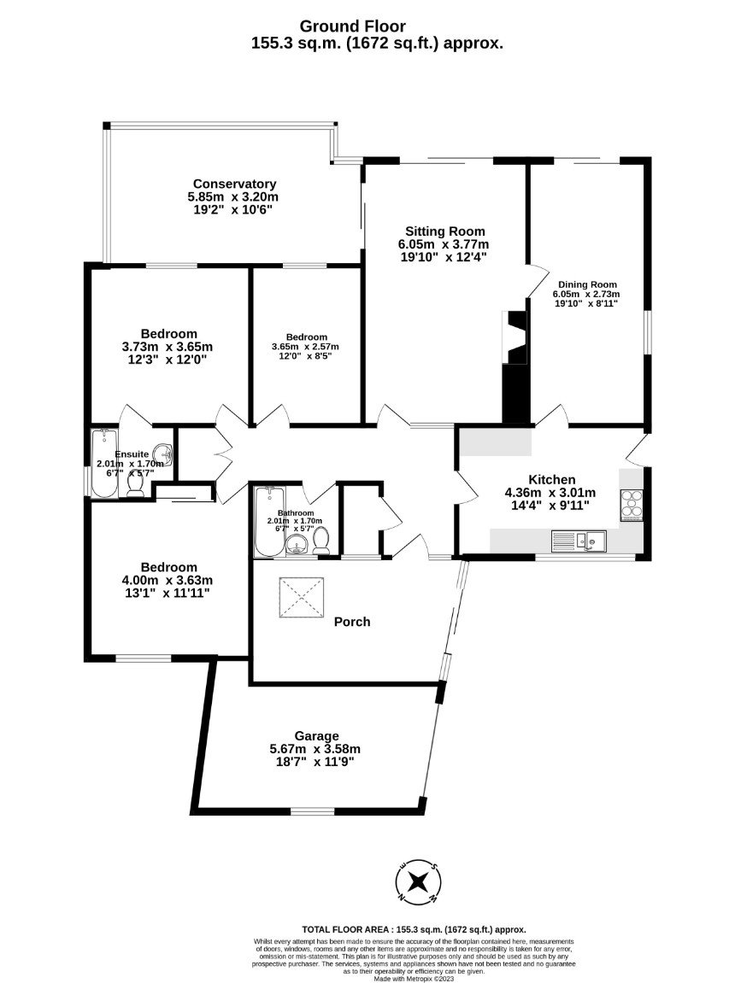
28, Foxholes Hill, Exmouth, Devon, EX8 2DQ
The property is located only a short distance from Jurassic coast walks along the cliff top and down to Exmouth Esplanade and Sea Front. The Esplanade runs the length of the beach where there are several cafe's, pubs and shops. With Exmouth Pavilion and Ocean providing a range of entertainment along with Side Shore water sports centre and Mickys Bistro from renowned chef Michael Cains.
​​​​​​​THE ACCOMMODATION COMPRISES: Sliding double glazed patio doors opening to:
SPACIOUS ENTRANCE PORCH: With cold water tap; skylight window; double glazed door with patterned glass giving access to the:
RECEPTION HALL: With access to loft space; two radiators; thermostat control for central heating; coved ceiling; walk-in coats cupboard with uPVC double glazed window with patterned glass and shelving; airing cupboard housing water cylinder and the gas boiler serving domestic hot water and central heating.
LOUNGE: A bright and spacious room with sliding double glazed patio doors opening onto a rear sun terrace gaining wonderful views towards the sea and over rolling countryside; further sliding double glazed patio doors opening onto the conservatory; fire surround with open grate; television point; additional wall lighting; coved ceiling.
CONSERVATORY: A fine and spacious addition to the accommodation with uPVC double glazed windows overlooking the rear gardens enjoying the sea and countryside views; radiator; wall lighting; range of power sockets.
KITCHEN: A generously sized kitchen fitted with a range of work top surfaces with tiled surrounds; inset single drainer one and a quarter bowl sink unit with mixer tap; base cupboards, drawer units, space and plumbing for washing machine beneath work tops; five ring Range style oven with stainless back and stainless-steel chimney style extractor hood over with light; matching wall mounted cupboards; space for upright fridge/freezer; radiator;
uPVC double glazed window to front aspect; uPVC double glazed door with patterned glass giving access to outside; glazed panelled door through to the:
DINING ROOM: (also accessed from the lounge). uPVC double glazed window to side aspect; sliding double glazed patio doors opening onto the rear garden enjoying the lovely sea and countryside views.
BEDROOM ONE: uPVC double glazed window to rear aspect; radiator; coved ceiling; door to:
EN-SUITE BATHROOM/WC: Comprising of a bath with Mira shower unit over; pedestal wash hand basin; WC; fully tiled walls; light/shaver socket; wall mounted mirror-fronted cabinet; uPVC double glazed window with patterned glass.
BEDROOM TWO: A good size second bedroom with uPVC double glazed window to front aspect; radiator; coved ceiling; built-in wardrobe with clothes rail and shelf.
BEDROOM THREE: uPVC double glazed window to rear aspect; radiator; coved ceiling.
BATHROOM/WC: Comprising of a bath with Mira shower unit over; pedestal wash hand basin; WC with push button flush; chrome heated towel rail; fully tiled walls; light/shaver socket; uPVC tilt and turn window with patterned glass.
OUTSIDE: The property is approached via a block paved driveway providing off-road parking for numerous cars and rockery style garden area to one side. There is a lawned area of garden to the front. A pedestrian gate and patio side pathway leads through to the REAR GARDEN which is a delightful feature of the property with patio sun terrace ideal for al-fresco dining/entertaining and ideally positioned to take full advantage of the wonderful coastal views; attractive areas of lawned garden with mature shrubs and bushes which offer an array of colour. Greenhouse (requiring some attention). A further side pathway and gate gives access back round to the front of the property.
SINGLE GARAGE:
With electrically operated up and over; power and light connected.
MORTGAGE ASSISTANCE: We are pleased to recommend Meredith Morgan Taylor, who would be pleased to help irrelevant of which estate agent you finally buy through. For a free initial, no obligation chat please contact us on 01395 264111 to arrange an appointment.

