Slide 1
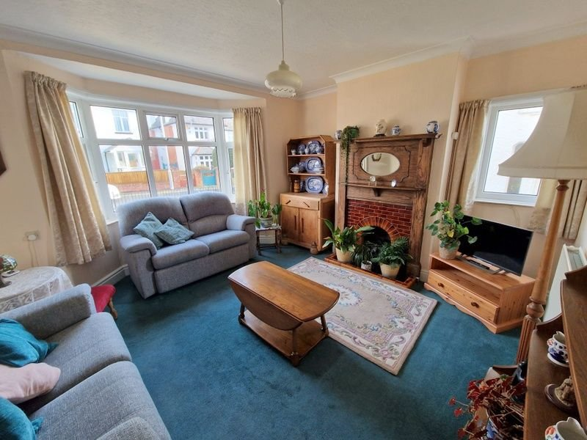
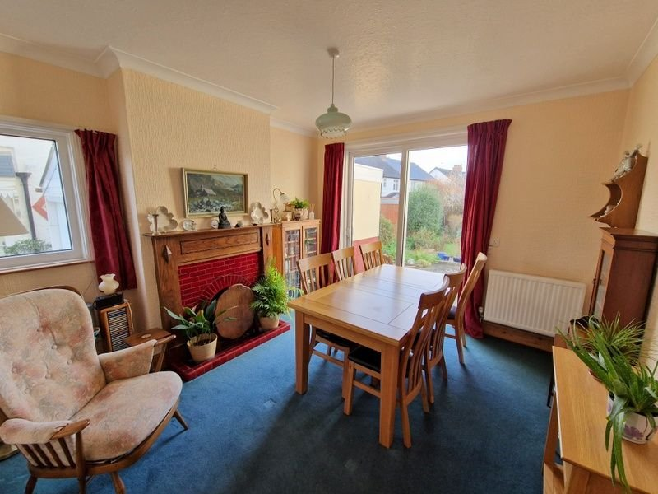
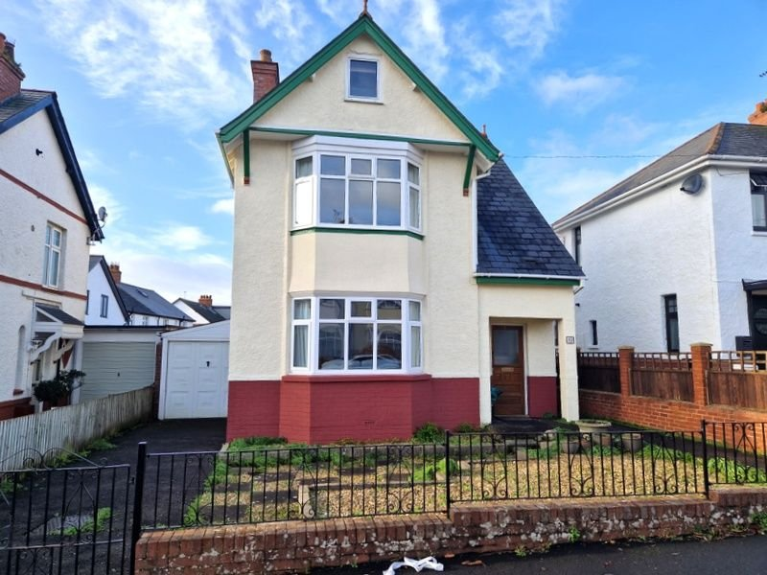
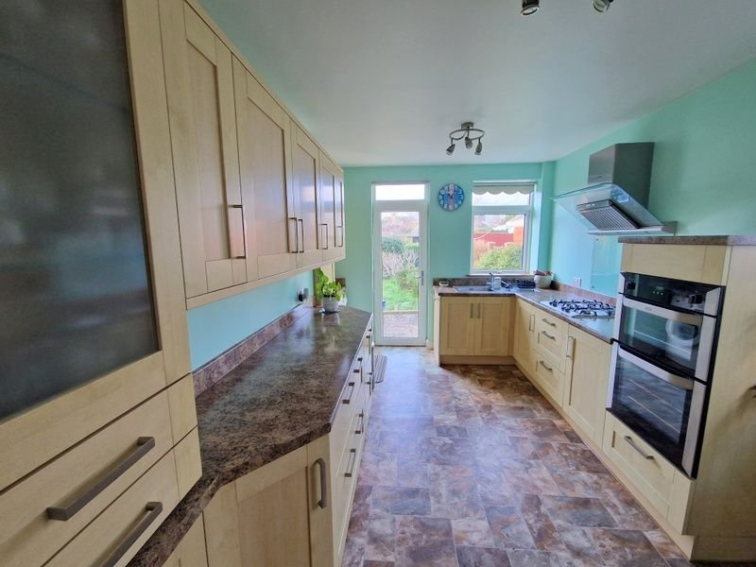
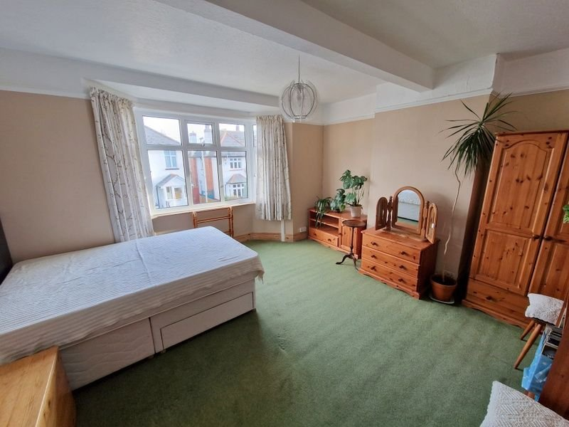
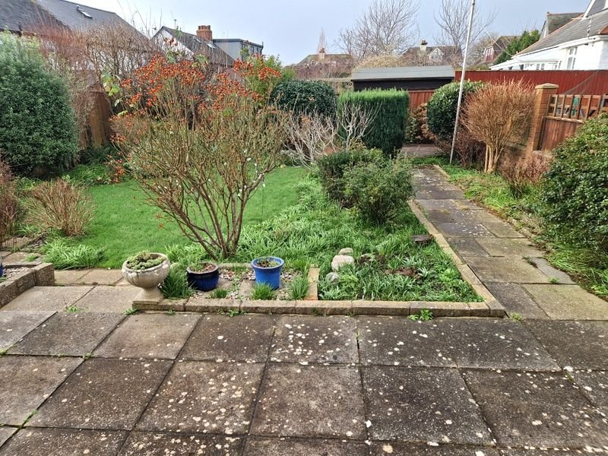
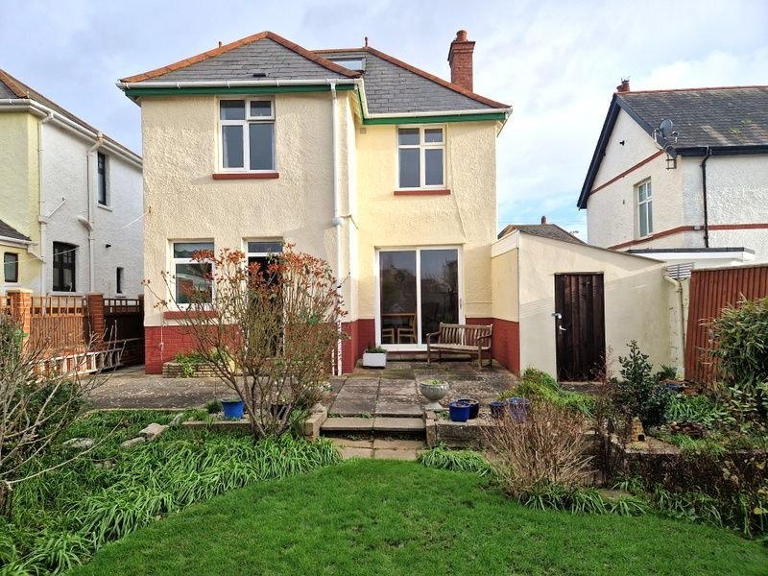
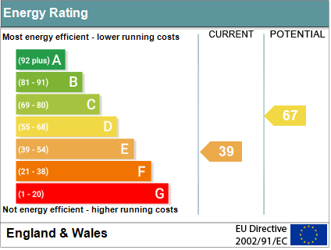
www.pennys.net
10 Grange Avenue, Exmouth, EX8 3HU
GUIDE PRICE £484,950
TENURE Freehold
A Well Presented Older Style Detached House Enjoying An Enviable Location Close To Schools, Shops And Town Centre
Fine Period Features • Reception Hall •
Cloakroom/WC • Lounge • Dining Room •
Modern Kitchen/Breakfast Room • Three Bedrooms • Bathroom/WC •
Useful Boarded Attic Room • Gas Central Heating & Double Glazed Windows •
Lovely Gardens & Garage/Store • No Onward Chain•
Pennys Estate Agents Limited for themselves and for the vendor of this property whose agents they are give notice that:- (1) These particulars do not constitute any part of an offer or a contract. (2) All statements contained in these particulars are made without responsibility on the part of Pennys Estate Agents Limited. (3) None of the statements contained in these particulars are to be relied upon as a statement or representation of fact. (4) Any intending purchaser must satisfy himself/herself by inspection or otherwise as to the correctness of each of the statements contained in these particulars. (5) The vendor does not make or give and neither do Pennys Estate Agents Limited nor any person in their employment has any authority to make or give any representation or warranty whatever in relation to this property.
PENNYS ESTATE AGENTS
2 Rolle House, Rolle Street, Exmouth, Devon, EX8 2SN
Tel: 01395 264111 EMail: help@pennys.net

Slide 2
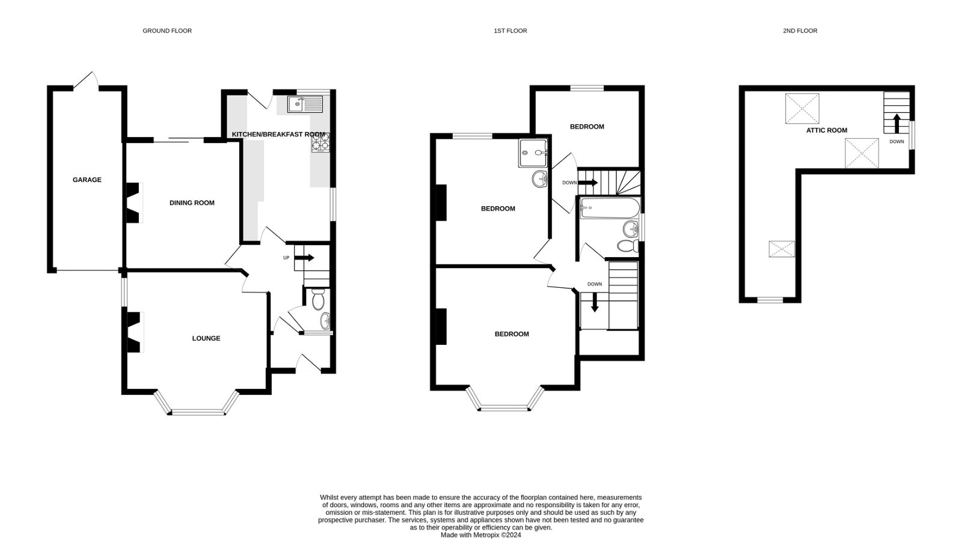
10 Grange Close, Exmouth, EX8 3HU
THE ACCOMMODATION COMPRISES: Open pillared entrance canopy with courtesy light; part glazed solid wood front door to: ENTRANCE PORCH: Tiled floor; double glazed window; cupboard housing meters. RECEPTION HALL: Turning staircase to the first floor landing with understairs cupboard beneath; double glazed window with pattern glass. GROUND FLOOR CLOAKROOM/WC: WC; wash hand basin with tiled splash back; picture window. LOUNGE: 4.27m x 3.81m (14'0" x 12'6") Feature original fireplace with tiled hearth housing living flame coal effect gas fire; television point; radiator; double glazed bay window to front and side aspect; two radiators; television point; telephone point. DINING ROOM: 3.96m x 3.58m (13'0" x 11'9") Feature original fireplace with open grate and tiled hearth; radiator; double glazed window to side aspect and sliding double glazed doors to rear garden. KITCHEN/BREAKFAST ROOM: 4.27m x 2.74m (14'0" x 9'0") Modern kitchen with a range of gloss finish pattern worktop surfaces with cupboards and drawer units beneath; plumbing for an automatic washing machine; wall mounted cupboards including a dresser style unit; integrated fridge freezer; four ring gas hob with glass splashback and Bosch chimney style extractor hood over with light; built-in oven and grill; single drainer sink unit with mixer tap; double glazed windows and door to side and rear aspect; radiator. FIRST FLOOR LANDING: With access to eaves storage space; double glazed window with pattern glass; picture rails. BEDROOM ONE: 4.27m x 3.4m (14'0" x 11'2") Double glazed bay window to front aspect; radiator; picture rails; television point. BEDROOM TWO: 3.89m x 3.35m (12'9" x 11'0") Double glazed windows to rear and side aspects; radiator; shower cubicle; pedestal wash hand basin; picture rails. BATHROOM/WC: 1.83m x 1.78m (6'0" x 5'10") Bath with shower over; shower splash screen; pedestal wash hand basin; WC; double glazed window with pattern glass; radiator. From landing door to INNER LANDING with staircase to SECOND FLOOR and first floor bedroom three: BEDROOM THREE: 3.3m x 2.41m (10'10" x 7'11") Double glazed window to rear aspect; radiator; understairs cupboard. ATTIC ROOM: 6.93m x 5.49m (22'9" x 18'0") Narrowing to 5'4" (1.63m) A spacious 'L' shaped area with two double glazed windows and three velux windows; access to eaves storage areas; power and light connected.
OUTSIDE: To the front of the property there is a decorative stone front garden with pedestrian gate and pathway to property. Double wrought iron gates lead to driveway and GARAGE/STORE. A further side gate and pathway to the rear garden. The rear garden is a lovely feature being level and comprises of a patio sun terrace and pathway, lawn gardens edged with colourful well stocked shrub beds, decorative patio area to the rear of the garden and outside tap. GARAGE/STORE: 5.31m x 2.21m (17'5" x 7'3") Up and over door; door to rear garden; light connected.
FLOOR PLAN:

