Slide 1
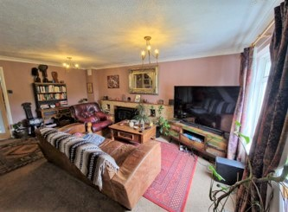
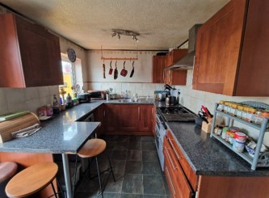
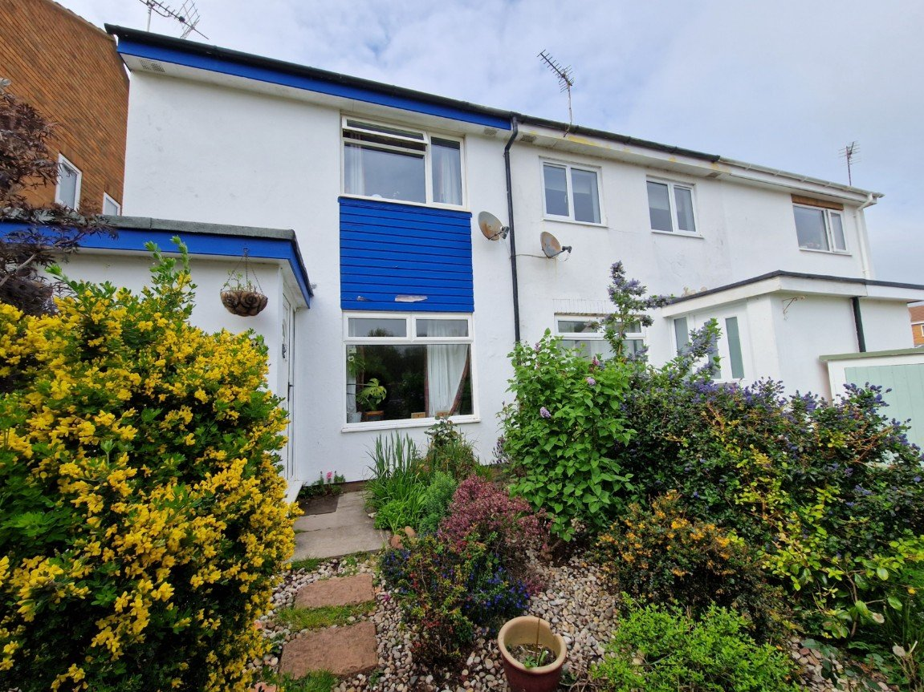
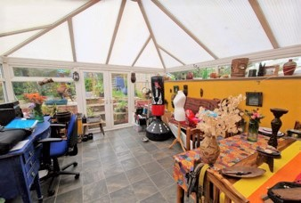
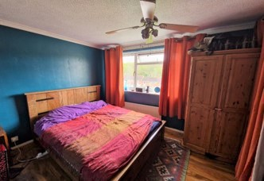
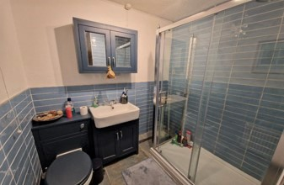
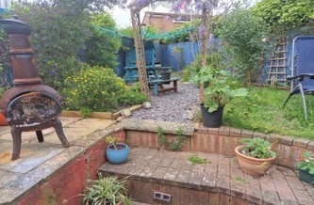
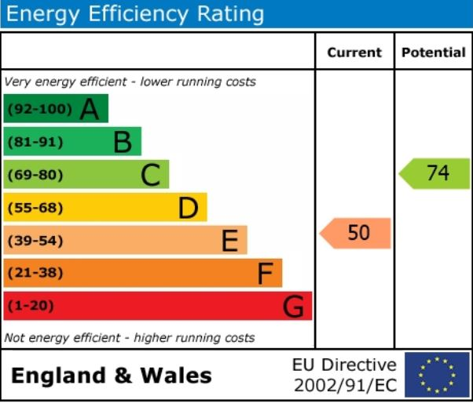
www.pennys.net
46 Hawthorn Grove, Exmouth, Devon, EX8 4HD
PRICE £272,000
TENURE Freehold
A Three Bedroom End Link House Situated In A Popular Location
Good Size Lounge • Modern Fitted Kitchen/Breakfast Room •
Three Bedrooms • Stylish Shower Room/WC • Large Conservatory•
Double Glazed Windows • Gas Central Heating Via Newly Installed Boiler •
Attractive Gardens • Garage In Block Close By •
Pennys Estate Agents Limited for themselves and for the vendor of this property whose agents they are give notice that:- (1) These particulars do not constitute any part of an offer or a contract. (2) All statements contained in these particulars are made without responsibility on the part of Pennys Estate Agents Limited. (3) None of the statements contained in these particulars are to be relied upon as a statement or representation of fact. (4) Any intending purchaser must satisfy himself/herself by inspection or otherwise as to the correctness of each of the statements contained in these particulars. (5) The vendor does not make or give and neither do Pennys Estate Agents Limited nor any person in their employment has any authority to make or give any representation or warranty whatever in relation to this property.
PENNYS ESTATE AGENTS
2 Rolle House, Rolle Street, Exmouth, Devon, EX8 2SN
Tel: 01395 264111 EMail: help@pennys.net

Slide 2
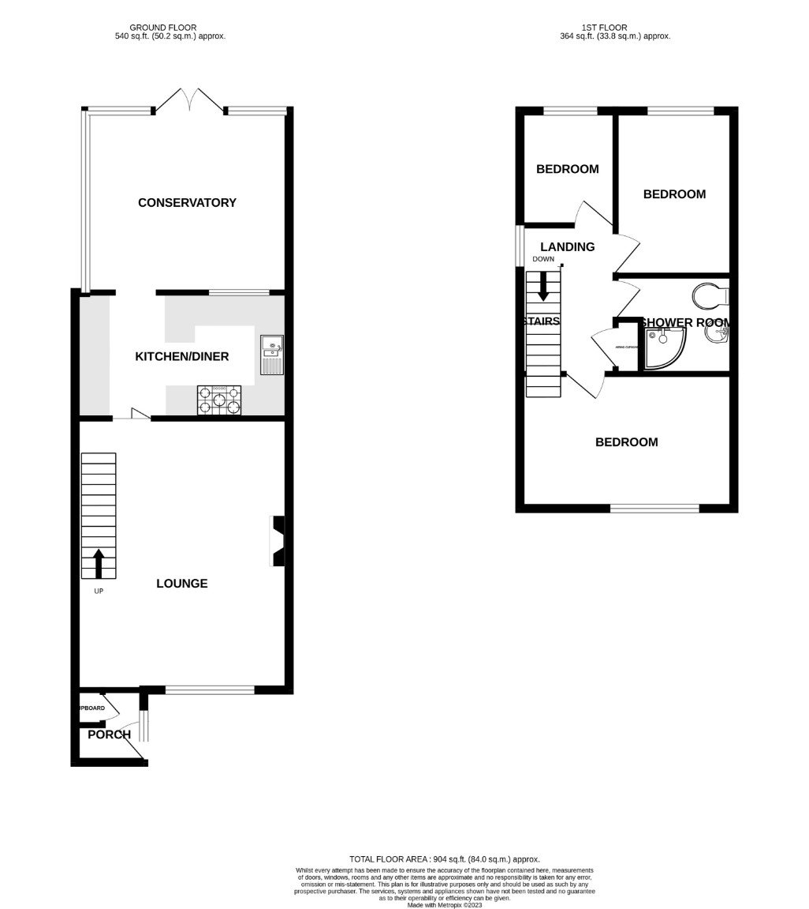
46 Hawthorn Grove, Exmouth, Devon, EX8 4HD
THE ACCOMODATION COMPRISES: uPVC front entrance door with window with matching picture window to one side of the front door giving access to:
ENTRANCE PORCH: With coved ceiling; dado rail; wood effect flooring; floor to ceiling storage cupboard housing meters; inner door giving access to:
LOUNGE: 5.44m x 4.24m (17'10" x 13'11") A most spacious room with uPVC double glazed window overlooking the front elevation enjoying a pleasant open outlook; stone fireplace and surround extended to provide a display area with tiled hearth; radiator; television point; coved ceiling; stairs rising to the first floor with useful understairs recess.
KITCHEN/BREAKFAST ROOM: 4.27m x 2.59m (14'0" x 8'6") Well fitted with a range of units comprising of gloss finish patterned working surfaces extended to provide a breakfast bar area and sold wood work surface with space and plumbing for automatic washing machine and dishwasher, cupboards and drawer units beneath; gas cooker point with stainless steel chimney style extractor hood; inset stainless steel one and a half bowl sink unit and drainer with mixer tap; matching cupboards at eye-level; wall mounted modern gas boiler supplying domestic hot water and central heating and timer control for hot water and central heating; space for upright fridge freezer; tiled flooring; uPVC double glazed window to rear aspect; opening to:
CONSERVATORY: 3.91m x 3.91m (12'10" x 12'10") A superb addition to the property with uPVC double glazed windows and uPVC double glazed double doors opening onto the area garden under a polycarbonate roof; tiled flooring; radiator.
FIRST FLOOR LANDING: With access to the roof space via loft ladder; uPVC double glazed window to side elevation; linen cupboard with slatted shelving; doors to:
BEDROOM ONE: 3.43m x 2.69m (11'3" x 8'10") excluding measurement into full length wardrobe recess with handing rail and shelving; uPVC double glazed window to front elevation enjoying a pleasant open outlook; radiator; coved ceiling; ceiling fan light; television point.
BEDROOM TWO: 3.18m x 2.31m (10'5" x 7’7”) uPVC double glazed window to rear elevation; wood laminate flooring; television point; radiator; wall mounted storage cabinet.
BEDROOM THREE: 2.21m x 1.85m (7'3" x 6'1") uPVC double glazed window to rear elevation; radiator.
SHOWER ROOM/WC: Re-fitted as a quality shower room comprising of a shower cubicle with shower; splash screen doors; wash hand basin with cupboards below; WC with push button plush; attractive part tiled walls; extractor fan; radiator.
OUTSIDE: The property enjoys an elevated position in a popular cul-de-sac. To the front of the property there is an attractive well-planned garden edged with shrubs and a patio pathway giving access to the property. A side pathway and gate leads to the rear garden which is again well presented and planned with ease of maintenance in mind comprising of a raised patio sun terrace, feature decorative stone garden seating areas and companion seat. The rear garden is fully enclosed. The property also benefits from a GARAGE in a block close by.
MORTGAGE ASSISTANCE: We are pleased to recommend Meredith Morgan Taylor, who would be pleased to help irrelevant of which estate agent you finally buy through. For a free initial, no obligation chat please contact us on 01395 264111 to arrange an appointment.
FLOOR PLAN:

