Slide 1
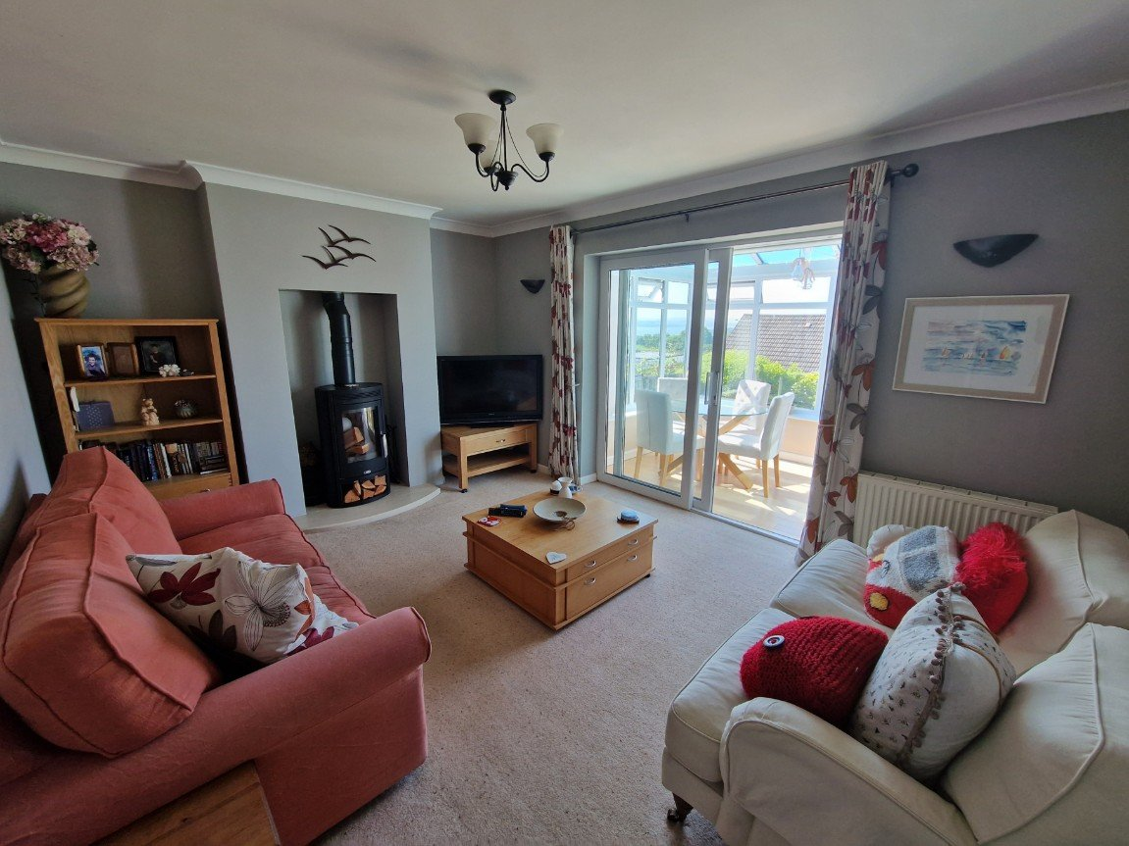
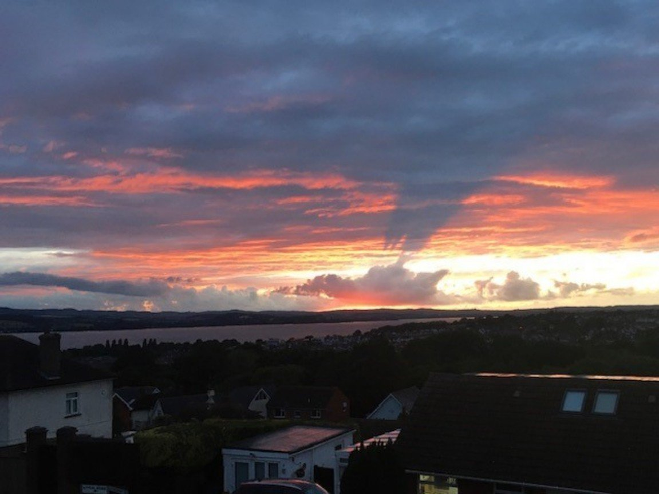
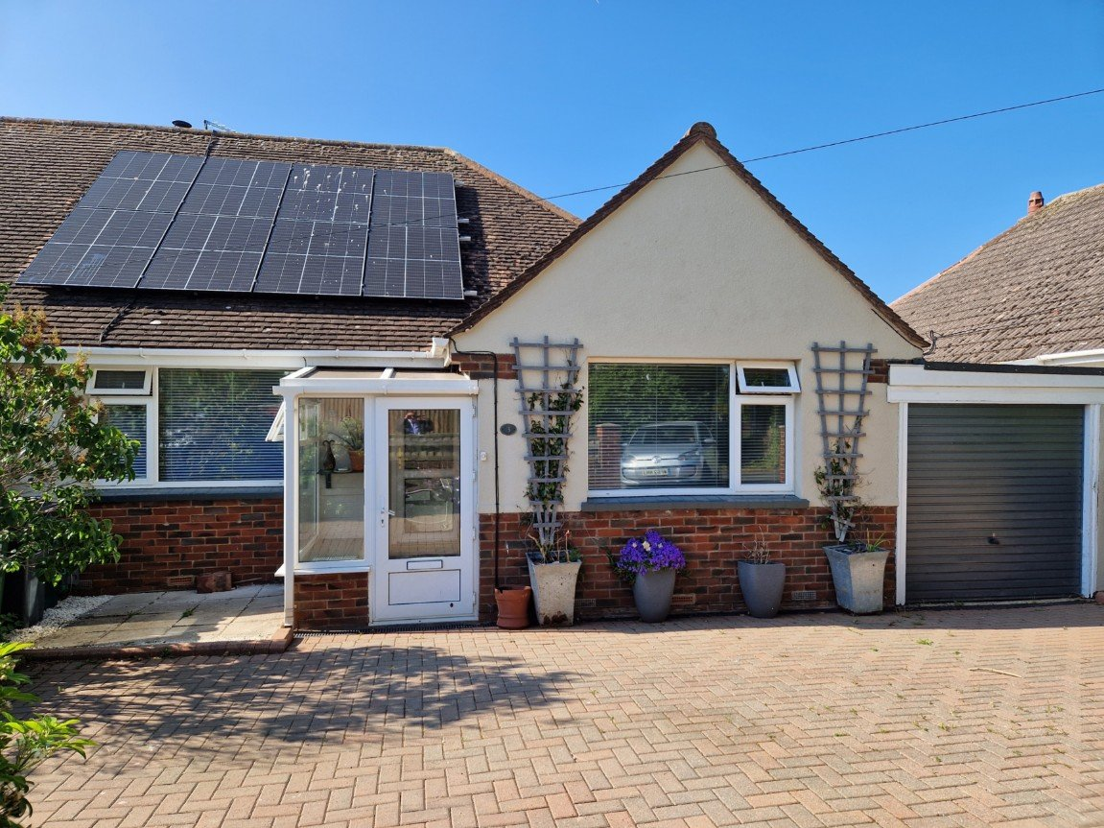
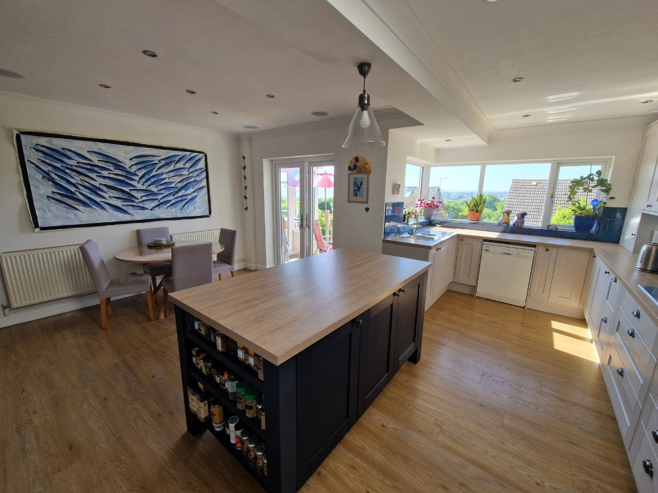
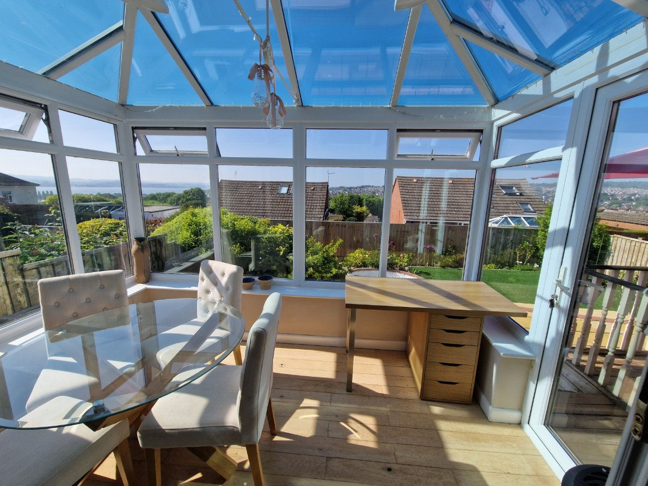
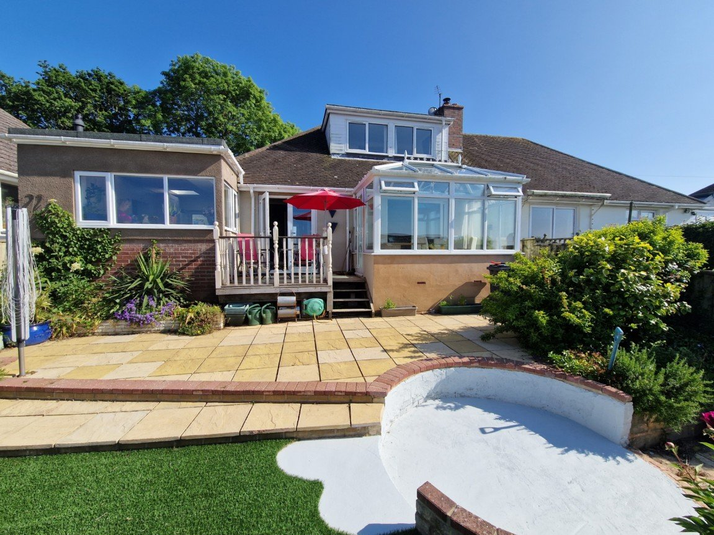
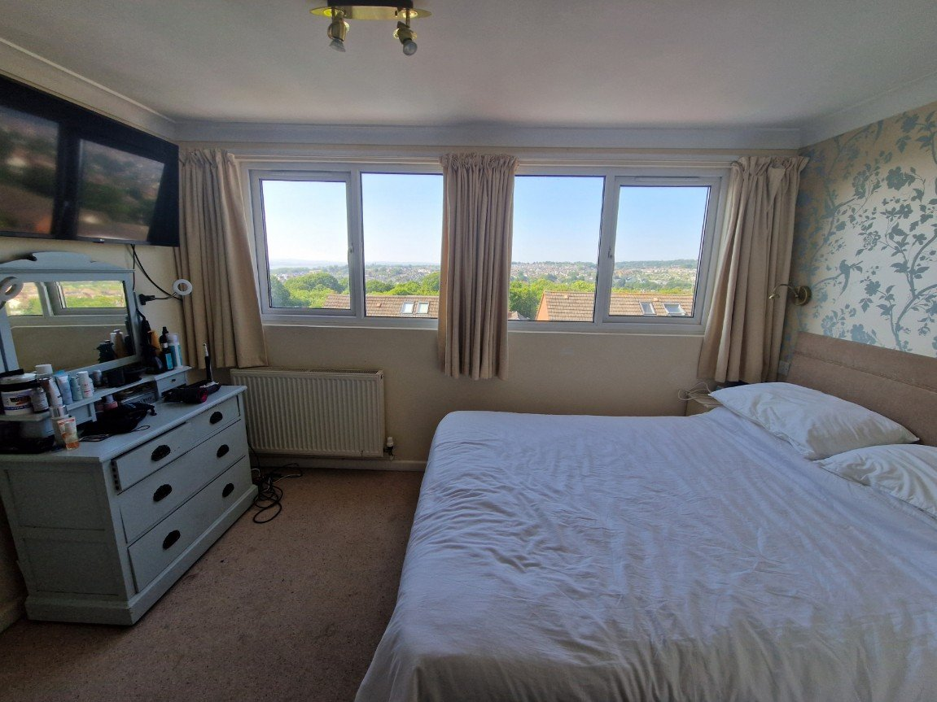
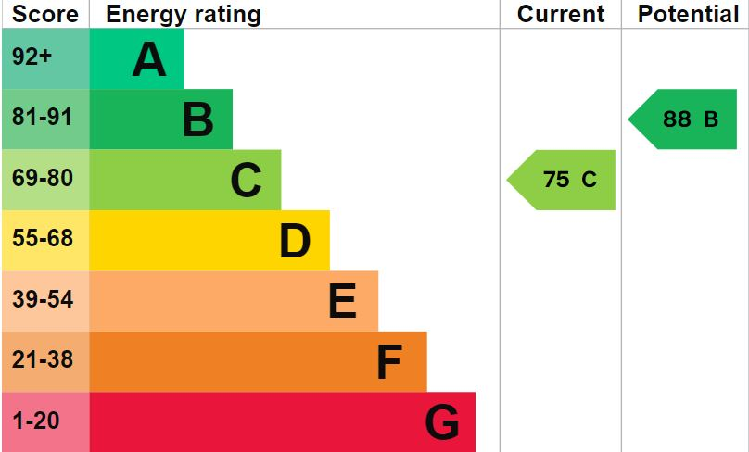
www.pennys.net
3 Hamilton Lane, Exmouth, Devon,
EX8 2JT
GUIDE PRICE £495,000
TENURE Freehold
A Deceptively Spacious Chalet Style Bungalow With Fabulous Views Across The Town Towards Estuary And Coastline Beyond
Attractive Lounge With Log Burner • Superb Open Plan Modern Kitchen/Dining Room • Two Ground Floor Bedrooms • Ground Floor Shower Room/WC •
First Floor Bedroom Suite With En-Suite Bathroom/WC •
Double Glazed Windows And Gas Central Heating •
Block Paved Parking, Garage And Attractive Rear Landscaped Garden •
Pennys Estate Agents Limited for themselves and for the vendor of this property whose agents they are give notice that:- (1) These particulars do not constitute any part of an offer or a contract. (2) All statements contained in these particulars are made without responsibility on the part of Pennys Estate Agents Limited. (3) None of the statements contained in these particulars are to be relied upon as a statement or representation of fact. (4) Any intending purchaser must satisfy himself/herself by inspection or otherwise as to the correctness of each of the statements contained in these particulars. (5) The vendor does not make or give and neither do Pennys Estate Agents Limited nor any person in their employment has any authority to make or give any representation or warranty whatever in relation to this property.
PENNYS ESTATE AGENTS
2 Rolle House, Rolle Street, Exmouth, Devon, EX8 2SN
Tel: 01395 264111 EMail: help@pennys.net

Slide 2
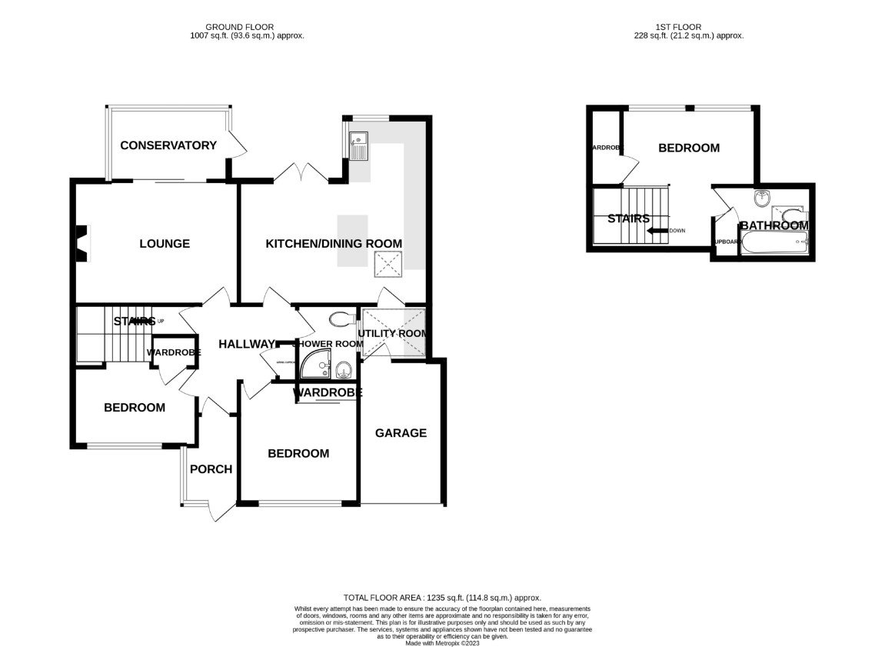
3 Hamilton Lane, Exmouth, Devon, EX8 2JT
THE ACCOMMODATION COMPRISES: uPVC double glazed front door to: ENTRANCE PORCH: 2.67m x 1.52m (8'9" x 5'0") narrowing to 2'11 (2.67m x 1.52m) uPVC double glazed windows; tiled floor; courtesy lighting; uPVC double glazed inner door with patterned glass giving access to: RECEPTION HALL: Radiator; coved ceiling; good sized coats cupboard with clothes rail and shelf; additional storage cupboard over; smoke detector; feature wood flooring. LOUNGE: 4.57m x 3.35m (15'0" x 11'0") A most attractive room with a wood burner stove set in chimney recess and standing on a marble hearth; television point; additional wall lighting; radiator; uPVC double glazed sliding patio doors opening onto: CONSERVATORY: 3.35m x 2.26m (11'0" x 7'5") A fine addition to the accommodation with uPVC double glazed windows overlooking the rear gardens enjoying lovely views across the town towards the estuary and coastline in the distance; feature wood flooring; upright radiator; uPVC double glazed door giving access to rear garden via raised decked sun terrace. KITCHEN/DINING ROOM: 5.64m x 5.13m (18'6" x 16'10") Fitted with a range of wood effect work tops with tiled surrounds; base cupboards and drawer units, space for dishwasher beneath; four ring gas hob with extractor hood over; built-in oven with deep drawer units above and below; space for microwave; inset sink unit;; space for upright fridge freezer; spacious island unit with cupboards under; uPVC double glazed corner windows to side aspect overlooking the fabulous views; skylight window; two radiators; recess ceiling spot lighting; wood flooring; Double glazed double doors opening onto the rear garden and double glazed door giving access to: UTILITY ROOM: With plumbing for automatic washing machine; space for tumble dryer beneath work surface; wall mounted cupboards; tiled flooring; door giving direct access to the GARAGE. BEDROOM TWO: 3.4m x 3.35m (11'2" x 11'0") Double glazed window to front elevation; radiator; recessed ceiling spotlighting; coved ceiling; built-in wardrobe with clothes rail and shelving. BEDROOM THREE: 3.35m x 3.05m (11'0" x 10'0") maximum into wall access (3.35m x 3.05x) Double glazed window to front elevation; radiator; recessed ceiling spotlighting; coved ceiling; built-in single wardrobe with clothes rail and shelving. GROUND FLOOR SHOWER ROOM: Fitted with a good-sized corner shower cubicle with curved shower and splash screen doors; shower unit; shower tray and tiled cubicle; pedestal wash hand basin with mirror fronted cabinet over; WC; fully tiled walls; chrome towel rail; double glazed window with patterned glass. INNER HALLWAY: With turning staircase rising to the FIRST FLOOR; coved ceiling; radiator.
BEDROOM ONE: 3.96m x 3.78m (13'0" x 12'5") Superb first floor bedroom suite with two sets of double glazed windows overlooking the rear elevation gaining wonderful views across the town towards the Estuary and coastline beyond; television point; radiator; coved ceiling; smoke detector; built-in single wardrobes with two clothes rails and shelf. EN-SUITE BATHROOM/WC: Comprising bath with shower attachment; pedestal wash hand basin; WC; tiled walls; coved ceiling; double glazed Velux window; radiator; fitted storage cupboard with clothes rail and shelf; extractor fan; mirror fronted medicine cabinet. OUTSIDE: To the front of the property is a blocked paved front garden and driveway area providing off road parking edged with flower beds and leading to a GARAGE 3.91m x 2.21m (12'10" x 7'3") with up and over door; power and light connected and door giving access into the property. The REAR GARDEN is beautifully landscaped with various patio sun terraced areas; circular artificial lawn; greenhouse; raised decked area with balustrade and colourful flower and shrub beds. The garden is fully enclosed via timber garden fencing and enjoys a sunny aspect with Estuary views. MORTGAGE ASSISTANCE: We are pleased to recommend Meredith Morgan Taylor, who would be pleased to help irrelevant of which estate agent you finally buy through. For a free initial, no obligation chat please contact us on 01395 264111 to arrange an appointment.
FLOOR PLAN:

