Slide 1
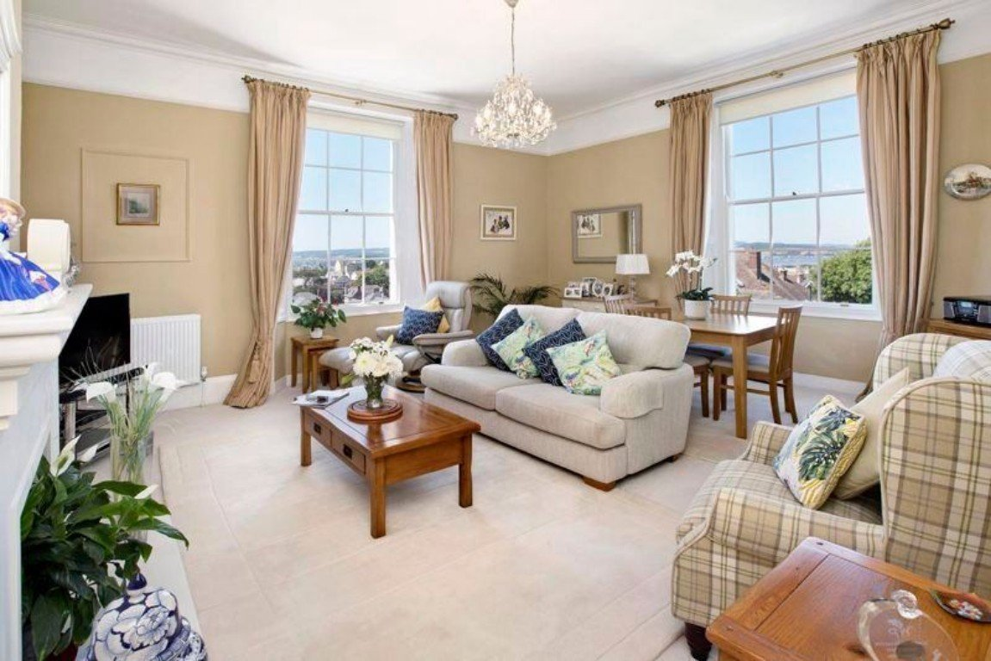
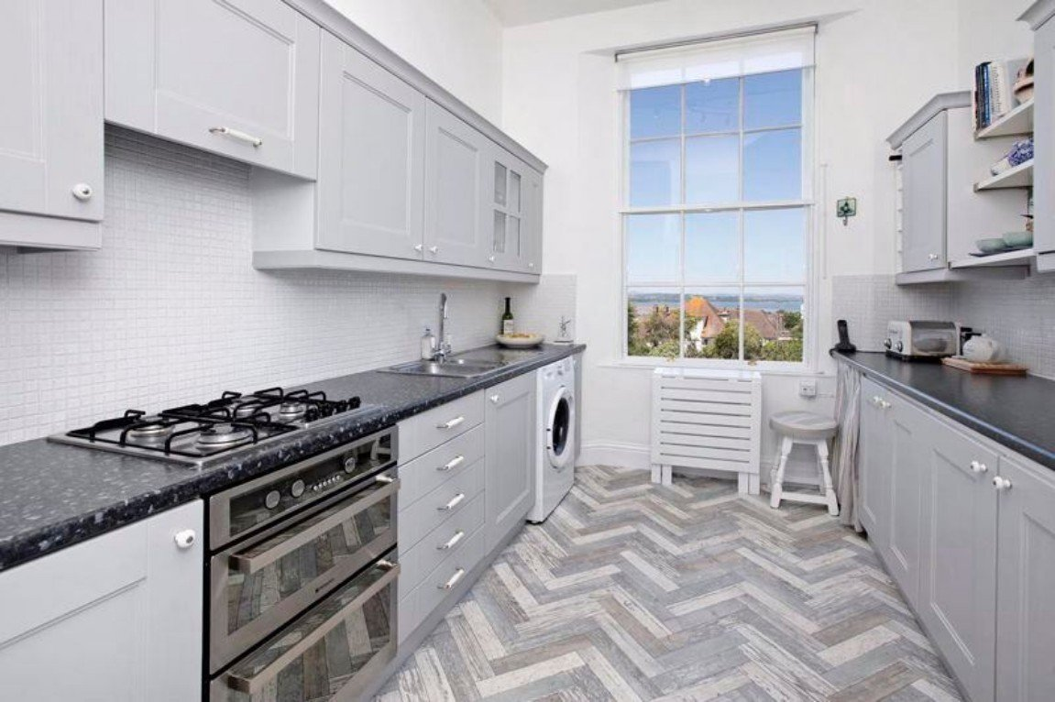
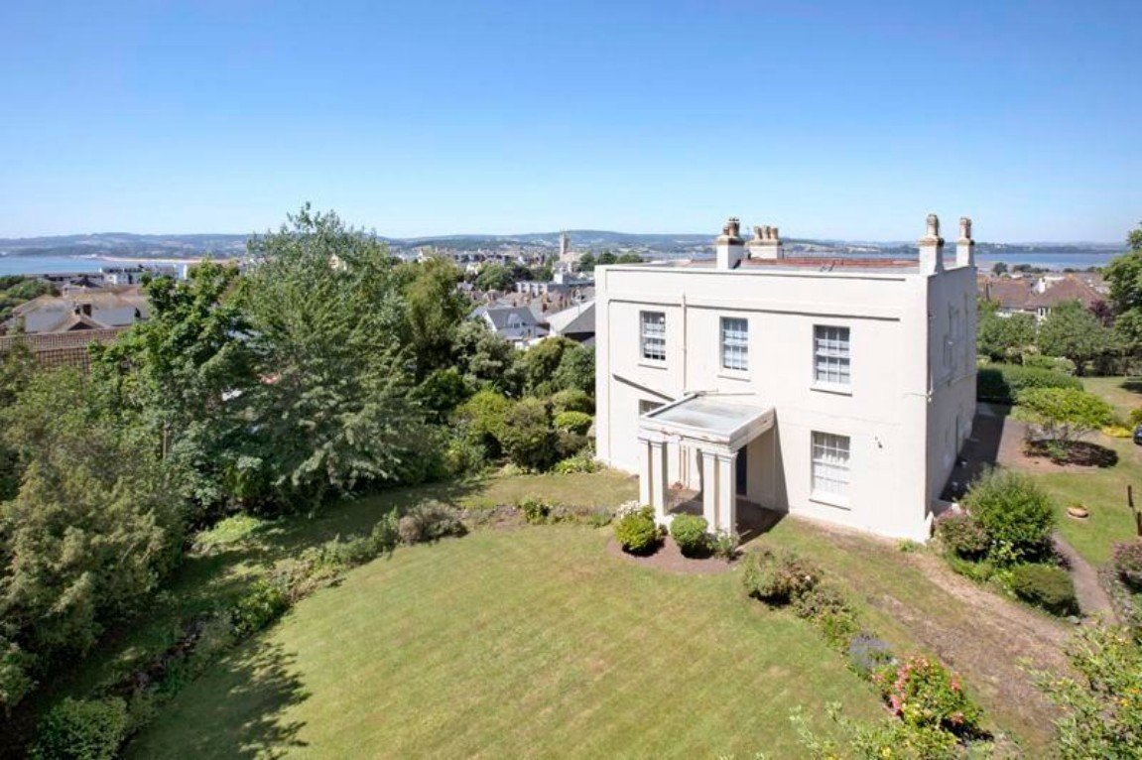
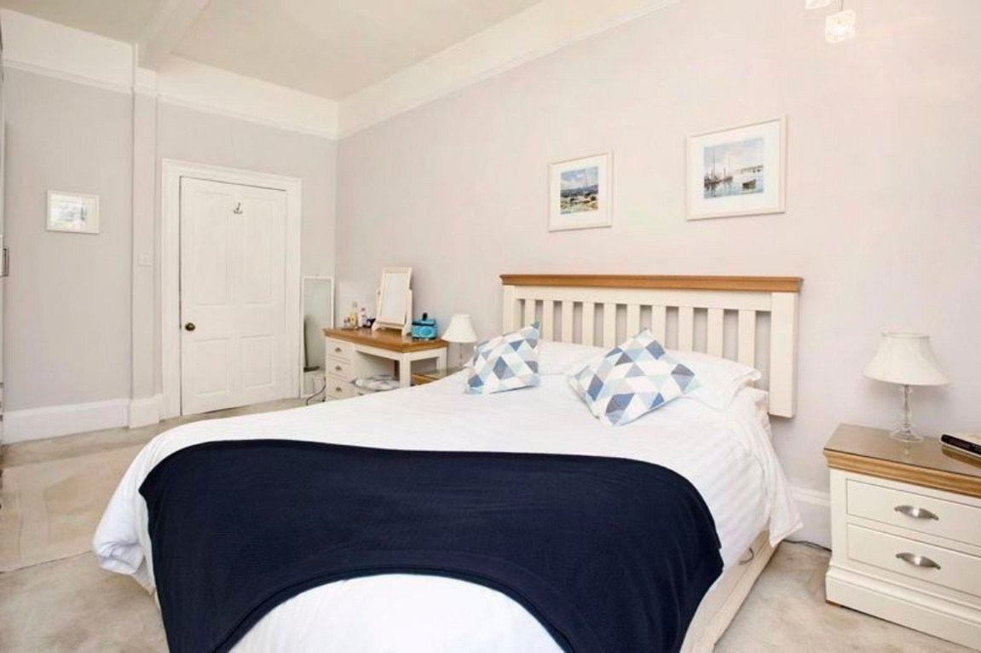
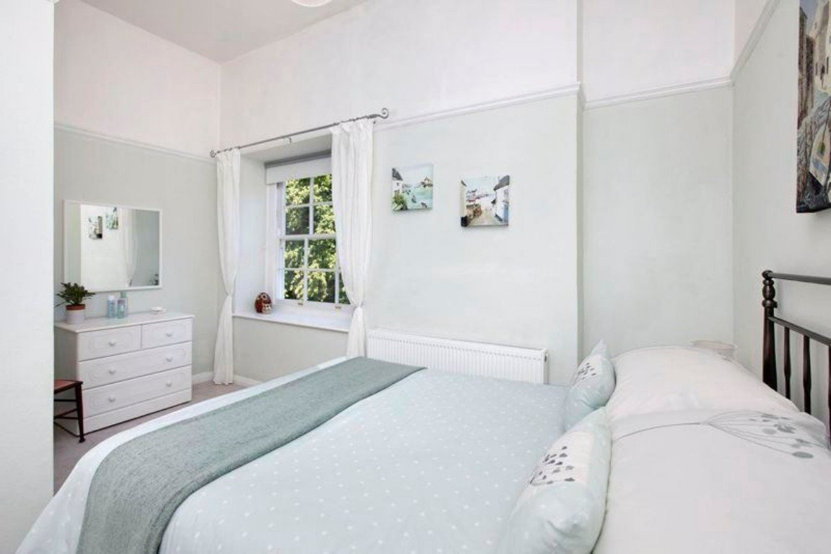
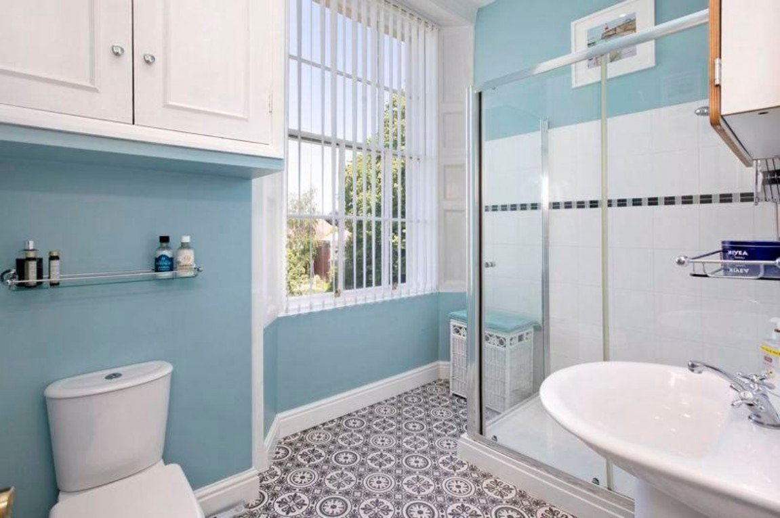
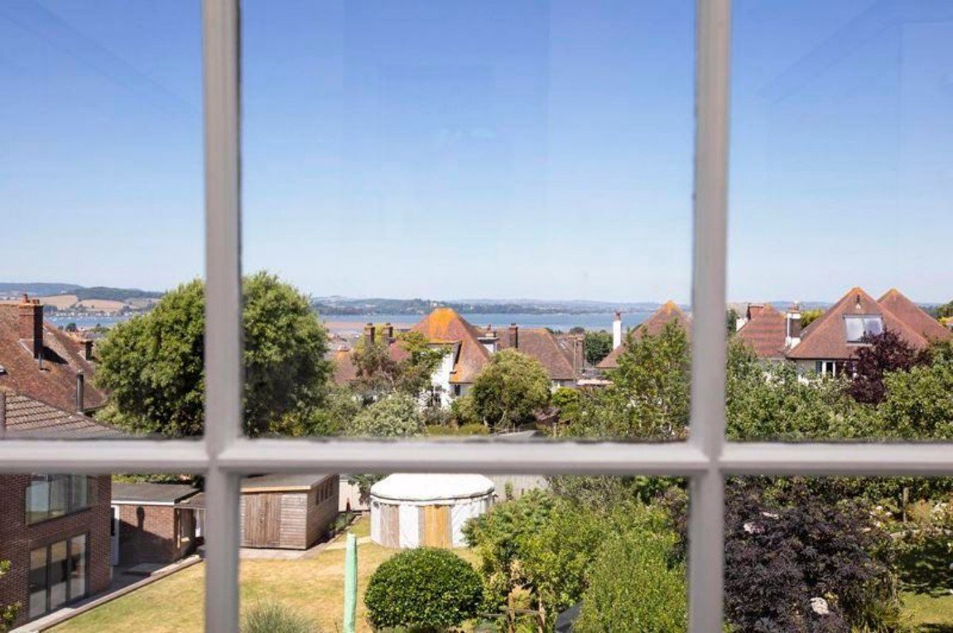
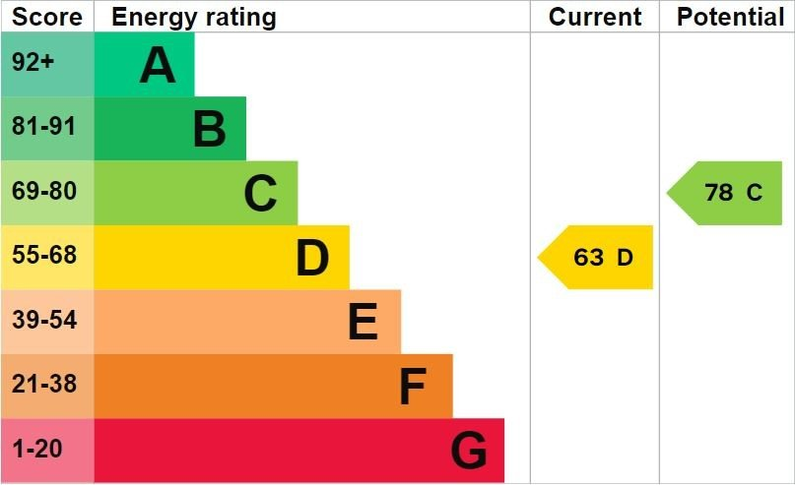
www.pennys.net
Flat 4 Gaveney House, 5 Salterton Road, Exmouth, EX8 2BW
GUIDE PRICE £300,000
TENURE Leasehold
A Beautifully Presented Two Bedroom First Floor Grade II Listed Apartment Situated Only A Short Distance From Both Exmouth Town Centre And Sea Front
Entrance Porch & Reception Hall • Attractive Lounge/Dining Room With Dual Aspect •
Modern Kitchen • Two Double Bedrooms • Shower Room/WC •
Far Reaching Estuary & Coastline Views • Single Garage & Parking Space •
Additional Storage Space in Communal Basement • Gas Central Heating •
Viewing Highly Recommended •
Pennys Estate Agents Limited for themselves and for the vendor of this property whose agents they are give notice that:- (1) These particulars do not constitute any part of an offer or a contract. (2) All statements contained in these particulars are made without responsibility on the part of Pennys Estate Agents Limited. (3) None of the statements contained in these particulars are to be relied upon as a statement or representation of fact. (4) Any intending purchaser must satisfy himself/herself by inspection or otherwise as to the correctness of each of the statements contained in these particulars. (5) The vendor does not make or give and neither do Pennys Estate Agents Limited nor any person in their employment has any authority to make or give any representation or warranty whatever in relation to this property.
PENNYS ESTATE AGENTS
2 Rolle House, Rolle Street, Exmouth, Devon, EX8 2SN
Tel: 01395 264111 EMail: help@pennys.net

Slide 2
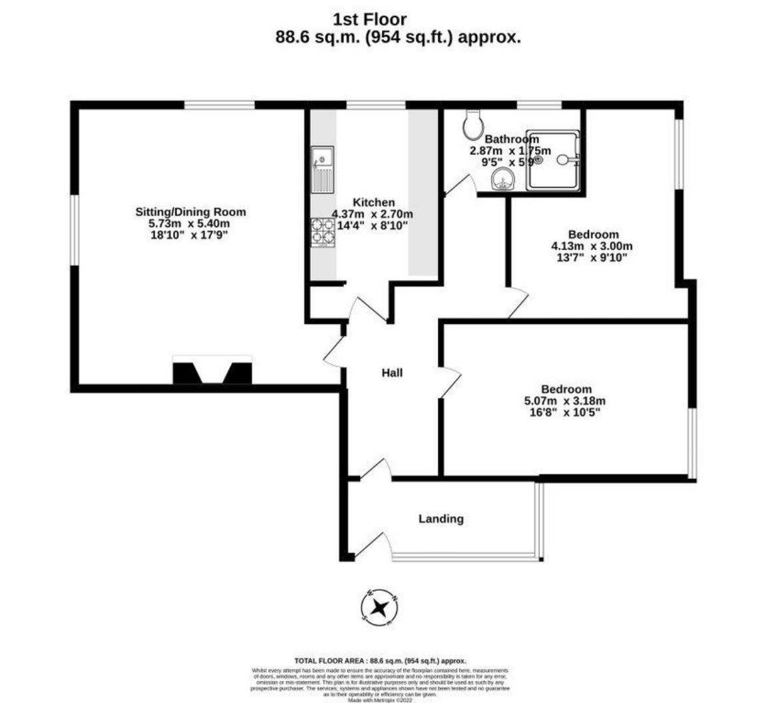
Flat 4 Gaveney House, 5 Salterton Road, Exmouth, EX8 2BW
THE ACCOMMODATION COMPRISES: Communal door with entry intercom system; opening to communal hallway with letter boxes; communal under stairs cupboard housing electric meters; stairs rising to FIRST FLOOR. Own private entrance door leading to ENTRANCE PORCH: Further door leading to: RECEPTION HALL: A fine entrance to the property with entry security intercom phone; radiator; consumer unit; coved ceiling; picture rail; built-in cupboard; doors to: LOUNGE/DINING ROOM: 5.74m x 5.41m (18'10" x 17'9") An attractive bright and spacious room offering a beautiful dual aspect through sash windows with views towards the sea, estuary and coastline beyond; radiator; coved ceiling; picture rails; television point; feature fireplace displayed in a wooden surround which is a stunning feature to the room. KITCHEN: 4.37m x 2.69m (14'4" x 8'10") Fitted with a range of patterned work top surfaces with tiled surrounds; cupboards and drawer units beneath; built in electric oven with four ring gas hob and extractor hood above; space and plumbing for washing machine; inset one and a half bowl sink unit with chrome mixer tap above; space for upright fridge/freezer; wall mounted cupboards; wall mounted wine rack; recess ceiling spotlighting; built-in wall recess with plumbing and space for dishwasher; storage cupboard with shelving above; telephone point; internet point; sash window to side aspect with stunning views beyond. BEDROOM ONE: 5.08m x 3.18m (16'8" x 10'5") Sash window overlooking the communal grounds; picture rail; radiator; access to loft space. BEDROOM TWO: 4.14m x 3m (13'7" x 9'10") Sash window to side aspect; picture rail; radiator.
SHOWER ROOM/WC: 2.87m x 1.75m (9'5" x 5'9") Comprising of a double width shower cubicle with stainless steel shower and splash screen; pedestal wash hand basin with chrome mixer tap; WC with push button flush; chrome heated towel rail; wall mounted mirror fronted cabinet; wall mounted cupboard housing gas boiler serving domestic hot water and gas central heating; sash window with a beautiful outlook. OUTSIDE: Gaveney House is an elegant Grade II listed Georgian building built in 1805 standing within its own impressive and extensive private communal grounds. From the pillared entrance, a substantial sweeping driveway around a circular lawn area where you will find parking spaces and No.4 benefits from a garage in a block. The remaining communal grounds are made up of patio sun terrace areas, large lawned areas and a variety of plants, shrubs, trees and fruit trees. The property also benefits from a communal bin storage area; communal drying area and communal basement for additional storage. GARAGE: 4.88m x 2.44m (16'0" x 8'0") Up and over door.
TENURE AND OUTGOINGS: We understand the property is held on a 999 year lease from 2004. The service charges are approx. £1970
MORTGAGE ASSISTANCE: We are pleased to recommend Meredith Morgan Taylor, who would be pleased to help irrelevant of which estate agent you finally buy through. For a free initial, no obligation chat please contact us on 01395 264111 to arrange an appointment.
FLOOR PLAN:

