Slide 1
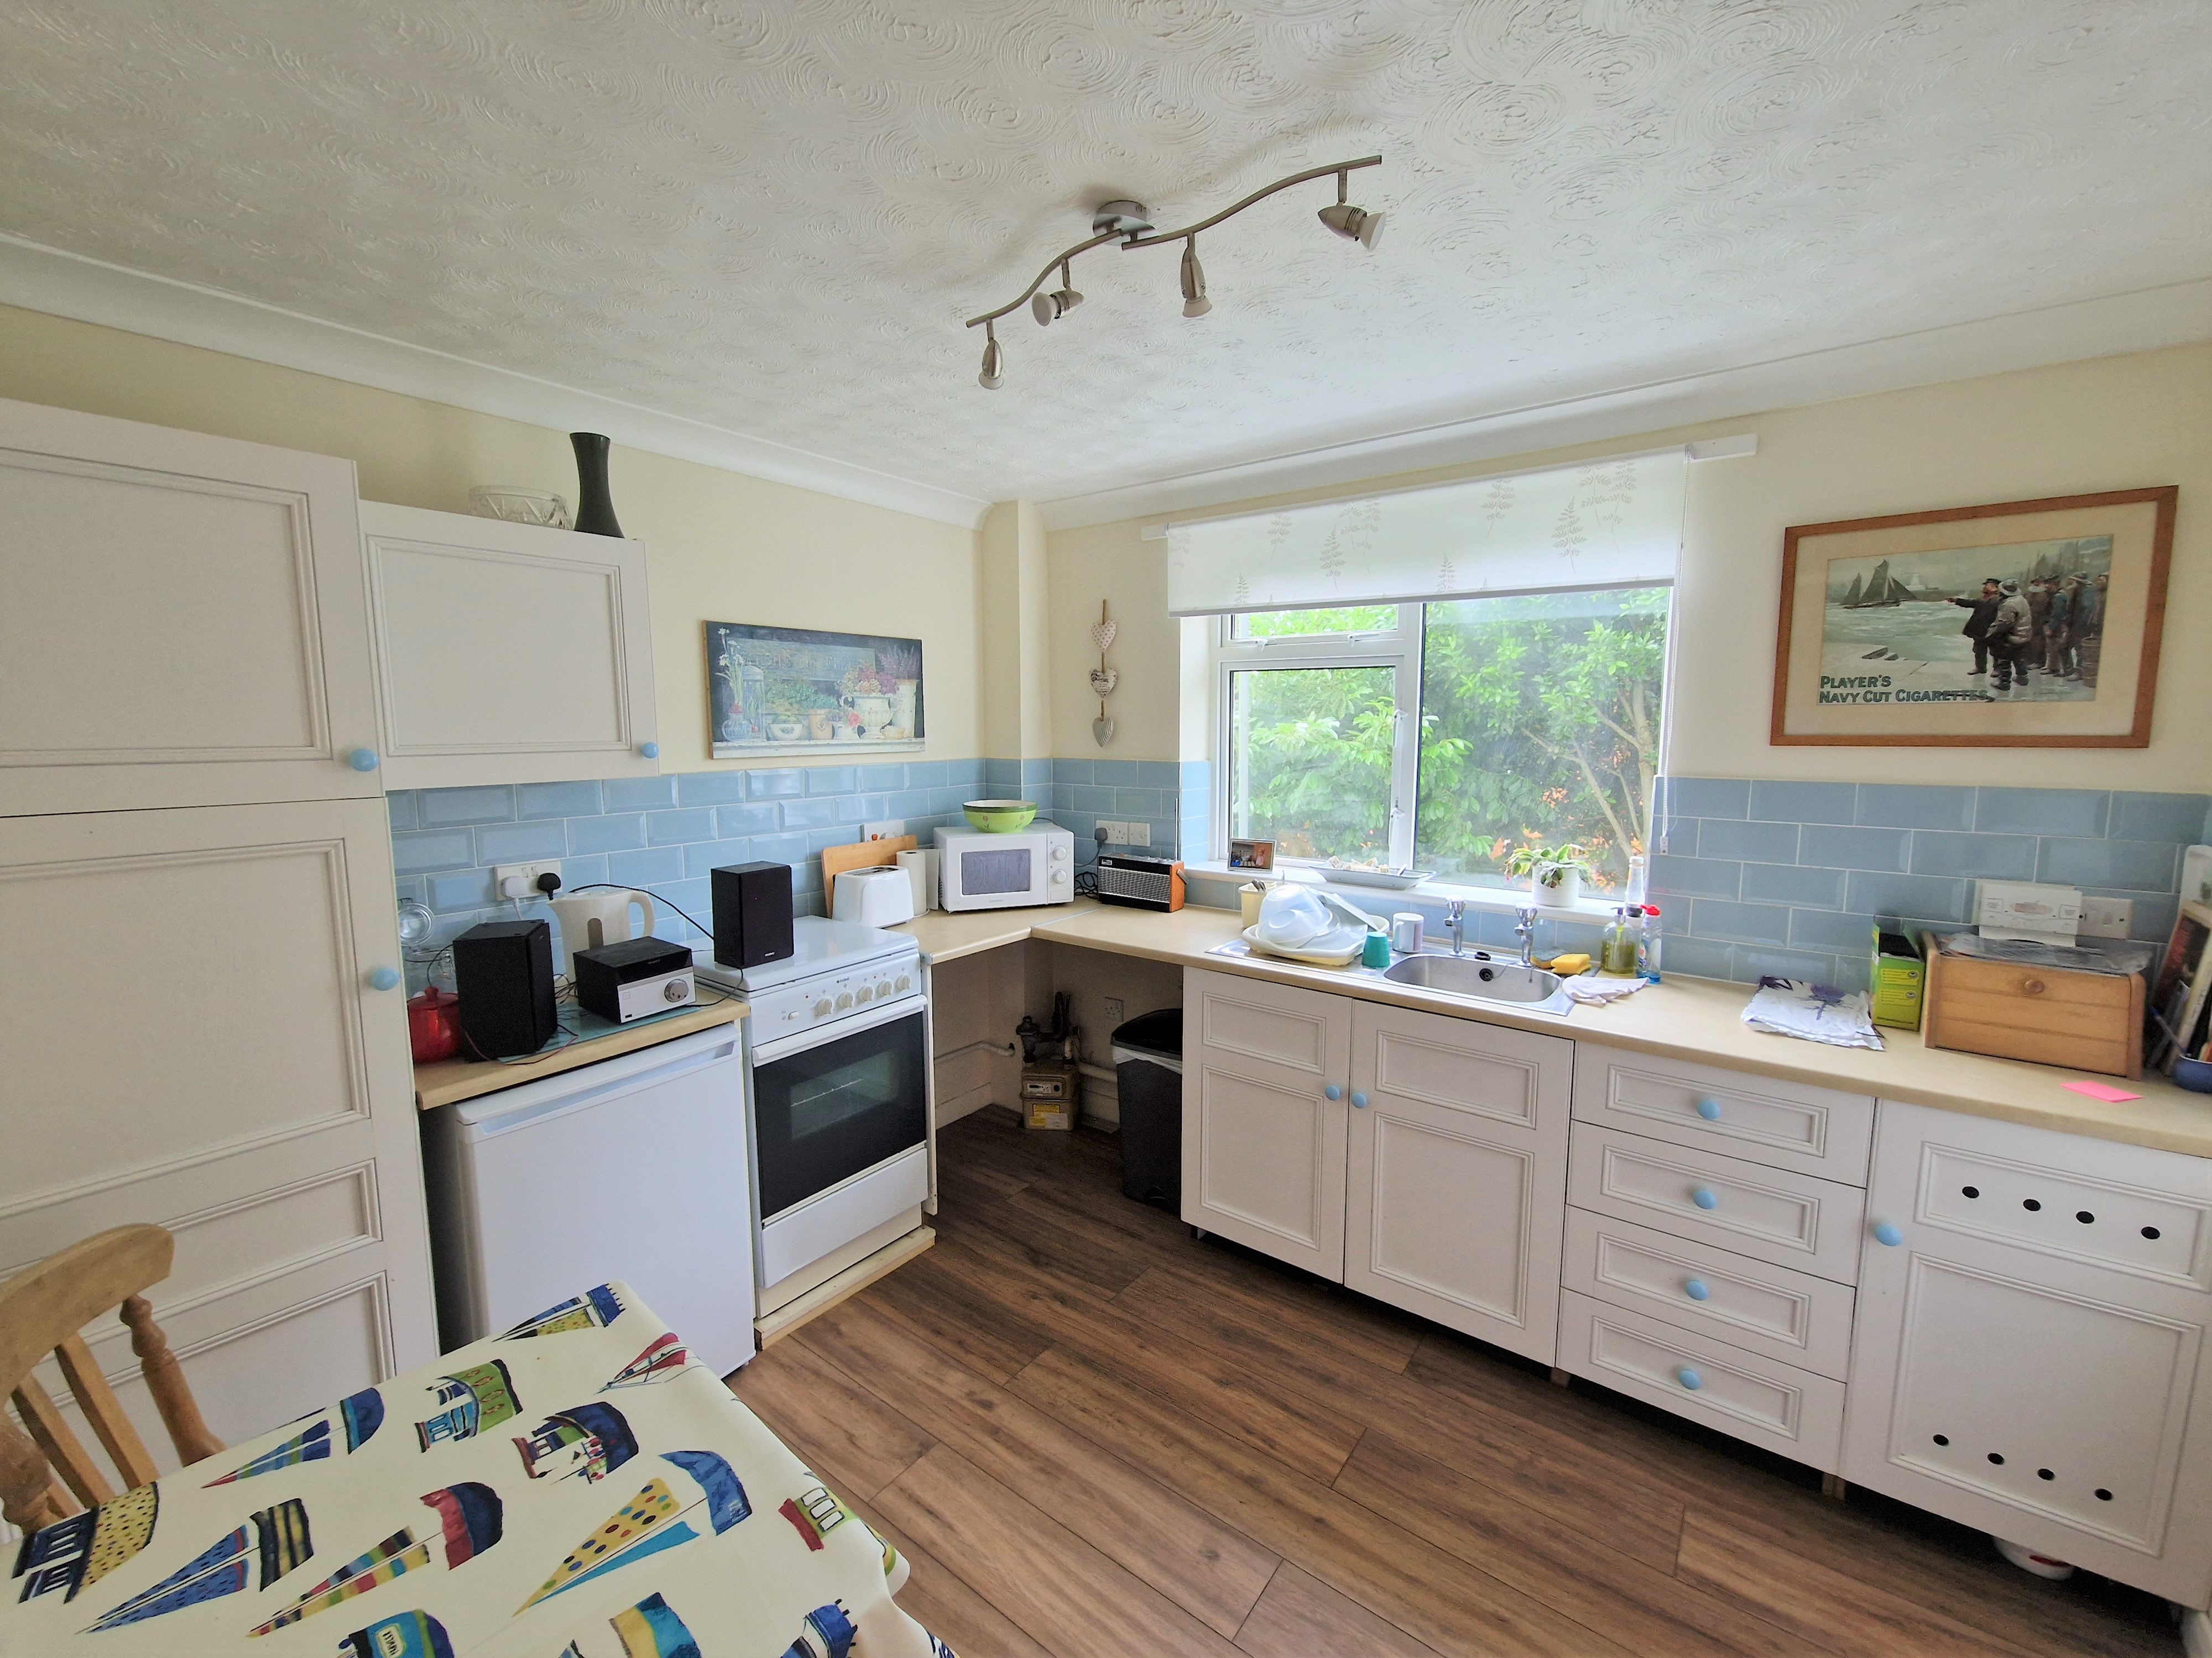
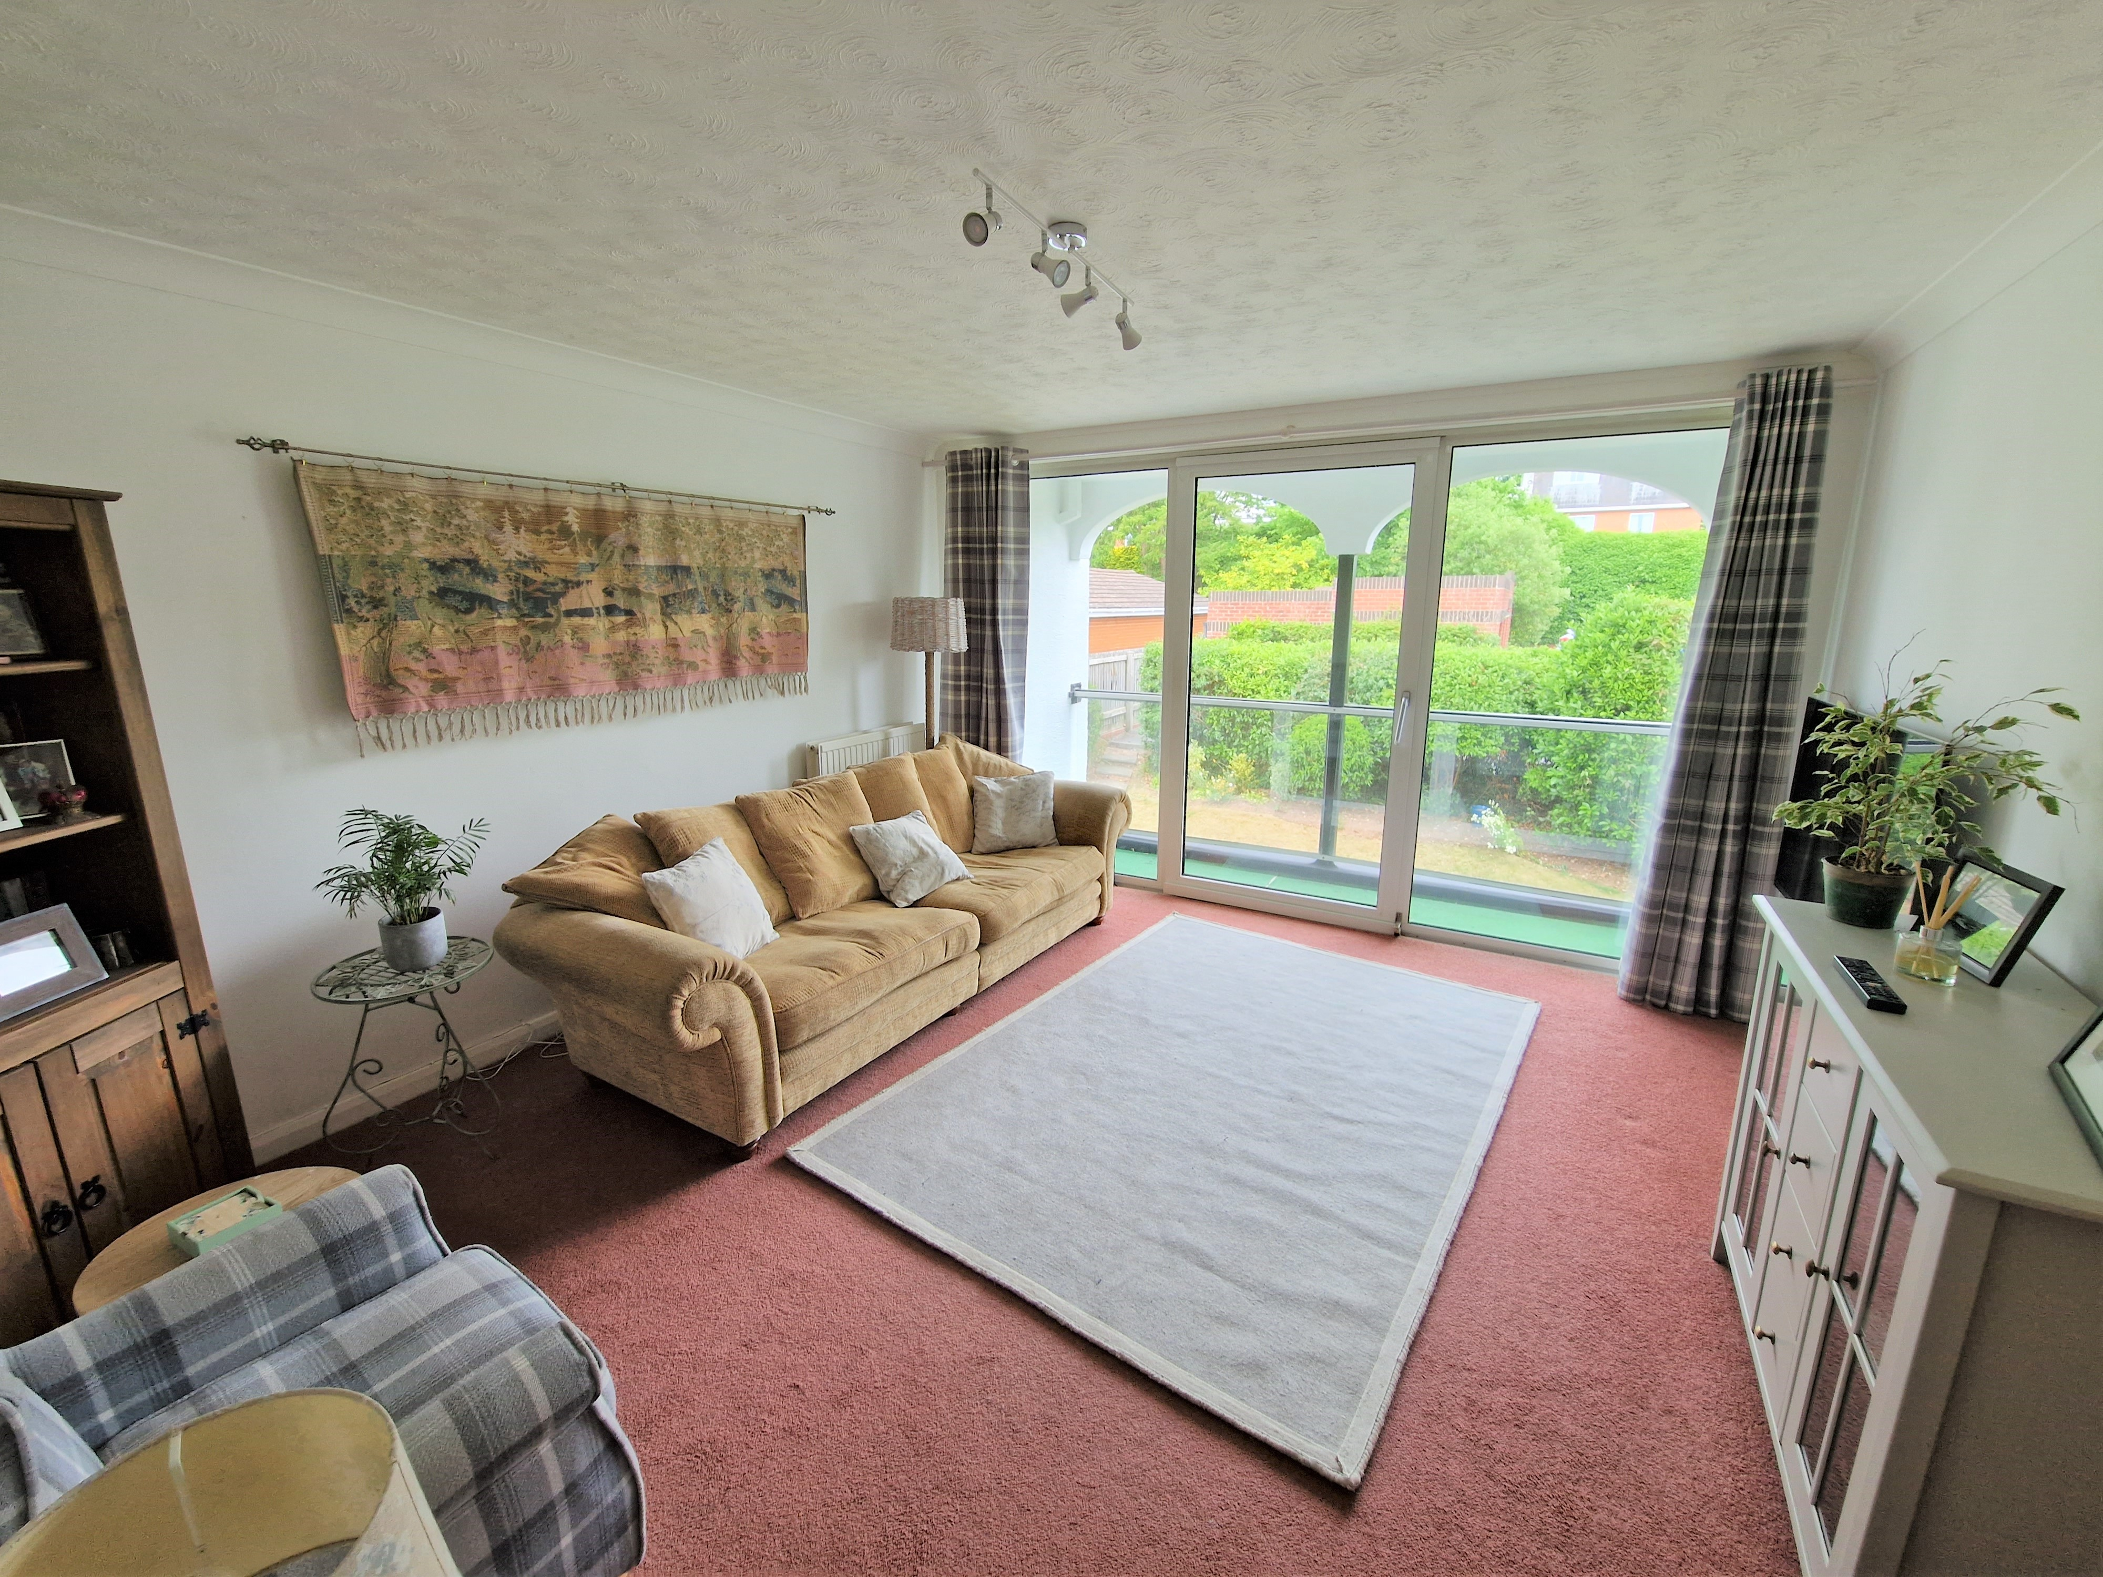
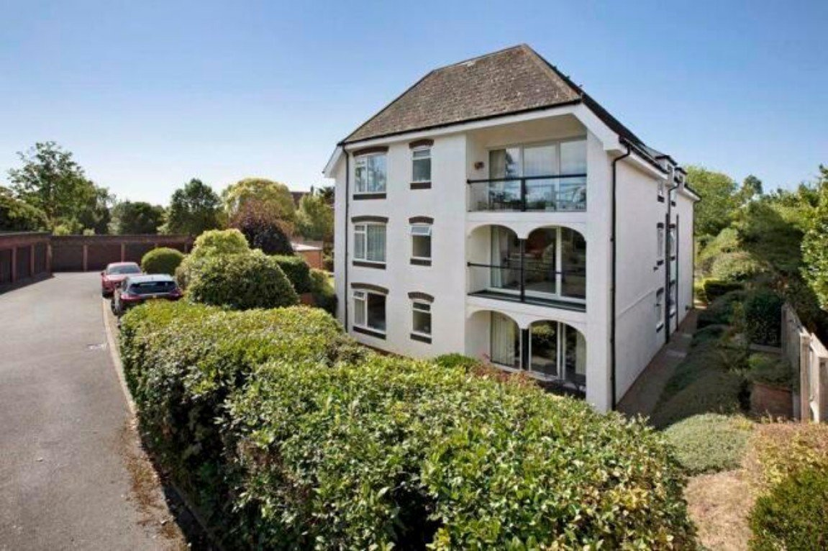
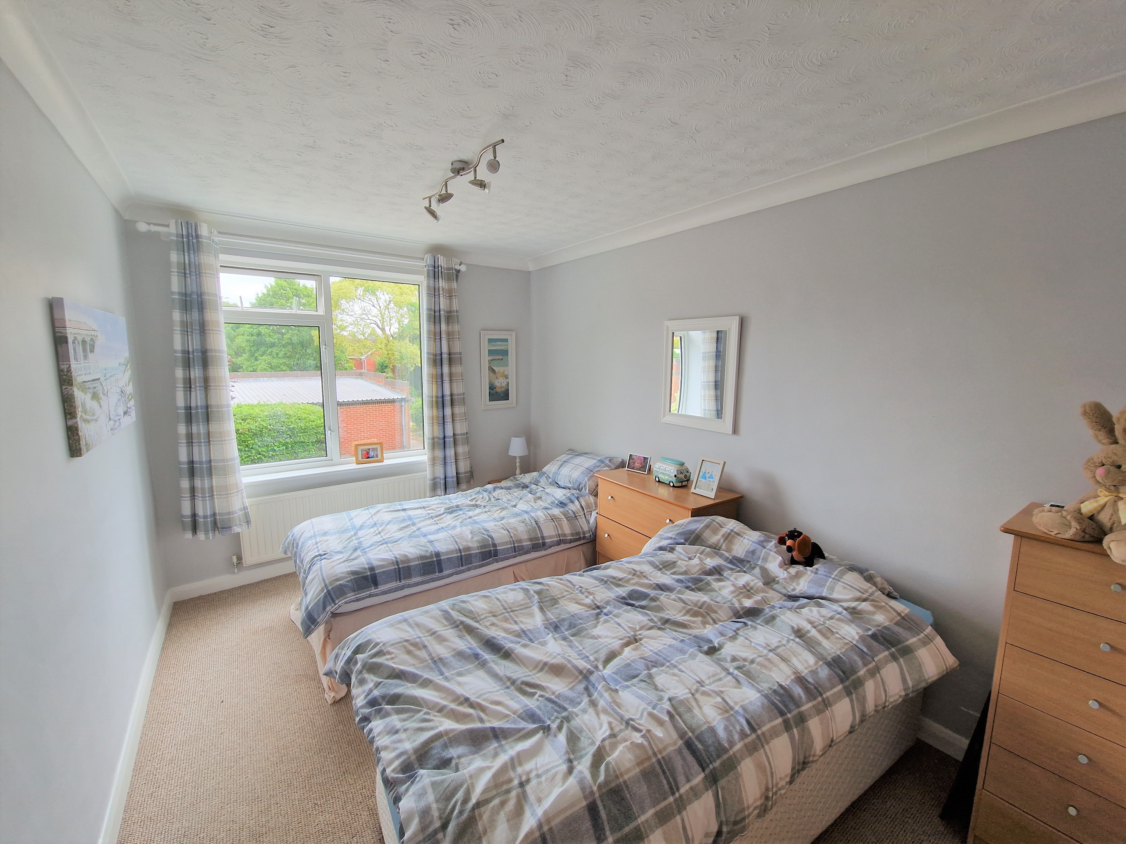
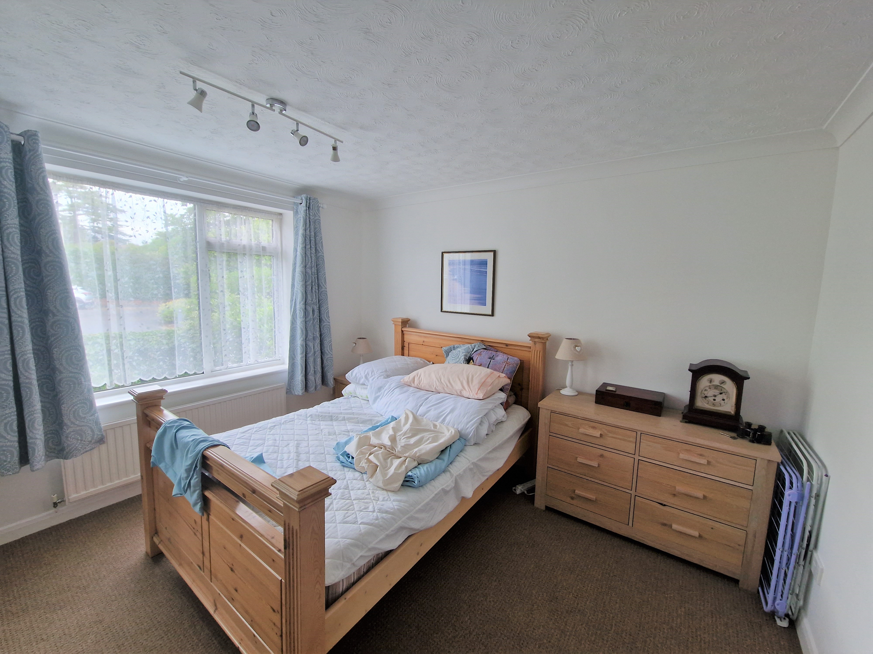
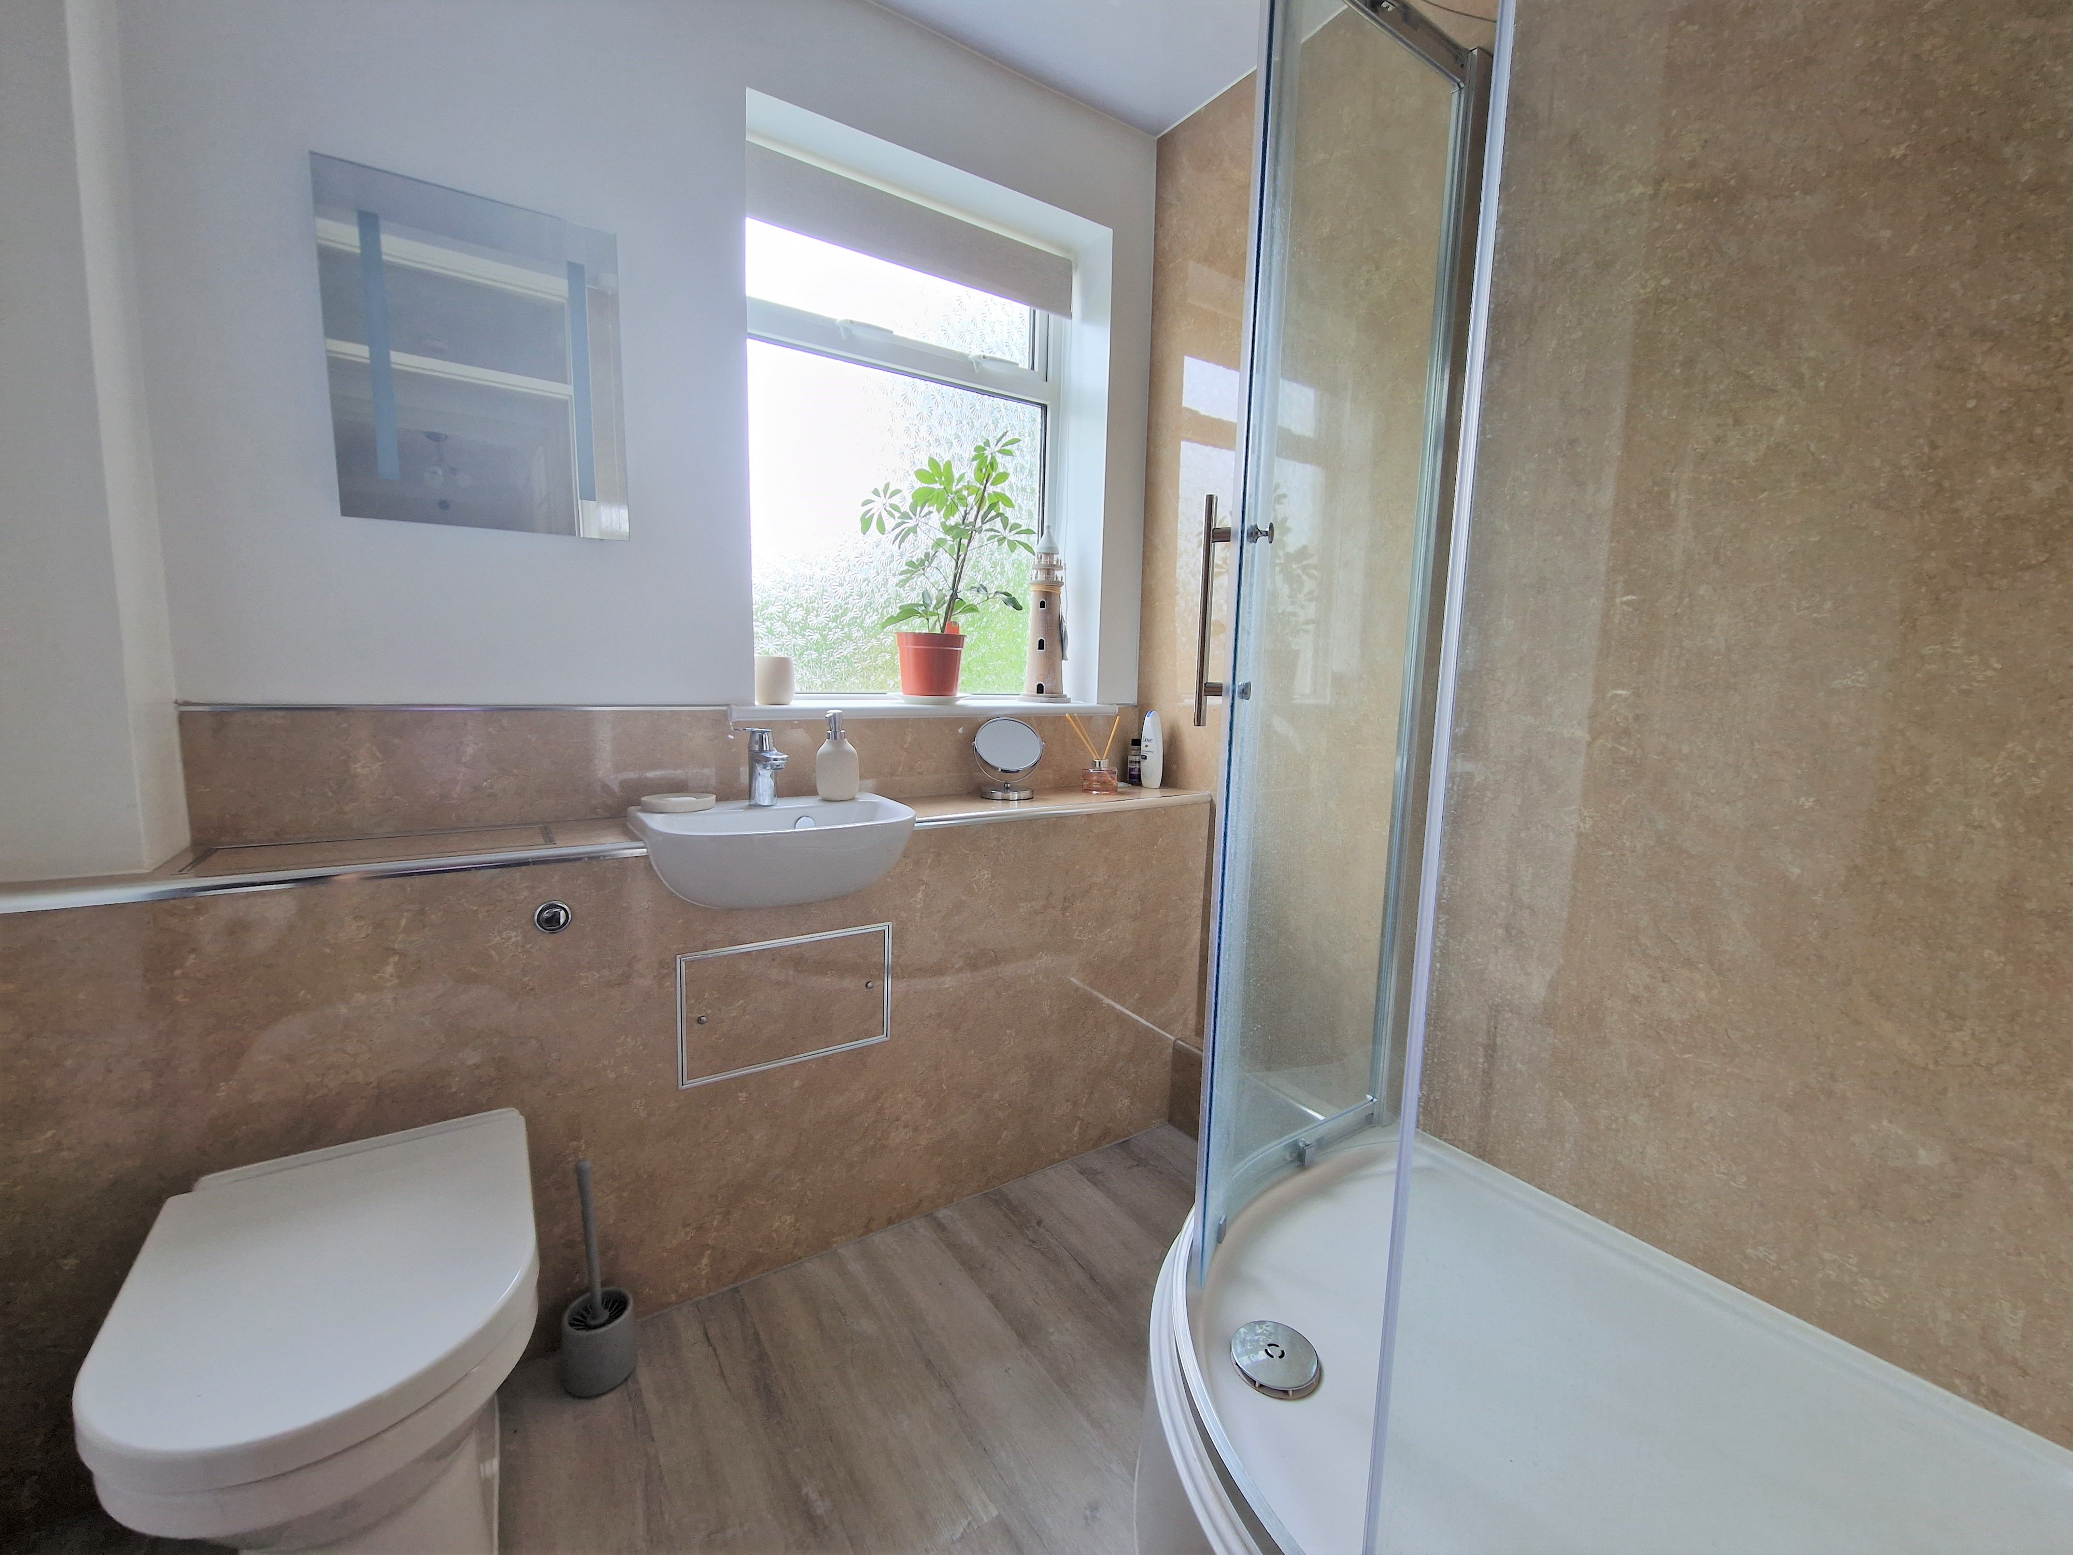
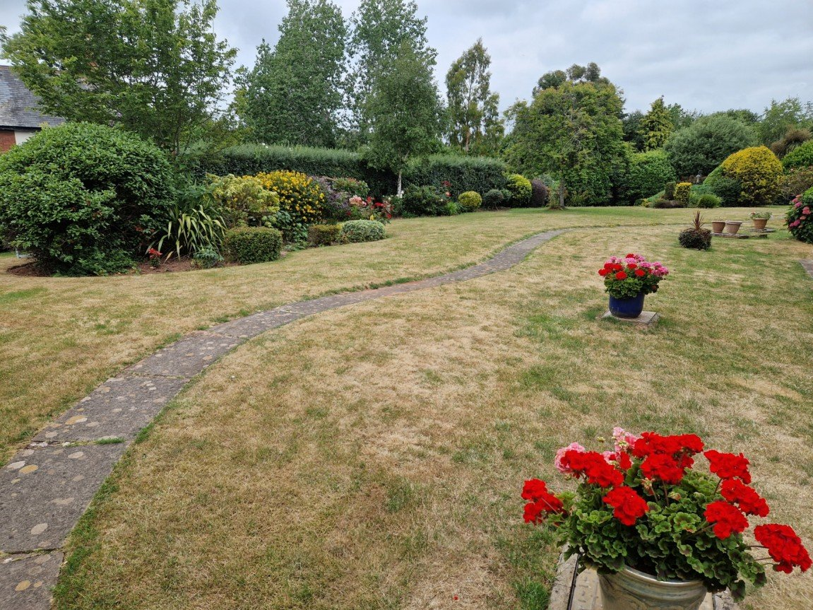
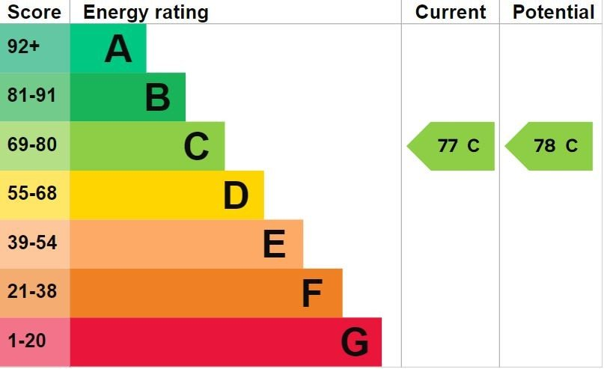
www.pennys.net
Flat 4 White Stones, 3 Cranford Avenue, Exmouth, Devon, EX8 2HP
PRICE £250,000
TENURE Share of
Freehold
A Well Presented First Floor Purpose Built Apartment Enjoying
An Enviable Location With Well Presented Communal
Gardens And Garage
Sitting/Dining Room • Sun Balcony •
Kitchen/Breakfast Room • Two Double Bedrooms • Modern Shower Room/WC •
Cloakroom/WC (Currently A Utility Room) • Double Glazed Windows •
Gas Central Heating • No Onward Chain •
Pennys Estate Agents Limited for themselves and for the vendor of this property whose agents they are give notice that:- (1) These particulars do not constitute any part of an offer or a contract. (2) All statements contained in these particulars are made without responsibility on the part of Pennys Estate Agents Limited. (3) None of the statements contained in these particulars are to be relied upon as a statement or representation of fact. (4) Any intending purchaser must satisfy himself/herself by inspection or otherwise as to the correctness of each of the statements contained in these particulars. (5) The vendor does not make or give and neither do Pennys Estate Agents Limited nor any person in their employment has any authority to make or give any representation or warranty whatever in relation to this property.
PENNYS ESTATE AGENTS
2 Rolle House, Rolle Street, Exmouth, Devon, EX8 2SN
Tel: 01395 264111 EMail: help@pennys.net

Slide 2
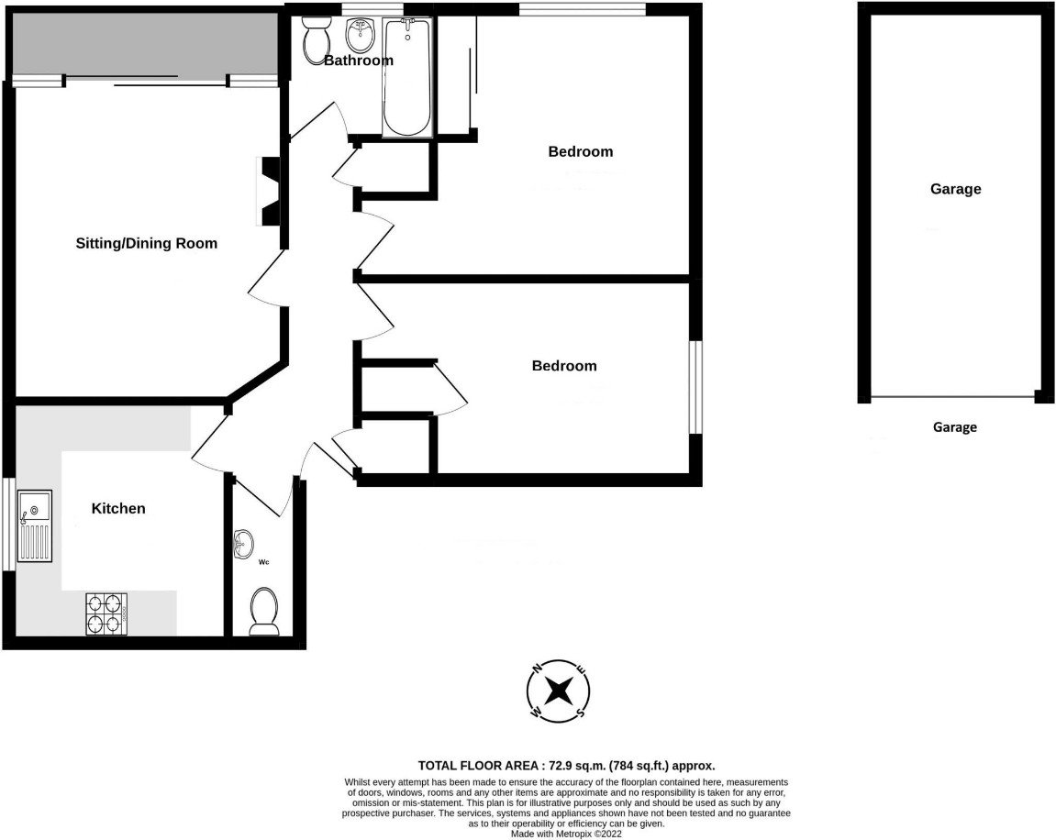
Flat 4 White Stones, 3 Cranford Avenue, Exmouth, Devon, EX8 2HP
THE ACCOMMODATION COMPRISES: Communal entrance with door entry system with stairs to FIRST FLOOR. ENTRANCE HALL: Radiator; door entry phone; wood effect flooring; airing cupboard; coats cupboard. SITTING/DINING ROOM: 3.86m x 4.34m (12'8" x 14'3") Triple aspect windows; door to BALCONY which overlooks the front elevation; television point; radiator; telephone point. KITCHEN/BREAKFAST ROOM: 3.18m x 2.79m (10'5" x 9'2") Wood effect work tops; cupboards and drawer units; plumbing for automatic washing machine beneath; wall mounted eye-level cupboards; tiled surrounds; radiator; double glazed window; wood effect flooring; inset one and half bowl sink unit with mixer tap above; gas cooker point; space for fridge and freezer. BEDROOM ONE: 3.68m x 3.48m (12'1" x 11'5") Double glazed window; triple floor to ceiling built-in wardrobes with mirror fronts; radiator. BEDROOM TWO: 3.86m x 2.72m (12'8" x 8'11") plus door recess: Double glazed window; built-in wardrobe; radiator. SHOWER ROOM/WC: Comprising of a corner shower cubicle; wash hand basin set-in display surface; WC with concealed cistern; splashback walls; heated towel rail; ceiling spotlighting; extractor fan; double glazed window with obscured glass. CLOAKROOM/WC: Currently used as a Utility Room with plumbing for automatic washing machine; radiator. OUTSIDE: There is a communal driveway leading to the garages. Paved pathway to the communal entrance with lawned areas and mature shrubs and trees. There are further communal gardens to rear of the property which are beautifully maintained. The property has the added advantage of a GARAGE in a block with up and over door. White Stones has some parking spaces allocated for visitors.
TENURE AND OUTGOINGS: The property is held on a 999 year lease with benefit of owning a 1/18th share of the freehold known as White Stones Management Company. Managing agents are Whitton & Laing. Service charges are approximately £350.00 per quarter.
FLOOR PLAN:

