Slide 1
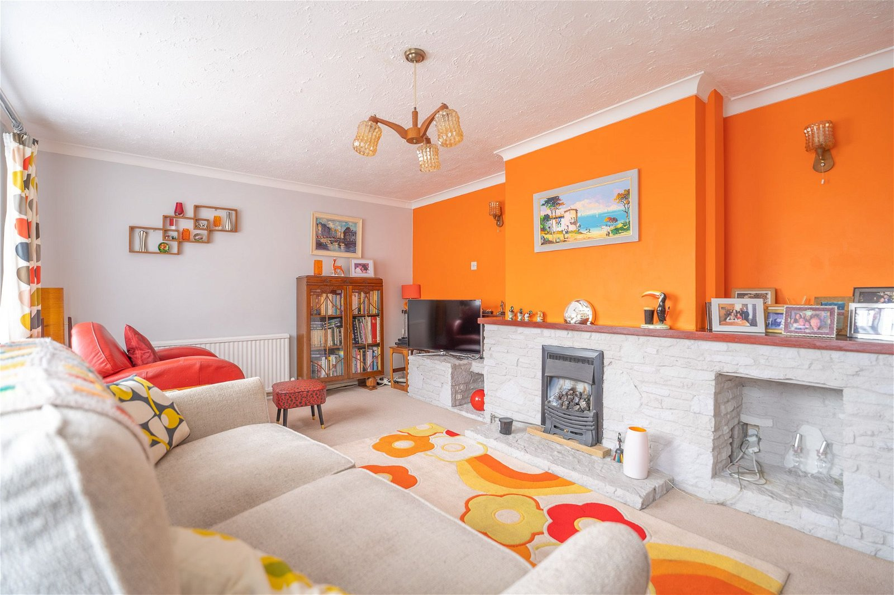
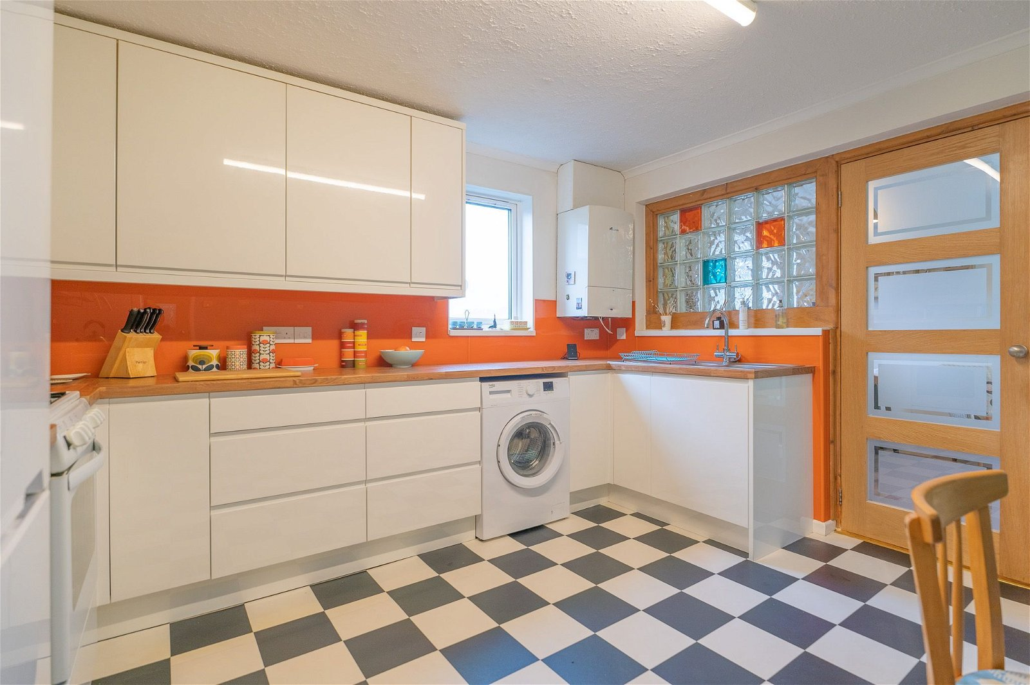
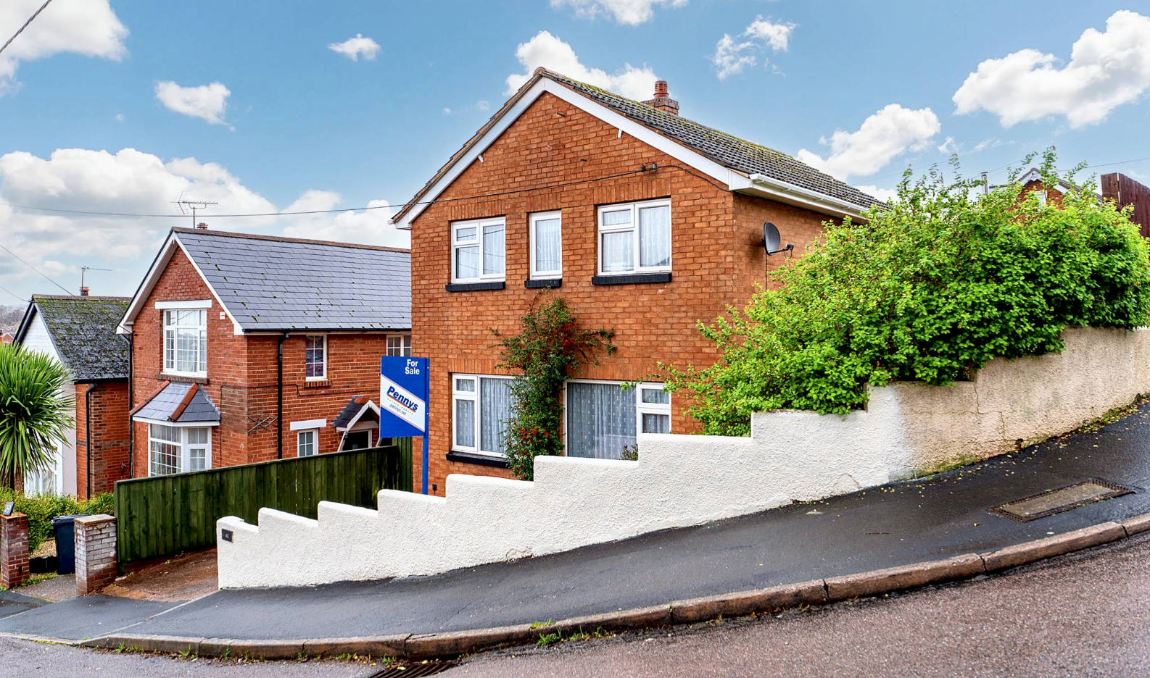
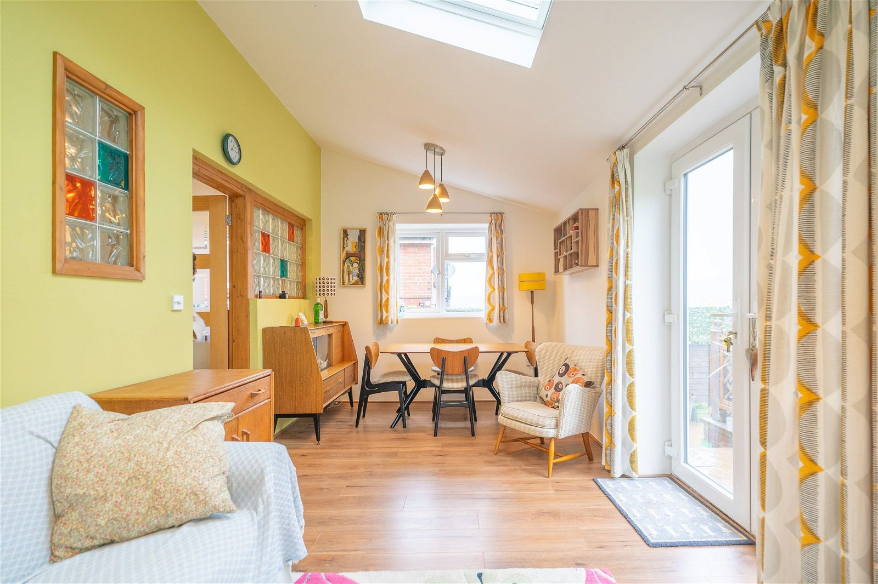
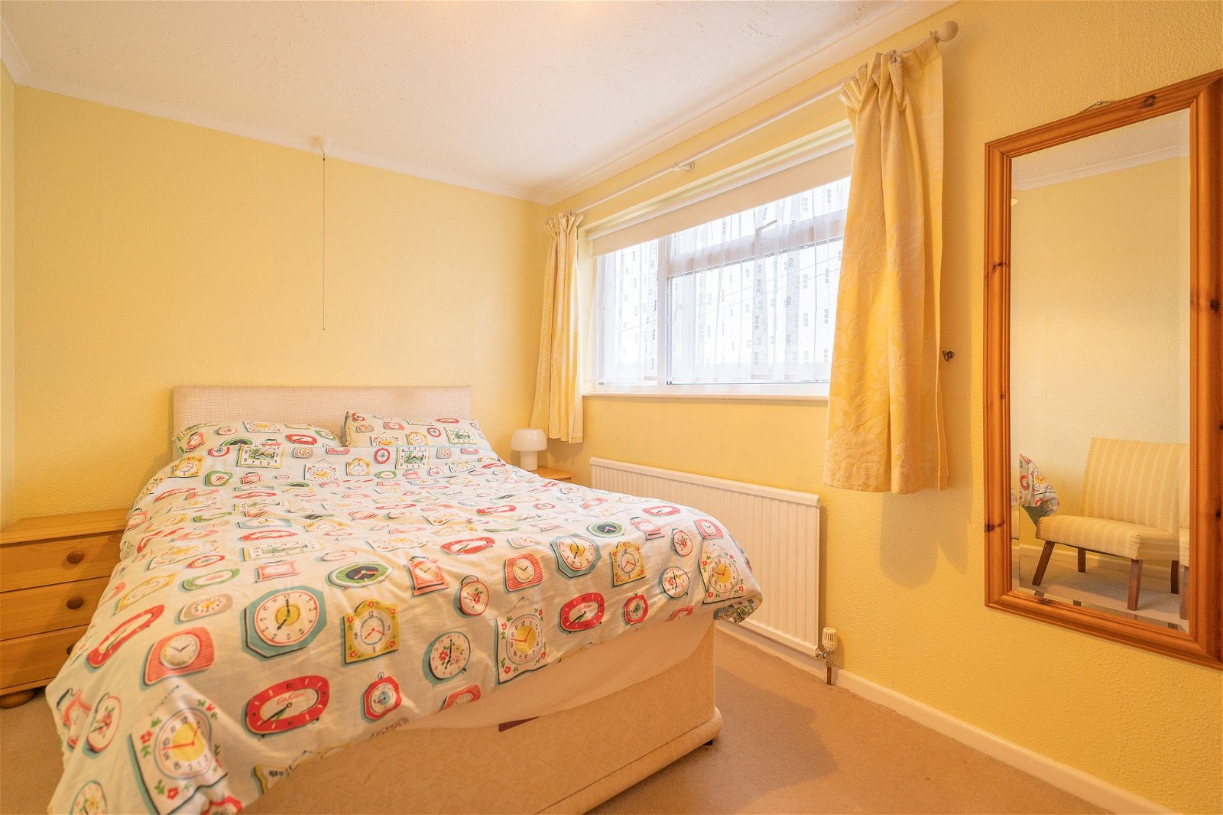
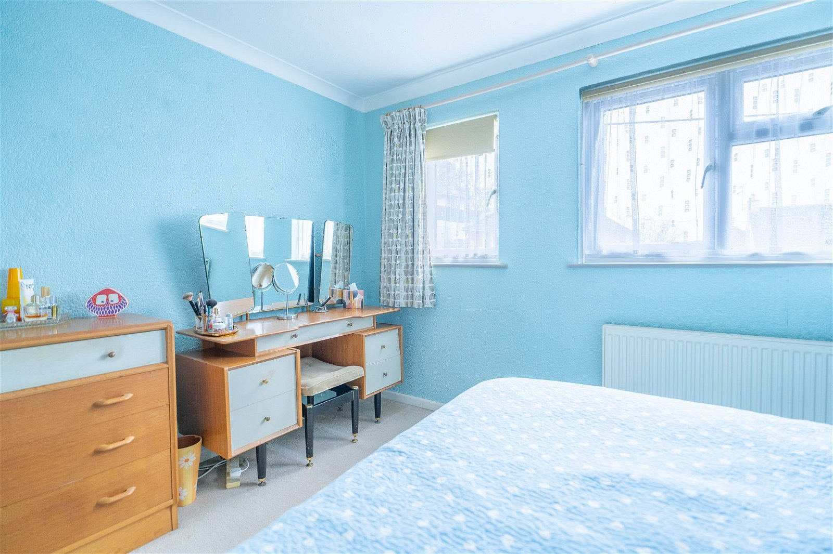
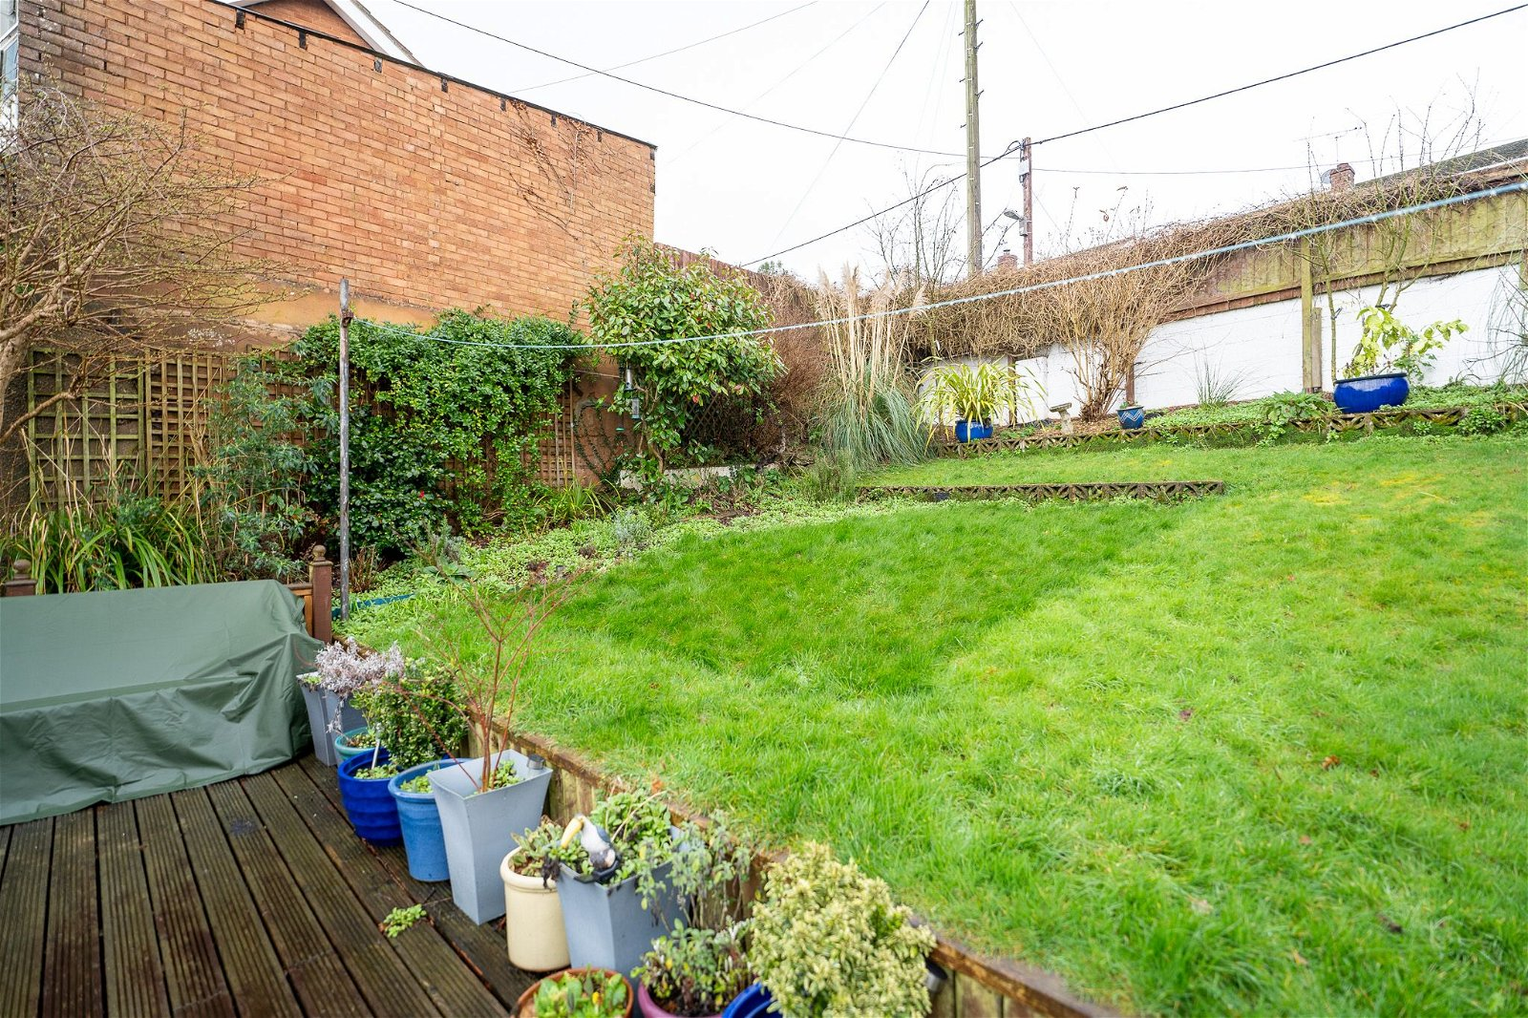
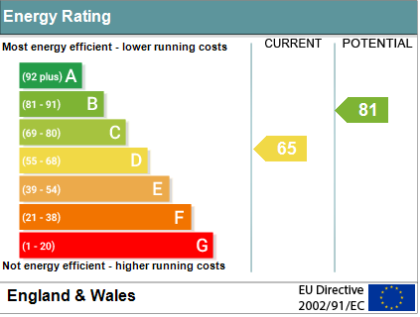
www.pennys.net
41 Masey Road, Exmouth, EX8 4AR
GUIDE PRICE £399,950
TENURE Freehold
A Beautifully Presented And Extended Detached House With Sunny Aspect, Secluded Gardens And Off-Road Parking
Spacious Lounge • Modern Kitchen/Breakfast Room •
Sitting Room Extension • Three Bedrooms • Modern Bathroom/WC •
Gas Central Heating • Double Glazed Windows •
Super Family Home •
Pennys Estate Agents Limited for themselves and for the vendor of this property whose agents they are give notice that:- (1) These particulars do not constitute any part of an offer or a contract. (2) All statements contained in these particulars are made without responsibility on the part of Pennys Estate Agents Limited. (3) None of the statements contained in these particulars are to be relied upon as a statement or representation of fact. (4) Any intending purchaser must satisfy himself/herself by inspection or otherwise as to the correctness of each of the statements contained in these particulars. (5) The vendor does not make or give and neither do Pennys Estate Agents Limited nor any person in their employment has any authority to make or give any representation or warranty whatever in relation to this property.
PENNYS ESTATE AGENTS
2 Rolle House, Rolle Street, Exmouth, Devon, EX8 2SN
Tel: 01395 264111 EMail: help@pennys.net

Slide 2
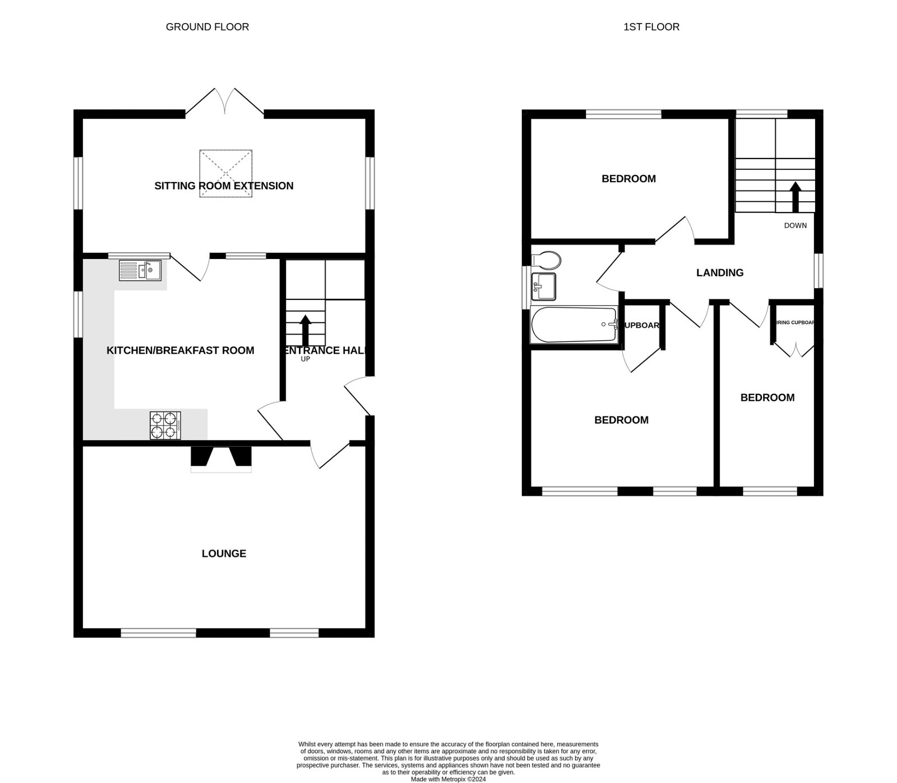
41 Masey Road, Exmouth, EX8 4AR
The current owners have chosen decor to reflect the vibrancy of the early '60's - in keeping from when the house was built.
THE ACCOMMODATION COMPRISES: Double glazed front door to:
RECEPTION HALL: Wood effect flooring; radiator; stairs to first floor landing; with understairs cupboard beneath; telephone point. LOUNGE: 5.59m x 3.71m (18'4" x 12'2") A bright and spacious room with two double glazed windows to front aspect; feature stone fireplace and display areas with wood mantle over and housing coal effect gas fire; two radiators; television point. KITCHEN/BREAKFAST ROOM: 3.81m x 3.63m (12'6" x 11'11") A stylish modern kitchen with wood effect worktop surfaces with glass splash backs and cupboards, drawer units and plumbing for an automatic washing machine beneath; inset one and a half bowl sink unit; gas cooker point; wall mounted cupboards; double glazed windows to side aspect; Worcester gas boiler; radiator; part glazed door to: SITTING ROOM EXTENSION: 5.49m x 2.74m (18'0" x 9'0") A lovely addition to the accommodation enjoying a triple aspect with double glazed windows and double glazed double doors to rear garden; double glazed velux window; wood effect flooring; radiator. FIRST FLOOR LANDING: Radiator; double glazed windows to side and rear aspects; access to fully insulated and boarded loft space via foldaway ladder; doors to: BEDROOM ONE: 3.51m x 2.77m (11'6" x 9'1") Plus door recess. Radiator; shelved wardrobe; two double glazed windows to the front aspect with open views over the town towards the estuary and coastline in the distance. BEDROOM TWO: 3.68m x 2.41m (12'1" x 7'11") Double glazed window to rear aspect; radiator. BEDROOM THREE: 3.66m x 1.98m (12'0" x 6'6") Airing cupboard housing water cylinder; double glazed window to front with open aspect; radiator. BATHROOM/WC: 1.98m x 1.6m (6'6" x 5'3") A modern suite with low level bath, splash screen wall, Mira shower unit and shower splash screen; vanity wash hand basin; WC with push button flush; radiator; double glazed window with pattern glass; mirror fronted medicine cabinet; part tiled walls. OUTSIDE: Driveway and turning area providing parking for two cars. A side path with outside lighting and side raised garden leads via a gate to the rear garden. The rear garden is a super feature to the property enjoying views across the town. Offering privacy and seclusion, the garden is enclosed and attractively planned with decked sun terrace ideal for outside entertaining; lawn garden, colorful shrub beds, outside power point, patio path and terrace with timber garden shed, outside lighting and outside tap. A further side pathway with two wooden gates and storage containers leads back round to the front of the property.
FLOOR PLAN:

