Slide 1
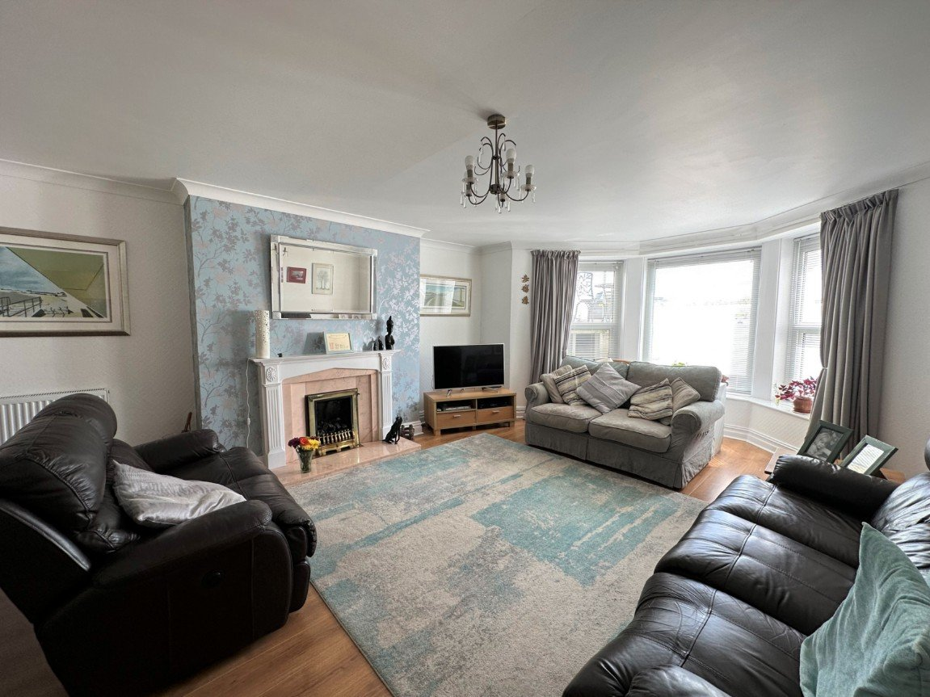
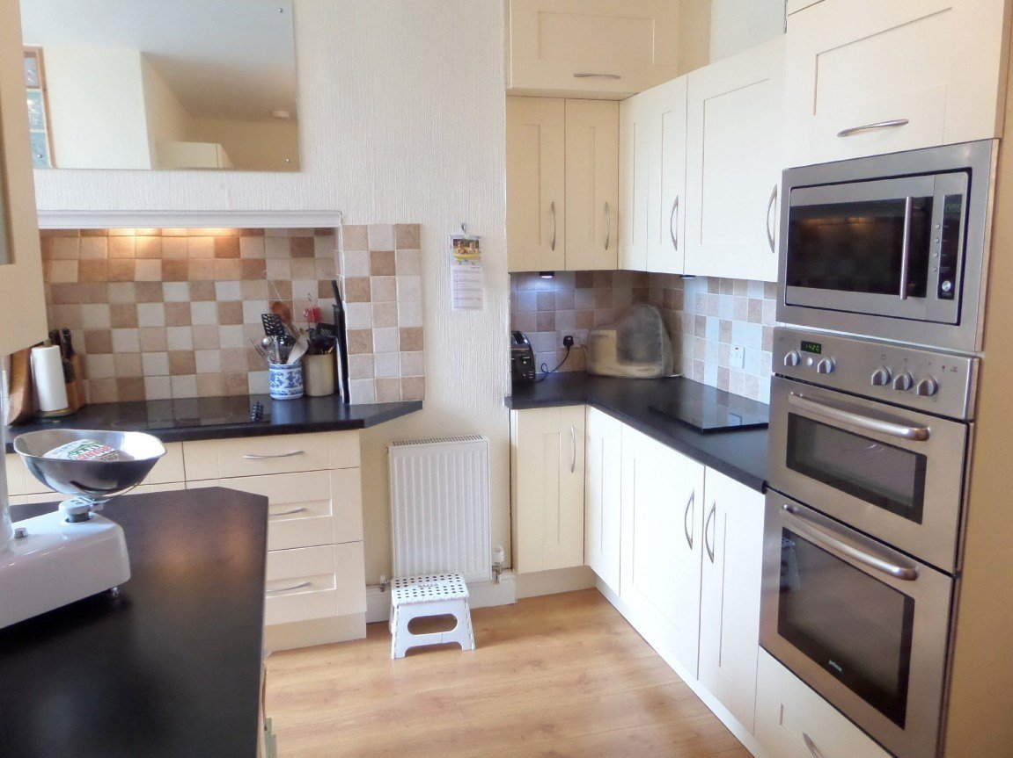
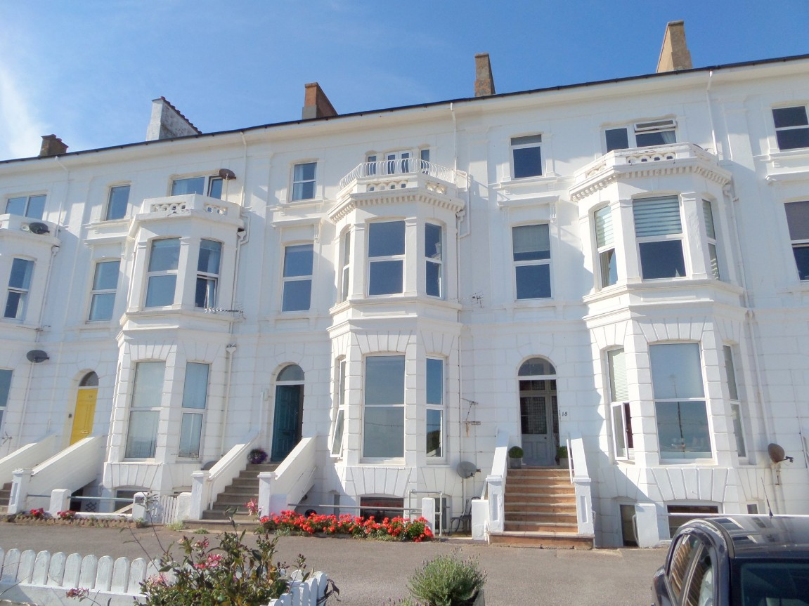
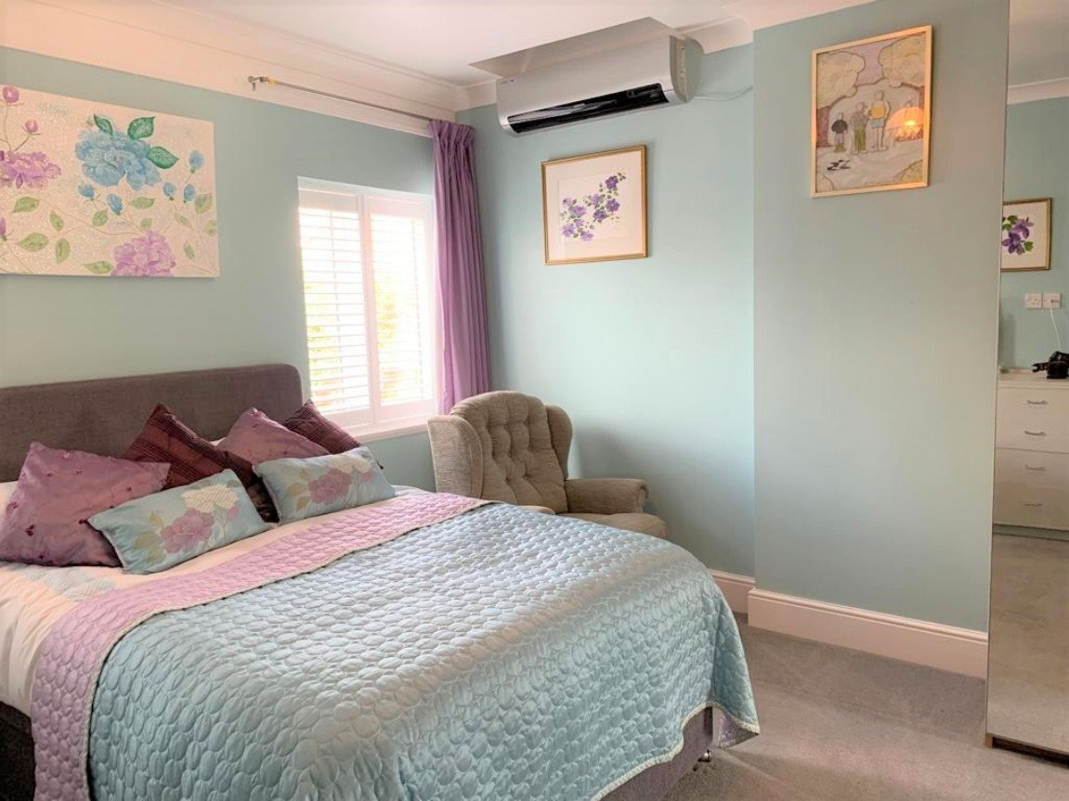
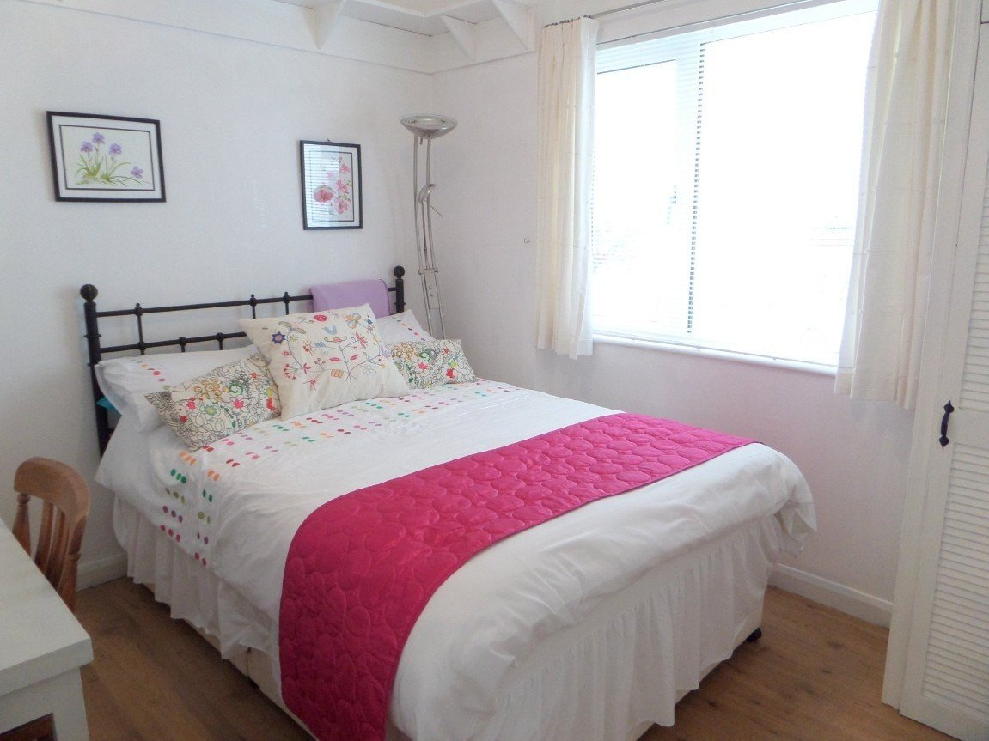
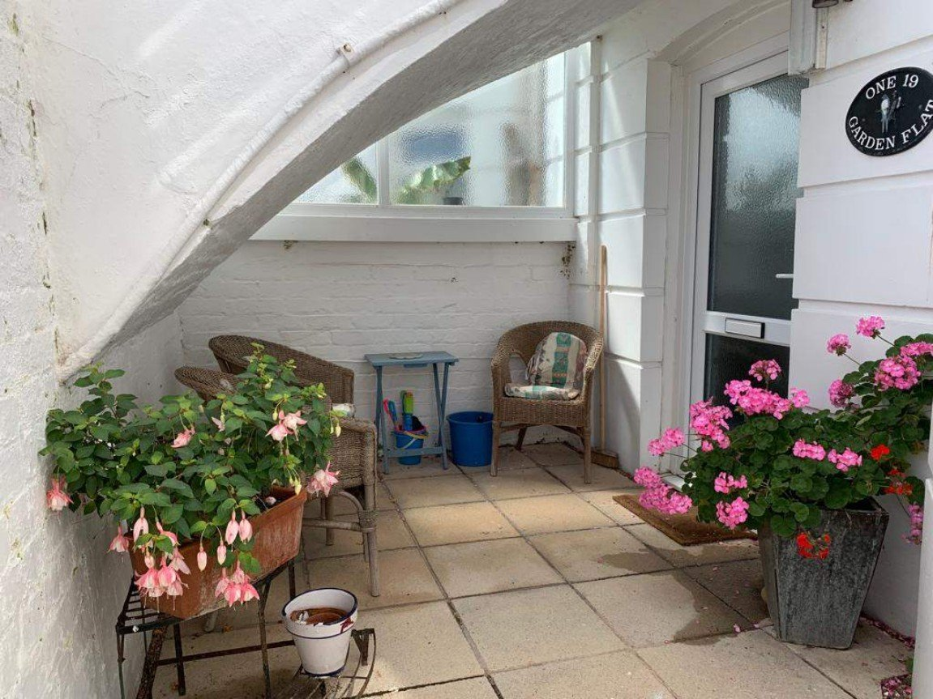
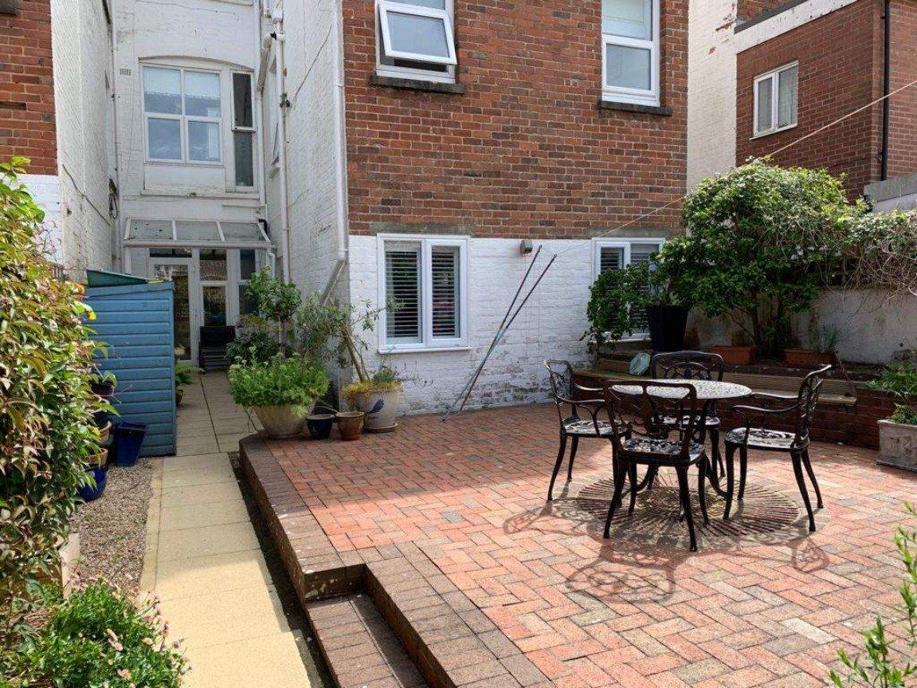
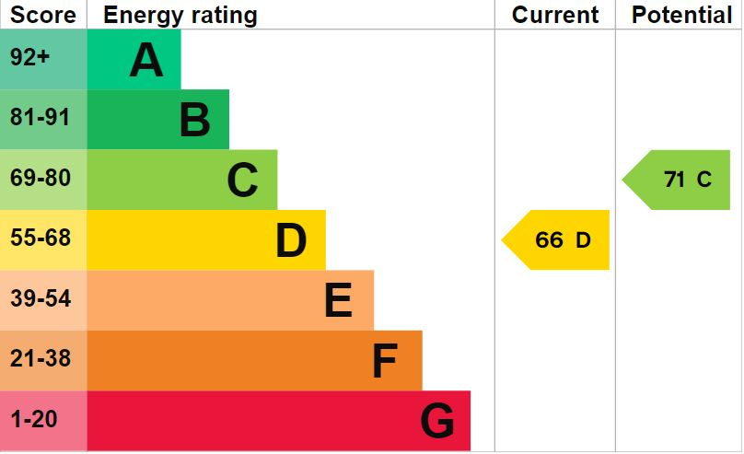
www.pennys.net
Flat 1, 19 Morton Crescent, Exmouth, EX8 1BG
GUIDE PRICE £385,000
TENURE Share of Freehold
A Stunning And impeccably Presented Two Bedroom Garden Flat Occupying The Whole Of The Lower Ground Floor Of A Property Located On Exmouth Seafront
Spacious Bay Fronted Sitting Room • Useful Dining Hall •
Modern Fitted Kitchen With Integrated Appliances • Two Bedrooms • Attractive Refitted Shower Room/WC • Double Glazing And Central Heating •
Front Patio Garden And Private Rear Garden • Off Road Parking Area •
Beautifully Presented • Early Viewing Highly Recommended•
Pennys Estate Agents Limited for themselves and for the vendor of this property whose agents they are give notice that:- (1) These particulars do not constitute any part of an offer or a contract. (2) All statements contained in these particulars are made without responsibility on the part of Pennys Estate Agents Limited. (3) None of the statements contained in these particulars are to be relied upon as a statement or representation of fact. (4) Any intending purchaser must satisfy himself/herself by inspection or otherwise as to the correctness of each of the statements contained in these particulars. (5) The vendor does not make or give and neither do Pennys Estate Agents Limited nor any person in their employment has any authority to make or give any representation or warranty whatever in relation to this property.
PENNYS ESTATE AGENTS
2 Rolle House, Rolle Street, Exmouth, Devon, EX8 2SN
Tel: 01395 264111 EMail: help@pennys.net

Slide 2
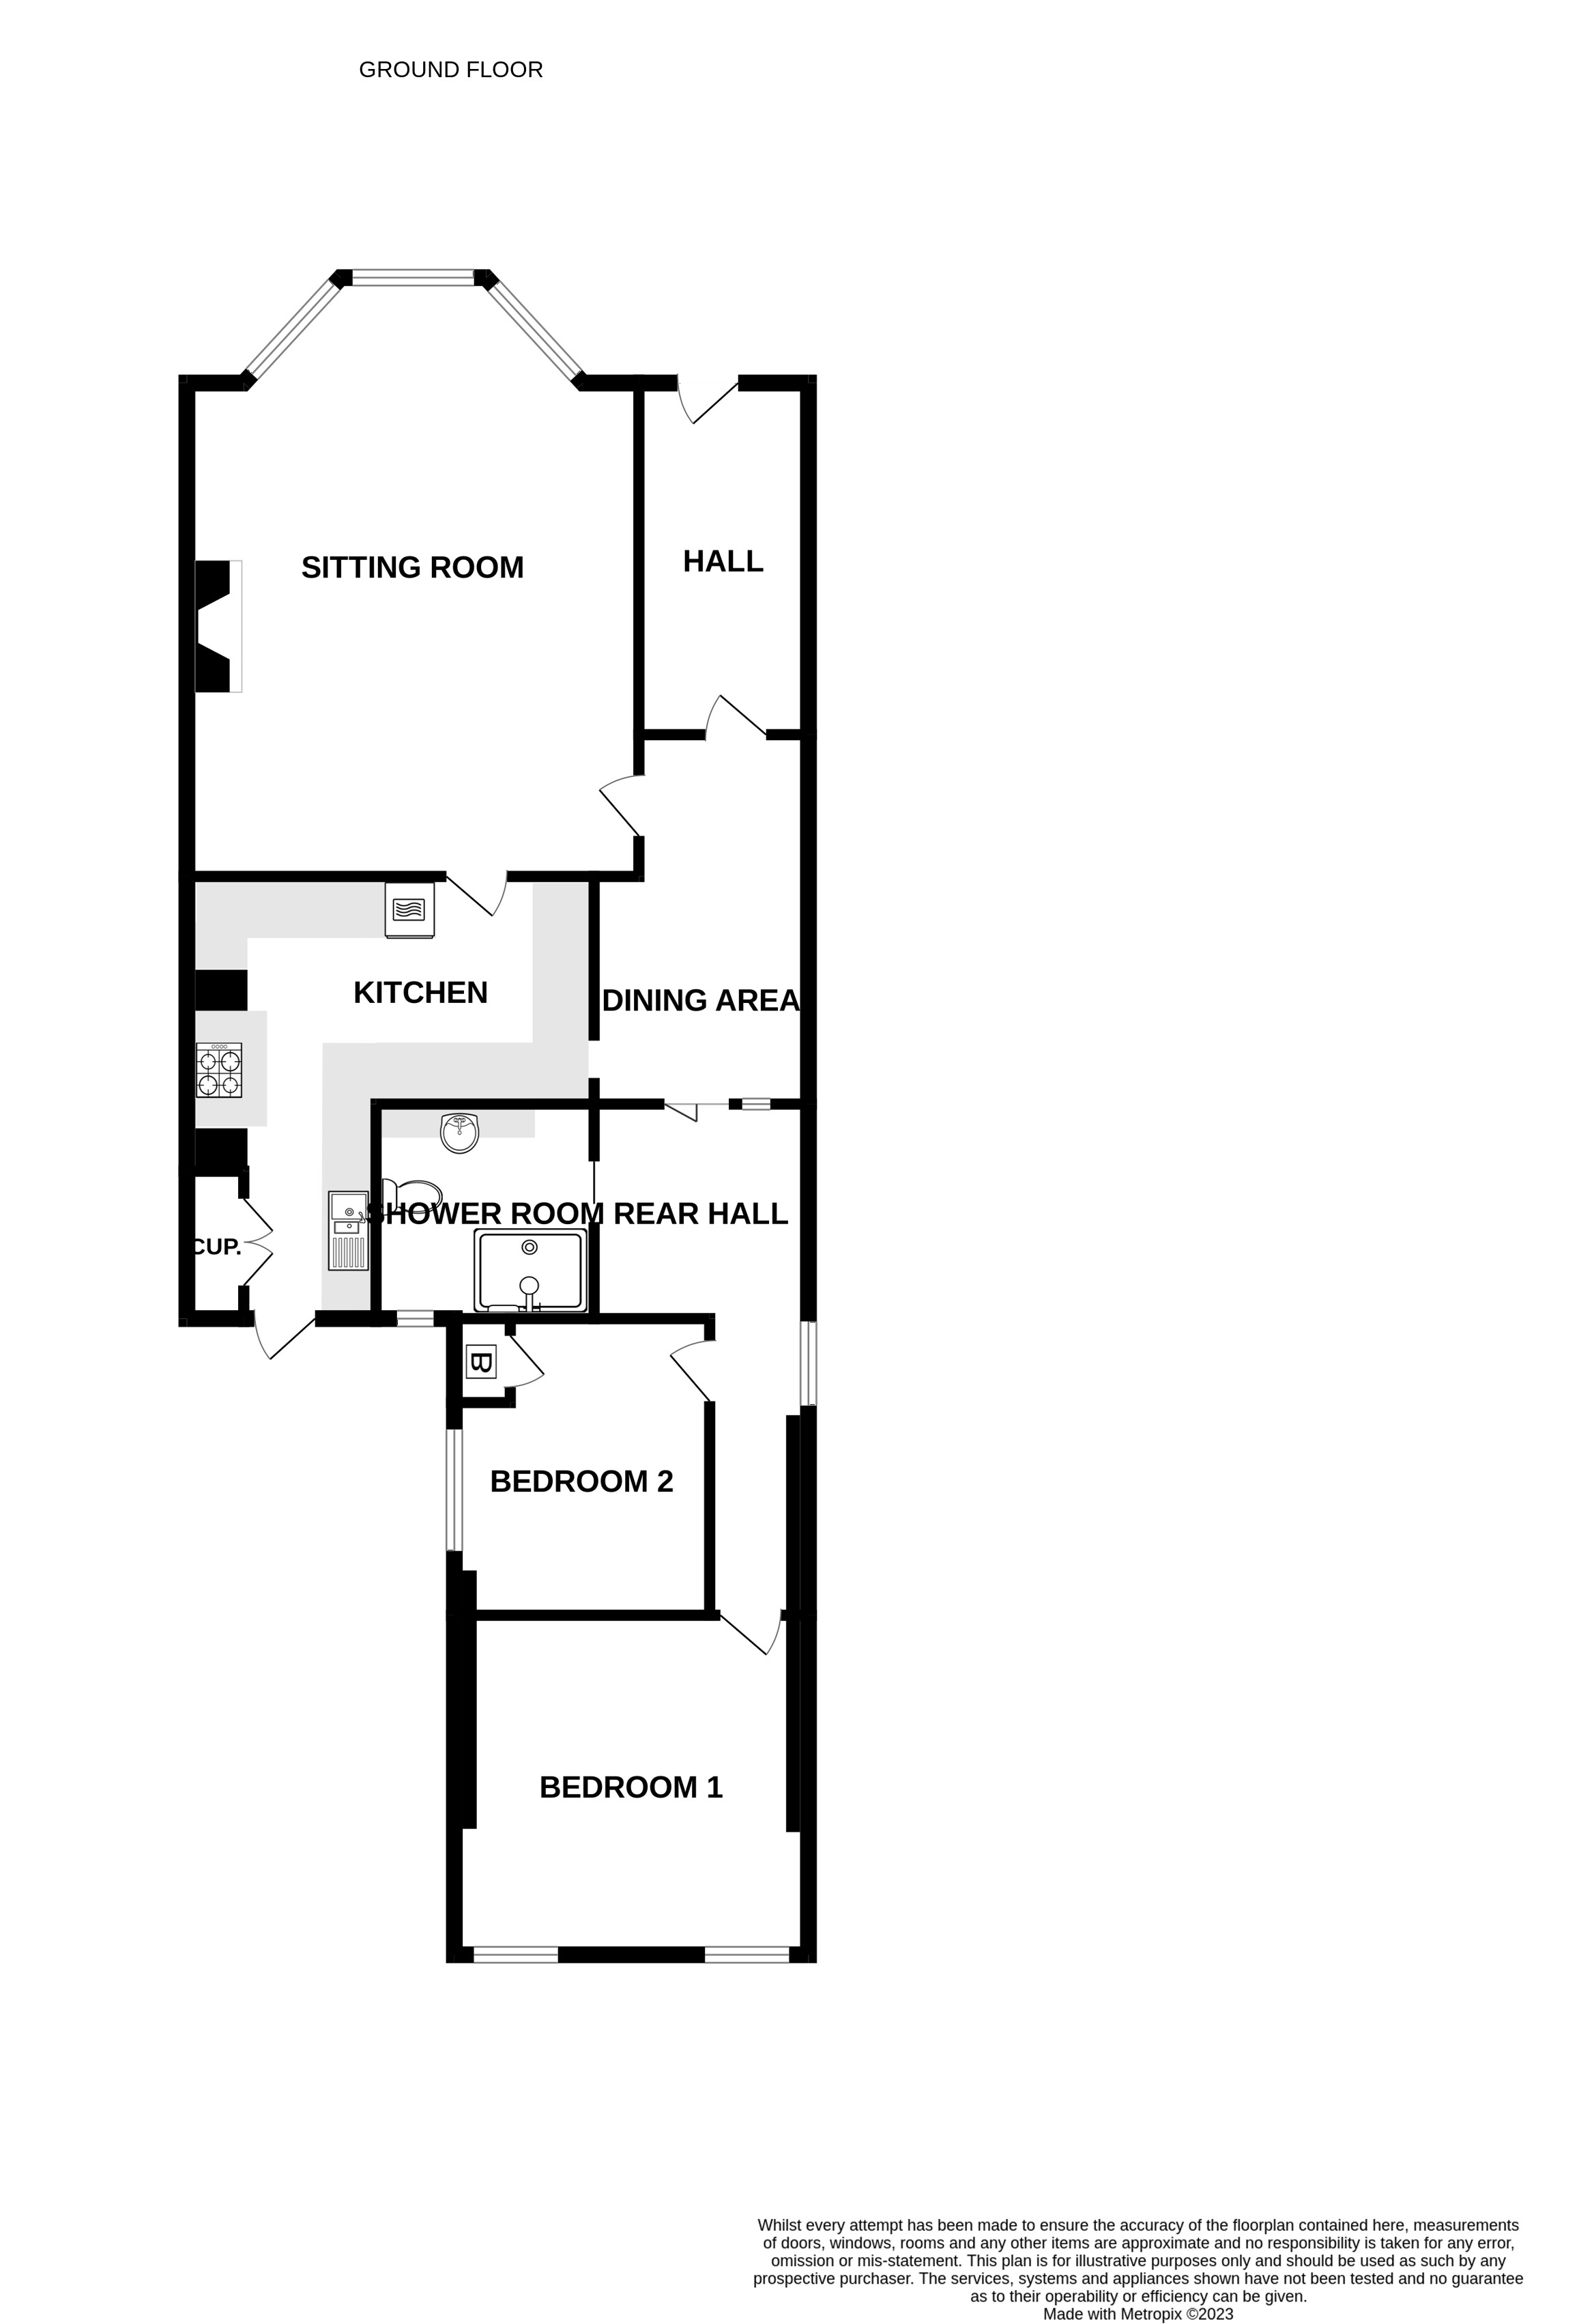
Flat 1, 19 Morton Crescent, Exmouth, EX8 1BG
THE ACCOMMODATION COMPRISES: Obscure double glazed entrance door leading to: ENTRANCE HALLWAY: Dado rail; built in storage cupboard with central mirror providing space for coats and shoes; radiator; obscure glazed inner door leading to DINING HALL: 4.52m x 2.29m (14'10" x 7'6") A useful area with glass inner brick wall providing light from the entrance hall; wood style laminate flooring; radiator; inset ceiling down-lighters; serving hatch from the kitchen; obscure glazed bi-fold doors leading to the inner hallway and door to: SITTING ROOM: 6.71m x 4.83m (22'0" x 15'10") A most impressive bay fronted room with double glazed bay window to the front aspect; feature Living Flame coal effect gas fire set in attractive surround; wood style laminate flooring; television aerial point; telephone point; two radiators; obscure glazed inner door leading to: KITCHEN: 4.39m x 2.54m (14'5" x 8'4") Plus return of 7' 8" x 5' 1" (2.34m x 1.52m) A superb feature of the property having been re-fitted with a modern range of quality cream fronted units; one and a half bowl composite sink unit set in roll edge worktop surface; complementary tiled splash back; comprehensive range of base cupboard and drawer units; matching eye level units over; integrated double oven and microwave; inset four ring ceramic hob with concealed cooker hood over; integrated dishwasher; integrated fridge, freezer and washer / dryer; wood style laminate flooring; wall mounted mirror; radiator; double glazed door with side panel window leading onto the rear patio. INNER HALLWAY: Obscure double glazed window to the side aspect; radiator; doors leading to: BEDROOM ONE: 3.89m x 3.76m (12'9" x 12'4") A delightful room with two double glazed windows to the rear aspect with a pleasant outlook over the rear garden; radiator; television aerial point. BEDROOM TWO: 3.05m x 2.84m (10'0" x 9'4") Double glazed window to side aspect with a pleasant outlook over the rear patio; high level display shelving; television aerial point; wood style laminate flooring; radiator; built in airing cupboard housing gas fired combination boiler. SHOWER ROOM/WC: A most attractive well appointed room with a double width shower cubicle with glass splash screen and wall mounted shower; close coupled WC; wash hand basin with storage cupboards below; tiled splash back; wall mounted vanity unit over incorporating mirror and shaver point with light over; chrome finish heated towel rail; obscure double glazed window to the rear aspect; inset ceiling down lighters; attractive pebble finish flooring. OUTSIDE: To the front of the property is a very pleasant enclosed seating area with a small upper decked area providing some views towards the sea. To the rear of the property there is a delightful enclosed private area of garden with a paved patio adjoining the kitchen; outside lighting; beyond the patio is the main area of garden which is designed as a patio style garden with inlaid herringbone brick surrounded by very well stocked mature flower and shrub borders; raised brick built seating area; pathway leading via a timber gate to a parking area providing off road parking for one large and one small car.
TENURE AND OUTGOINGS: We understand the property will benefit from a new 999 year lease from 2023 and benefits from an equal share of the freehold. Service charges approx £75.00 per month.
FLOOR PLAN:

