Slide 1
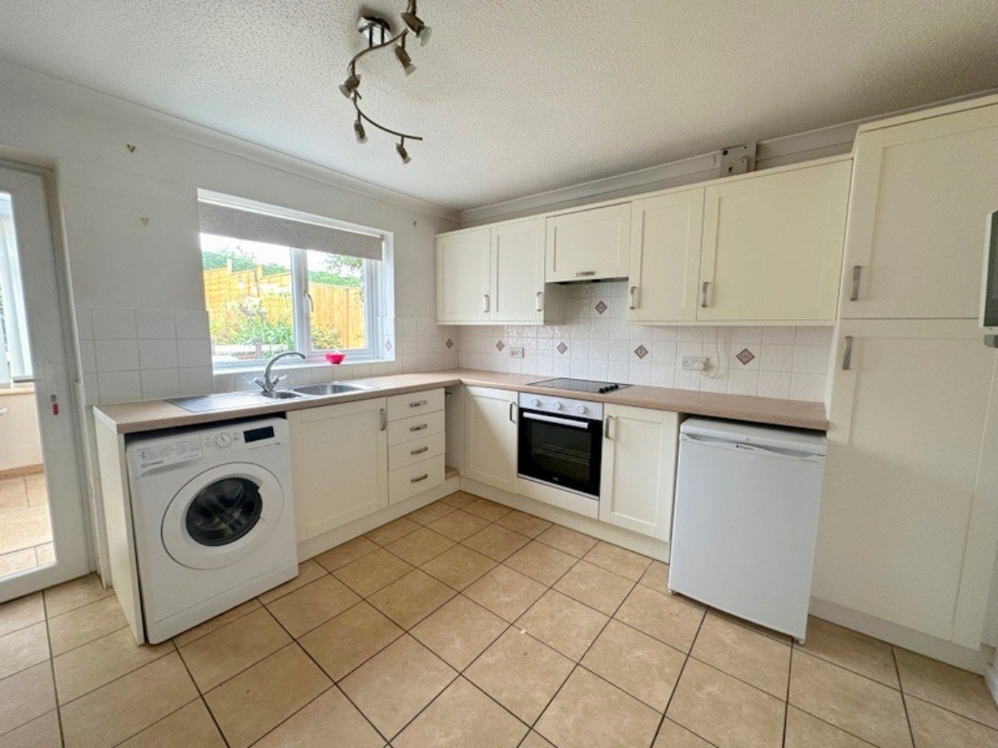
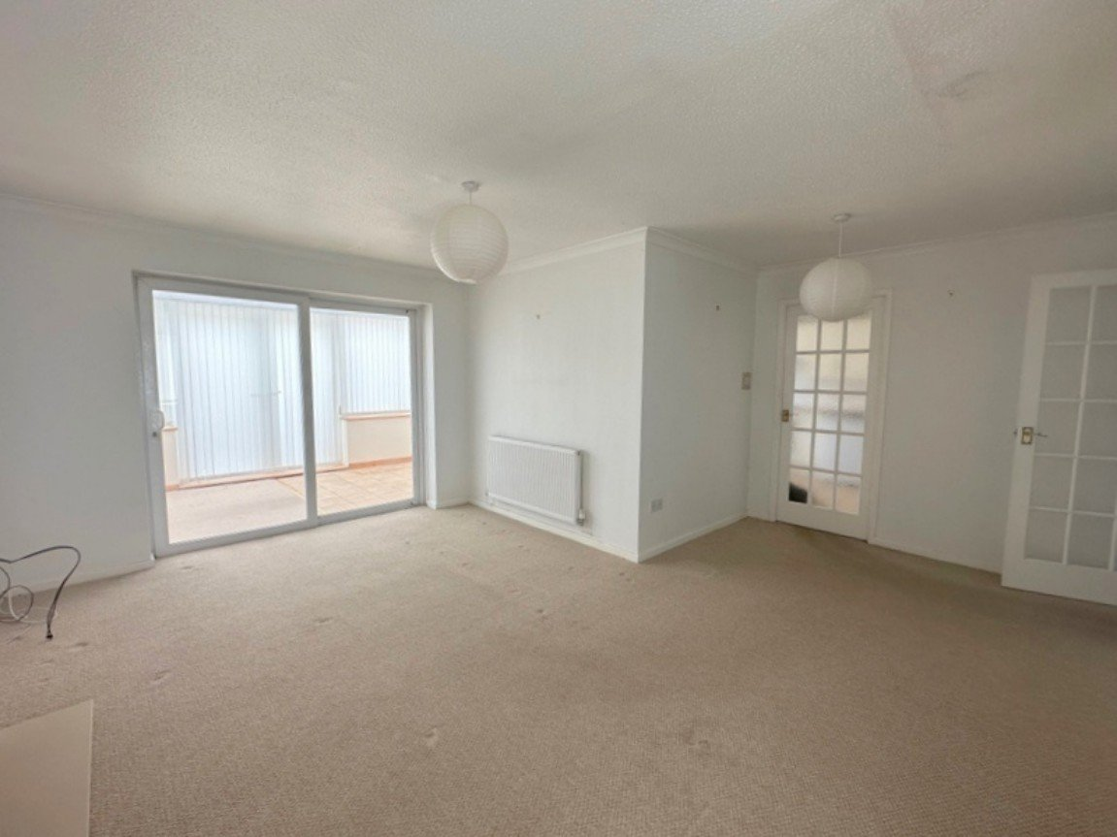
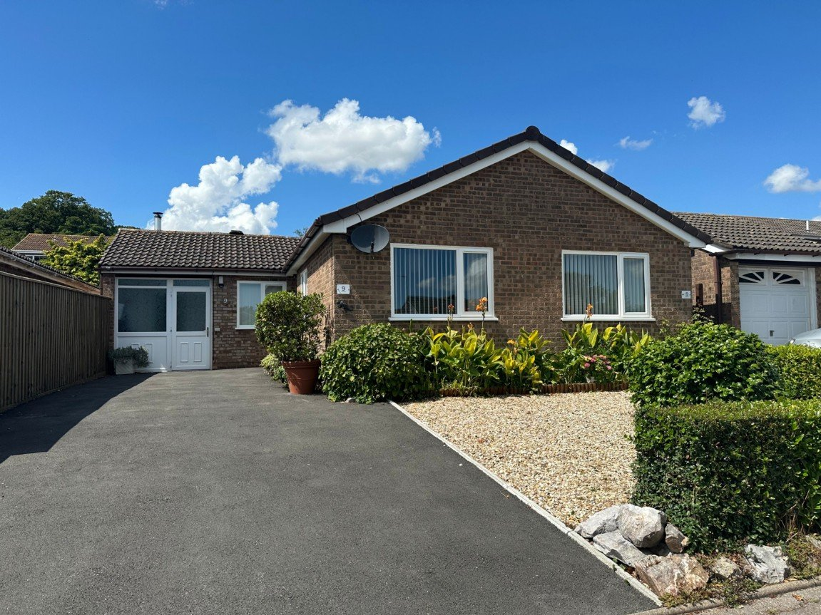
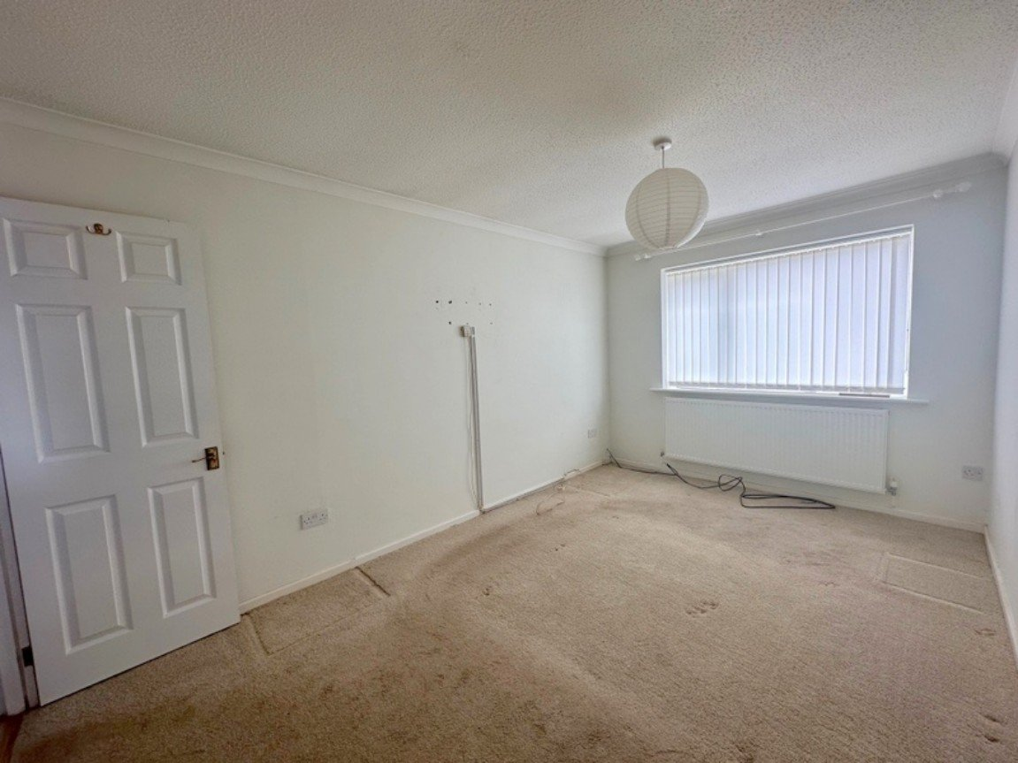
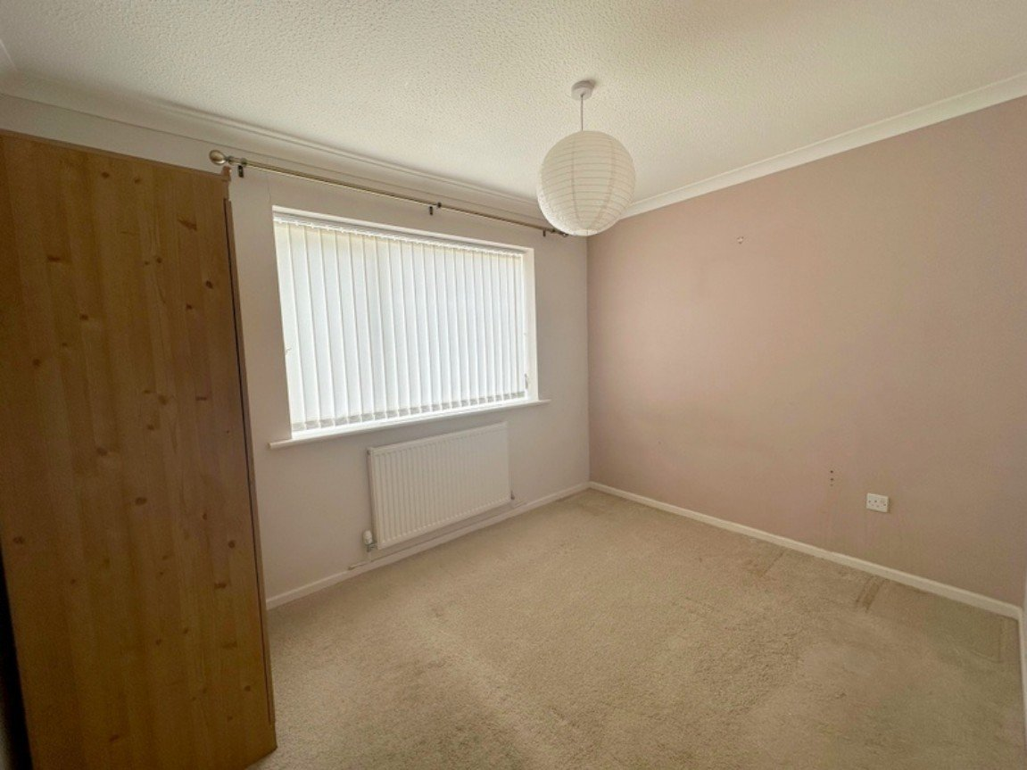
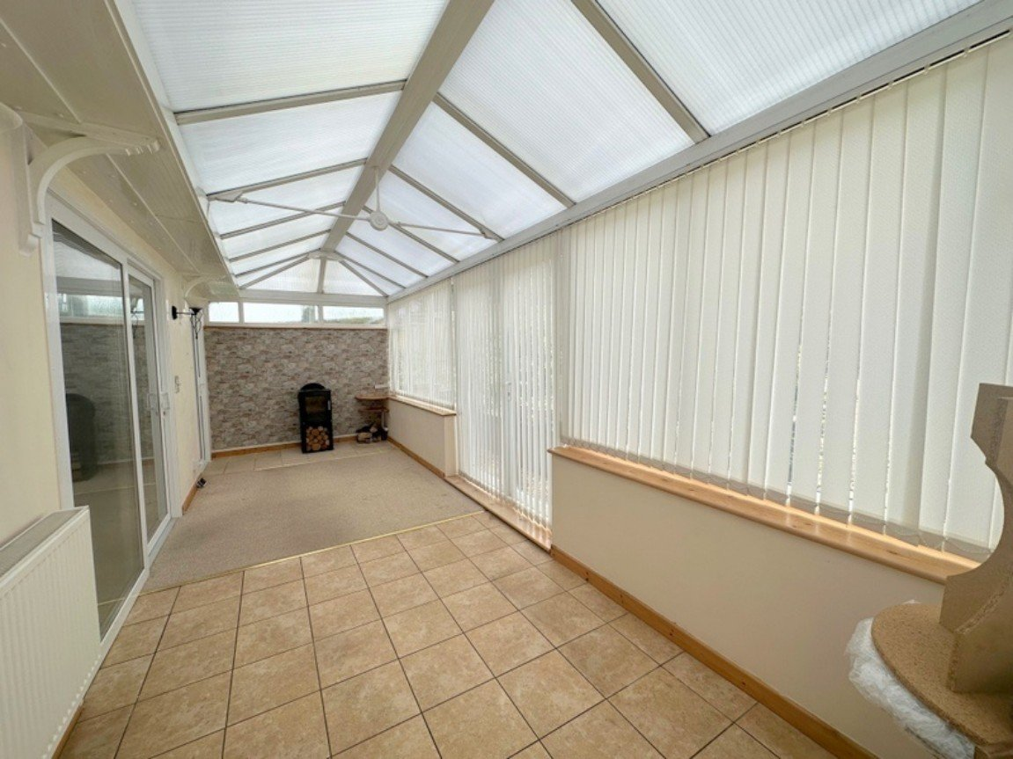
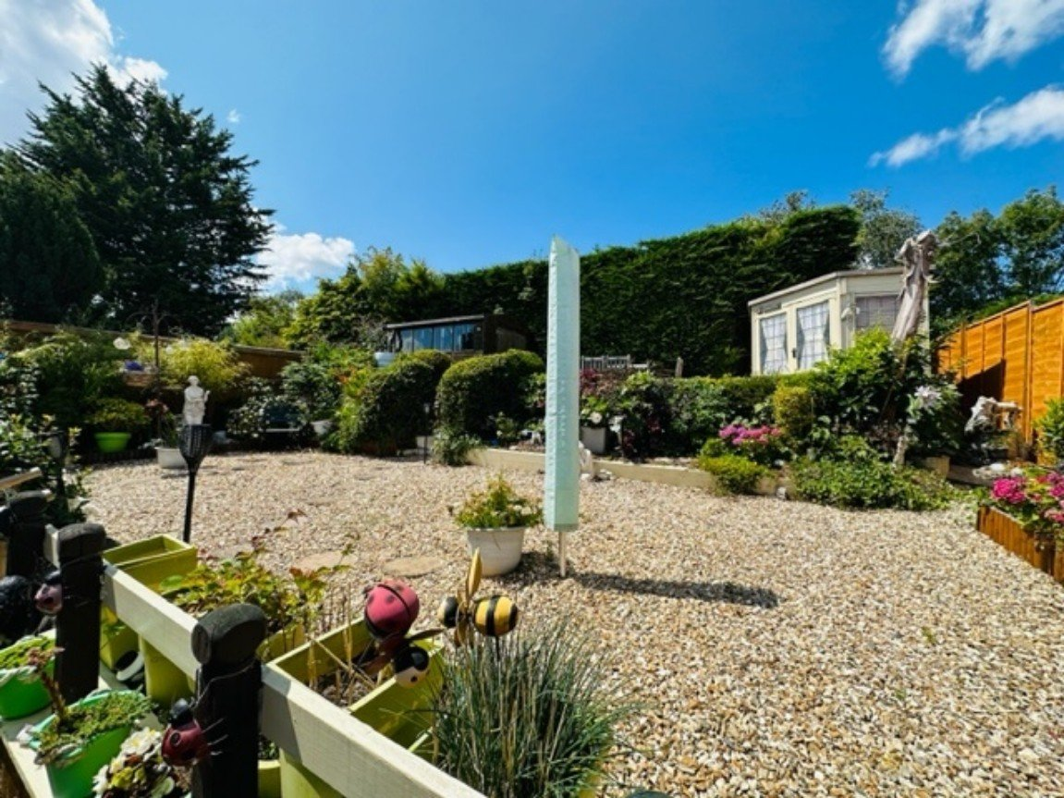
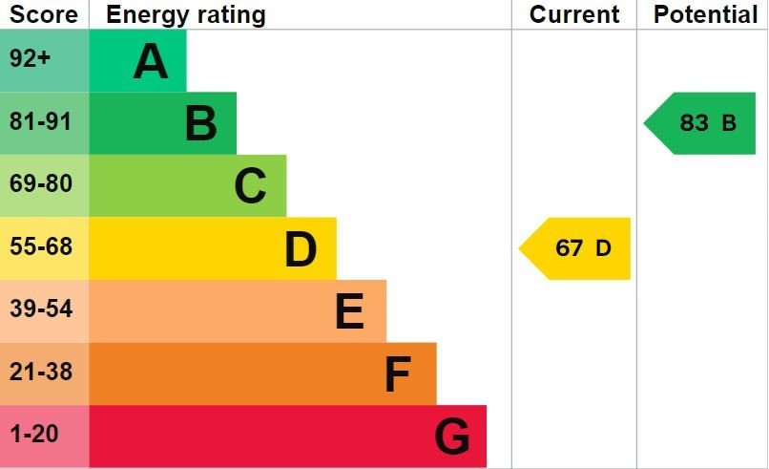
www.pennys.net
9 Silverdale, Exmouth, Devon, EX8 4NB
GUIDE PRICE £400,000
TENURE Freehold
A Beautifully Presented Three Bedroom Detached Bungalow With Attractive Gardens and Driveway Offering Ample Parking In A Convenient And Favoured Location With No Onward Chain
Reception Hall • Spacious Lounge • Modern Kitchen/Breakfast Room • Three Bedrooms - One With Ensuite/Wet-Room • Bathroom/WC • Conservatory With Log Burner •
Driveway Offering Parking for Numerous Cars • Converted Garage/Utility Room •
Beautifully Maintained Attractive Front and Rear Garden With Shed/Workshop & Summer House • Double Glazed Windows & Gas Central Heating •
Pennys Estate Agents Limited for themselves and for the vendor of this property whose agents they are give notice that:- (1) These particulars do not constitute any part of an offer or a contract. (2) All statements contained in these particulars are made without responsibility on the part of Pennys Estate Agents Limited. (3) None of the statements contained in these particulars are to be relied upon as a statement or representation of fact. (4) Any intending purchaser must satisfy himself/herself by inspection or otherwise as to the correctness of each of the statements contained in these particulars. (5) The vendor does not make or give and neither do Pennys Estate Agents Limited nor any person in their employment has any authority to make or give any representation or warranty whatever in relation to this property.
PENNYS ESTATE AGENTS
2 Rolle House, Rolle Street, Exmouth, Devon, EX8 2SN
Tel: 01395 264111 EMail: help@pennys.net

Slide 2
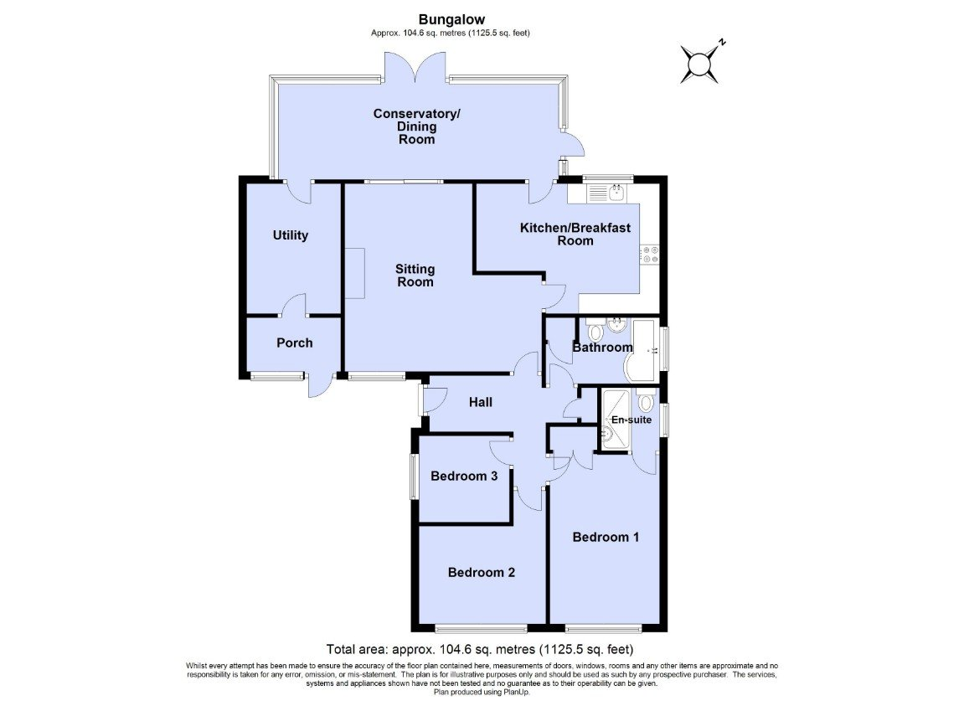
9 Silverdale, Exmouth, Devon, EX8 4NB
THE ACCOMMODATION COMPRISES: uPVC double glazed front door with feature panel, outside courtesy lighting; leading to: ENTRANCE HALLWAY: With radiator; telephone point; access to partially boarded roof space via loft ladder with power and light connected; smoke alarm; built-in cupboard with coat rack and shelving; also housing the electric consumer unit. LOUNGE: A well proportioned 'L' shaped room measuring 4.93m x 4.67m (16'2" x 15'4") narrowing to 8'7 "2.62m) in the door area. uPVC double glazed window to front aspect; double glazed sliding patio doors opening onto CONSERVATORY; feature fireplace with inset gas coal effect fire, attractive hearth and wooden mantle over; two radiators; television point; glazed door leading to: KITCHEN/BREAKFAST ROOM: 4.62m x 3.28m (15'2" x 10'9") Narrowing to 7'0(2.13m) A beautifully presented room fitted with a range of cream fronted base units and drawers; wall mounted eye-level units; inset one and a half bowl stainless steel sink with mixer tap over; fitted with a range of patterned work top surfaces; uPVC double glazed window to rear aspect overlooking the garden; tiled splash back; integrated electric oven with inset four ring ceramic hob and concealed cooker hood over; space and plumbing for automatic washing machine; space for freestanding under counter fridge/freezer; attractive tiled flooring; radiator; wall mounted Worcester boiler serving domestic hot water and gas central heating; television point; double glazed door leading to: CONSERVATORY: 7.32m x 2.29m (24'0" x 7'6") A fine addition to the property with part tiled floor and part carpet floor; uPVC double glazed windows and double glazed french doors opening onto the rear garden. Further double glazed door leading to the side; two wall lights; radiator; feature wood burner; television point further double glazed door leading into the UTILITY ROOM.
UTILITY ROOM: 3.51m x 2.36m (11'6" x 7'9") (Was previously the garage) space for additional appliances; wall shelving; access to additional eaves storage space; power and light connected; uPVC door to: SECONDARY PORCH: uPVC double glazed door with obscured glass picture inset and matching obscured glass window leading onto the driveway; coat hook; shelving. BEDROOM ONE: 4.24m x 2.72m (13'11" x 8'11") uPVC double glazed window to front aspect; radiator; television point; built-in double wardrobe with hanging rail; door to: ENSUITE/WETROOM: 1.57m x 1.45m (5'2" x 4'9") Comprising of a wall mounted shower; shower rail and shower curtain; WC with push button flush; grab rails; wash hand basin with mixer tap over; mirror fronted cabinet; obscure double glazed window to side aspect; chrome heated towel rail; extractor fan; fully tiled walls. BEDROOM TWO: 3.2m x 2.54m (10'6" x 8'4") Plus further door recess area: uPVC double glazed window to front aspect; radiator; wall mounted mirror; television point.
BEDROOM THREE: 2.29m x 2.16m (7'6" x 7'1") uPVC double glazed window to side aspect; radiator; television point. BATHROOM/WC: 2.82m x 1.65m (9'3" x 5'5") Modern suite comprising of 'P' shaped bath with electric shower over and taps; curve glazed shower screen; pedestal wash hand basin with mixer tap; wall mounted mirror over and shaver point; WC with push button flush; ceramic wall tiling with complimentary floor tiling; chrome heated towel rail; extractor fan; built-in airing cupboard with slatted shelving.
OUTSIDE: To the front of the property there is a stoned area of garden with mature flowers and shrub borders. A pathway provides pedestrian access via timber gate that leads to the rear garden. A driveway providing off-road parking for numerous vehicles. To the rear of the property is a well established and attractively landscaped garden offering a seating area with circular paved patio area and stone chipping surround ideal for outside entertaining and al-fresco dining; outside tap; a step up leading to a gravelled area surrounding by a large variety of flowers and mature shrubs; further steps leading to a decked area with a TIMBER STORAGE SHED, further seating area and SUMMER HOUSE. The rear garden is fully enclosed with a high degree of privacy with fencing and laurel hedges.
FLOOR PLAN:

