Slide 1
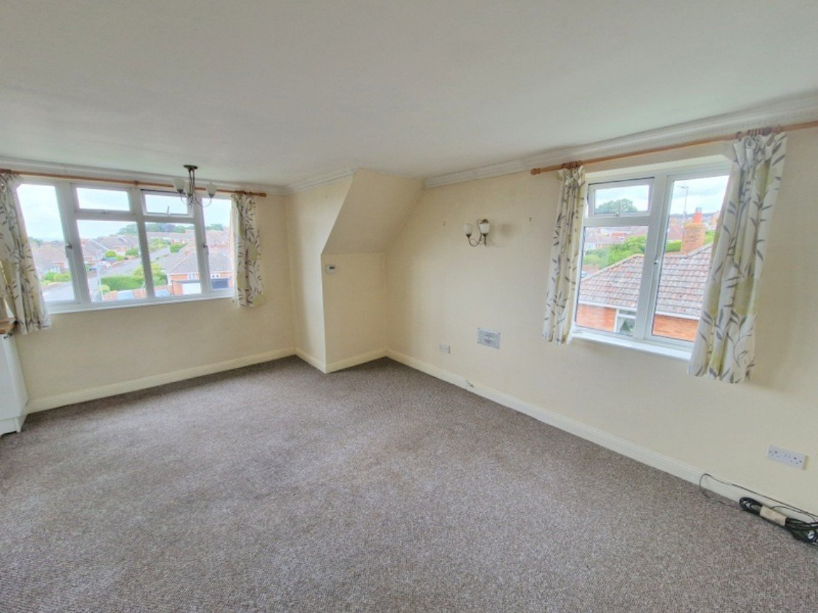
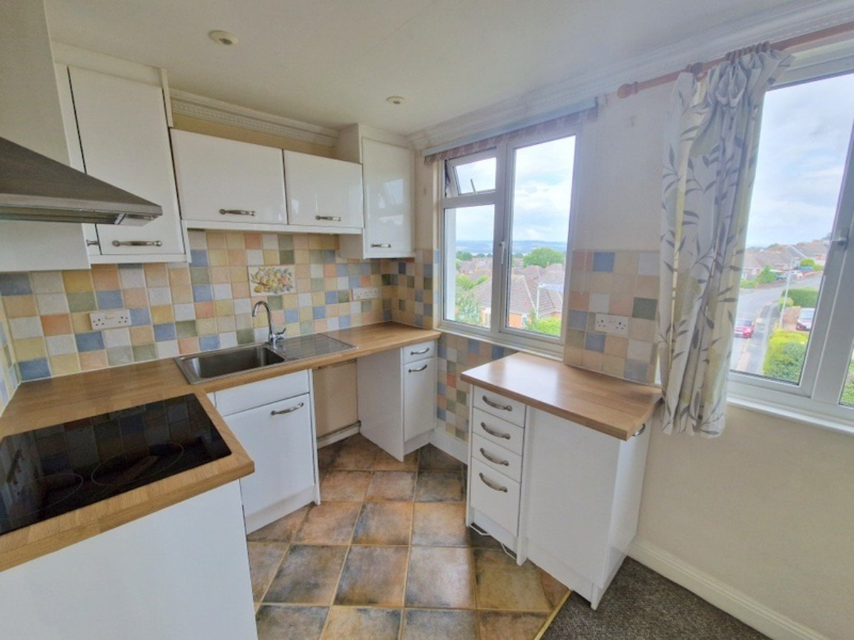
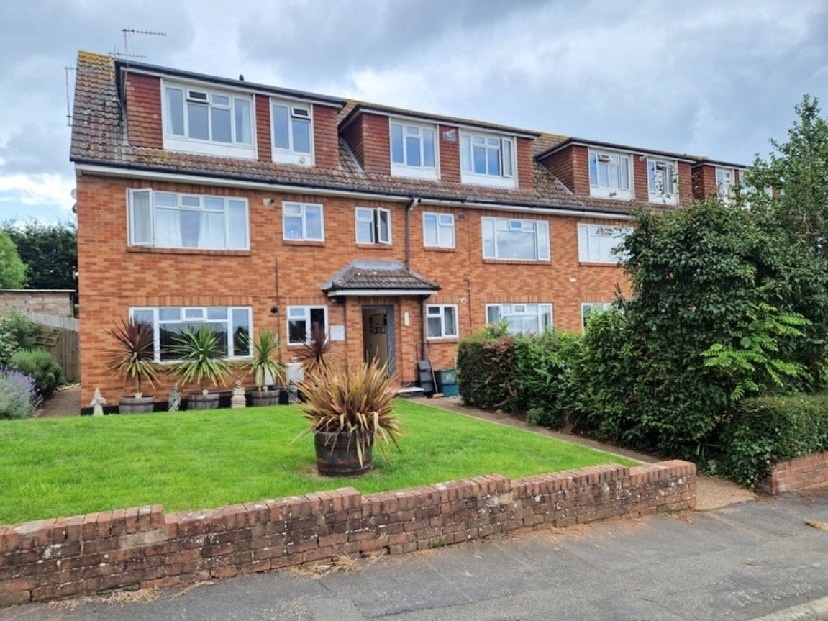
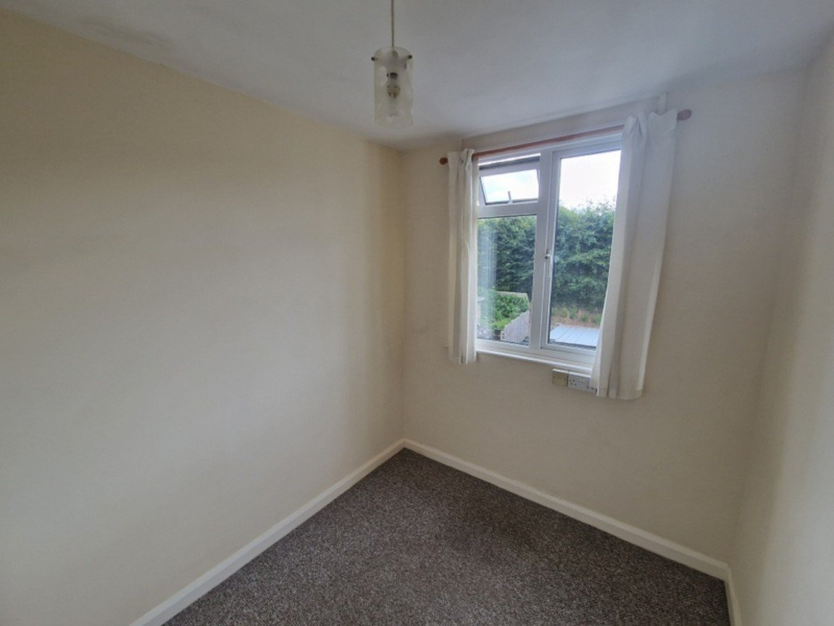
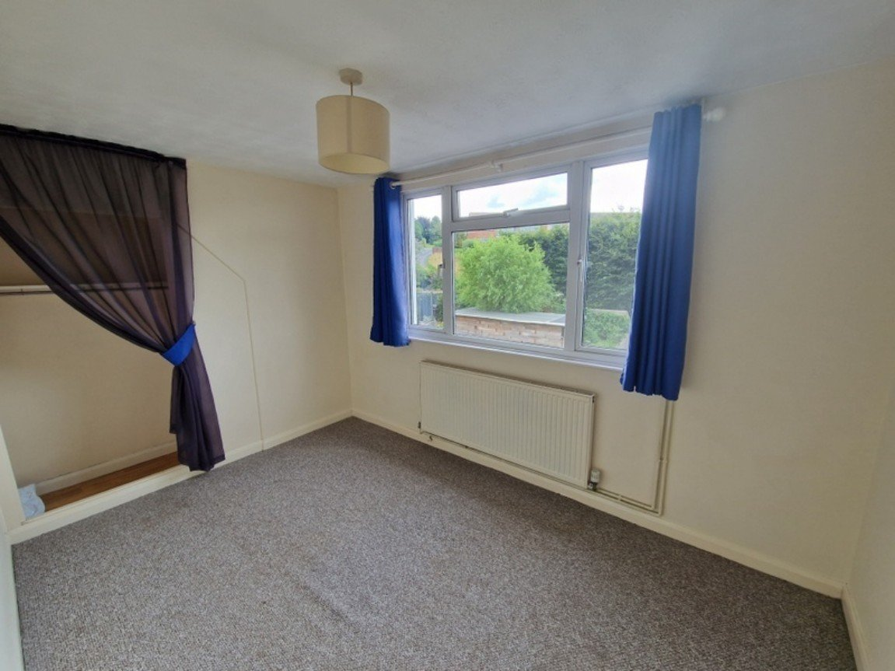
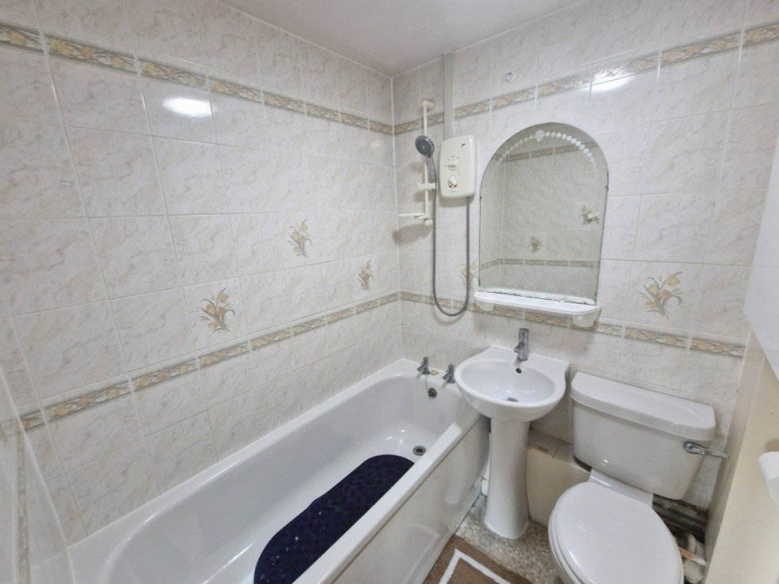
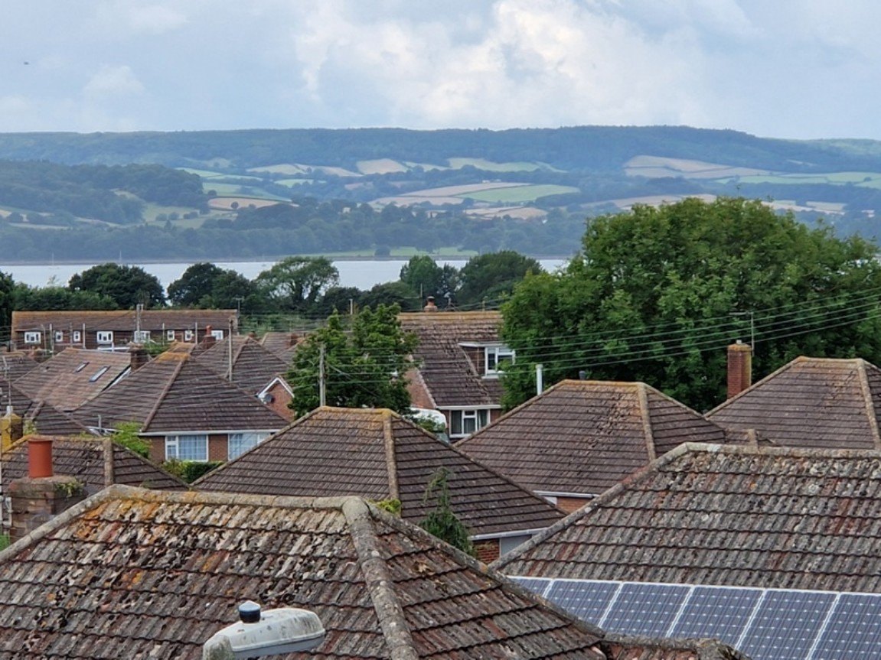
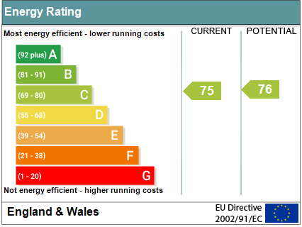
www.pennys.net
9 Mount Pleasant Court, Exmouth, Devon, EX8 4QX
PRICE £174,950
TENURE Leasehold
A Well Presented Purpose Built Second Floor Two Bedroom Flat Situated In A Quiet Favoured Location Close To Amenities Enjoying Excellent Sea And Coastline Views And Offered For Sale With No Ongoing Chain
Reception Hall • Open Plan Lounge/Dining Room • Modern Kitchen •
Two Bedrooms • Bathroom/WC • Double Glazed Windows •
Gas Central Heating Via Modern Boiler •
Garage In A Block Close By With Parking Space To The Front • Long Lease •
Pennys Estate Agents Limited for themselves and for the vendor of this property whose agents they are give notice that:- (1) These particulars do not constitute any part of an offer or a contract. (2) All statements contained in these particulars are made without responsibility on the part of Pennys Estate Agents Limited. (3) None of the statements contained in these particulars are to be relied upon as a statement or representation of fact. (4) Any intending purchaser must satisfy himself/herself by inspection or otherwise as to the correctness of each of the statements contained in these particulars. (5) The vendor does not make or give and neither do Pennys Estate Agents Limited nor any person in their employment has any authority to make or give any representation or warranty whatever in relation to this property.
PENNYS ESTATE AGENTS
2 Rolle House, Rolle Street, Exmouth, Devon, EX8 2SN
Tel: 01395 264111 EMail: help@pennys.net

Slide 2
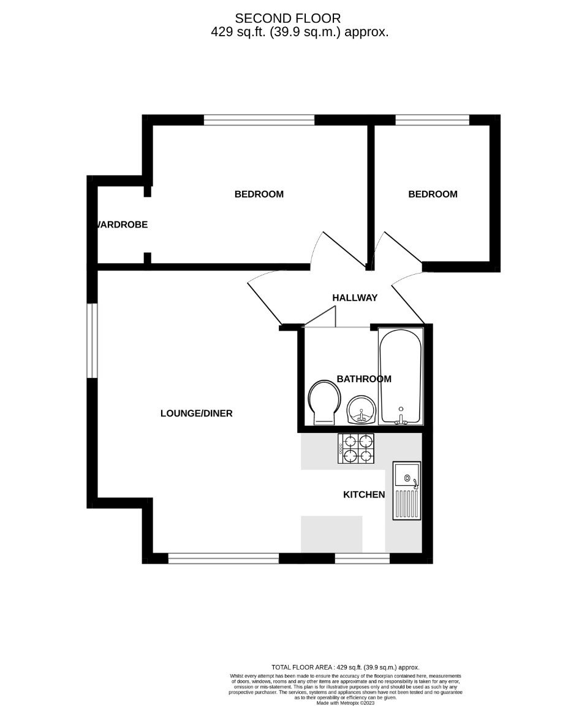
9 Mount Pleasant Court, Exmouth, Devon, EX8 4QX
THE ACCOMMODATION COMPRISES: Communal entrance with staircase rising to the SECOND FLOOR. Replacement fireproof front door giving access to:
RECEPTION HALL: Radiator; modern electric consumer unit.
LOUNGE/DINING ROOM: - 4.93m x 3.45m (16'2" x 11'4") A bright and spacious open plan dual aspect room with double glazed windows to front and side aspects gaining excellent views across the town towards the estuary and coastline in the distance; Sky/television point; radiator; wall lighting; timer control for hot water and central heating; opening through to the:
KITCHEN: - 2.01m x 2.11m (6'7" x 6'11") A modern kitchen fitted with wood effect work top surfaces with tiled surrounds; inset ingle drainer sink unit; base cupboards, drawer units, space and plumbing for washing machine beneath work tops; inset four ring electric hob with built-in oven below and extractor hood over; wall mounted cupboards; tiled flooring; double glazed window enjoying estuary and coastline views.
BEDROOM ONE: - 3.61m x 2.39m (11'10" x 7'10") Double glazed window to rear aspect; radiator; built-in wardrobe with clothes rail and shelf; Sky/television point.
BEDROOM TWO: - 2.36m x 1.98m (7'9" x 6'6") Double glazed window to rear aspect; radiator.
BATHROOM/WC: - 1.8m x 1.65m (5'11" x 5'5") Comprising of a bath with Mira shower unit over; pedestal wash hand basin; WC; electric heated towel rail; wall mounted cupboard housing the modern gas boiler providing domestic hot water and central heating.
OUTSIDE: The property benefits from a GARAGE located in a block to the rear of the development with a PARKING SPACE directly to the front.
GARAGE: 5.41m x 2.46m (17'9" x 8'1") With up and over door; fitted shelving.
TENURE AND OUTGOINGS: We understand that the property is held on a 189 year lease from 2006. The current service charge is approximately £725.00 per annum and there is a peppercorn ground rent.
MORTGAGE ASSISTANCE: We are pleased to recommend Meredith Morgan Taylor, who would be pleased to help irrelevant of which estate agent you finally buy through. For a free initial, no obligation chat please contact us on 01395 264111 to arrange an appointment.
AGENTS NOTE: Temporary service charge is £2836.00 to cover major planned works for 2024.
FLOOR PLAN:

