Slide 1
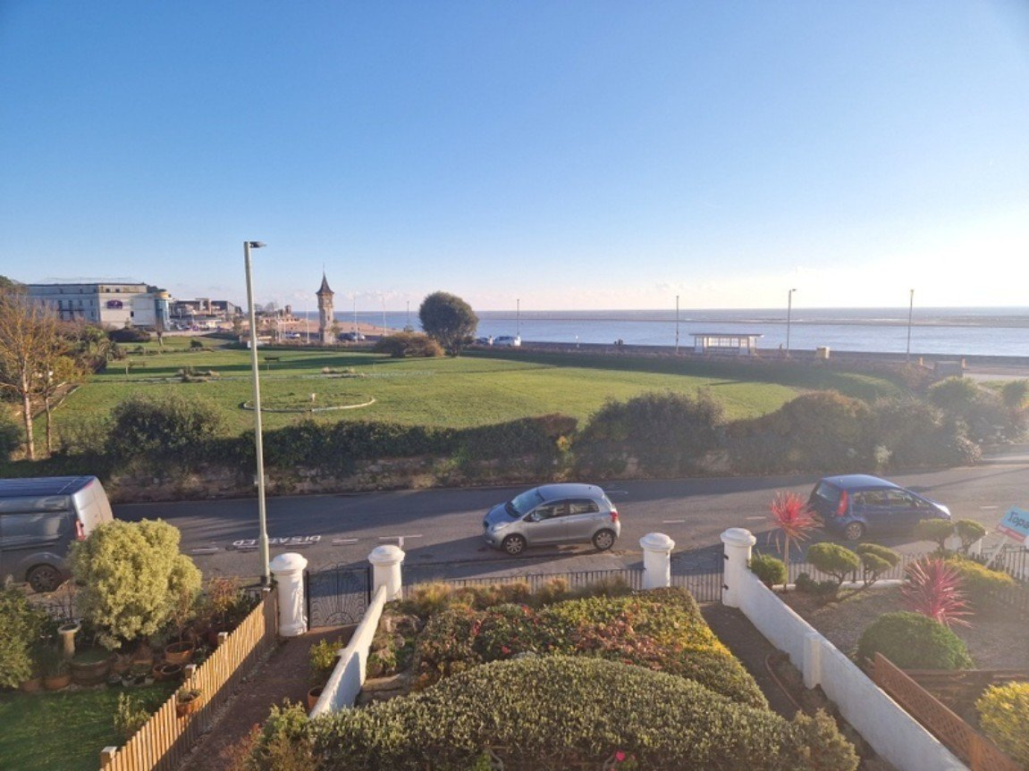
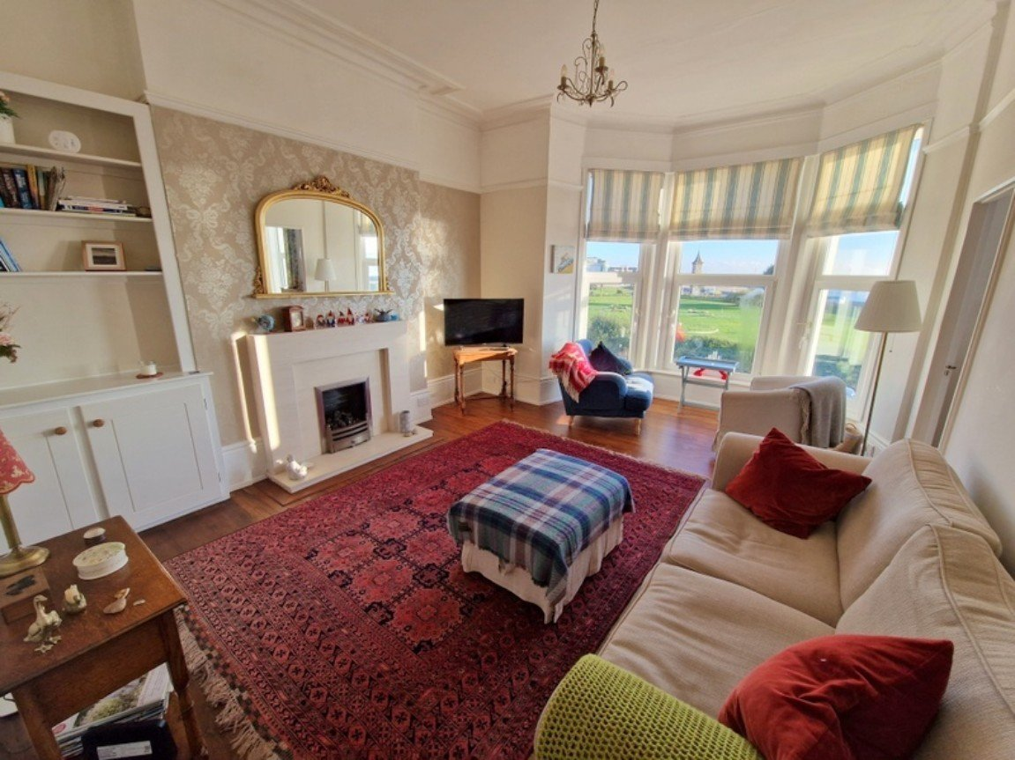
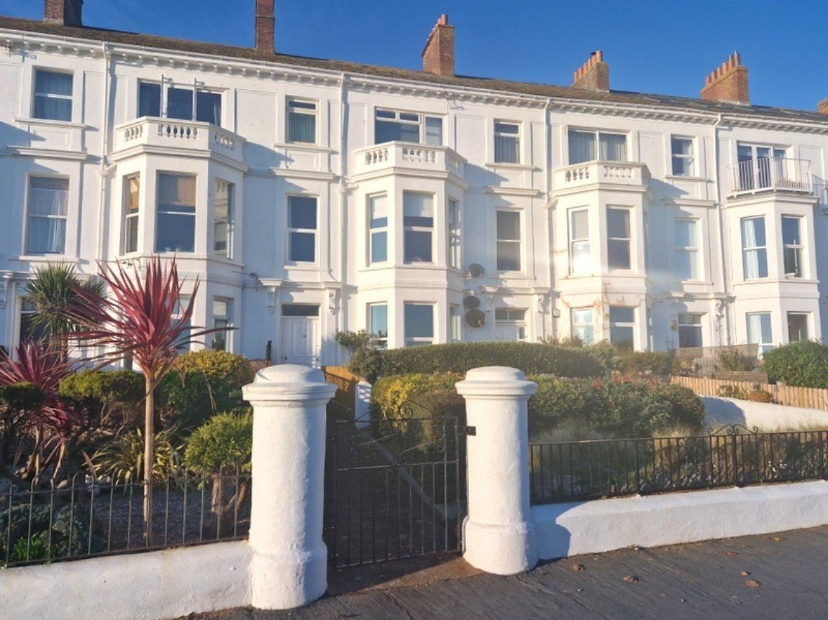
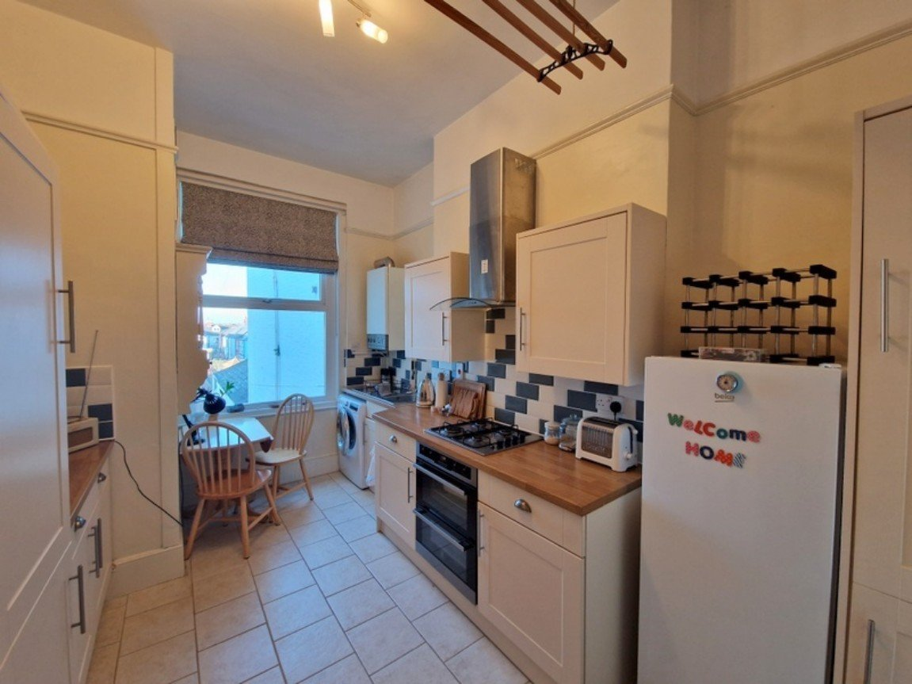
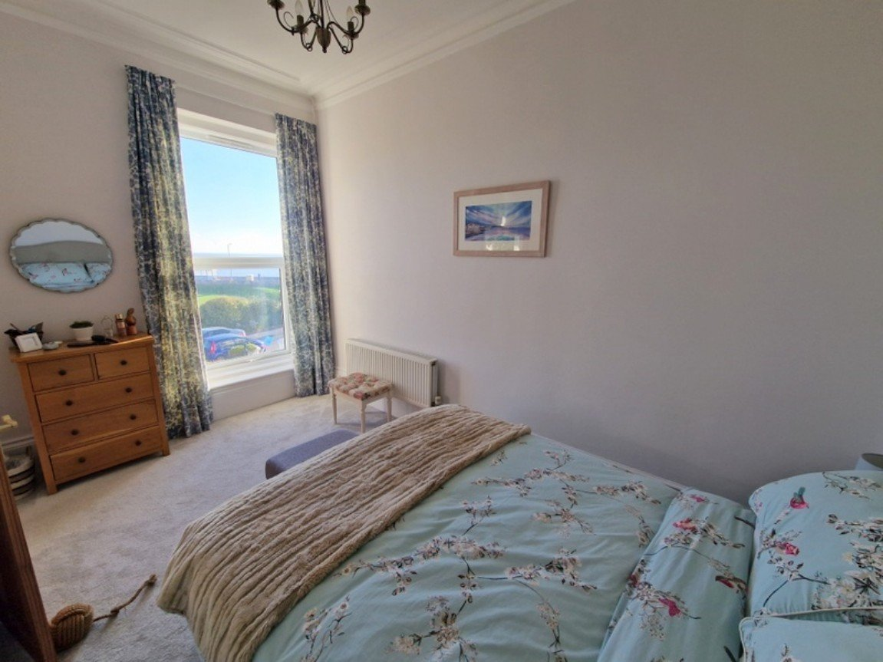
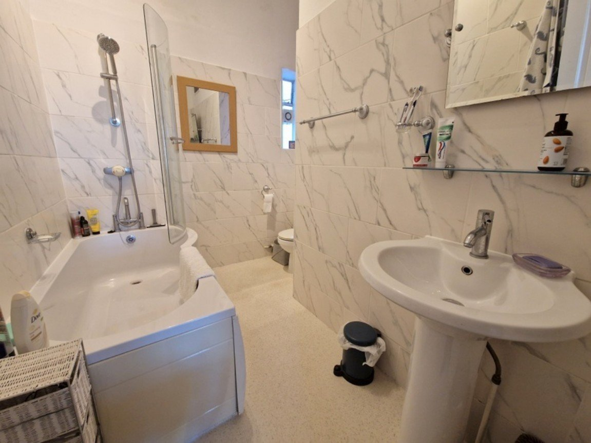
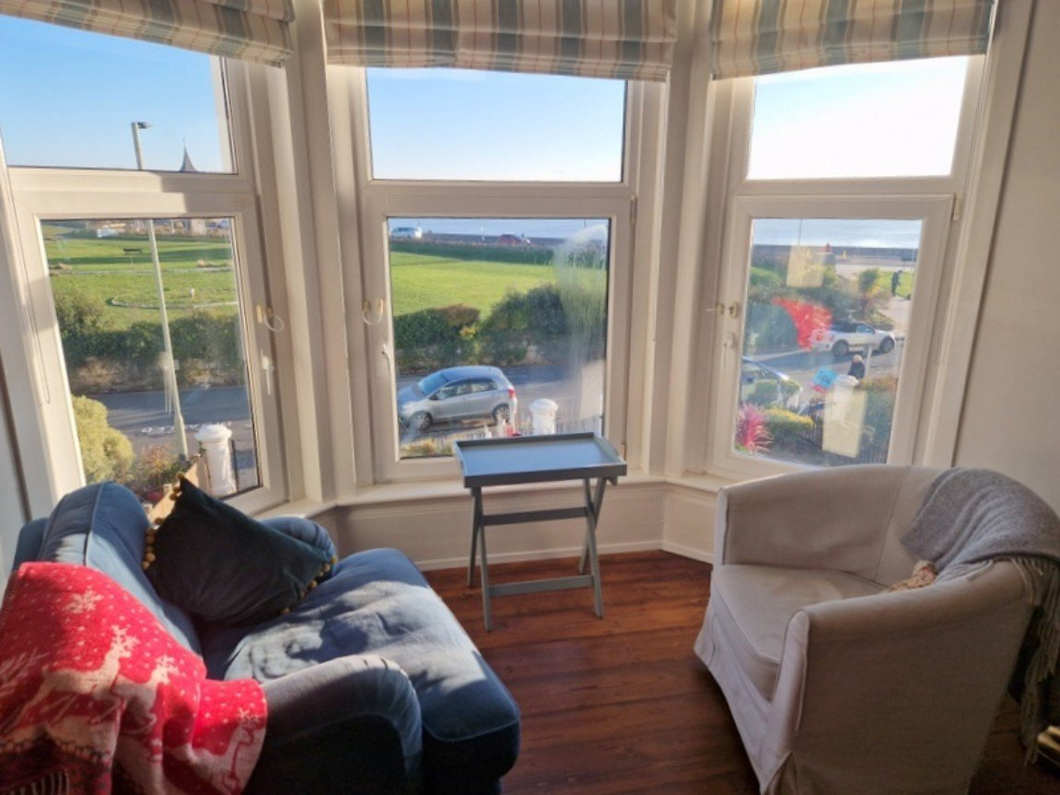
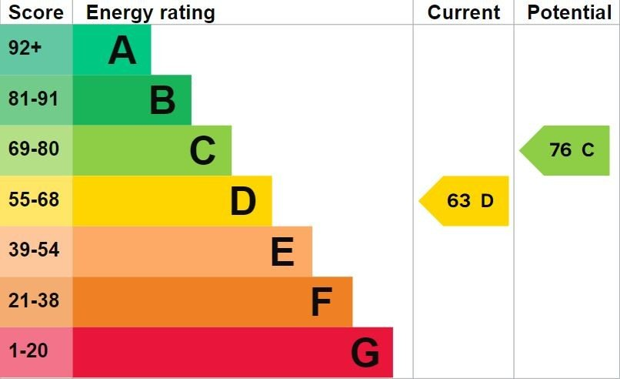
www.pennys.net
Flat 2, 16 Alexandra Terrace, Exmouth, EX8 1BD
GUIDE PRICE £225,000
TENURE Leasehold
A Beautifully Presented Apartment Enjoying A Superb Location Overlooking Exmouth Seafront
Good Size Lounge/Dining Room With Exceptional Views •
Modern Kitchen/Breakfast Room • Double Bedroom With Lovely Sea Views •
Spacious Bathroom/WC • Gas Central Heating • Double Glazing •
Ideal Permanent /Investment/Holiday Retreat •
No Onward Chain •
Pennys Estate Agents Limited for themselves and for the vendor of this property whose agents they are give notice that:- (1) These particulars do not constitute any part of an offer or a contract. (2) All statements contained in these particulars are made without responsibility on the part of Pennys Estate Agents Limited. (3) None of the statements contained in these particulars are to be relied upon as a statement or representation of fact. (4) Any intending purchaser must satisfy himself/herself by inspection or otherwise as to the correctness of each of the statements contained in these particulars. (5) The vendor does not make or give and neither do Pennys Estate Agents Limited nor any person in their employment has any authority to make or give any representation or warranty whatever in relation to this property.
PENNYS ESTATE AGENTS
2 Rolle House, Rolle Street, Exmouth, Devon, EX8 2SN
Tel: 01395 264111 EMail: help@pennys.net

Slide 2
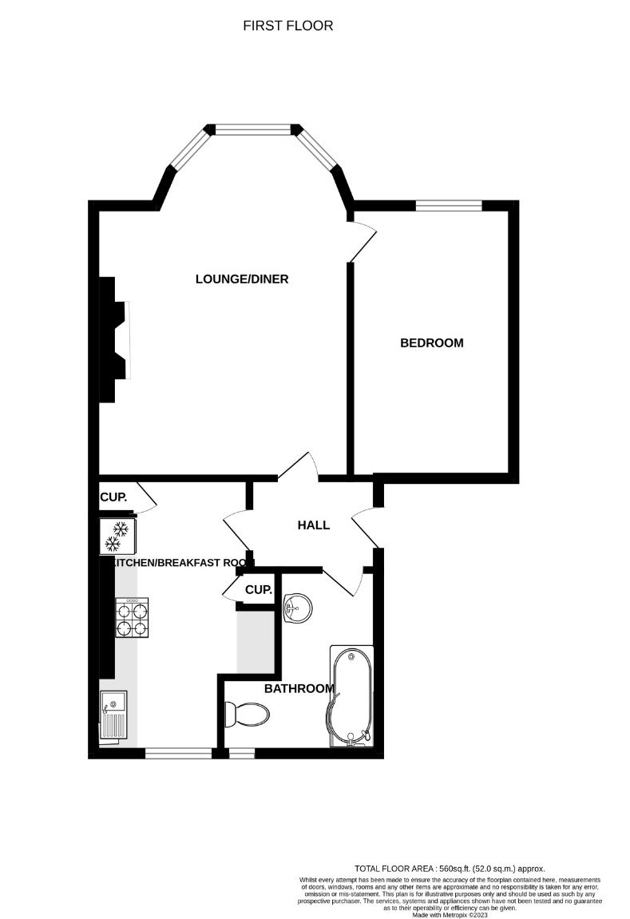
Flat 2, 16 Alexandra Terrace, Exmouth, EX8 1BD
THE ACCOMMODATION COMPRISES: Communal entrance with staircase to FIRST FLOOR; private front door to: ENTRANCE HALL: Stripped wood flooring; electric consumer unit. LOUNGE/DINING ROOM: 5.64m x 4.09m (18'6" x 13'5") Measurement into double glazed tilt and turn bay window to front elevation and gaining stunning uninterrupted views over Exmouth beach, sea and coastline beyond. Attractive fire surround housing living flame effect gas fire; radiator; fitted dresser unit in wall recess; picture rail; cornice ceiling; television point; wood flooring. KITCHEN/BREAKFAST ROOM: 4.44m x 2.97m (14'7" x 9'9") Maximum overall measurement. A modern kitchen fitted with wood effect work top surfaces with tiled surrounds; Inset single drainer sink unit and four ring gas hob set into work surface with stainless steel chimney style extractor hood over; built-in oven beneath; plumbing for an automatic washing machine, cupboards and drawers beneath work tops; matching wall mounted cupboards; gas boiler serving domestic hot water and gas central heating; space for upright fridge freezer; two upright larder style cupboards; double glazed window to rear elevation; radiator; tiled floor. BEDROOM: 4.52m x 2.62m (14'10" x 8'7") Double glazed window affording stunning views of the beach and seafront; cornice ceiling; radiator. BATHROOM/WC: 2.79m x 1.5m (9'2" x 4'11") Widening to 7'11". A modern suite with bath and mira shower over; curved splash screen; pedestal wash hand basin with fitted mirror over; WC with push button flush; heated towel rail; double glazed window with extractor fan; extensively tiled walls. TENURE AND OUTGOINGS: The property is leasehold and has 99 years from 2015. The management of the building is organised within the development. Charges to be confirmed.
FLOOR PLAN:

