Slide 1
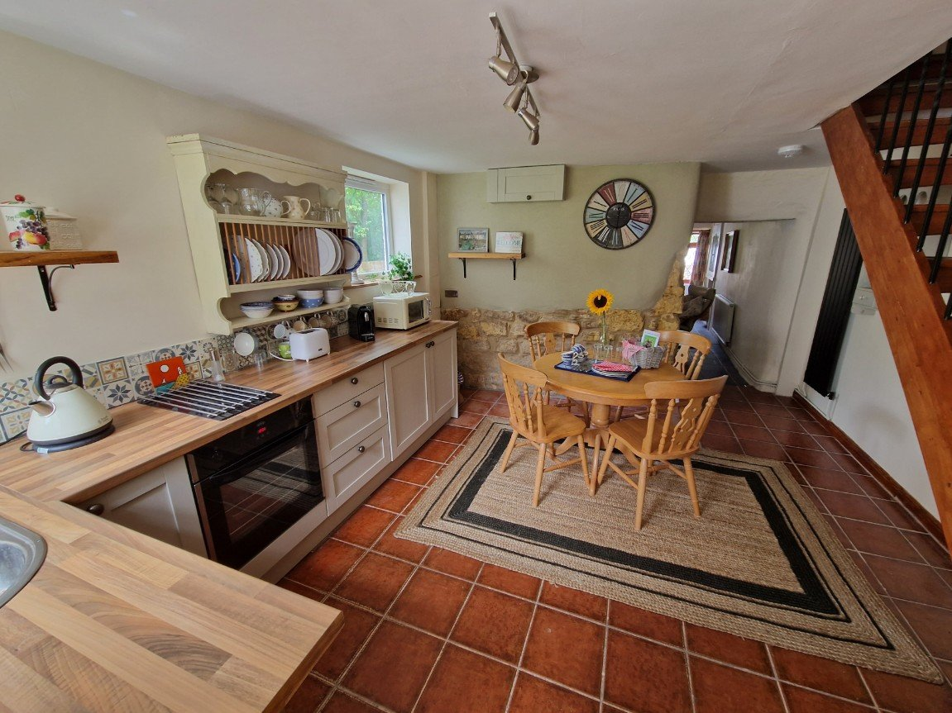
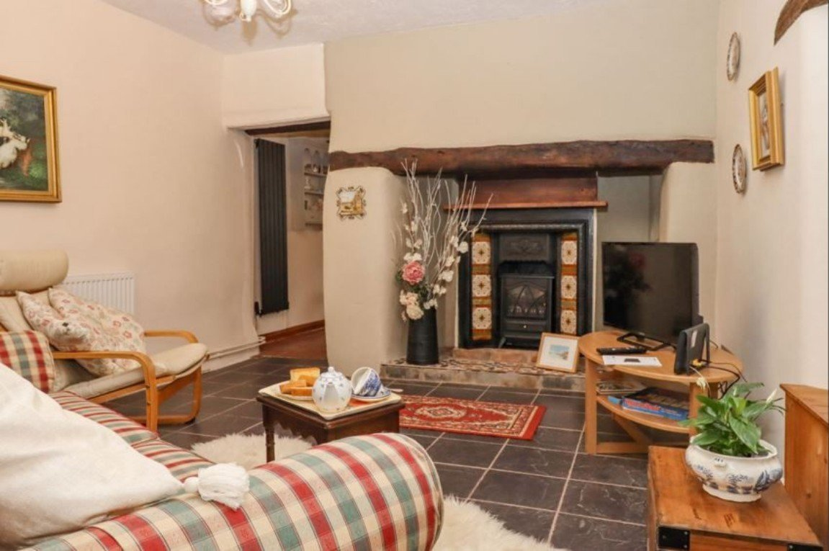
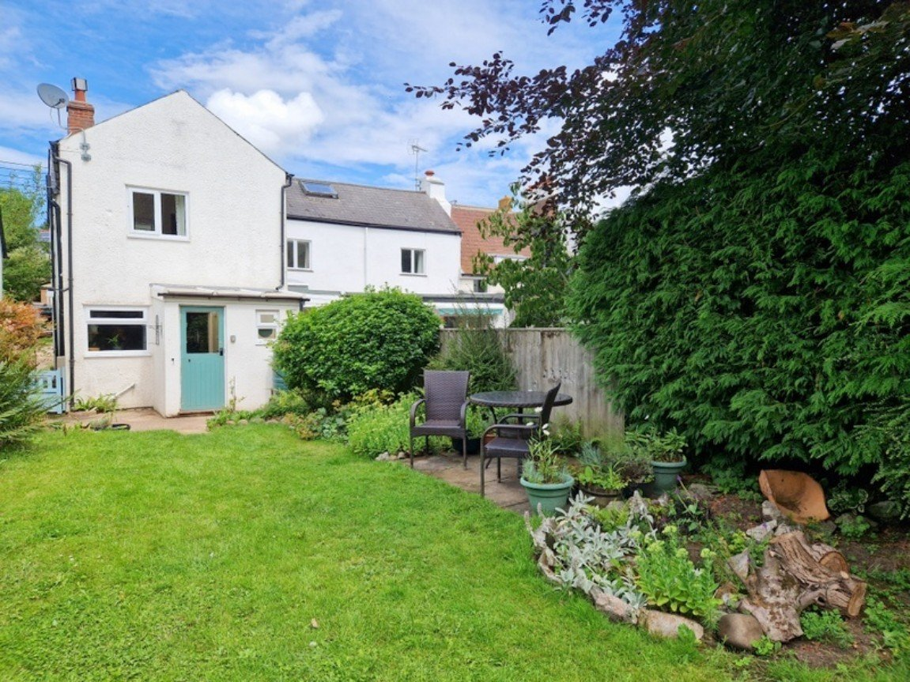
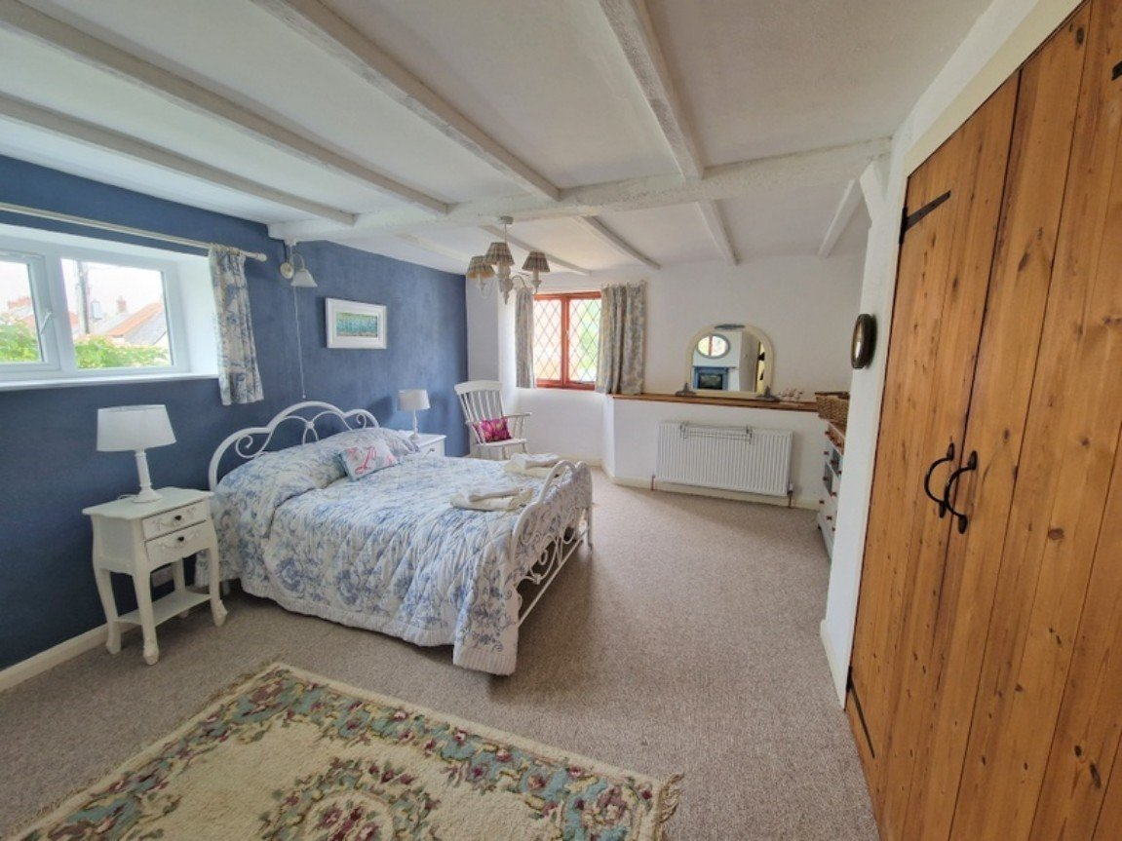
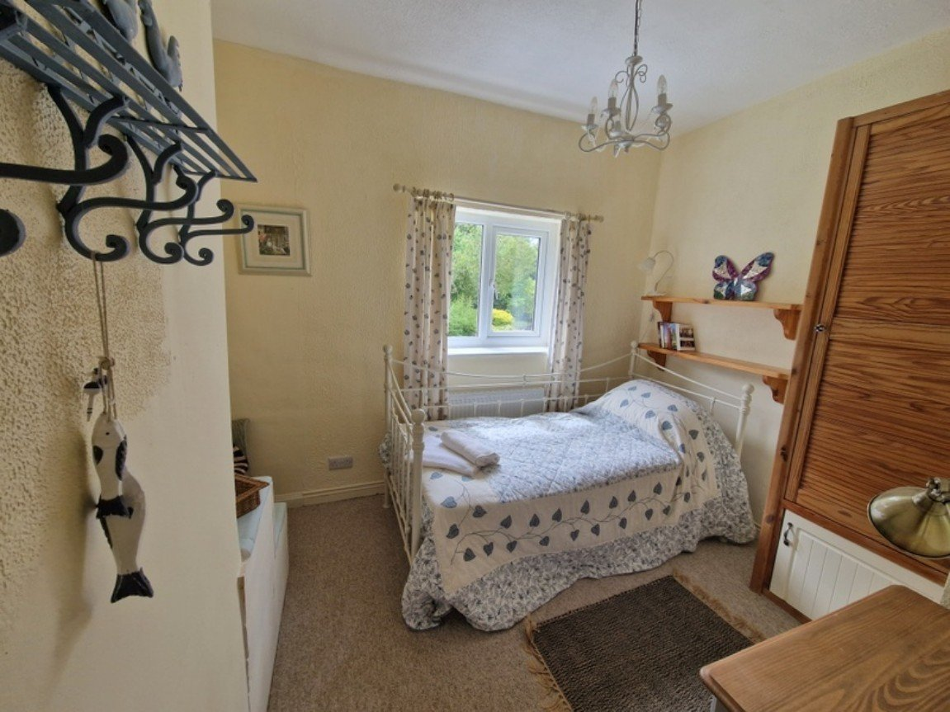
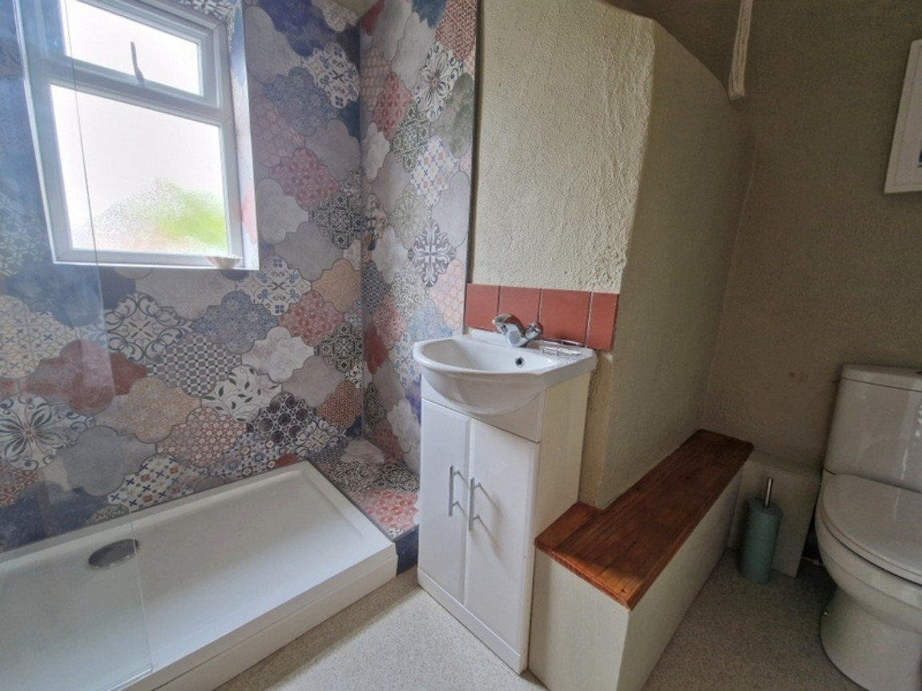
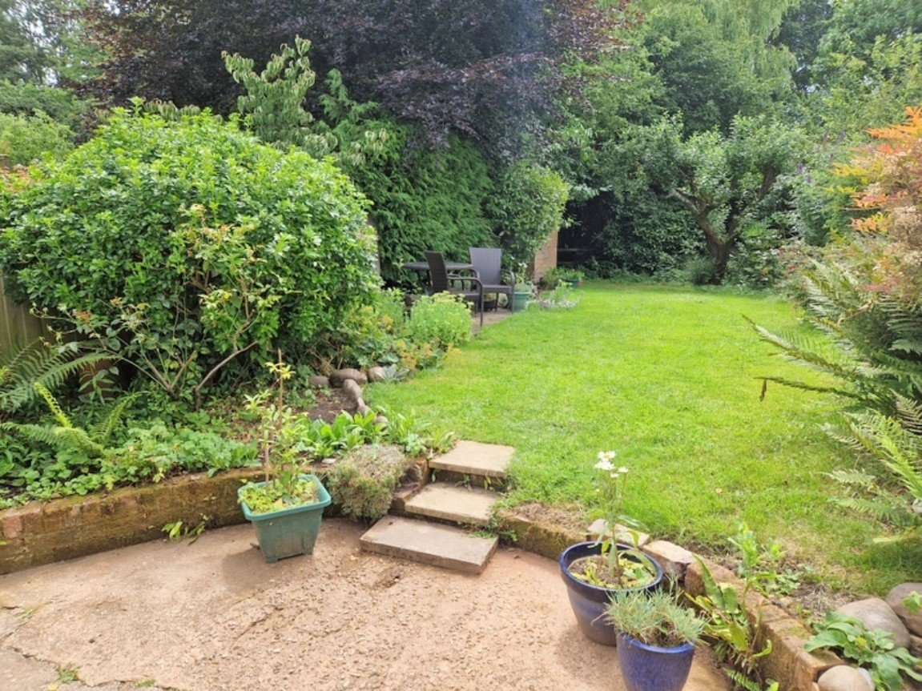
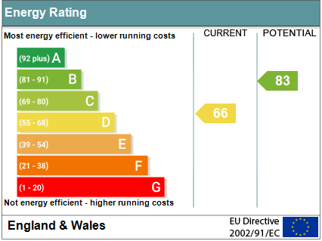
www.pennys.net
12 Bakers Cottages, Longmeadow Road, Lympstone, Devon, EX8 5LP
PRICE £385,000
TENURE Freehold
A Deceptively Spacious End Of Terrace Cottage Which Has Recently Undergone A Programme Of Modernisation And Refurbishment Now Providing A Wonderful Home Full Of Character Enjoying A Sought After Village Setting
Charming Sitting Room • Newly Fitted Spacious Kitchen/Dining Room •
Rear Porch & Ground Floor Cloakroom/WC • Two Good Size First Floor Bedrooms •
Stylish Shower Room/WC • Gas Central Heating •
Generously Sized Rear Garden • Wonderful Permanent Home Or Holiday Retreat •
Pennys Estate Agents Limited for themselves and for the vendor of this property whose agents they are give notice that:- (1) These particulars do not constitute any part of an offer or a contract. (2) All statements contained in these particulars are made without responsibility on the part of Pennys Estate Agents Limited. (3) None of the statements contained in these particulars are to be relied upon as a statement or representation of fact. (4) Any intending purchaser must satisfy himself/herself by inspection or otherwise as to the correctness of each of the statements contained in these particulars. (5) The vendor does not make or give and neither do Pennys Estate Agents Limited nor any person in their employment has any authority to make or give any representation or warranty whatever in relation to this property.
PENNYS ESTATE AGENTS
2 Rolle House, Rolle Street, Exmouth, Devon, EX8 2SN
Tel: 01395 264111 EMail: help@pennys.net

Slide 2
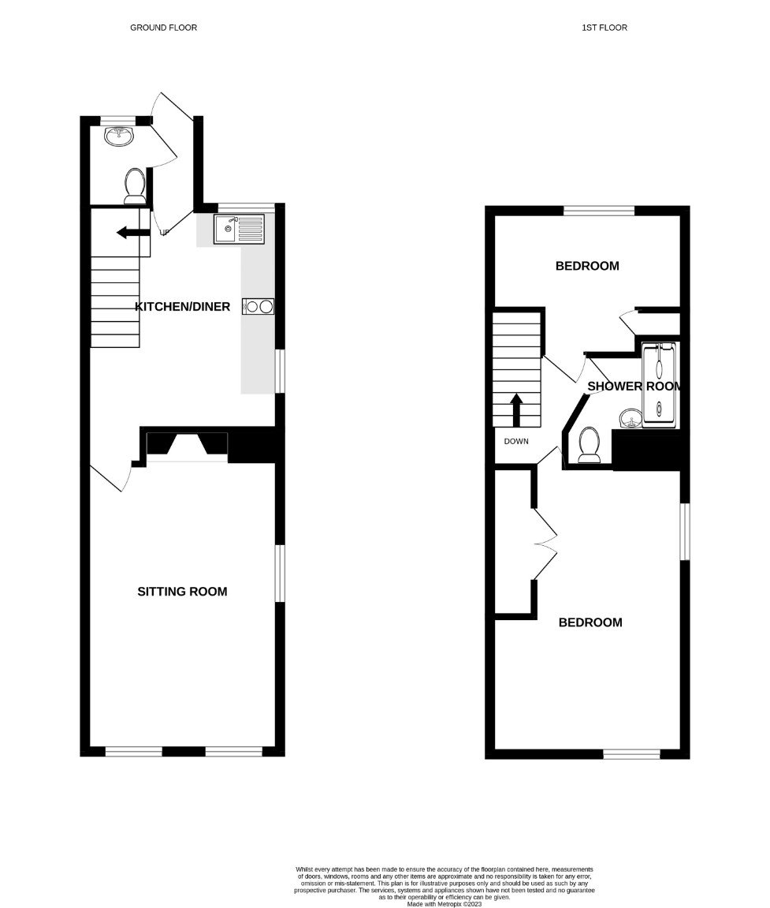
12 Bakers Cottages, Longmeadow Road, Lympstone, Devon, EX8 5LP
The property is located in Lympstone which is a sought-after East Devon Village off the River Exe with a selection of pubs, church, village shop, cafes, primary school, railway station and a variety of clubs and societies including an active sailing club.
THE ACCOMMODATION COMPRISES: The property is currently accessed to the rear of the building via a side pathway with outside lighting and pedestrian gates. Wooden part glazed stable style door with window inset giving access to:
ENTRANCE PORCH: With courtesy light; tiled flooring; access to:
GROUND FLOOR CLOAKROOM/WC: Comprising of a wash hand basin; plumbing for washing machine; WC with push button flush; fully tiled walls; tiled flooring; uPVC double glazed window with patterned glass.
From the entrance porch a glazed door gives access to:
KITCHEN/DINING ROOM: 16' 5" x 12' 4" (5m x 3.76m) maximum overall measurement into doorway recess. A most charming room with exposed stone brickwork. Newly fitted with a range of wood effect work top surfaces with tiled surrounds; inset single drainer circular sink unit with swan neck mixer tap; base cupboards, drawer units, integrated fridge and freezer beneath work tops; built-in oven with two ring hob and extractor hood over; space for upright fridge freezer; stylish upright radiator; tiled flooring; open tread feature staircase with balustrade rising to the first floor and feature wall lights; uPVC double glazed windows to front and side aspects; opening to:
SITTING ROOM: 15' 8" x 12' 7" (4.78m x 3.84m) A charming room full of character with impressive chimney recess with solid wood beam over, tiled and slate hearth and currently housing an electric fire; three sets of leaded light style windows overlooking the front and side aspects two with fitted window seats with storage cupboards beneath; glass display cabinet housed in wall recess with open recess beneath; television point; tiled flooring; two radiators.
FIRST FLOOR LANDING: With smoke detector and access to:
BEDROOM ONE: 18' 3" x 13' 5" (5.56m x 4.09m) A most spacious dual aspect room with uPVC double glazed window to side aspect and leaded light window to front aspect; radiator; with display surface over; feature fire surround; ceiling beams; built-in double wardrobe; feature wall lights.
BEDROOM TWO: 9' 0" (2.74m) extending to 12'5" (3.78m) into wall recess x 8' 7" (2.62m) uPVC double glazed window to rear aspect; radiator; built-in linen cupboard housing the gas boiler serving domestic hot water and central heating; useful shelving; feature wall lights.
BATHROOM/WC: A stylish room comprising of a shower cubicle with shower unit; wash hand basin with display cabinet over; WC; tiling to splash prone areas; chrome heated towel rail; ceiling extractor fan; access to large roof space; uPVC double glazed window with patterned glass.
OUTSIDE: To the rear of the cottage is a wonderful secluded, generously sized garden which is mainly laid to lawn and edged with well stocked and colourful flower and shrub beds; productive fruit tree; patio seating area; timber shed and backing onto a brook while enjoying a tranquil setting. Outside cold water tap. We are advised by the current owner that there is a possibility (subject to permission) to erect a larger cabin/chalet or something similar, if required.
MORTGAGE ASSISTANCE: We are pleased to recommend Meredith Morgan Taylor, who would be pleased to help irrelevant of which estate agent you finally buy through. For a free initial, no obligation chat please contact us on 01395 264111 to arrange an appointment.
AGENTS NOTE: The current owner has had a new electrical consumer unit installed and a new gas boiler. The property can also be used for AIR B&B if wanted.
FLOOR PLAN:

