Slide 1
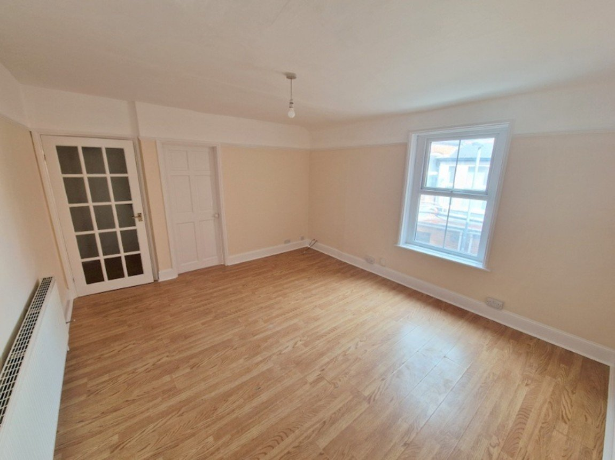
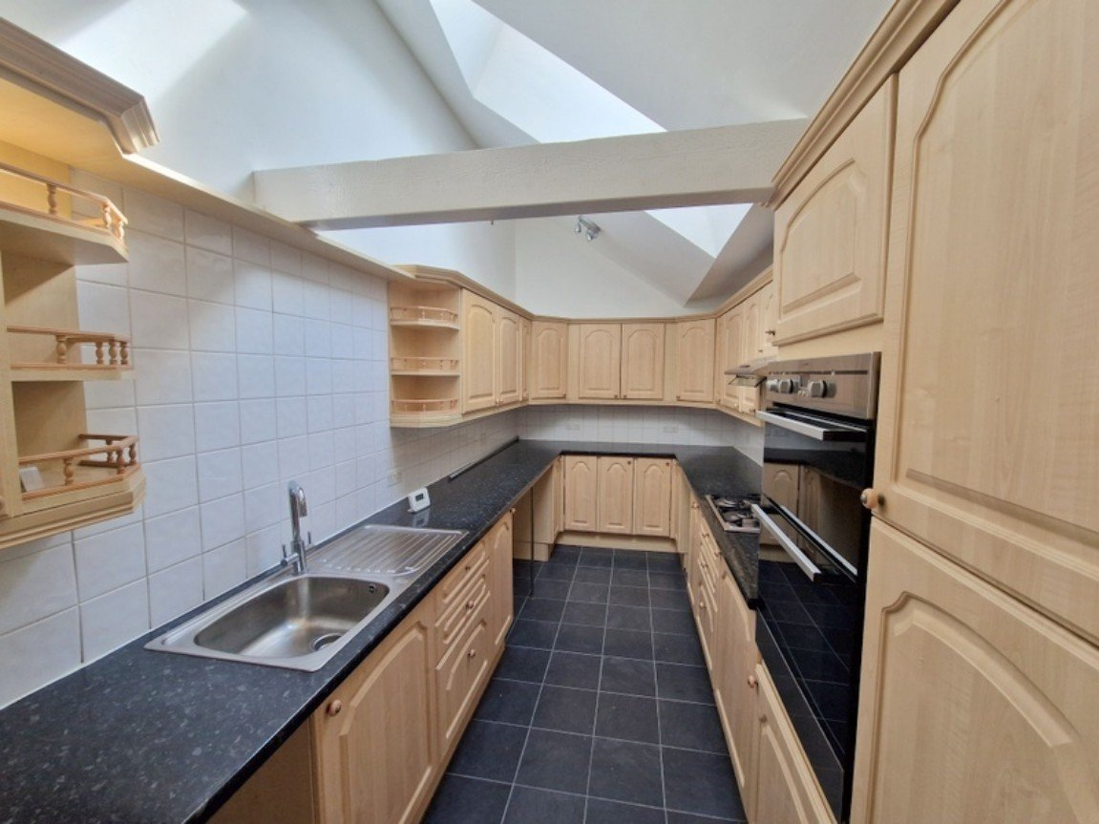
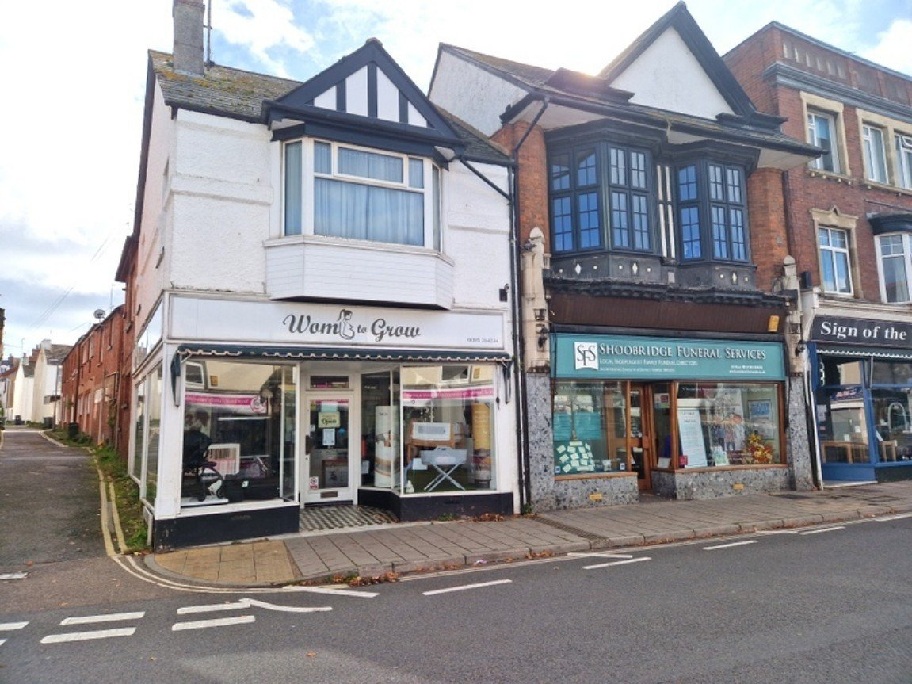
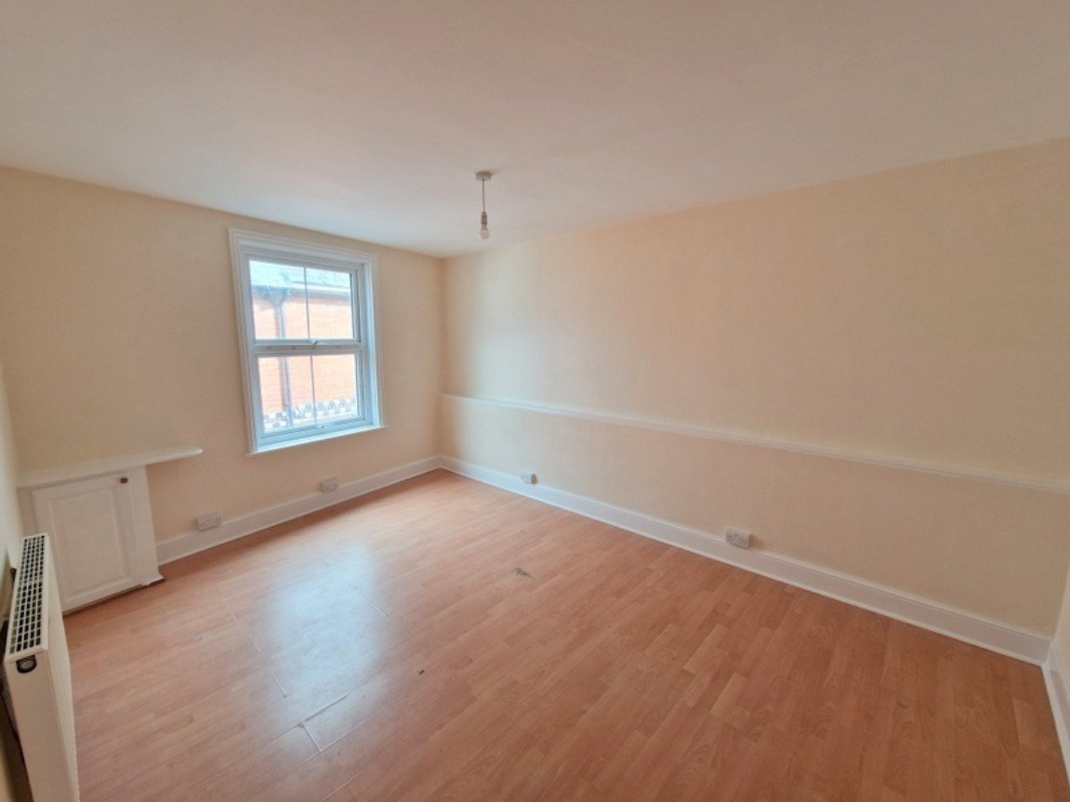
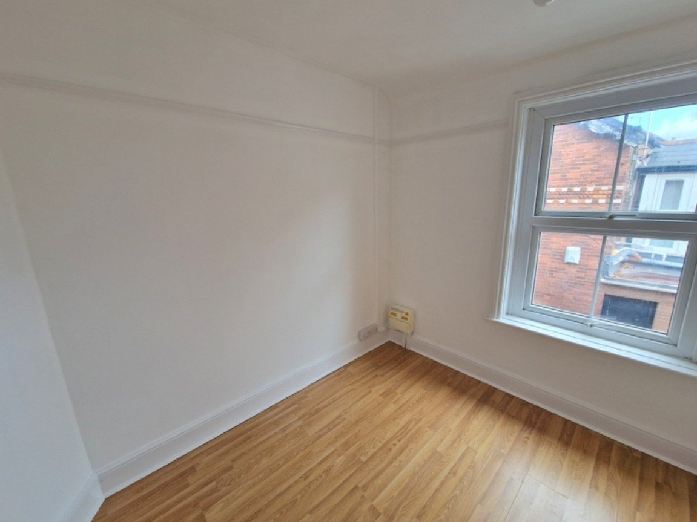
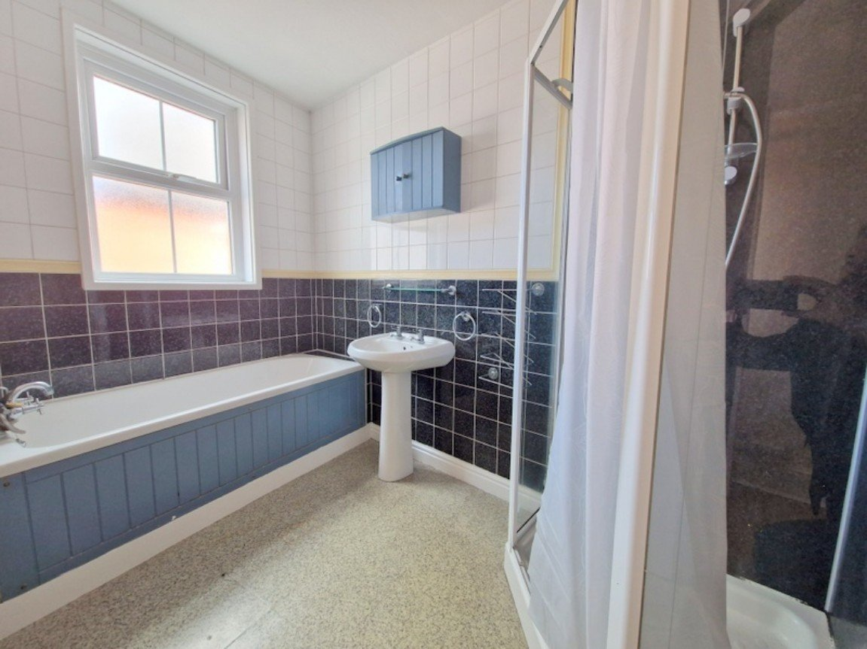
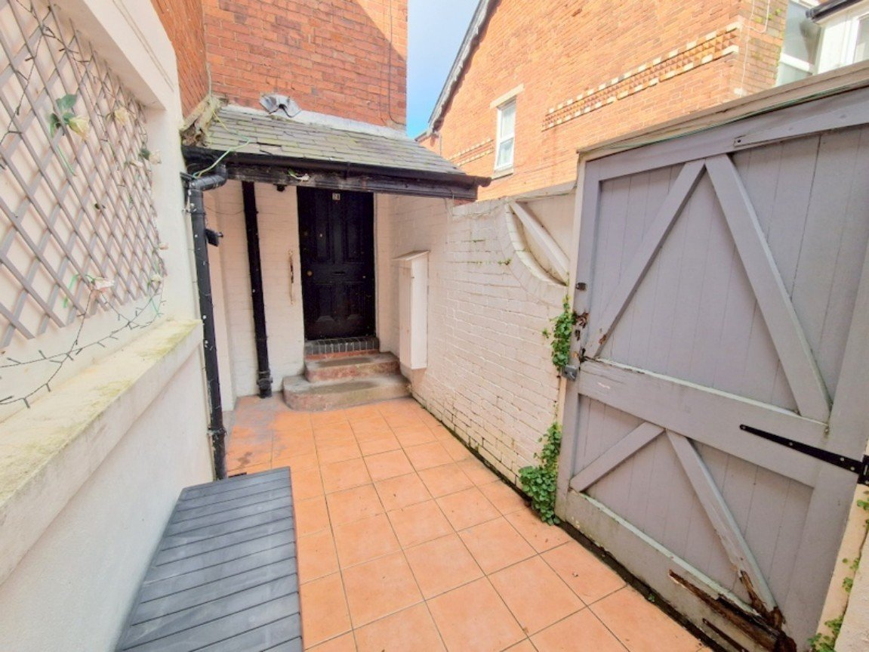
www.pennys.net
28 & 28A Exeter Road, Exmouth, EX8 1PP
GUIDE PRICE £335,000
TENURE Freehold
A Well Presented And Extremely Spacious Freehold Property Comprising Of A Ground Floor Shop Premises With A Two Bedroom Flat Over
Excellent Trading Position • Spacious Corner Shop With Generous Return Frontage - Currently Let As A Children's Retail Outlet •
Recently Redecorated First Floor Flat • Lounge • Fitted Kitchen •
Two Bedrooms • Bathroom With Shower Cubicle • Separate WC • Gas Central Heating •
Shared Courtyard •
EPC TO FOLLOW:
Pennys Estate Agents Limited for themselves and for the vendor of this property whose agents they are give notice that:- (1) These particulars do not constitute any part of an offer or a contract. (2) All statements contained in these particulars are made without responsibility on the part of Pennys Estate Agents Limited. (3) None of the statements contained in these particulars are to be relied upon as a statement or representation of fact. (4) Any intending purchaser must satisfy himself/herself by inspection or otherwise as to the correctness of each of the statements contained in these particulars. (5) The vendor does not make or give and neither do Pennys Estate Agents Limited nor any person in their employment has any authority to make or give any representation or warranty whatever in relation to this property.
PENNYS ESTATE AGENTS
2 Rolle House, Rolle Street, Exmouth, Devon, EX8 2SN
Tel: 01395 264111 EMail: help@pennys.net

Slide 2
28 & 28A Exeter Road, Exmouth, EX8 1PP
28 Exeter Road Retail Shop: RETAIL AREA: Frontage approximately 17'6" (5.33m). Overall depth 76'6" (23.32m). The front area of the shop with return frontage to Meadow Street offers approximately 620 sq ft (57.6 sq m). Steps then lead down to a rear retail section which offers approximately 665 sq ft (61 sq m). At the rear is a WASHROOM and W/C and gas central heating. Flat, 28A Exeter Road: THE ACCOMMODATION COMPRISES: Accessed via Meeting Street via gate into courtyard garden. Communal front door and staircase to first floor.
Private front door to: ENTRANCE HALL: 4.37m x 3.78m (14'4" x 12'5") Wood effect flooring; picture rail; inner glass panelled door to: LOUNGE: 4.37m x 3.78m (14'4" x 12'5") Double glazed window; television point; radiator; wood effect flooring; picture rail. INNER HALLWAY: Wood effect flooring; radiator. KITCHEN: 4.37m x 2.24m (14'4" x 7'4") Fitted with a range of pattern work top surfaces with cupboards and drawer units under; plumbing for an automatic washing machine and appliance space beneath; tiled surrounds; inset single drainer sink unit; matching wall mounted cupboards; inset gas hob with extractor over; upright cupboard housing modern Worcester boiler; velux; double glazed window set in sloping ceiling; tiled floor. BEDROOM ONE: 4.57m x 4.47m (15'0" x 14'8") Including door recess. Double glazed window; radiator; wood effect flooring; cupboard housing gas meter. BEDROOM TWO: 2.64m x 2.29m (8'8" x 7'6") Double glazed window; wood effect flooring; electric consumer unit; picture rail. BATHROOM/WC: 2.69m x 1.88m (8'10" x 6'2") Comprising of bath with shower attachment and shower cubicle with splash back walls; pedestal wash hand basin; radiator; fully tiled walls; medicine cabinet; wall mirror; double glazed window with obscure glass. SEPARATE/WC: W/C; double glazed window with pattern glass. OUTSIDE: Enclosed courtyard with tiled floor; outside tap; outside light and covered areas.
FLOOR PLAN: TO FOLLOW:

