Slide 1
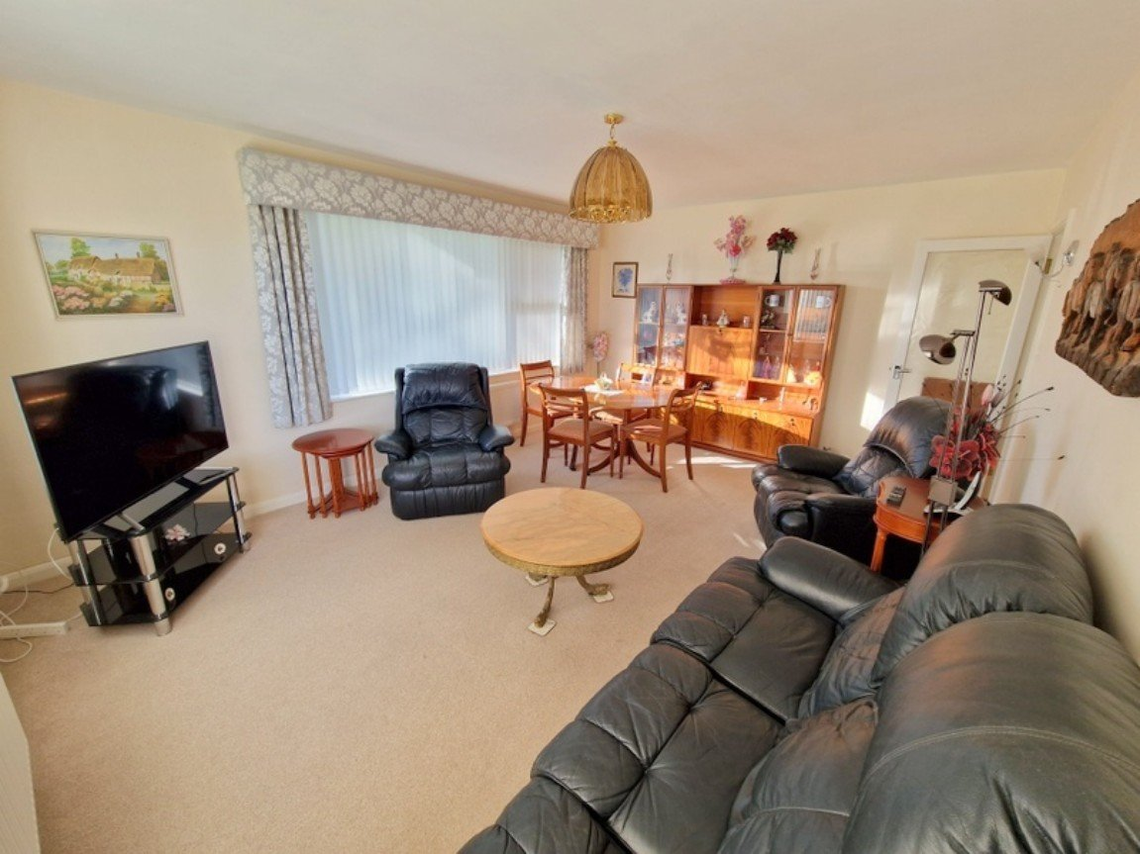
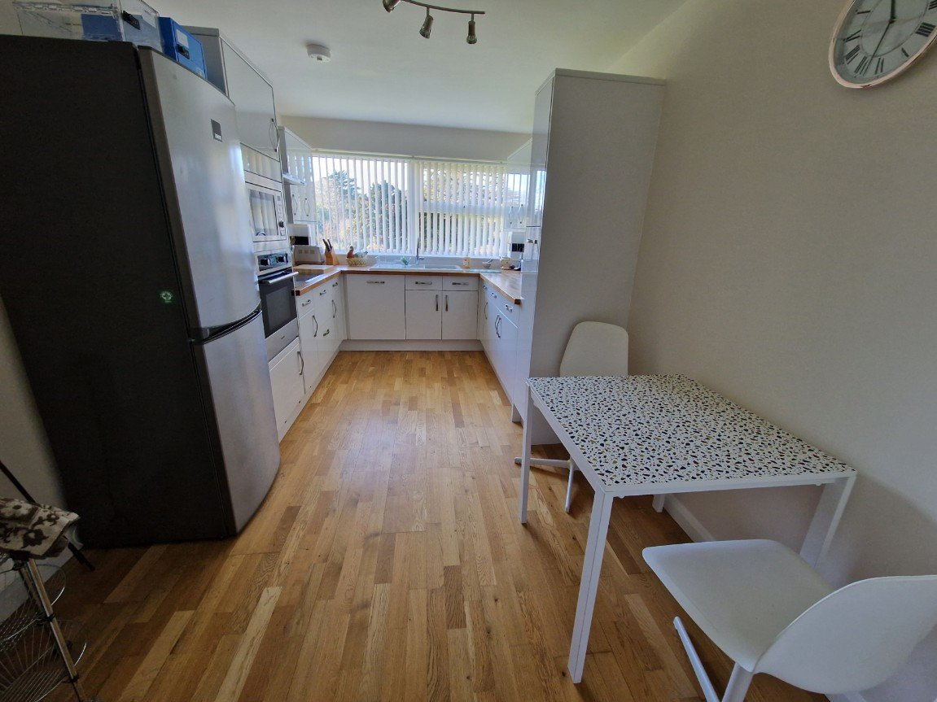
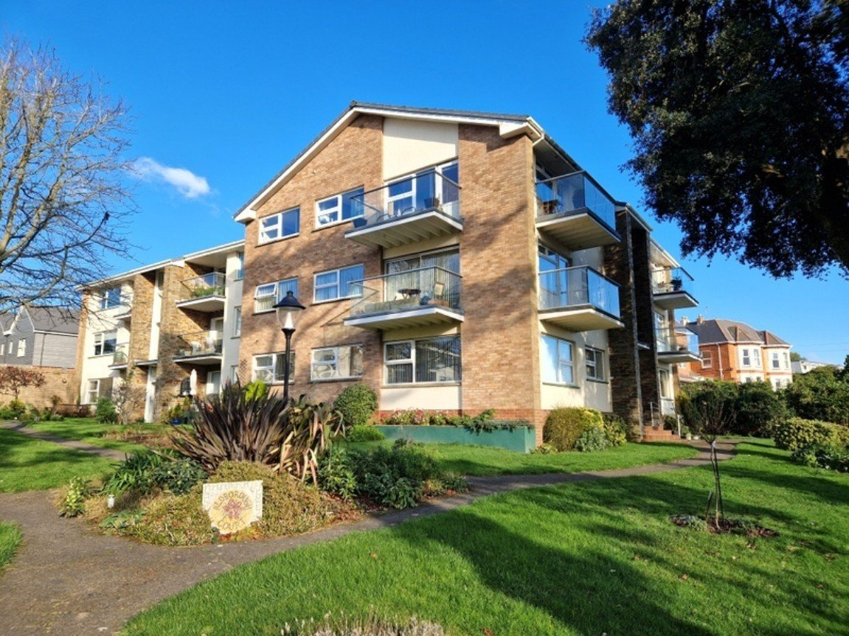
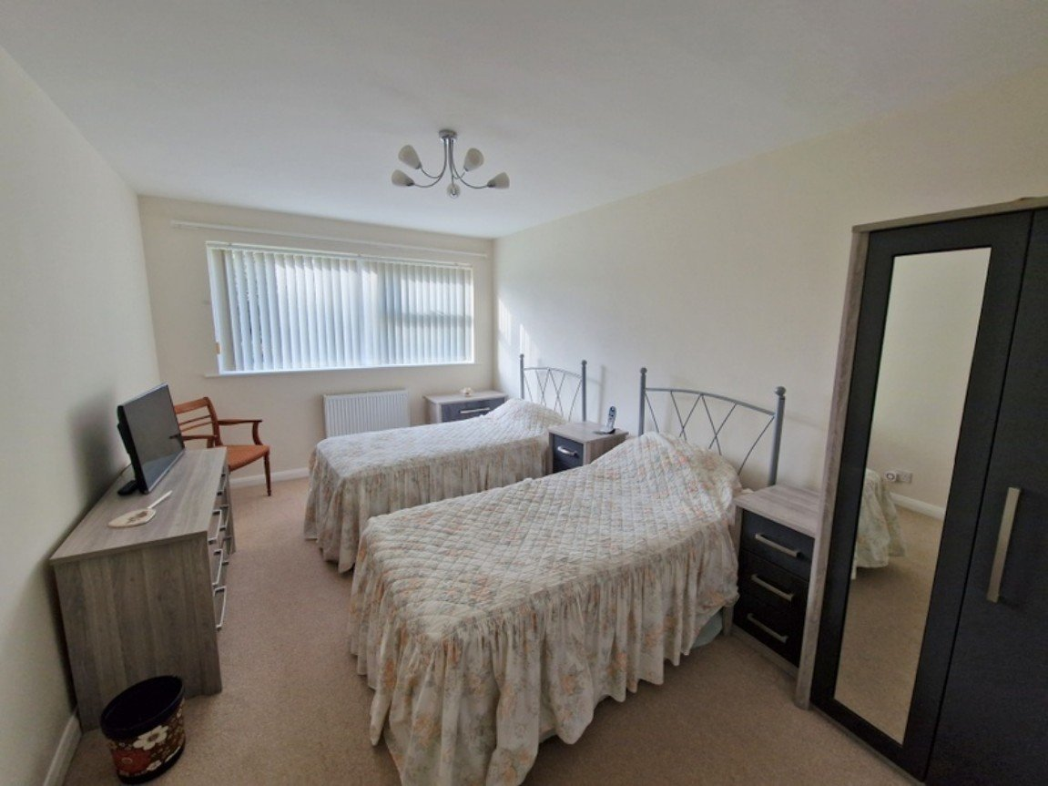
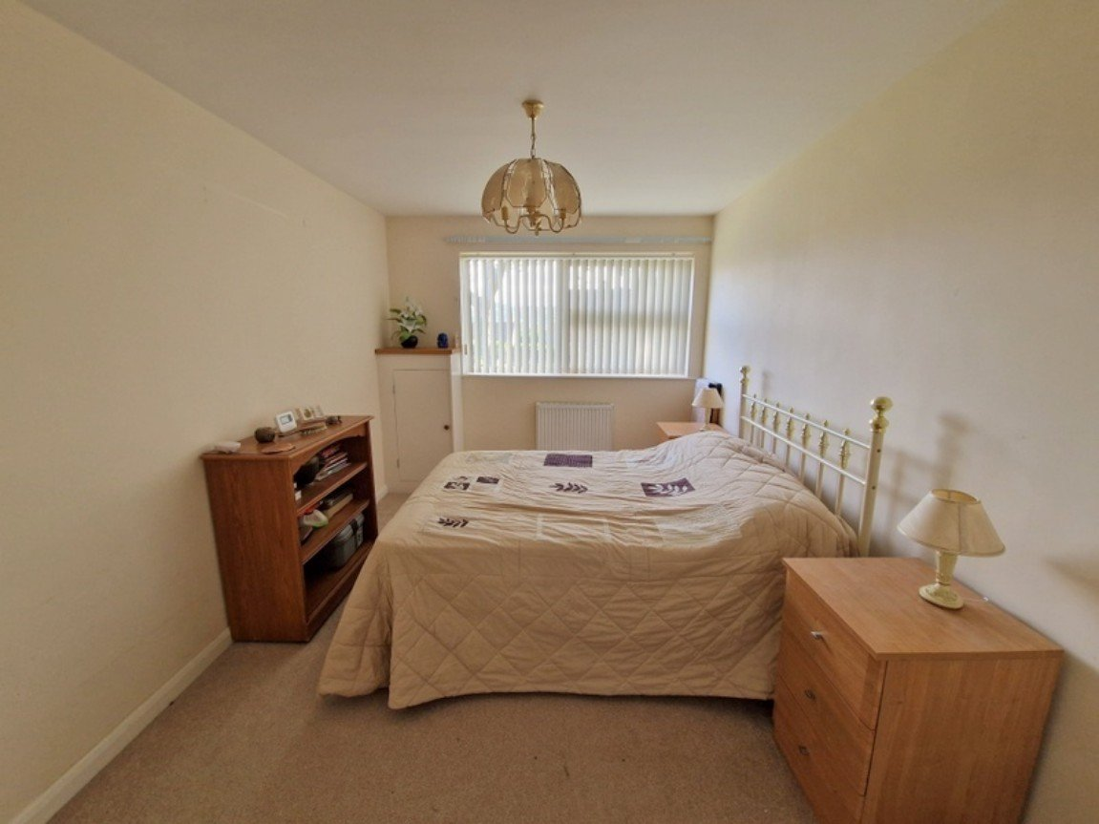
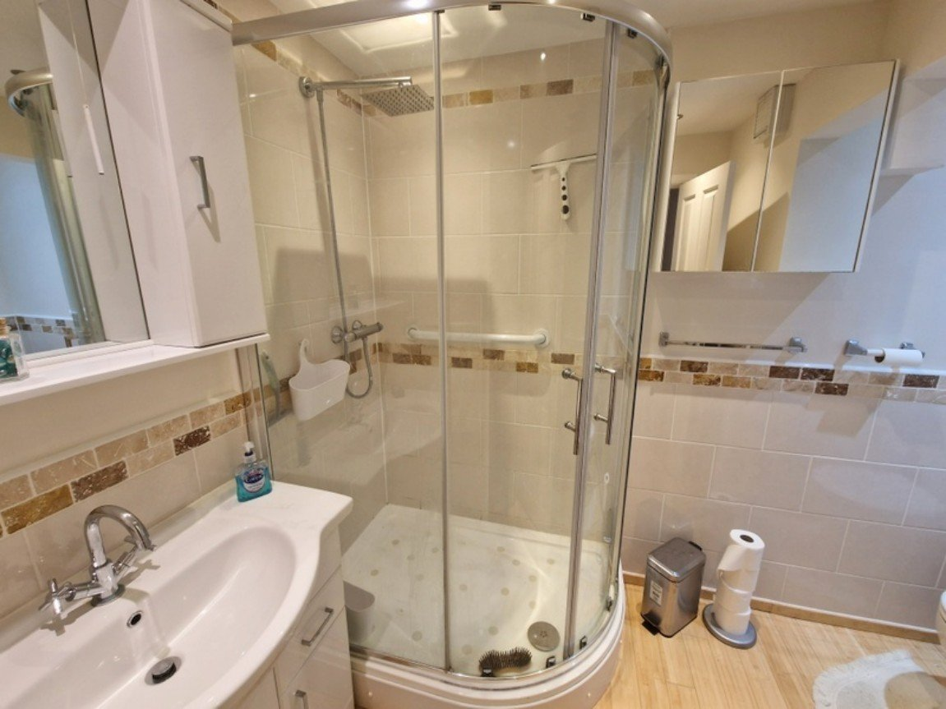
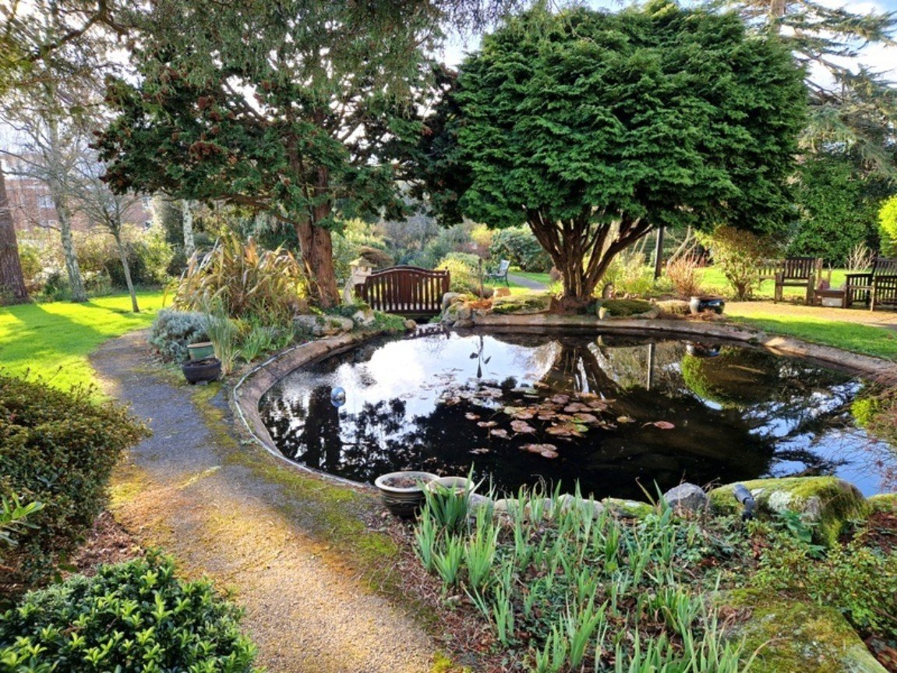
www.pennys.net
Flat 1 Aldborough Court, 21 Douglas Avenue, Exmouth, EX8 2HA
PRICE £275,000
TENURE Share of Freehold
A Beautifully Presented Purpose Built In Two Bedroom Ground Floor Apartment Located In A Desirable Development With Stunning Communal Gardens And Car Port
Spacious Reception Hall • Dual Aspect Lounge/Dining Room •
Stylish Modern Kitchen/Breakfast Room • Two Good Size Double Bedrooms •
Shower Room/WC • Utilities Cupboard •
Beautiful Communal Gardens •
Car Port •
EPC TO FOLLOW:
Pennys Estate Agents Limited for themselves and for the vendor of this property whose agents they are give notice that:- (1) These particulars do not constitute any part of an offer or a contract. (2) All statements contained in these particulars are made without responsibility on the part of Pennys Estate Agents Limited. (3) None of the statements contained in these particulars are to be relied upon as a statement or representation of fact. (4) Any intending purchaser must satisfy himself/herself by inspection or otherwise as to the correctness of each of the statements contained in these particulars. (5) The vendor does not make or give and neither do Pennys Estate Agents Limited nor any person in their employment has any authority to make or give any representation or warranty whatever in relation to this property.
PENNYS ESTATE AGENTS
2 Rolle House, Rolle Street, Exmouth, Devon, EX8 2SN
Tel: 01395 264111 EMail: help@pennys.net

Slide 2
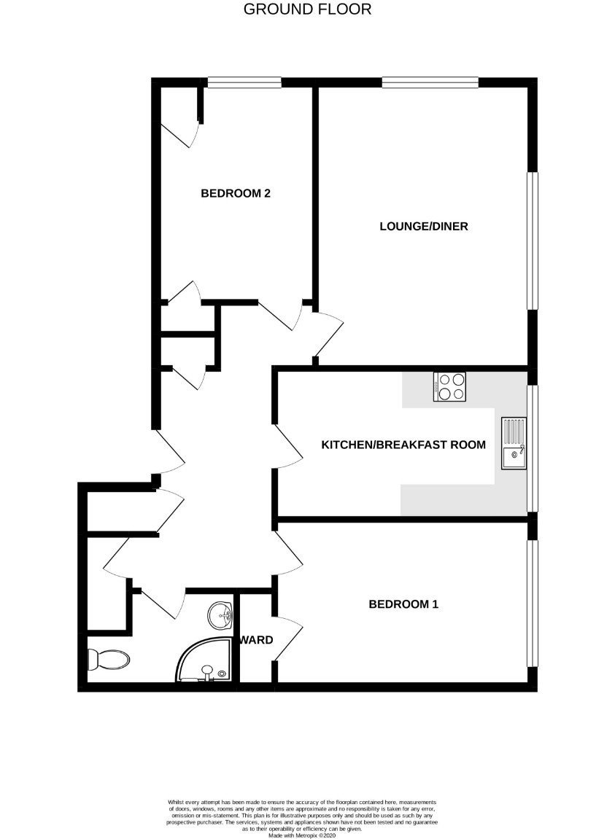
Flat 1 Aldborough Court, 21 Douglas Avenue, Exmouth, EX8 2HA
THE ACCOMMODATION COMPRISES: Communal entrance with door security entry system giving access to communal areas. The apartment is found on the GROUND FLOOR and accessed via its own private front door with spy hole giving access to: SPACIOUS RECEPTION HALL: A fine entrance to the property with feature wood flooring; door entry telephone; radiator; delivery/storage cupboard; good size coats cupboard with shelving and light. UTILITIES CUPBOARD: with plumbing for washing machine and display shelf with tumble dryer over, light, extractor fan and wood flooring. LOUNGE/DINING ROOM: 5.18m x 3.94m (17'0" x 12'11") A bright dual aspect room with uPVC double glazed windows to side and front aspects taking full advantage of the lovely communal gardens; three television points; two radiators; additional wall lighting. KITCHEN/BREAKFAST ROOM: 4.67m x 2.69m (15'4" x 8'10") A spacious stylish room fitted with a range of solid wood work top surfaces with tiled surrounds; inset ceramic one and a quarter bowl single drainer sink unit with Grohe chrome mixer tap over; range of base cupboards, drawer units and integrated dishwasher beneath work top surfaces; inset four ring induction hob with stainless steel chimney style extractor hood over with light; built-in oven and microwave with cupboards above and below; matching range of wall units at eye-level with concealed lighting beneath; pull-out larder style cupboard; space for upright fridge/freezer; feature wood flooring; television point; uPVC double glazed window overlooking the beautiful communal gardens. BEDROOM ONE: 4.7m x 3.02m (15'5" x 9'11") A spacious main bedroom with uPVC double glazed window overlooking the beautiful communal gardens; built-in wardrobe with clothes rail and shelf; telephone point; television point. BEDROOM TWO: 3.99m x 2.87m (13'1" x 9'5") Another lovely size bedrooms with uPVC double glazed window to side aspect; built-in wardrobe with clothes rail and shelf; cupboard housing modern Glow Worm gas boiler serving domestic hot water and central heating with display surface over; radiator; television point. SHOWER ROOM/WC: Stylishly fitted and comprising of an attractively tiled oversized shower cubicle with shower unit, hand rail and curved shower splash screen doors; wash hand basin in display surface with storage cupboards beneath and tiled splashback; wall mounted mirror with display light over and further matching storage cupboard; WC with push button flush; chrome heated towel rail; recess ceiling spotlighting; attractive part tiled walls. OUTSIDE: Aldborough Court is set in the highly sought after 'Avenues' area of Exmouth and enjoys stunning communal gardens which include seating areas, neatly kept lawned areas of garden with well stocked shrub and flower beds which offer an abundance of colour, Lilly pond with feature bridge over. The property also benefits from a CAR PORT. TENURE AND OUTGOINGS: We understand that the property is held on a 999 year lease from 2003 with a share of the freehold. The service charge is £350 per quarter payable to the management company.
FLOOR PLAN:

