Slide 1
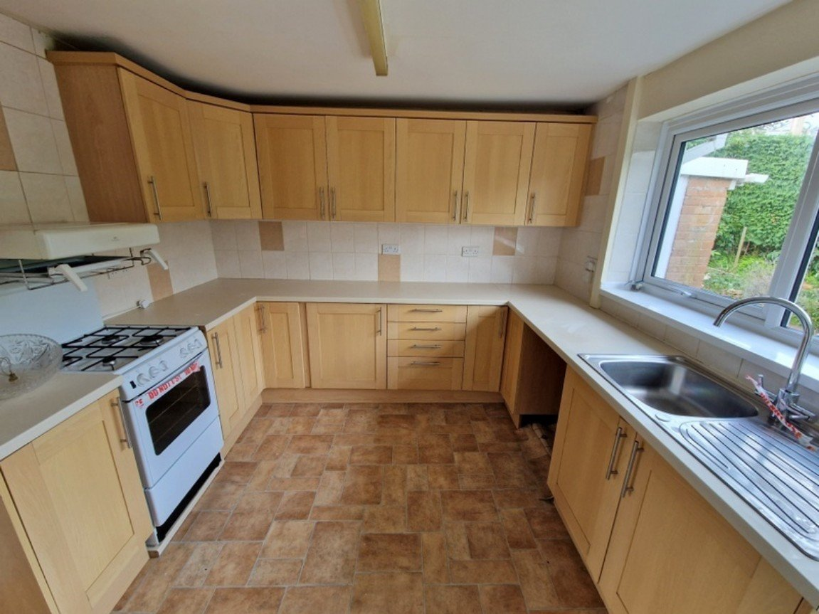
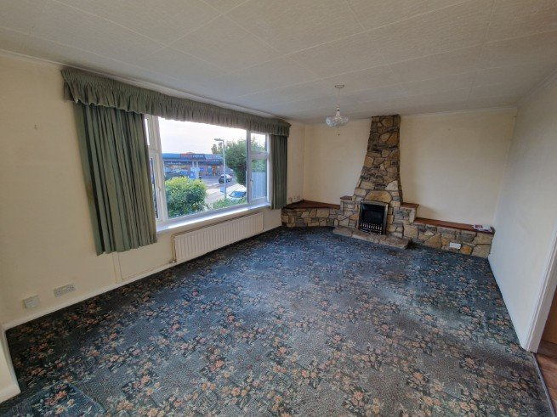
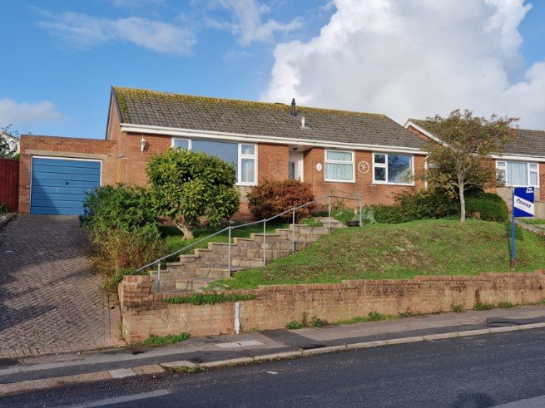
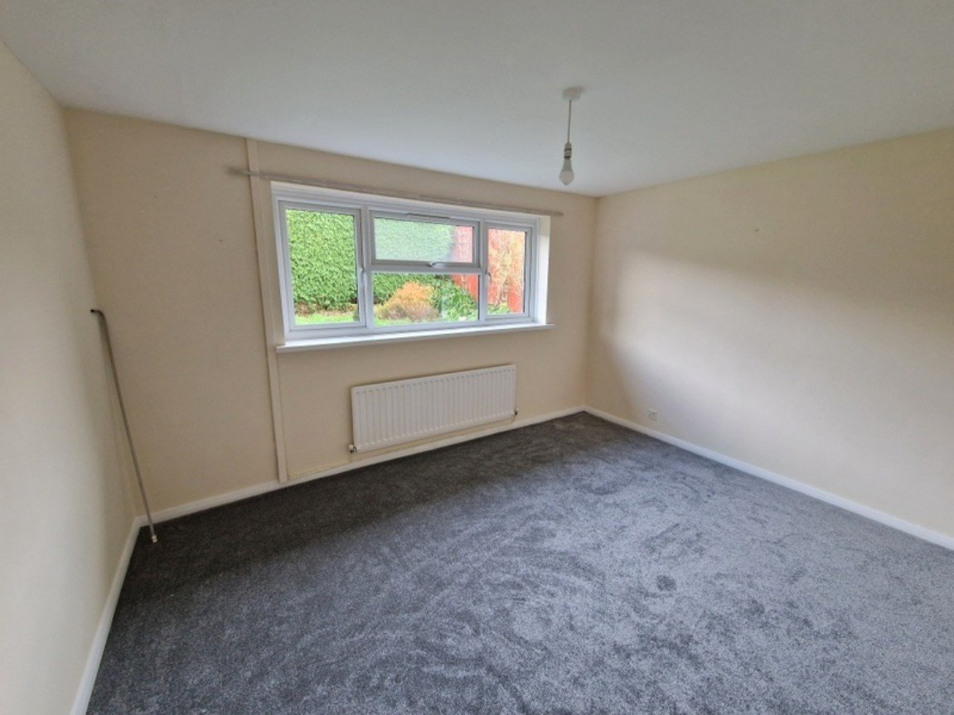
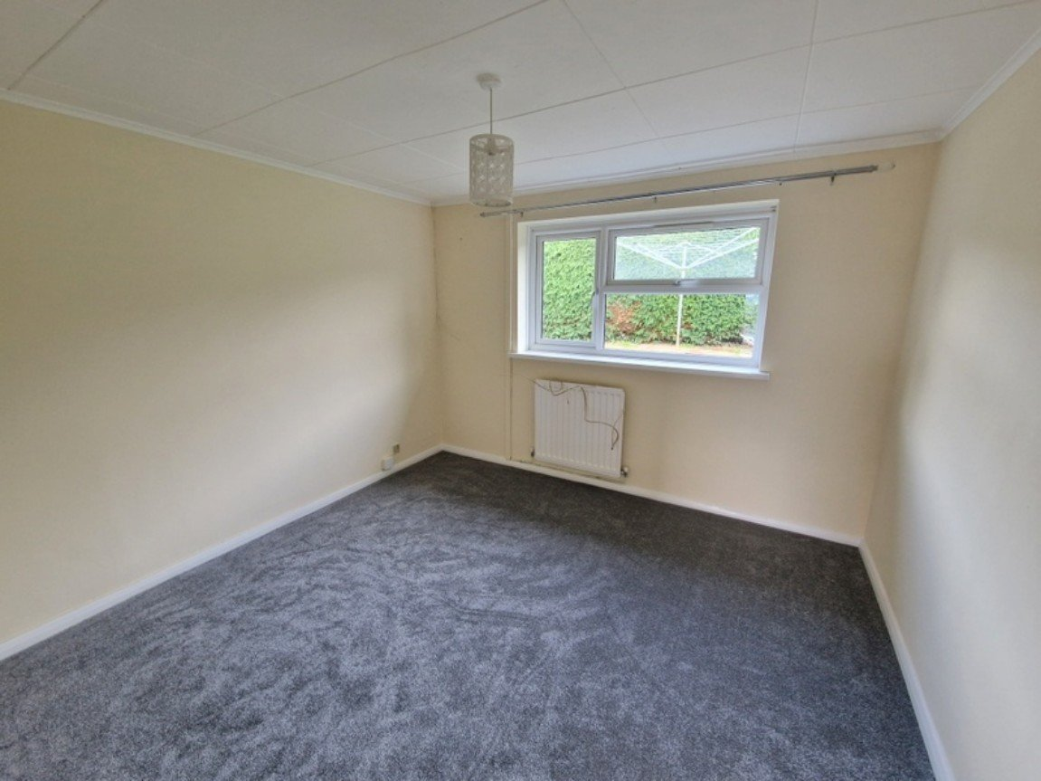
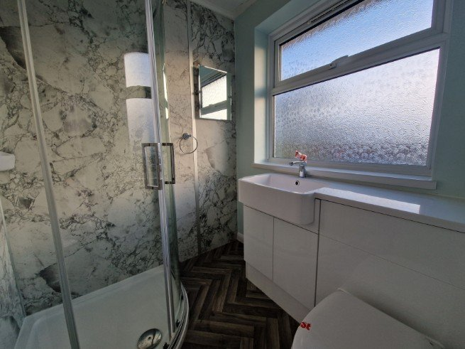
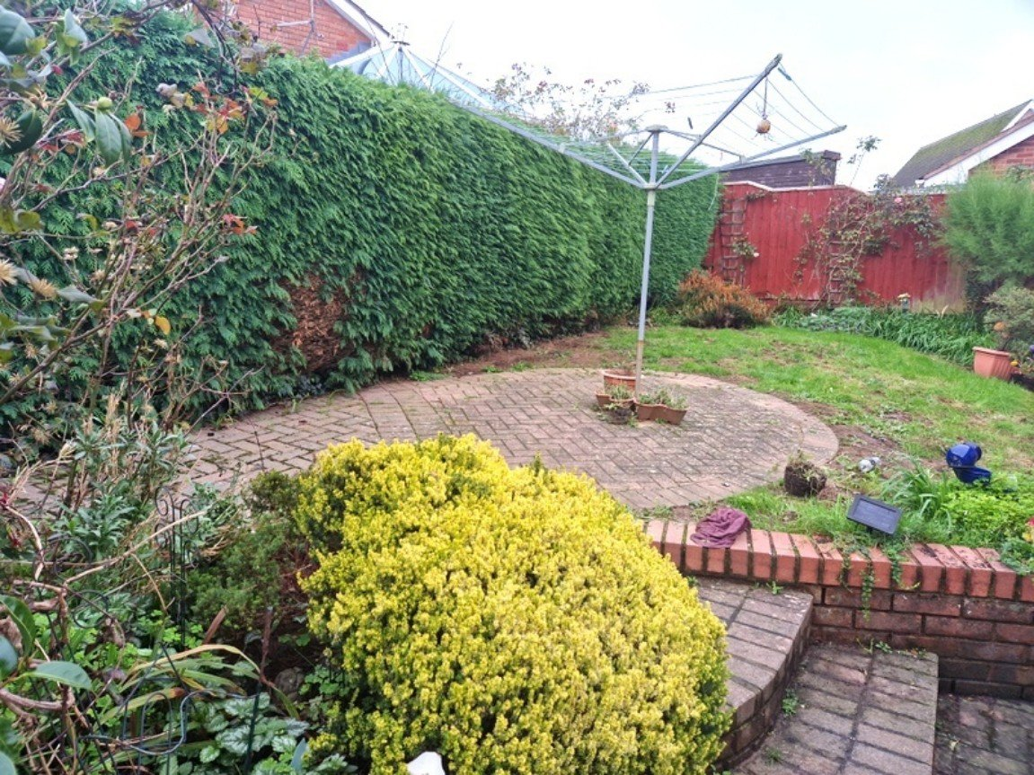
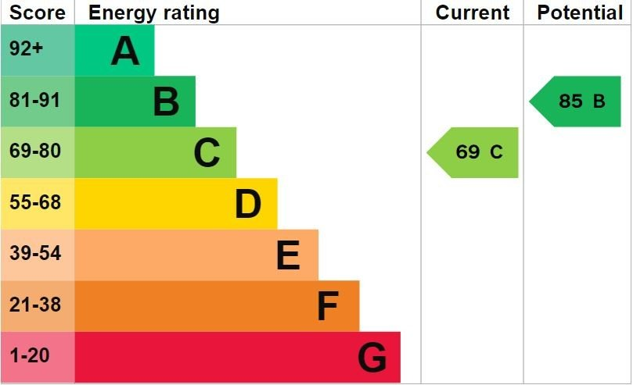
www.pennys.net
114 Churchill Road, Exmouth, EX8 2JJ
GUIDE PRICE £290,000
TENURE Freehold
A Detached Three Bedroom Detached Bungalow Enjoying A Convenient Location Close To Amenities With Gardens, Drive And Garage
Elevated Position Enjoying Open Outlook • Lounge/Dining Room •
Kitchen • Three Bedrooms • Modern Shower Room/WC •
Gas Central Heating • Double Glazed Windows •
Front & Rear Gardens • Driveway & Garage •
No Onward Chain •
Pennys Estate Agents Limited for themselves and for the vendor of this property whose agents they are give notice that:- (1) These particulars do not constitute any part of an offer or a contract. (2) All statements contained in these particulars are made without responsibility on the part of Pennys Estate Agents Limited. (3) None of the statements contained in these particulars are to be relied upon as a statement or representation of fact. (4) Any intending purchaser must satisfy himself/herself by inspection or otherwise as to the correctness of each of the statements contained in these particulars. (5) The vendor does not make or give and neither do Pennys Estate Agents Limited nor any person in their employment has any authority to make or give any representation or warranty whatever in relation to this property.
PENNYS ESTATE AGENTS
2 Rolle House, Rolle Street, Exmouth, Devon, EX8 2SN
Tel: 01395 264111 EMail: help@pennys.net

Slide 2
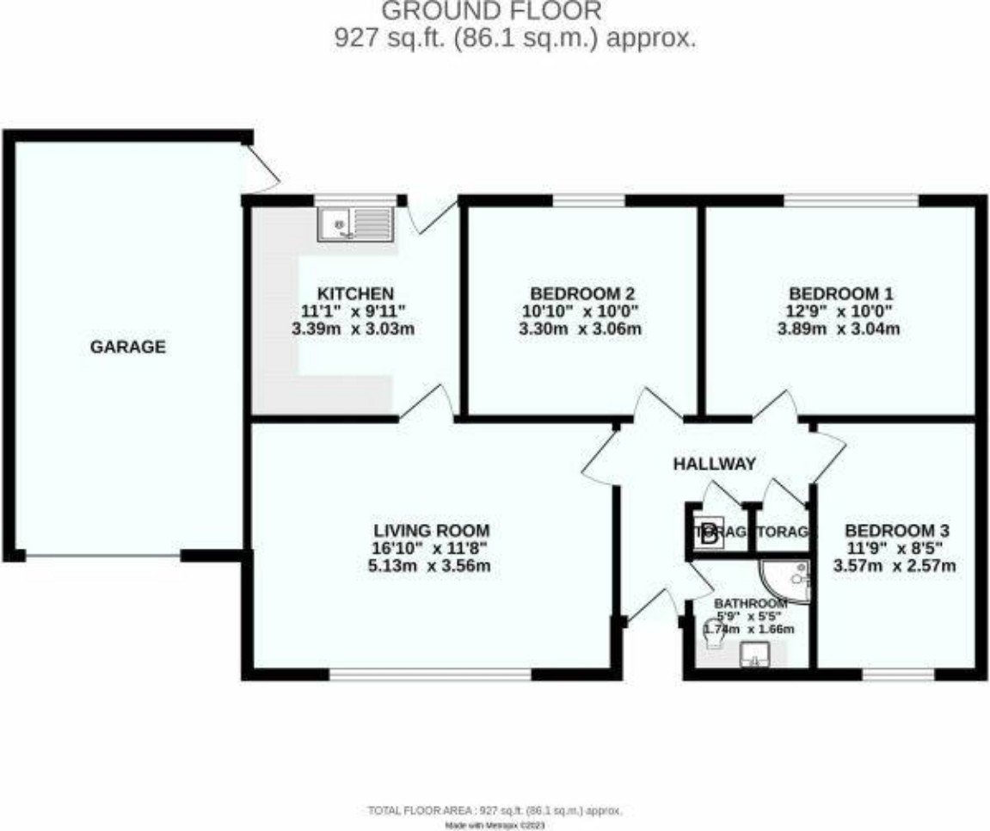
114 Churchill Road, Exmouth, EX8 4JJ
THE ACCOMMODATION COMPRISES: Entrance canopy with courtesy light; uPVC front door to: RECEPTION HALL: Linen cupboard with slatted shelving, radiator and housing gas boiler; adjoining cupboard with electric consumer unit and meter; access to roof void. LOUNGE/DINING ROOM: 5.13m x 3.56m (16'10" x 11'8") Double glazed window to front elevation; radiator; stone fire place and chimney breast with display areas and housing coal effect gas fire; radiator; television point; telephone point. KITCHEN: 3.38m x 3.02m (11'1" x 9'11") Fitted with a range of work top surfaces with cupboards and drawers; plumbing for an automatic washing machine beneath; tiled surrounds; gas cooker; wall mounted cupboards; radiator; double glazed window and door to REAR GARDEN. BEDROOM ONE: 3.89m x 3.05m (12'9" x 10'0") Double glazed window to rear elevation; radiator. BEDROOM TWO: 3.3m x 3.05m (10'10" x 10'0") Double glazed window to rear elevation; radiator; television point; telephone point. BEDROOM THREE: 3.58m x 2.57m (11'9" x 8'5") Double glazed window to front elevation; radiator. SHOWER ROOM: 1.75m x 1.65m (5'9" x 5'5") Re-fitted with a corner cubicle shower unit and tiled splash back walls; wash hand basin with adjoining display surface with cabinet and push button flush under; WC; heated towel rail; double glazed window with pattern glass; part splash back walls; fitted mirror. OUTSIDE: Located on an elevated position with lawn garden; block paved pathways and driveway to GARAGE decorative stone area and shrubs; outside light; side gate to REAR GARDEN which is enclosed and comprising of a block paved patio area and pathway; lawn area; flower and shrub beds; outside light; outside tap.
GARAGE: 5.08m x 2.92m (16'8" x 9'7") Up and over door; power and light connected; uPVC double glazed door to REAR GARDEN.
FLOOR PLAN:

