Slide 1
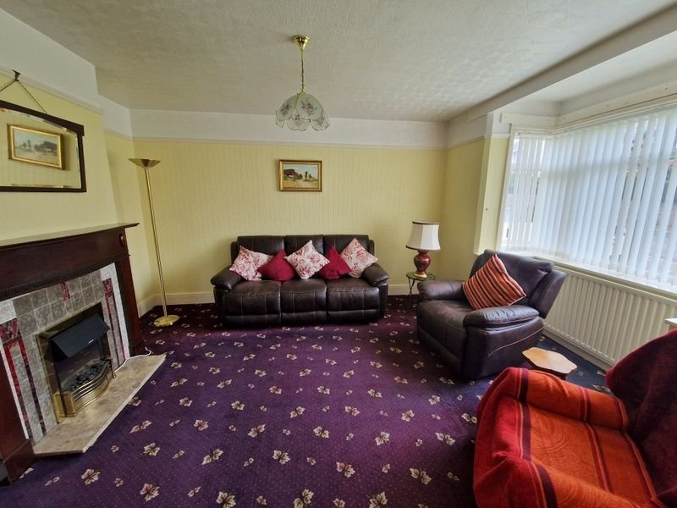
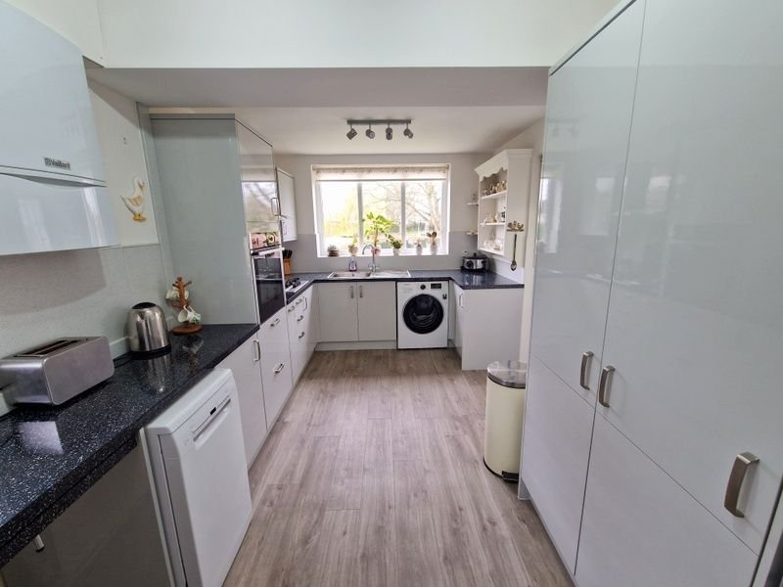
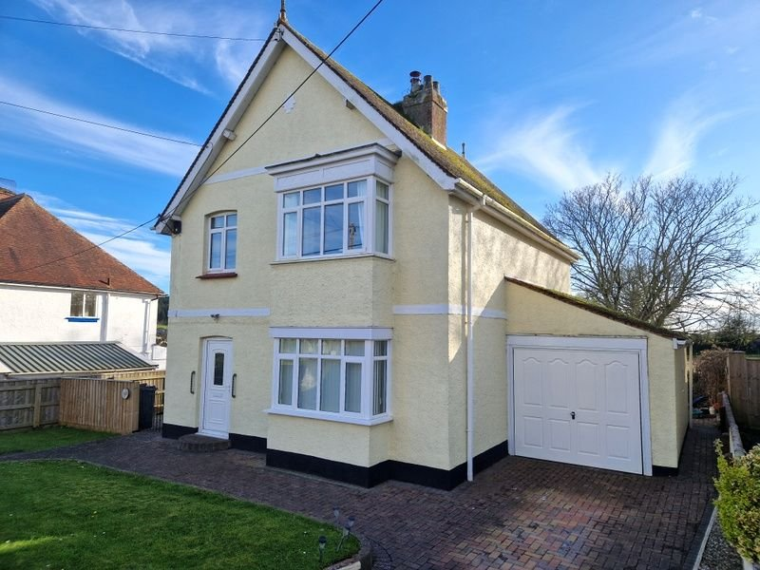
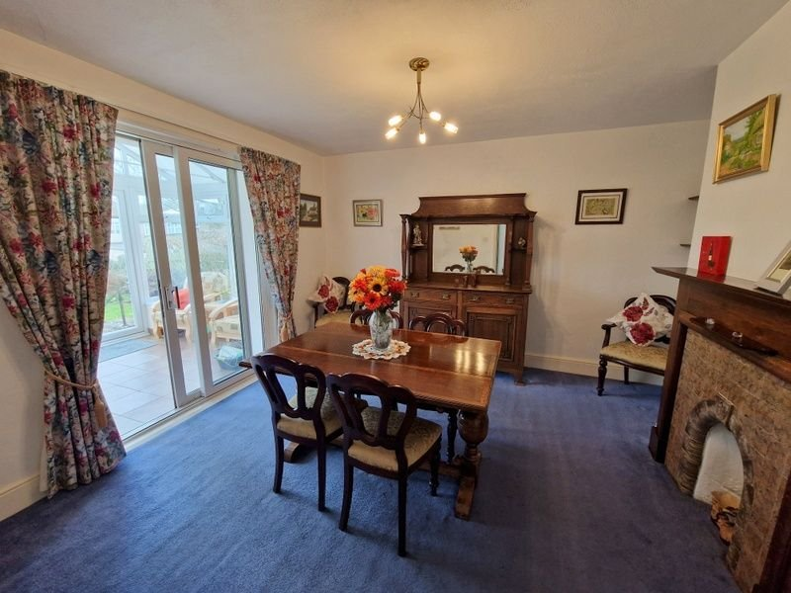
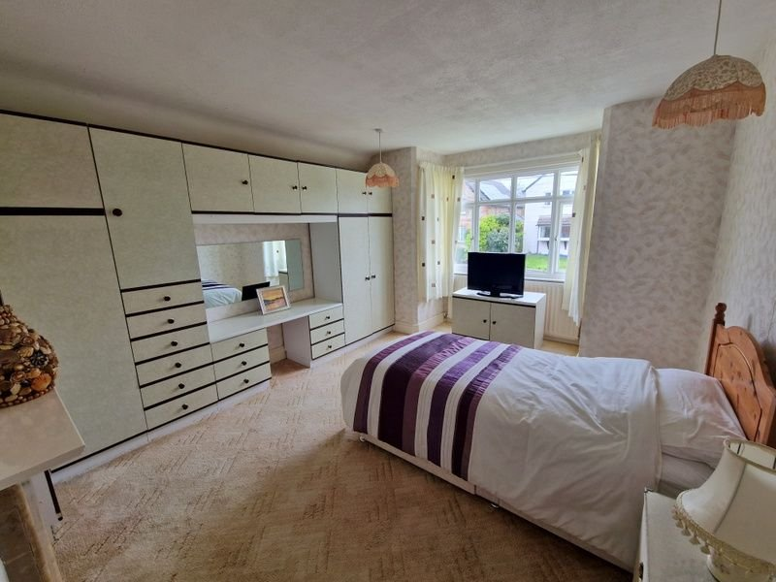
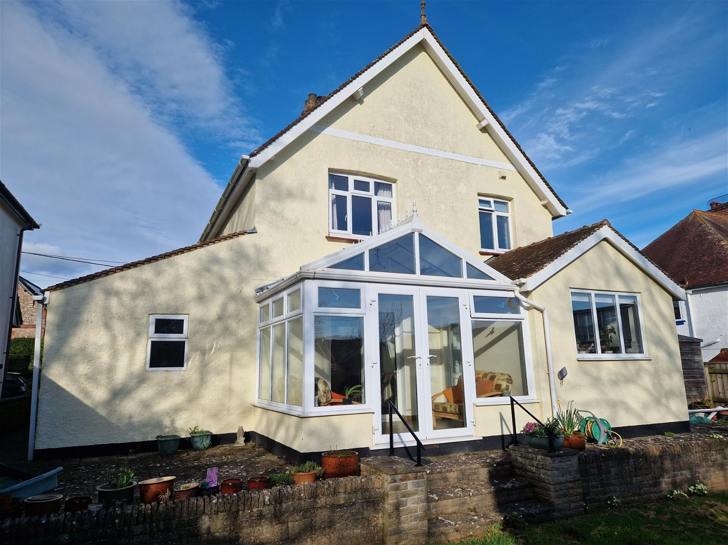
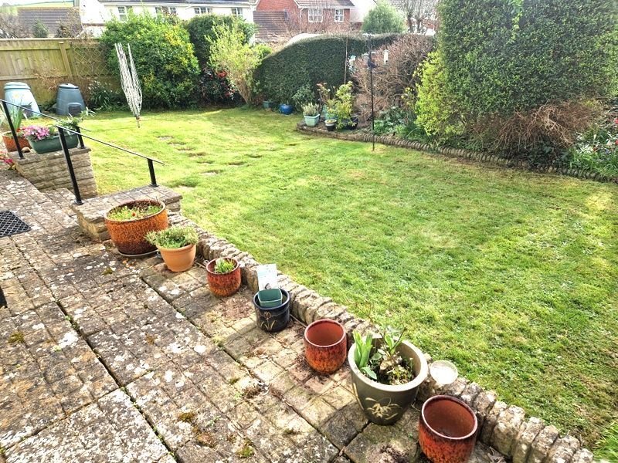
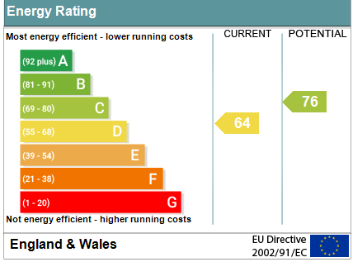
www.pennys.net
104 Littleham Road, Exmouth, EX8 2RD
GUIDE PRICE £465,000
TENURE Freehold
A Most Impressive Detached House With Some Fine Period Features, Well Planned Gardens & Garage
Entrance Porch & Spacious Reception Hall • Bay Fronted Lounge •
Separate Dining Room • Modern Well Appointed Kitchen/Breakfast Room • Conservatory •
Ground Floor Cloakroom/WC • Three First Floor Bedrooms • Shower Room/WC •
Gas Central Heating, Double Glazed Windows & Cavity Wall Insulation •
Super Family Home • No Onward Chain •
Pennys Estate Agents Limited for themselves and for the vendor of this property whose agents they are give notice that:- (1) These particulars do not constitute any part of an offer or a contract. (2) All statements contained in these particulars are made without responsibility on the part of Pennys Estate Agents Limited. (3) None of the statements contained in these particulars are to be relied upon as a statement or representation of fact. (4) Any intending purchaser must satisfy himself/herself by inspection or otherwise as to the correctness of each of the statements contained in these particulars. (5) The vendor does not make or give and neither do Pennys Estate Agents Limited nor any person in their employment has any authority to make or give any representation or warranty whatever in relation to this property.
PENNYS ESTATE AGENTS
2 Rolle House, Rolle Street, Exmouth, Devon, EX8 2SN
Tel: 01395 264111 EMail: help@pennys.net

Slide 2
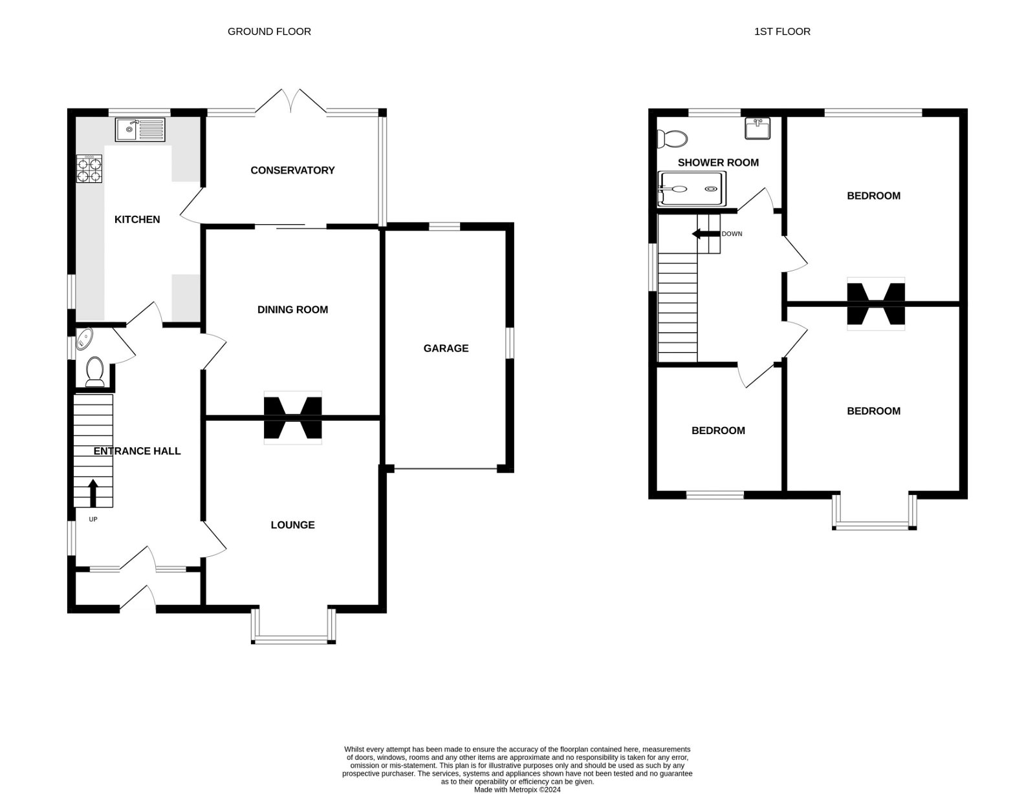
104 Littleham Road, Exmouth, EX8 2RD
THE ACCOMMODATION COMPRISES: uPVC double glazed front door to: ENTRANCE PORCH: Shelved cupboard with display surface over; inner solid wood door with pattern glass and two matching picture windows to: SPACIOUS RECEPTION HALL: 5.13m x 2.74m (16'10" x 9'0") An impressive entrance to the property with staircase rising to the first floor landing with understairs cupboard beneath; radiator; double glazed window to side aspect. CLOAKROOM/WC: WC; wash hand basin; radiator; double glazed window with pattern glass. LOUNGE: 4.8m x 3.71m (15'9" x 12'2") into double glazed square bay window to front aspect; original wooden fire surround with tiled inset and marble hearth housing living flame electric fire; television point; picture rail; radiator. DINING ROOM: 4.06m x 3.71m (13'4" x 12'2") Original wooden fire surround with tiled hearth; radiator; sliding double glazed patio doors to: CONSERVATORY: 3.53m x 2.26m (11'7" x 7'5") (Also accessed from the kitchen/breakfast room) With double glazed windows overlooking the rear gardens and double glazed double doors to rear garden; electric wall heater; skylight window; ceiling lighting and power sockets. EXTENDED KITCHEN/BREAKFAST ROOM: 4.5m x 2.79m (14'9" x 9'2") A modern stylish and well equipped kitchen with a range of gloss finish pattern worktop surfaces including 'pull-out' breakfast bar with splashback surrounds; range of cupboards, drawer units including two carousel units and slimline pull-out larder cupboard; plumbing for an automatic washing machine and dishwasher space beneath worktop surface; built-in oven with 'slide & hide' door, cupboard over and deep drawer unit beneath; four ring gas hob with glass splashback and chimney style extractor hood over with light; single drainer sink unit; further kitchen unit housing pull out larder cupboard and upright storage area; space for fridge freezer; two radiators; Valliant gas boiler; wall mounted cupboards and shelving; two double glazed windows and double glazed door to conservatory. FIRST FLOOR LANDING: Double glazed window with pattern glass. BEDROOM ONE: 4.83m x 3.66m (15'10" x 12'0") into double glazed square bay window to front aspect with outlook towards Littleham church and grounds; range of wardrobes, drawer units and dressing table; radiator; tiled fireplace with wood mantel. BEDROOM TWO: 4.01m x 3.71m (13'2" x 12'2") Double glazed window to rear aspect; radiator; picture rail; tiled fireplace with wooden mantle over. BEDROOM THREE: 2.74m x 2.69m (9'0" x 8'10") Double glazed window to front aspect with outlook towards Littleham church and grounds; radiator. SHOWER ROOM/WC: 2.62m x 1.8m (8'7" x 5'11") Double cubicle with fixed and detachable shower head hoses; vanity wash hand basin; WC with push button flush; radiator; fully tiled walls with mirror; chrome heated towel rail; ceiling extractor fan; access to roof space.
OUTSIDE:The property is approached via pedestrian gate and block paved pathway along with a block paved driveway providing off-road parking leading to the garage with two lawned areas of garden. A gate gives access to a side garden comprising of a decorative stone garden, circular patio and timber shed which inturn leads through to the rear garden. The rear garden comprises of a sun terrace area, lawn garden and well stocked flower and shrub beds, outside tap, block paved path back round to the front of the property. GARAGE: 5.74m x 2.79m (18'10" x 9'2") Electric door; power and light connected; two double glazed windows.
FLOOR PLAN:

