Slide 1
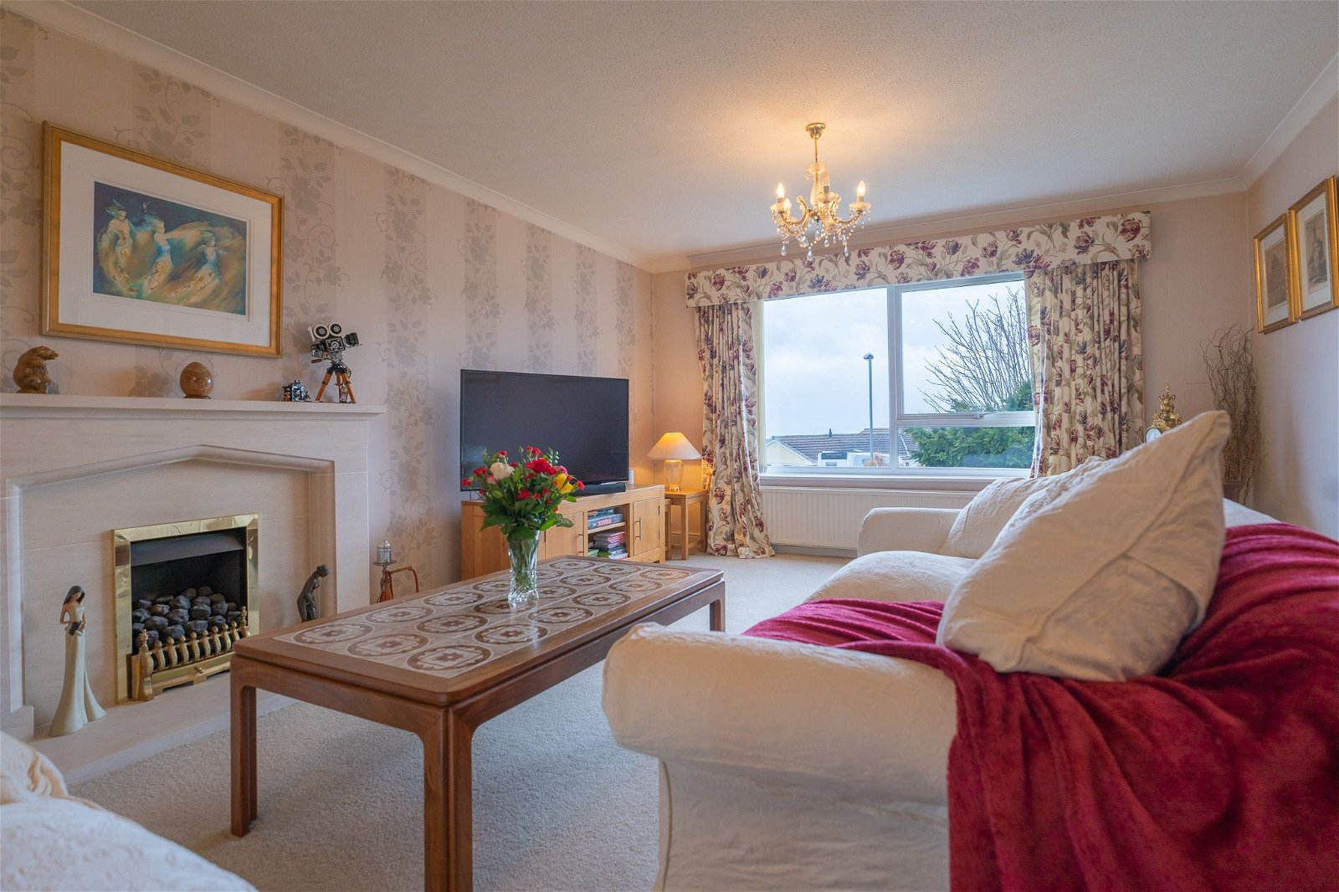
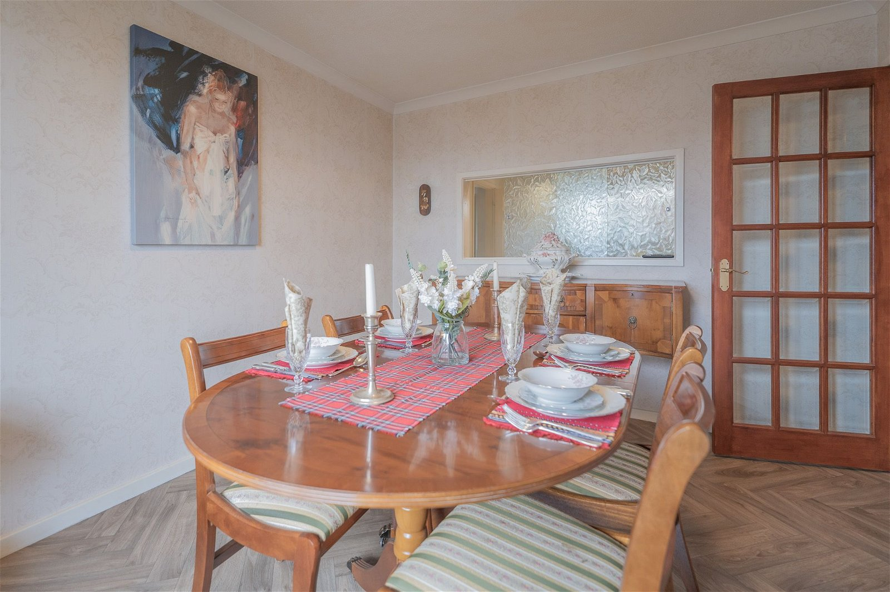
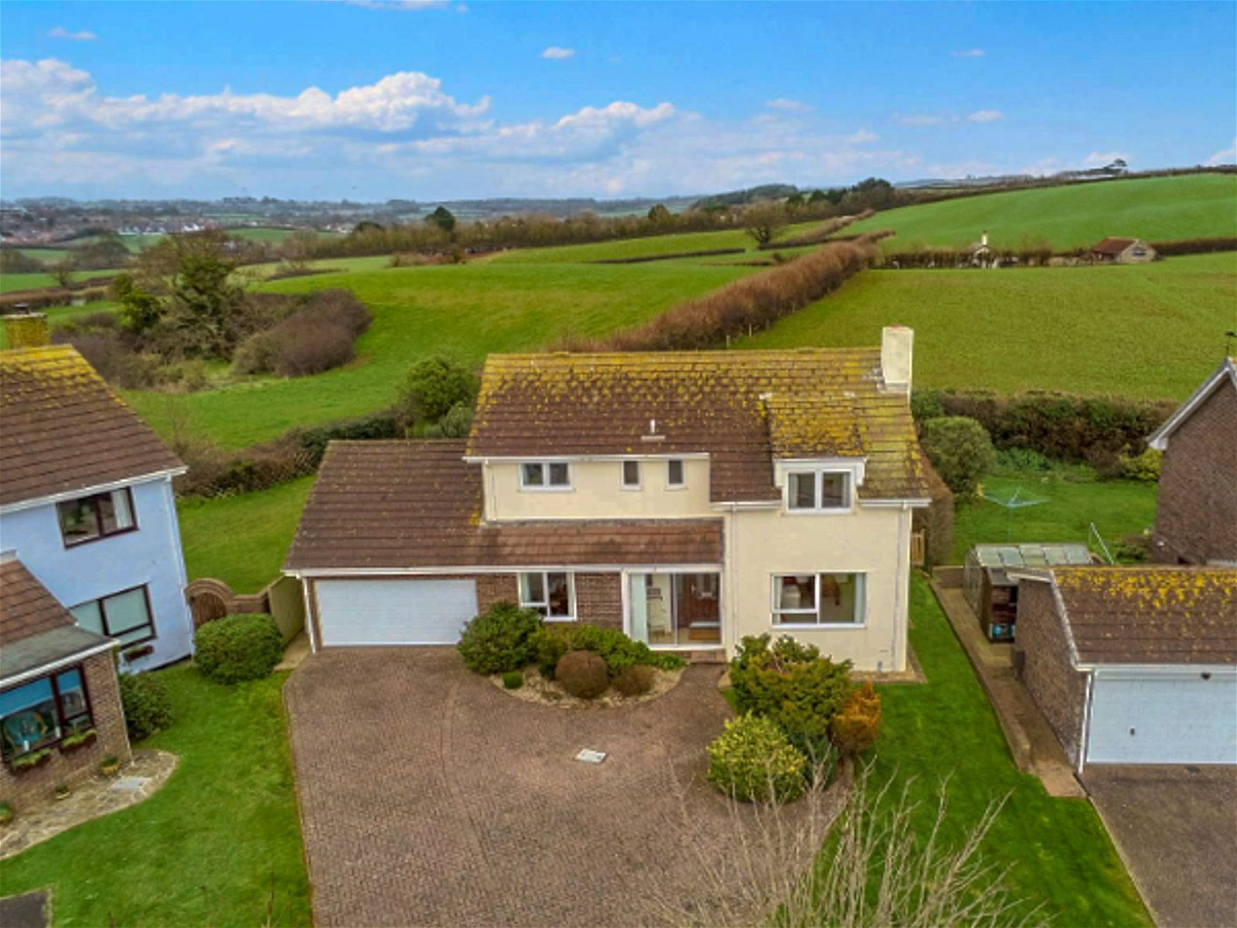
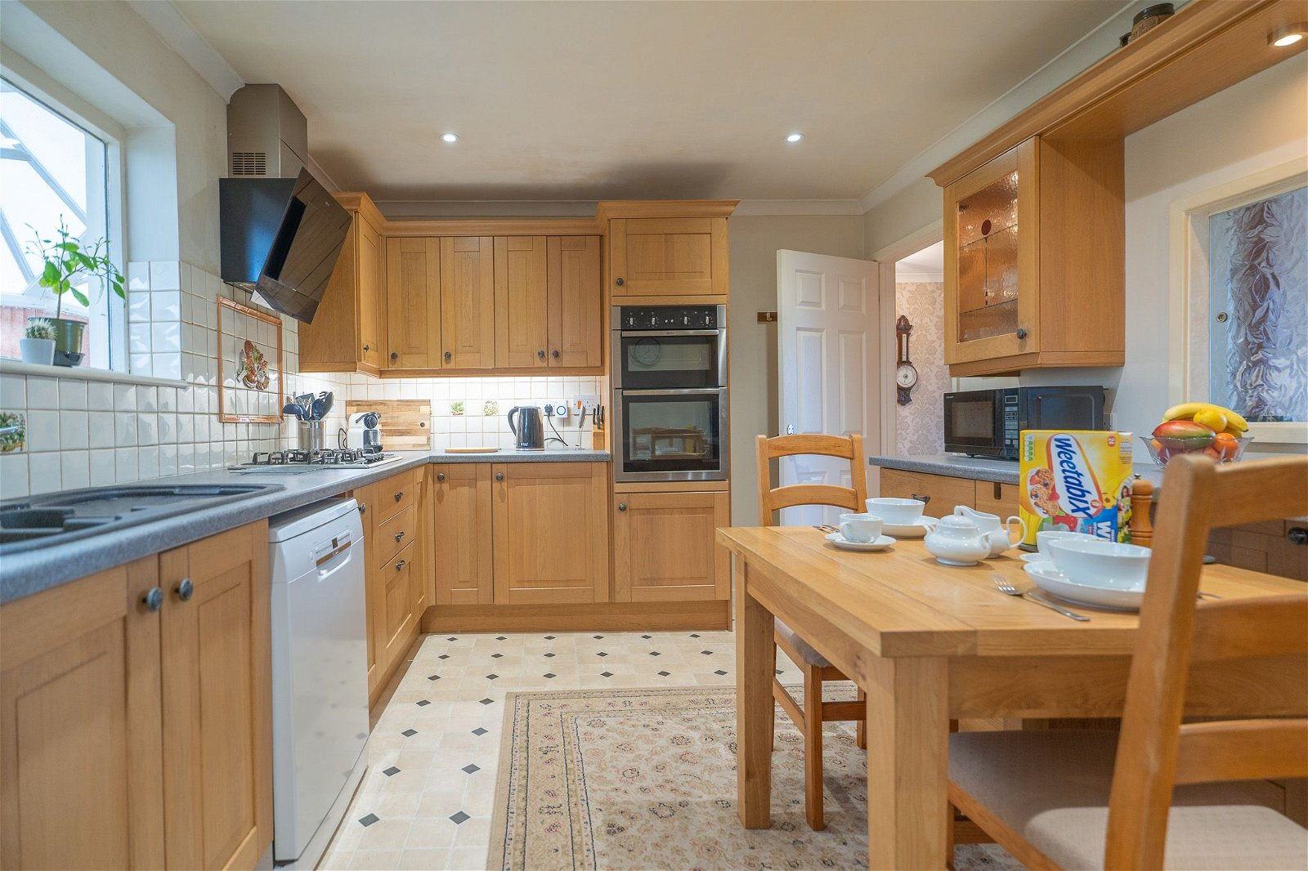
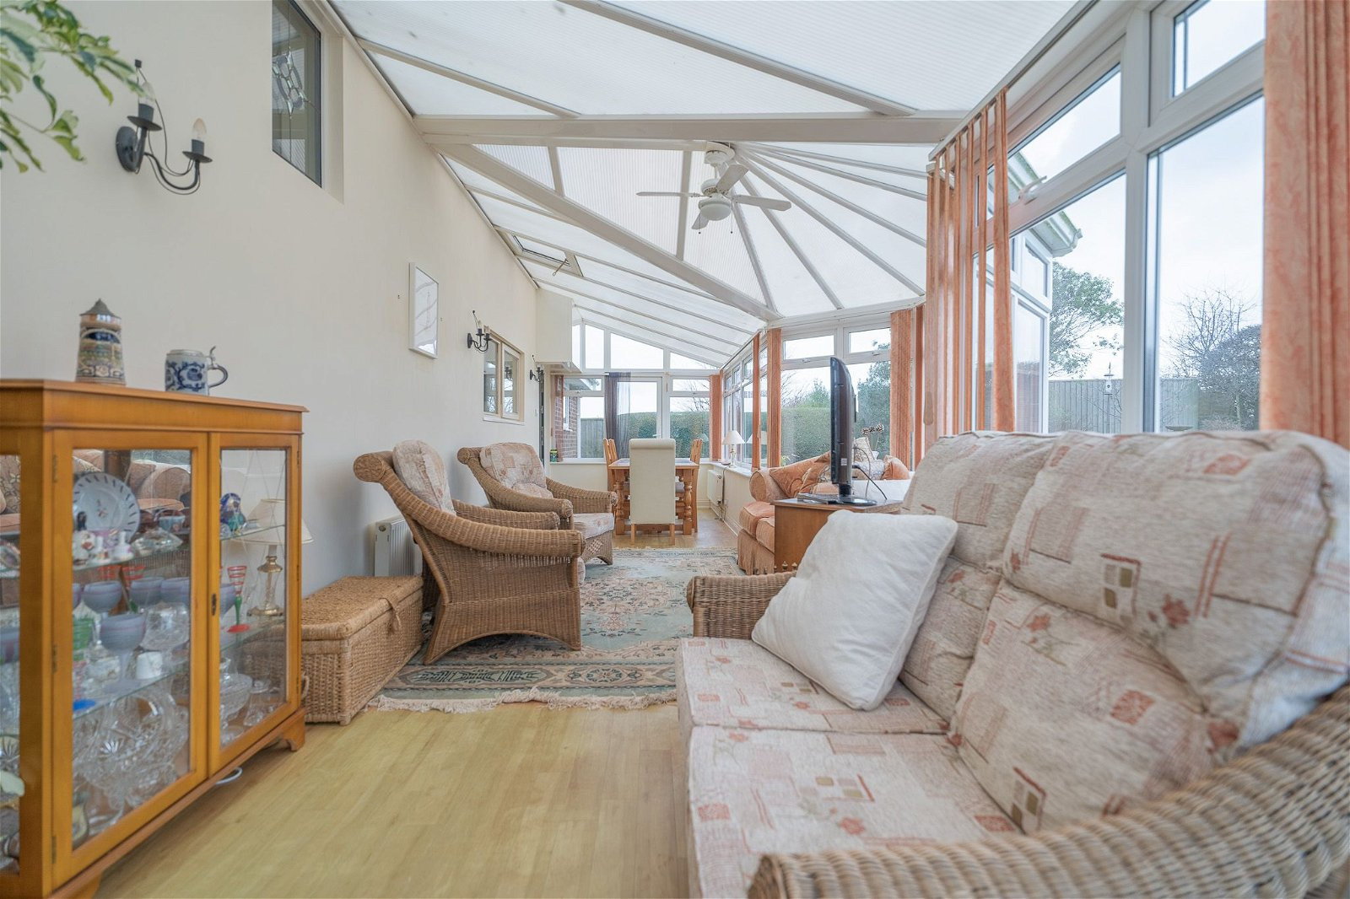
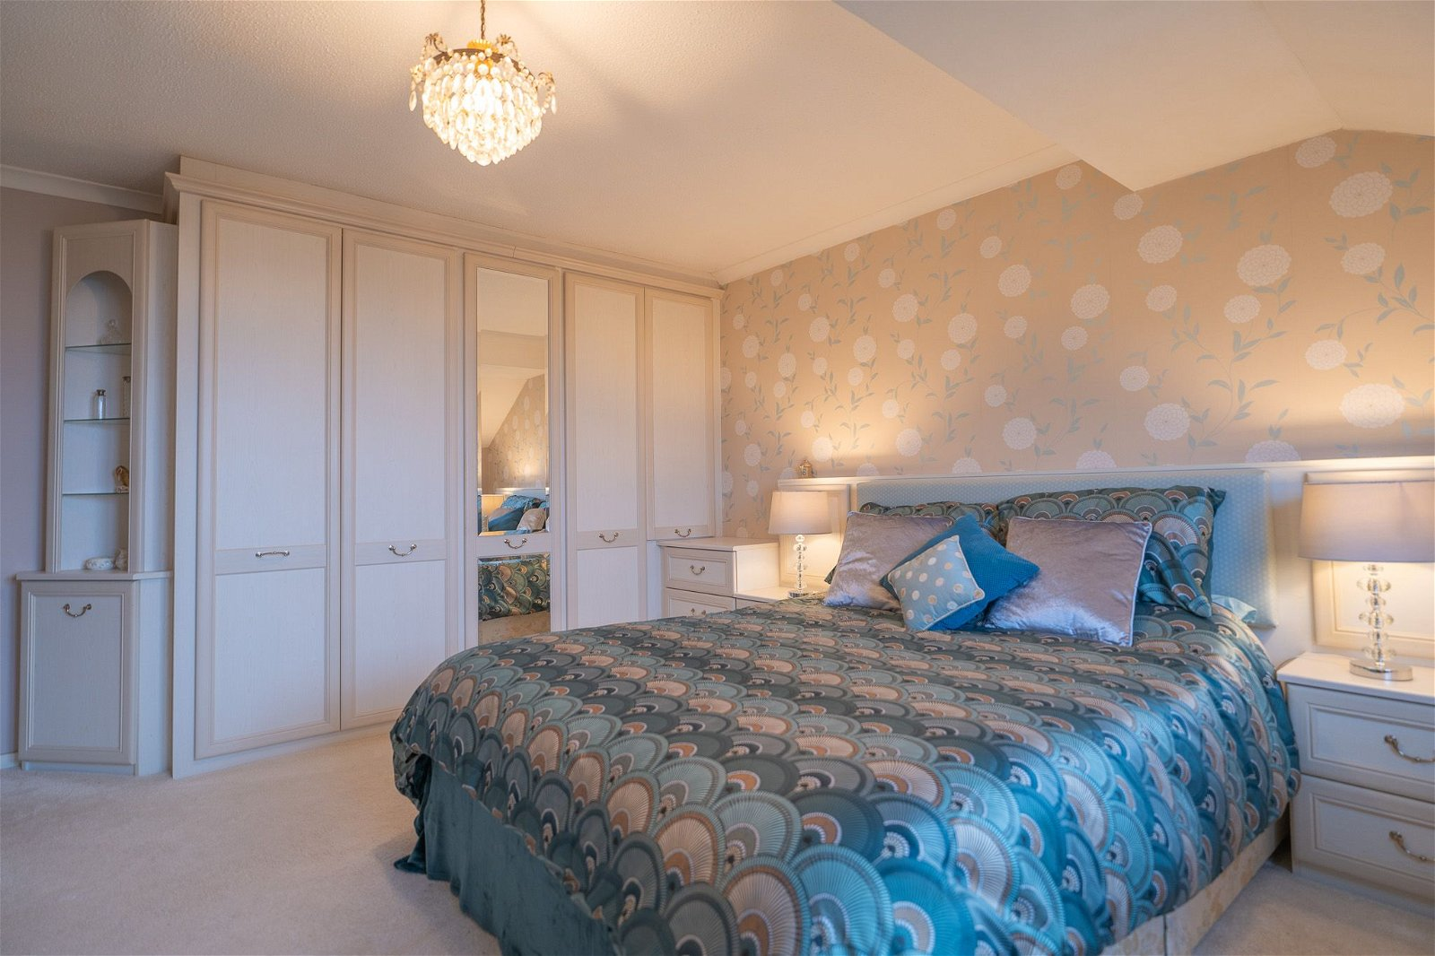
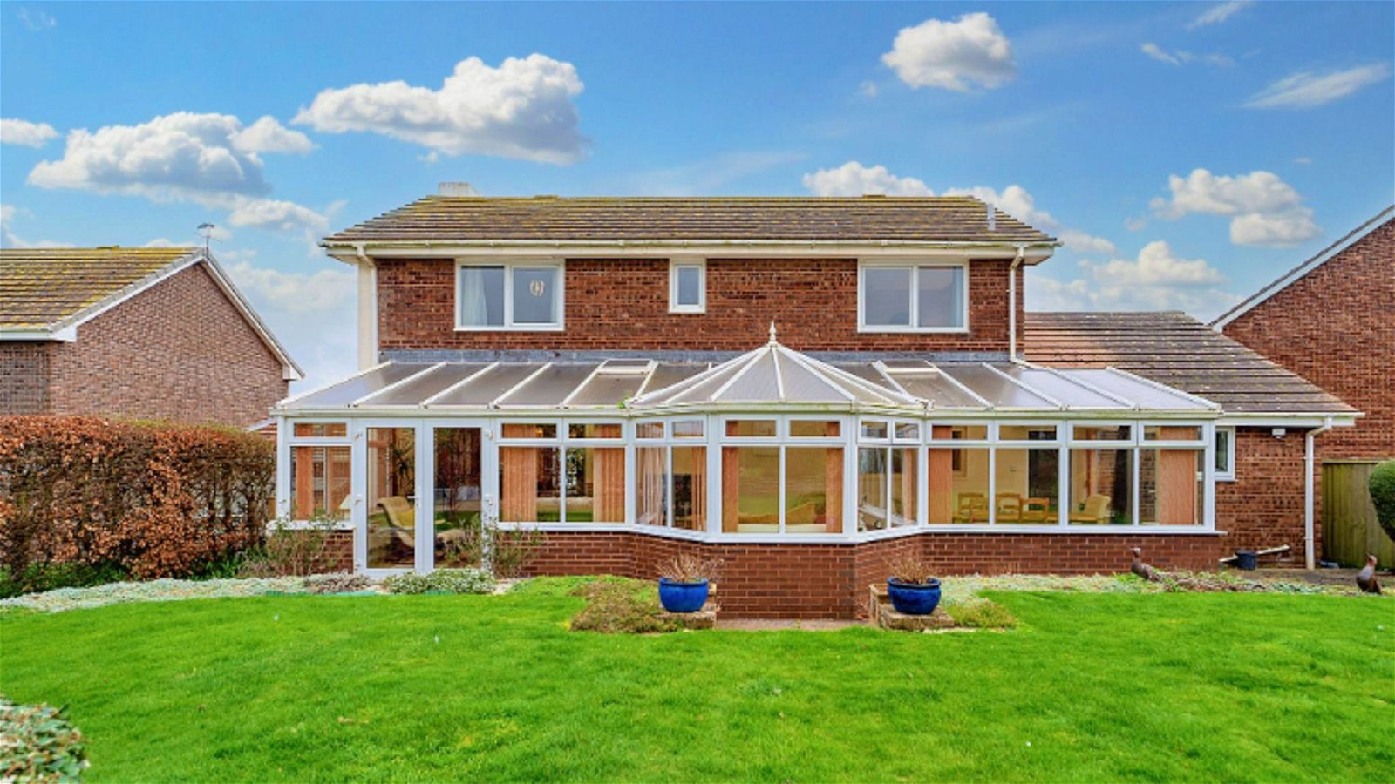
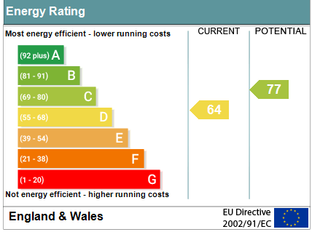
www.pennys.net
Henleaze, 90 Foxholes Hill, Exmouth, EX8 2DH
GUIDE PRICE £875,000
TENURE Freehold
A Superbly Positioned Detached Residence With Excellent Sea And Countryside Views, Lovely Gardens, Ample Parking And Double Garage
Spacious Lounge • Separate Dining Room •
Kitchen/Breakfast Room • Utility Room • Large Conservatory Extension •
Cloakroom/WC • Four Bedrooms •
En-Suite Shower Room/WC • Family Bathroom/WC •
Gas Central Heating & Double Glazed Windows • No Onward Chain •
Pennys Estate Agents Limited for themselves and for the vendor of this property whose agents they are give notice that:- (1) These particulars do not constitute any part of an offer or a contract. (2) All statements contained in these particulars are made without responsibility on the part of Pennys Estate Agents Limited. (3) None of the statements contained in these particulars are to be relied upon as a statement or representation of fact. (4) Any intending purchaser must satisfy himself/herself by inspection or otherwise as to the correctness of each of the statements contained in these particulars. (5) The vendor does not make or give and neither do Pennys Estate Agents Limited nor any person in their employment has any authority to make or give any representation or warranty whatever in relation to this property.
PENNYS ESTATE AGENTS
2 Rolle House, Rolle Street, Exmouth, Devon, EX8 2SN
Tel: 01395 264111 EMail: help@pennys.net

Slide 2
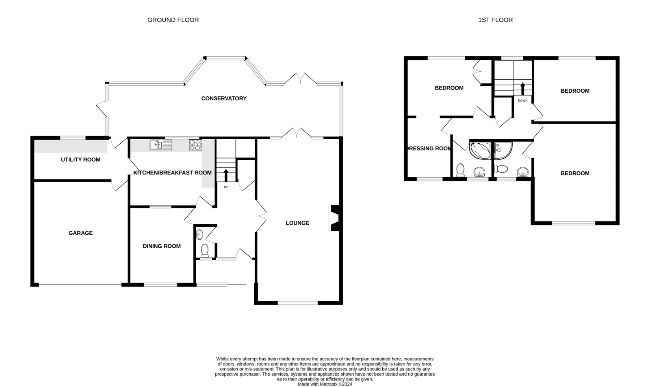
Henleaze, 90 Foxholes Hill, Exmouth, EX8 2DH
THE ACCOMMODATION COMPRISES: Sliding patio doors to: ENTRANCE PORCH: 2.44m x 1.17m (8'0" x 3'10") Inner wood effect double glazed door with matching side screen to: RECEPTION HALL: Radiator; turning staircase to FIRST FLOOR LANDING with useful understairs cupboard beneath; double glass panelled doors to: CLOAKROOM/WC: Fitted with wash hand basin set into display surface with cabinets beneath and large fitted mirror over; slimline upright cabinet; WC with push button flush; heated towel rail; recess ceiling spotlighting; window with pattern glass. LOUNGE: 7.62m x 3.96m (25'0" x 13'0") A spacious room with uPVC double glazed windows to front aspect with views to the sea and coastline; stone fireplace and hearth housing coal effect living flame gas fire; two radiators; glazed panelled doors to: CONSERVATORY EXTENSION: 9.45m x 2.44m (31'0" x 8'0") widening to 12'0 into bay window. A most spacious addition to the living area with uPVC double glazed windows overlooking the rear garden; two radiators; two skylight windows; power and light connected; double doors and single double glazed doors giving access to the rear garden. KITCHEN/BREAKFAST ROOM: 4.19m x 3.2m (13'9" x 10'6") A modern kitchen with pattern worktop surfaces with inset one and a quarter bowl single drainer sink unit with tiled surrounds; range of cupboards, drawers and space for dishwasher beneath; breakfast bar recess beneath worktops; inset four ring gas hob; built-in oven and grill with cupboards above and below; wall mounted cupboards; gloss fronted display cabinets with adjoining spotlighting; radiator; recess ceiling spotlights; gloss serving hatch to dining room; window to rear aspect. UTILITY ROOM: Worktops with plumbing for an automatic washing machine and tumble dryer space beneath; inset one and a quarter bowl single drainer sink unit; wall mounted cupboards; Worcester gas boiler; radiator; double glazed window to rear aspect and double glazed door to CONSERVATORY and uPVC double glazed door to GARAGE. DINING ROOM: 3.63m x 3.02m (11'11" x 9'11") Double glazed window to front aspect with sea views; television point; radiator. FIRST FLOOR LANDING: With two double glazed windows on half landing; airing cupboard with water tank; access via loft ladder to roof space. BEDROOM ONE: 4.57m x 3.96m (15'0" x 13'0") Double glazed to front aspect with wonderful sea and coastline views; fitted range of bedroom furniture to include floor to ceiling wardrobes, two bedside cabinets, chest of drawer units and dressing table. television point; part sloping ceiling; radiator. EN-SUITE SHOWER ROOM/WC: 1.88m x 1.85m (6'2" x 6'1") Shower cubicle; wash hand basin set into display surface with cabinet and shelving beneath; WC with push button flush; fully tiled walls; recess ceiling spotlighting; double glazed windows with pattern glass; heated towel rail; mirror fronted medicine cabinet. BEDROOM TWO: 4.04m x 3.02m (13'3" x 9'11") Double glazed tilt and turn window to rear aspect enjoying countryside views; radiator; built-in double wardrobe. BEDROOM THREE: 4.19m x 3.02m (13'9" x 9'11") Double glazed tilt and turn window to rear aspect with countryside views; radiator; built-in double wardrobe.
BEDROOM FOUR: 2.97m x 2.13m (9'9" x 7'0") (Accessed via both Bedroom 3 and First Floor Landing) Double glazed windows to front aspect with superb sea and coastal views; radiator. BATHROOM/WC: 1.96m x 1.93m (6'5" x 6'4") Corner whirlpool bath; pedestal wash hand basin; WC with push button flush; fully tiled walls; heated towel rail; mirror fronted medicine cabinet; double glazed window with pattern glass; fitted wall mirror. OUTSIDE: The property is approached via a long block paved driveway with turning area leading to a DOUBLE GARAGE. Lawn front garden with shrubs and decorative stone flower beds. A further lawn side garden with gate leads through to the rear garden. The rear garden is a wonderful feature to the property backing onto countryside with extensive lawn gardens, colourful raised shrub beds, patio sun terrace areas ideal for outside entertaining, pond with water feature and summer house. Outside tap and lighting. A gate and side pathway leads back to the front of the property. DOUBLE GARAGE: 4.83m x 4.65m (15'10" x 15'3") Electric up and over door; power and light connected; door to UTILITY ROOM.
FLOOR PLAN:

