Slide 1
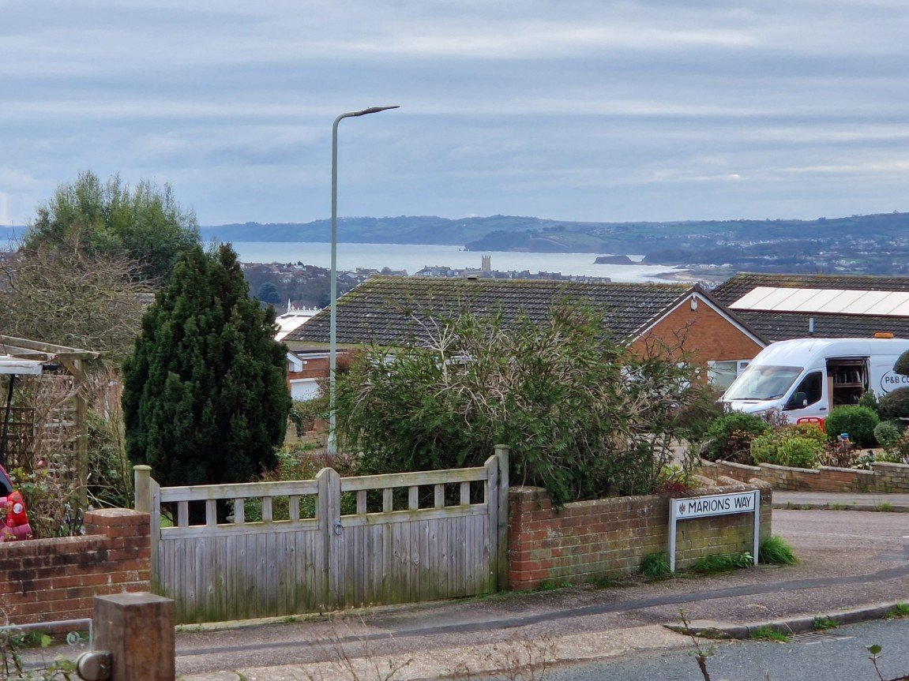
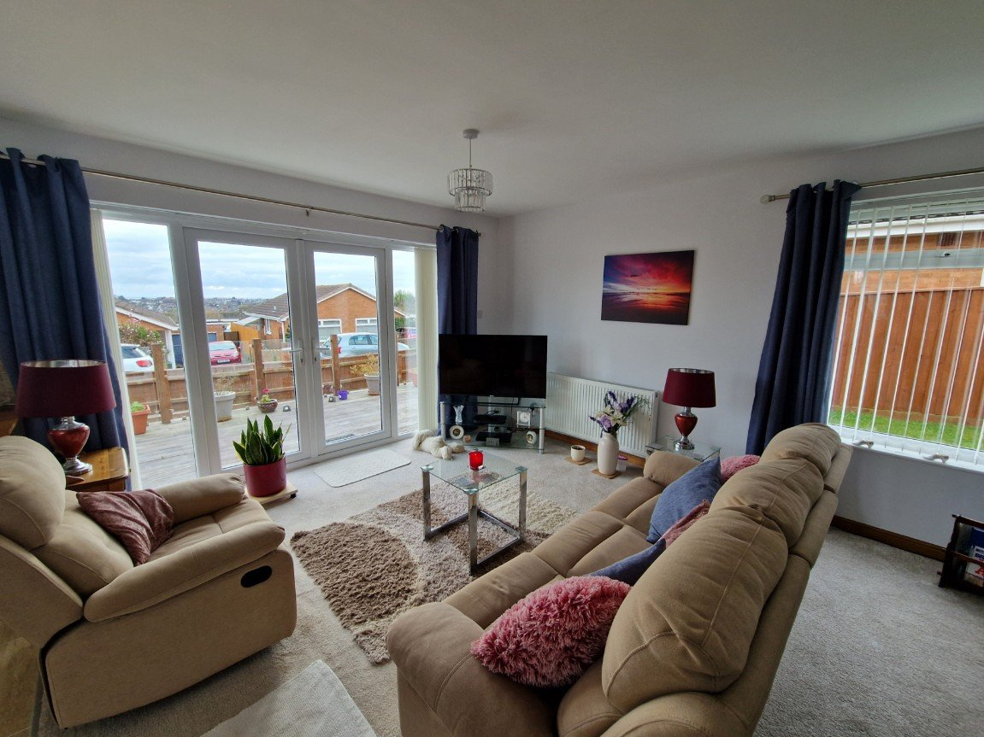
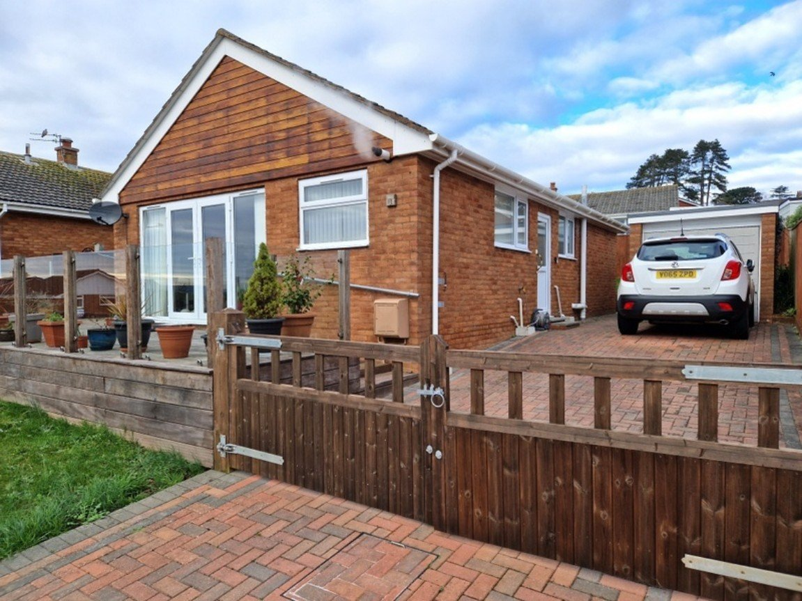
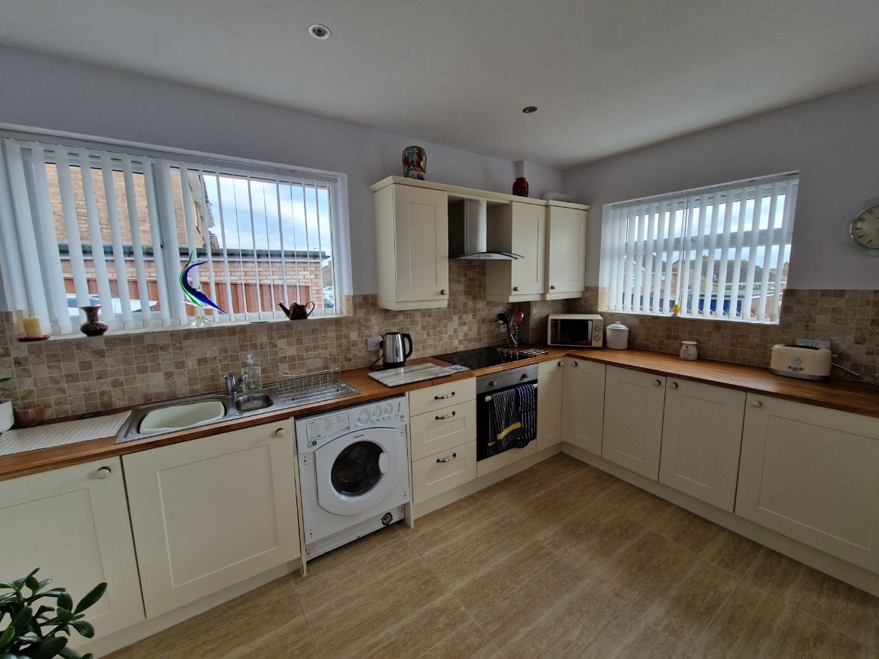
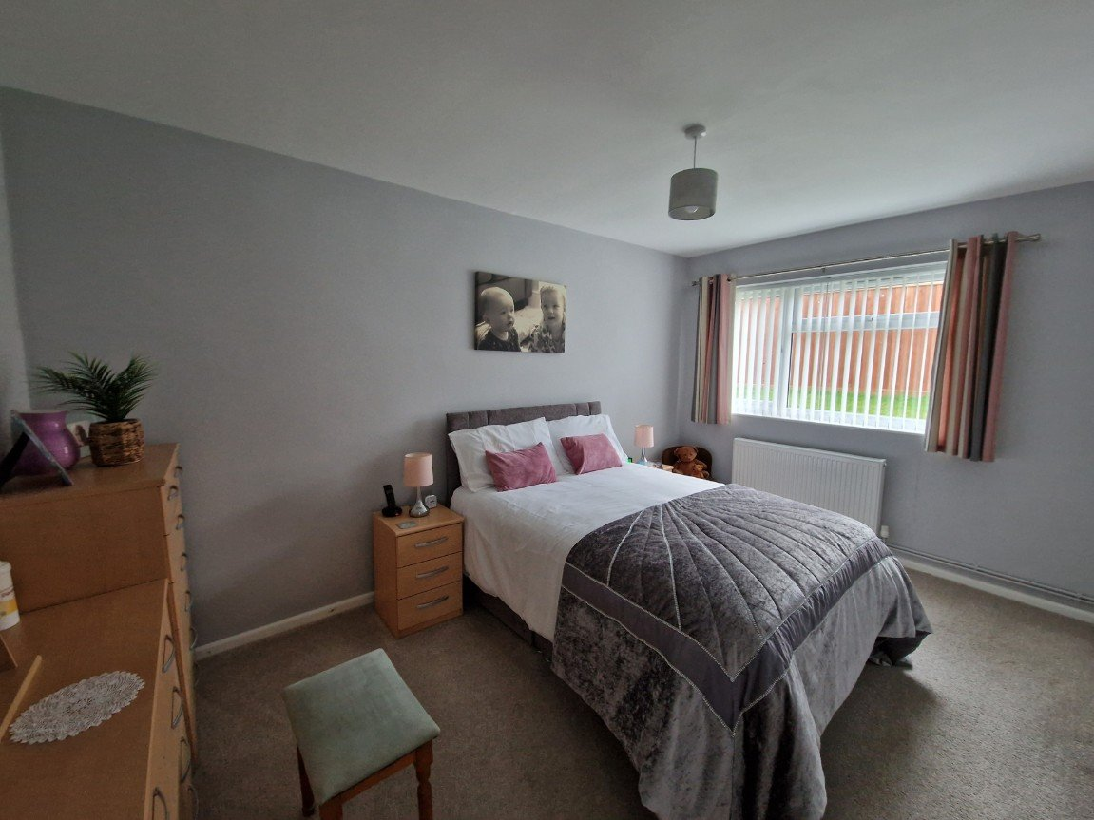
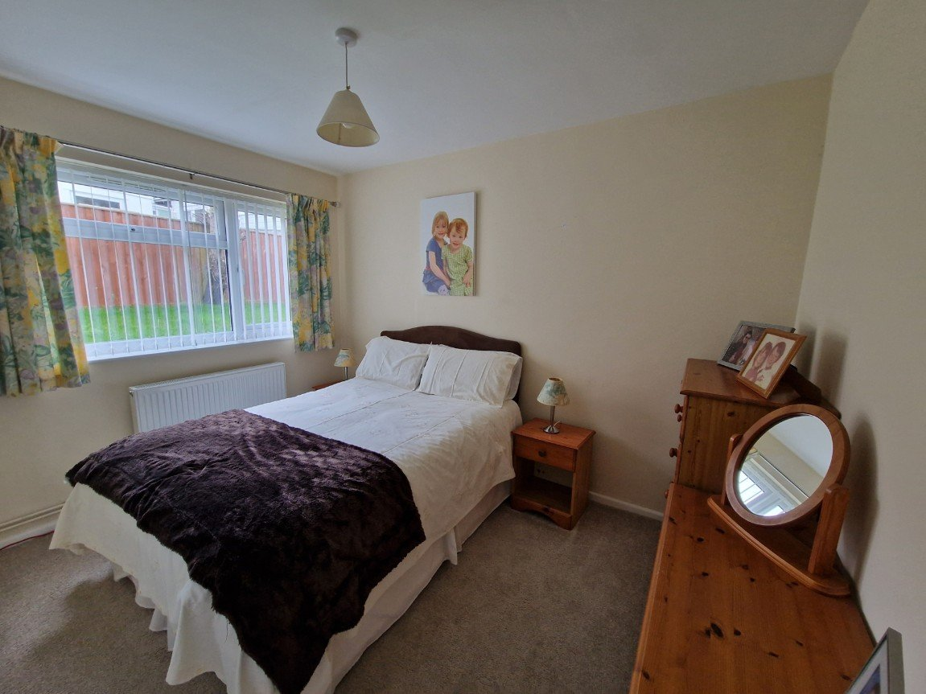
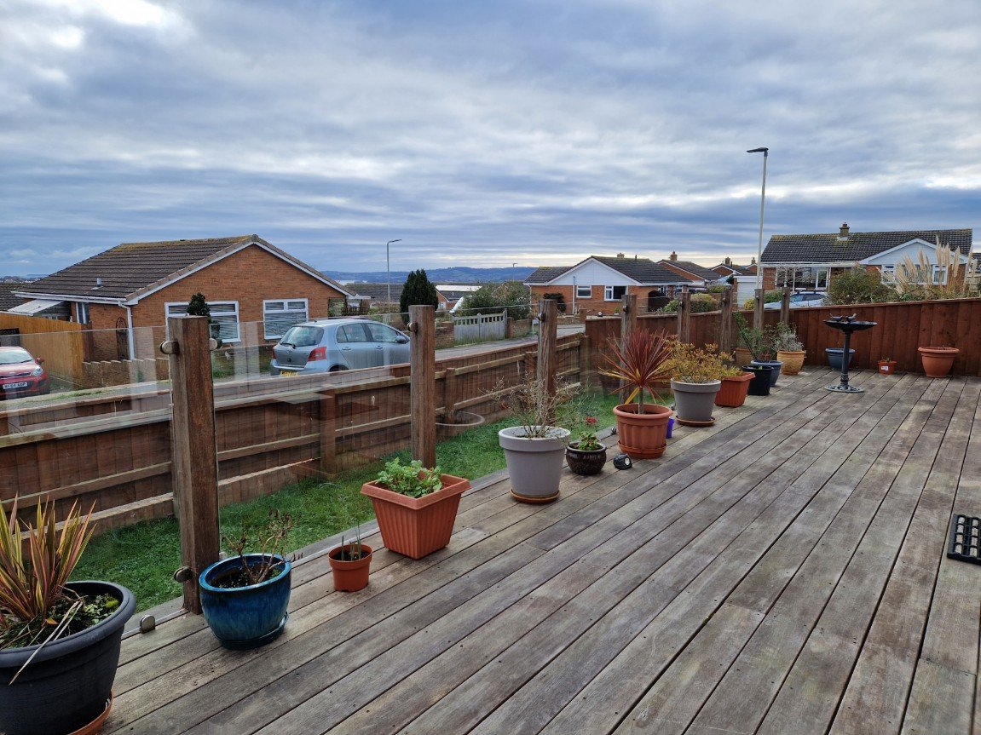
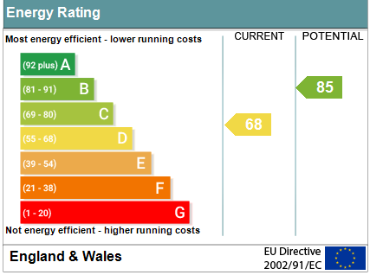
www.pennys.net
1 Marions Way, Exmouth, EX8 4LF
PRICE £380,000
TENURE Freehold
A Beautifully Presented Detached Bungalow Enjoying A Convenient Location With Views Towards The Estuary, Pleasant Gardens, Ample Parking And Garage
Open Plan Modern Kitchen And Dual Aspect Lounge/Dining Room •
Two Bedrooms • Stylish Shower Room/WC •
Raised Southerly Aspect Decked Sun Terrace • Gas Central Heating •
uPVC Double Glazing • Viewing Recommended •
Pennys Estate Agents Limited for themselves and for the vendor of this property whose agents they are give notice that:- (1) These particulars do not constitute any part of an offer or a contract. (2) All statements contained in these particulars are made without responsibility on the part of Pennys Estate Agents Limited. (3) None of the statements contained in these particulars are to be relied upon as a statement or representation of fact. (4) Any intending purchaser must satisfy himself/herself by inspection or otherwise as to the correctness of each of the statements contained in these particulars. (5) The vendor does not make or give and neither do Pennys Estate Agents Limited nor any person in their employment has any authority to make or give any representation or warranty whatever in relation to this property.
PENNYS ESTATE AGENTS
2 Rolle House, Rolle Street, Exmouth, Devon, EX8 2SN
Tel: 01395 264111 EMail: help@pennys.net

Slide 2
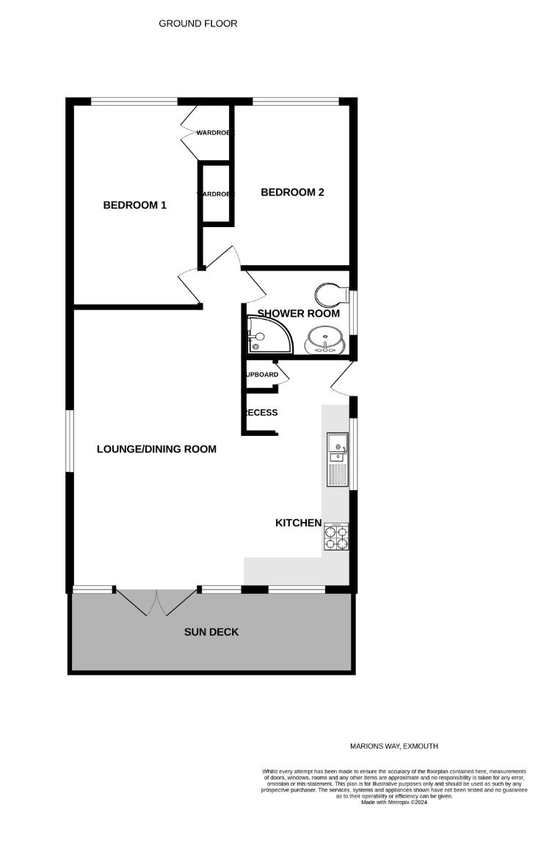
1 Marions Way, Exmouth, EX8 4LF
THE ACCOMMODATION COMPRISES: uPVC double glazed front door to:
KITCHEN: 5.03m x 2.41m (16'6" x 7'11") An open plan room, stylishly fitted with solid wood worktop surfaces with cupboards, drawer units and plumbing for an automatic washing machine beneath worktop surfaces; tiled surrounds; inset one and a quarter bowl sink unit with mixer tap; wall recess ideal to house upright fridge freezer; uPVC double glazed windows to side and front elevations; LED ceiling spotlights; tiled floor; storage cupboard; opening through to: LOUNGE/DINING ROOM: 6.07m x 3.81m (19'11" x 12'6") A bright room enjoying a southerly aspect with uPVC double glazed window to side elevation and picture windows and double french patio doors opening onto DECK SUN TERRACE overlooking the front aspect with estuary and coastline views; television point; radiator. INNER HALL: BEDROOM ONE: 4.44m x 2.87m (14'7" x 9'5") Built-in wardrobe; radiator; uPVC double glazed window to rear aspect. BEDROOM TWO: 3.51m x 3.28m (11'6" x 10'9") uPVC double glazed window to rear aspect; built-in wardrobe; radiator. SHOWER ROOM/WC: 2.34m x 1.83m (7'8" x 6'0") A good size shower cubicle with curved splash screens; fixed rainfall shower head and detachable hose; vanity wash hand basin with cabinets beneath sink unit; WC with push button flush; radiator; fully tiled walls with two integrated wall mirrors; matching tiled floor; uPVC double glazed window with pattern glass; extractor fan. OUTSIDE: A block paved driveway with double wooden gates leading to GARAGE. To the front of the property there is a lawn front garden and large decked sun terrace enjoying a southerly aspect with estuary and coastline views. To the rear and side lawn gardens; outside tap.
FLOOR PLAN:

