Slide 1
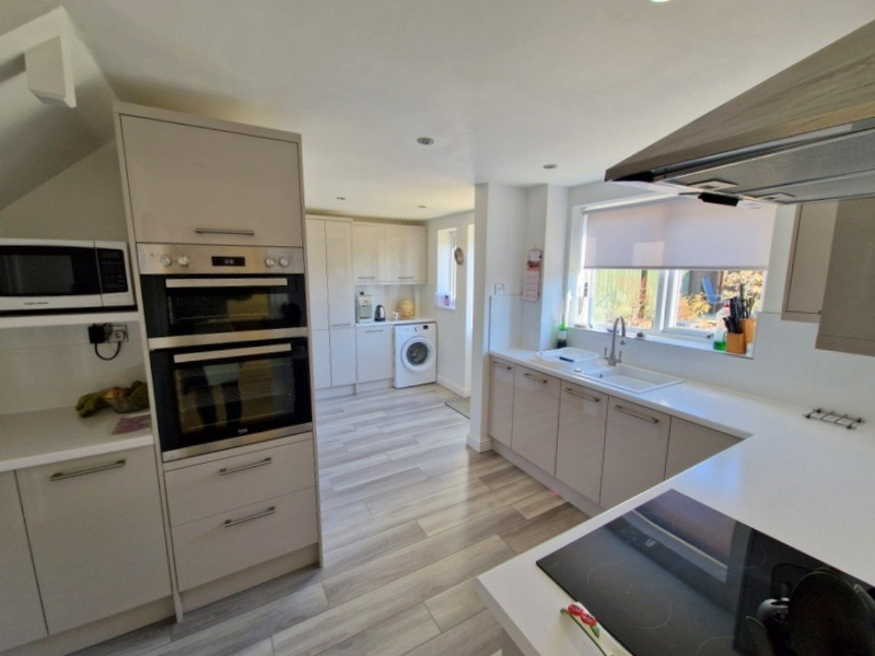
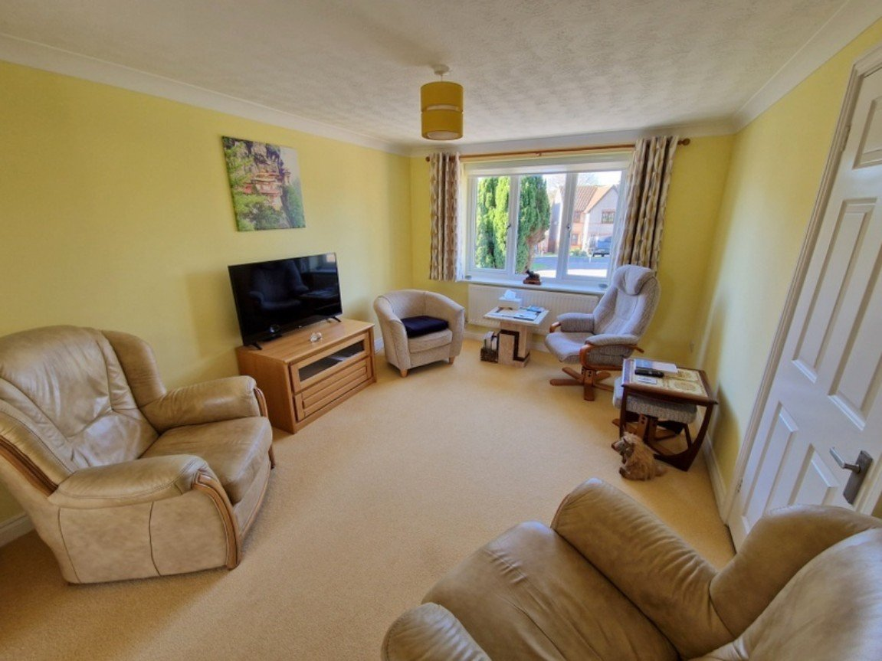
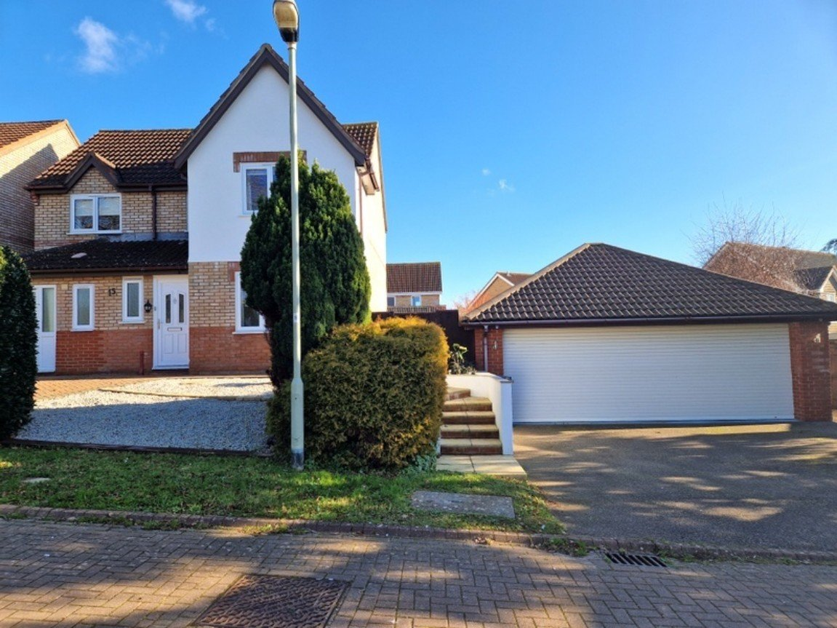
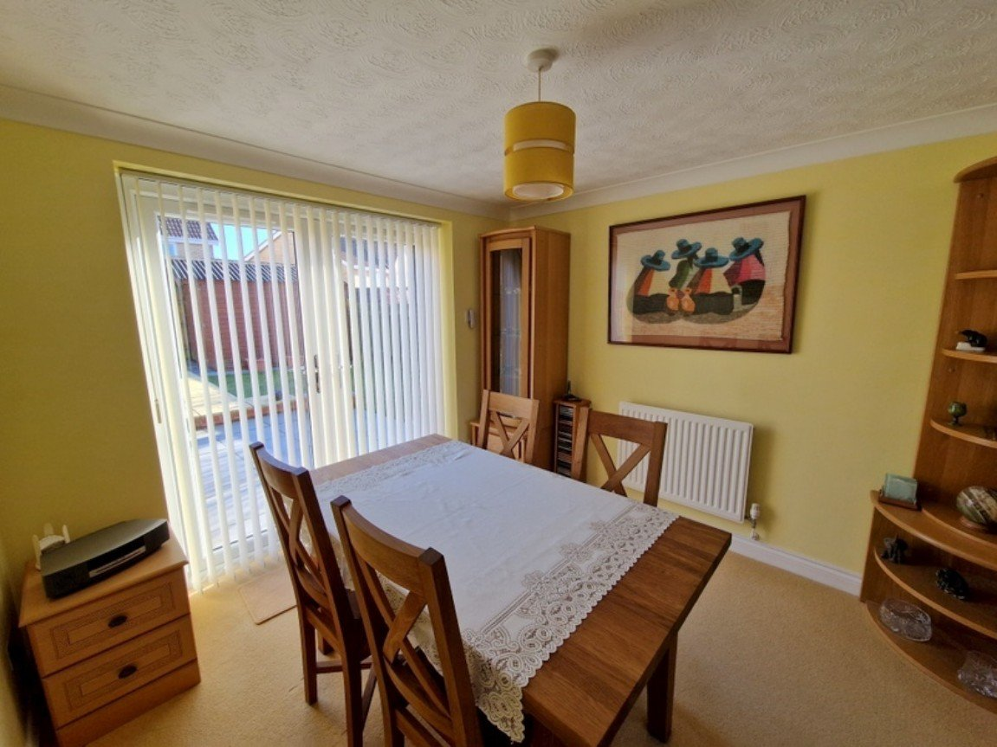
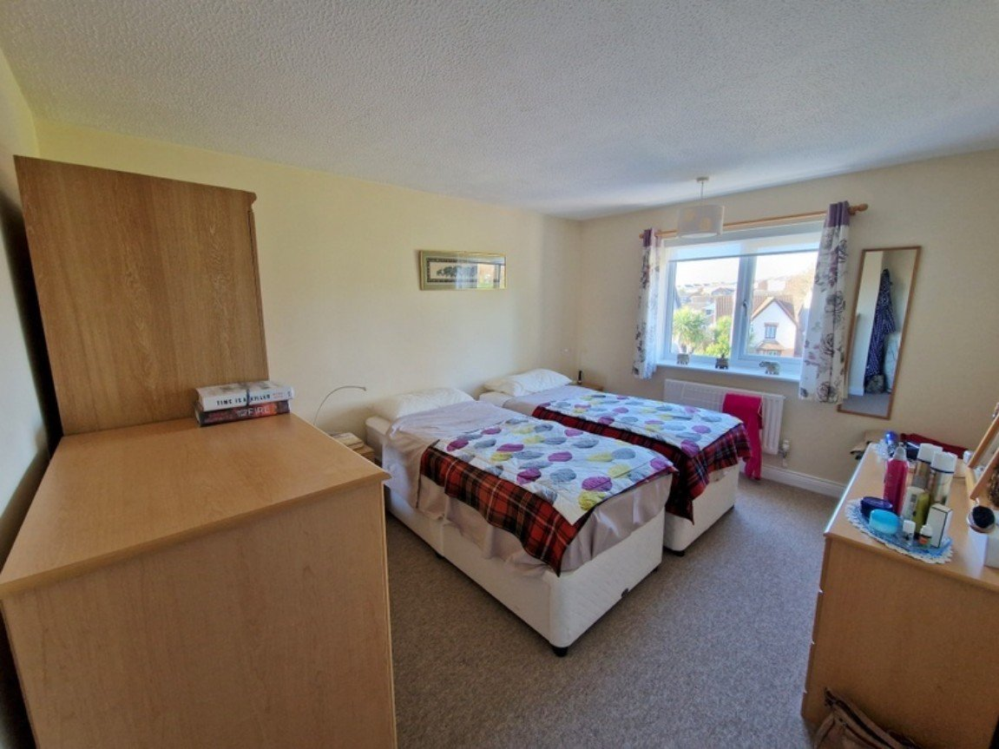
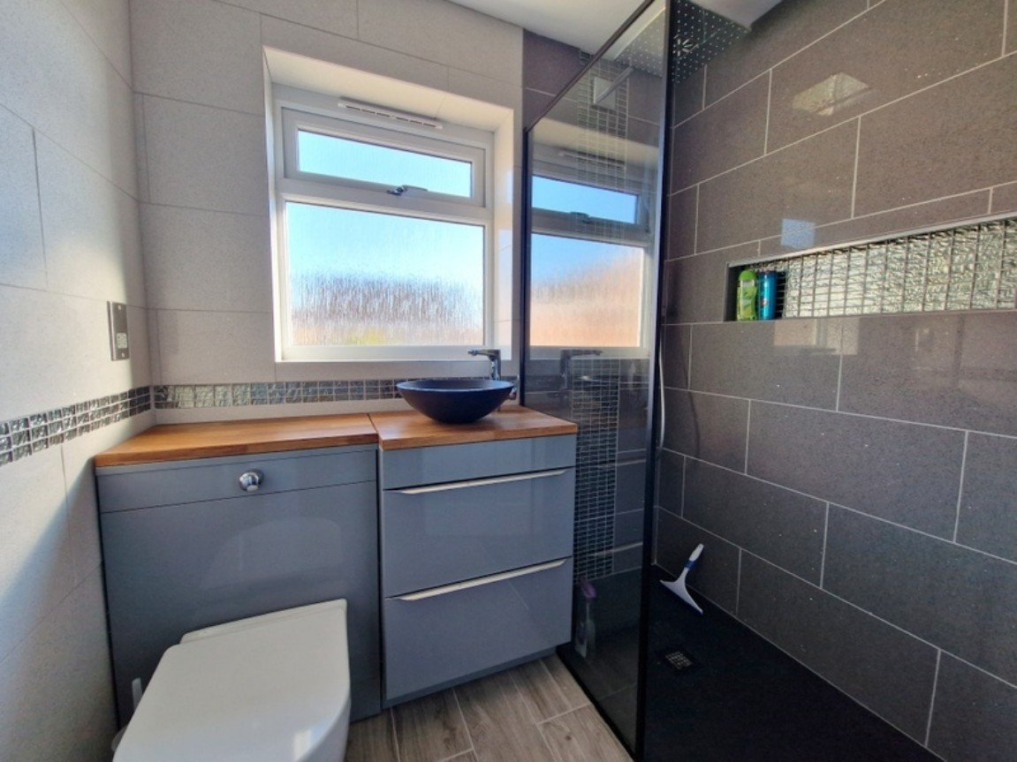
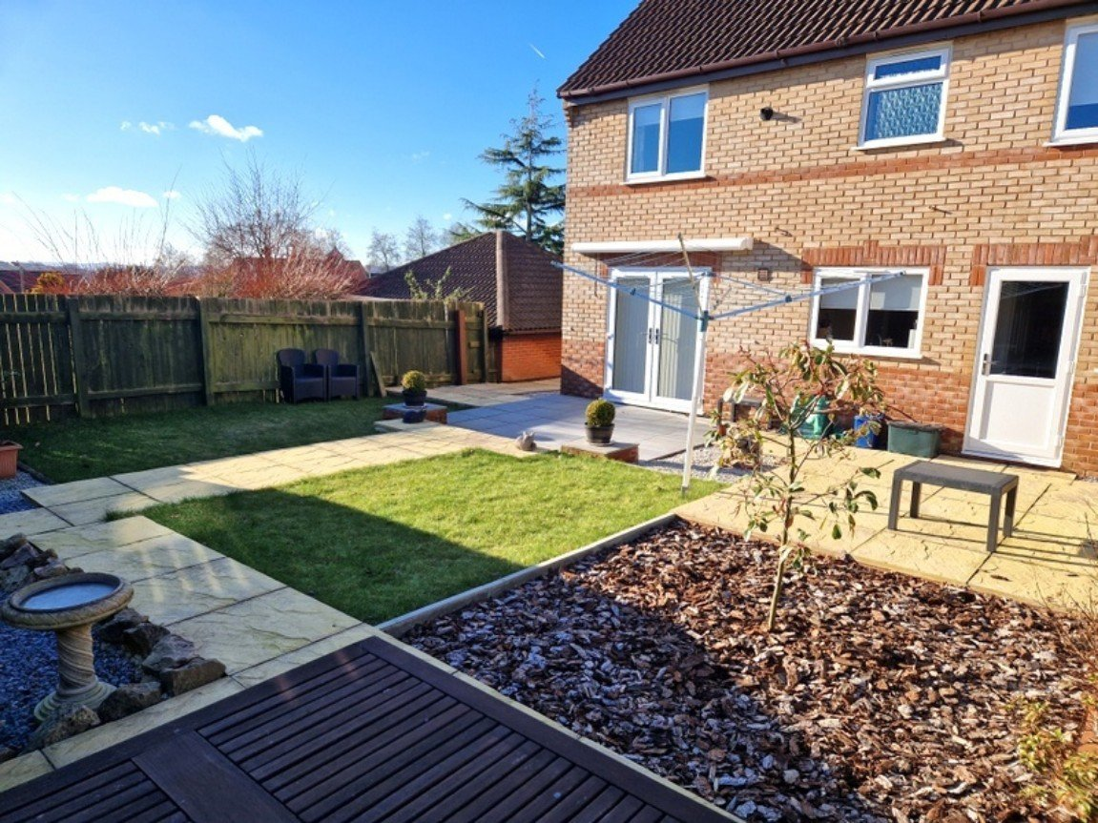
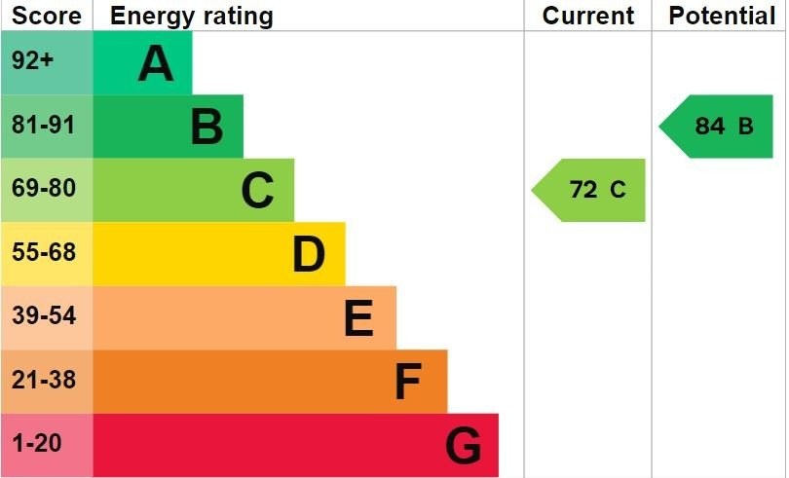
www.pennys.net
15 Cheriswood Avenue, Exmouth, EX8 4HG
GUIDE PRICE £555,000
TENURE Freehold
An Exceptional Detached House Which Has Been Significantly Improved And Enhanced And Enjoys Beautiful Landscaped Gardens, Two Driveways And Extraordinary Sized Detached Garage
Quiet Cul-De-Sac Location • Lounge And Dining Area •
Stylish Modern Kitchen And Utility Area •
Ground Floor Bedroom Four With En-Suite Shower Room/WC •
Three First Floor Double Bedrooms (Formally Arranged As Four Bedrooms) •
En-Suite Shower Room/WC • Main Stunning Shower Room/WC •
uPVC Double Glazed Windows & Gas Central Heating •
Beautiful Landscaped Rear Gardens • Viewing Essential •
Pennys Estate Agents Limited for themselves and for the vendor of this property whose agents they are give notice that:- (1) These particulars do not constitute any part of an offer or a contract. (2) All statements contained in these particulars are made without responsibility on the part of Pennys Estate Agents Limited. (3) None of the statements contained in these particulars are to be relied upon as a statement or representation of fact. (4) Any intending purchaser must satisfy himself/herself by inspection or otherwise as to the correctness of each of the statements contained in these particulars. (5) The vendor does not make or give and neither do Pennys Estate Agents Limited nor any person in their employment has any authority to make or give any representation or warranty whatever in relation to this property.
PENNYS ESTATE AGENTS
2 Rolle House, Rolle Street, Exmouth, Devon, EX8 2SN
Tel: 01395 264111 EMail: help@pennys.net

Slide 2
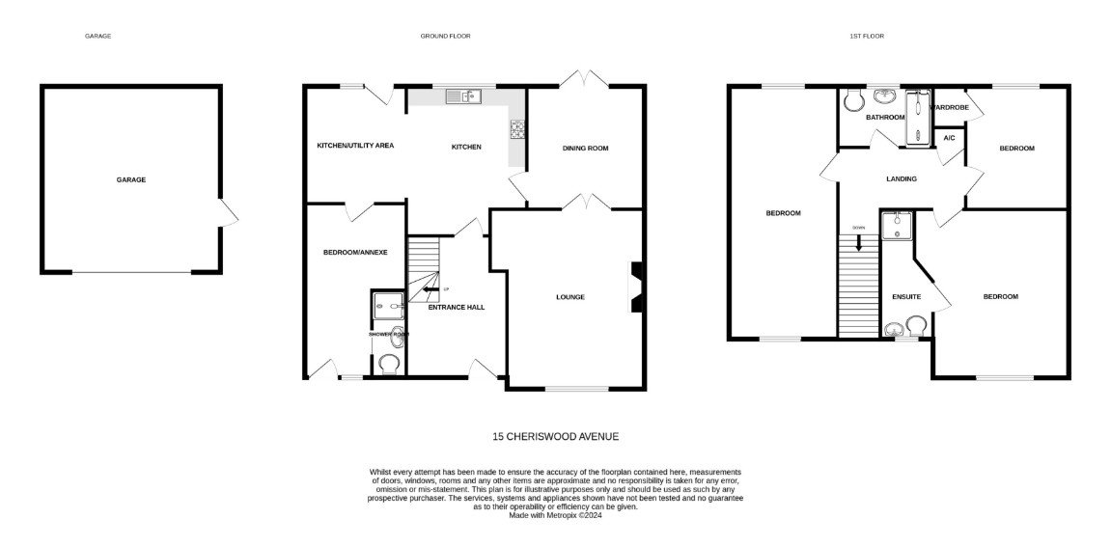
15 Cheriswood Avenue, Exmouth, EX8 4HG
THE ACCOMMODATION COMPRISES: uPVC front door to: RECEPTION HALL: Radiator; stairs to FIRST FLOOR LANDING with useful understairs recess; telephone point. LOUNGE: 4.47m x 3.15m (14'8" x 10'4") plus wall recess. uPVC double glazed window to front aspect; radiator; television point; opening to: DINING ROOM: 2.92m x 2.92m (9'7" x 9'7") uPVC double glazed double doors to rear garden; radiator; opening to: KITCHEN AND UTILITY AREA: 4.93m x 3.61m (16'2" x 11'10") (Also accessed via reception hall) Stylishly fitted with pattern worktop surfaces with tiled surrounds; cupboards, drawers and integrated dishwasher beneath; single drainer sink unit with hose style mixer tap; inset induction hob with stainless steel extractor hood over; built-in oven and grill with drawer cupboards beneath; and cupboard over; integrated fridge freezer with adjoining larder cupboard; worktop surface with plumbing for automatic washing machine and further cupboard under; chrome heated towel rail; recess ceiling LED spotlighting; uPVC double glazed picture window to overlooking rear garden and uPVC double glazed doors to rear garden; telephone point. BEDROOM FOUR/ANNEXE: 4.93m x 2.41m (16'2" x 7'11") Narrowing to 4'7 (1.4m) Accessed via external uPVC double glazed front door with picture window to one side; recess ceiling LED spotlighting; door to KITCHEN. EN-SUITE SHOWER ROOM/WC: Shower cubicle; wash hand basin with cupboard beneath and splashback; WC with push button flush; uPVC double glazed window; heated towel rail. FIRST FLOOR LANDING: Linen cupboard also housing gas boiler; access to roof space; doors to: BEDROOM ONE: 4.04m x 3.12m (13'3" x 10'3") plus door recess. uPVC double glazed window to front aspect with pleasant outlook; radiator. EN-SUITE SHOWER ROOM/WC: Shower cubicle; wash hand basin set into display surface with WC beneath and push button flush; chrome heated towel rail (can be used as an electric radiator with a thermostat control); LED ceiling spotlighting; mirror fronted medicine cabinet; motion sensor light; double glazed window with pattern glass. BEDROOM TWO: 5.46m x 2.44m (17'11" x 8'0") (Formally Two Rooms) Two radiators; uPVC double glazed windows over the front and rear aspects; fitted cupboard over stairwell recess; LED ceiling spotlighting. BEDROOM THREE: 3.4m x 2.49m (11'2" x 8'2") uPVC double glazed window to rear aspect; radiator; built-in wardrobe. SHOWER ROOM/WC: 2.03m x 1.65m (6'8" x 5'5") Stylishly fitted with a contemporary suite beautifully fitted tiled walls with ease of access walk-in double width shower cubicle with splash back screen; circular wash hand basin with free standing mixer tap standing on a wooden display surface with drawer units and WC beneath with push button flush; antique style radiator with heated towel rail; attractive fitted mirror with integrated light; ceiling spotlighting with extractor fan; uPVC double glazed window with pattern glass.
OUTSIDE: Enjoying a generously sized plot with beautifully landscaped gardens, the property enjoys a block paved drive with decorative stone garden directly in front of the house together with a further large driveway leading to a LARGE GARAGE with additional garden to one side of the drive. Side pedestrian gate and patio pathway leads through to a beautiful rear garden enjoying various patio areas to take full advantage of the sun at various parts of the day. Lawn garden areas, flower beds and borders and timber garden shed. There is an electrically operated sun canopy over the main patio area.
EXCEPTIONALLY SIZED GARAGE: 6.63m x 6.32m (21'9" x 20'9") Electric up and over door; power and light connected; uPVC pedestrian door.
FLOOR PLAN:

