Slide 1
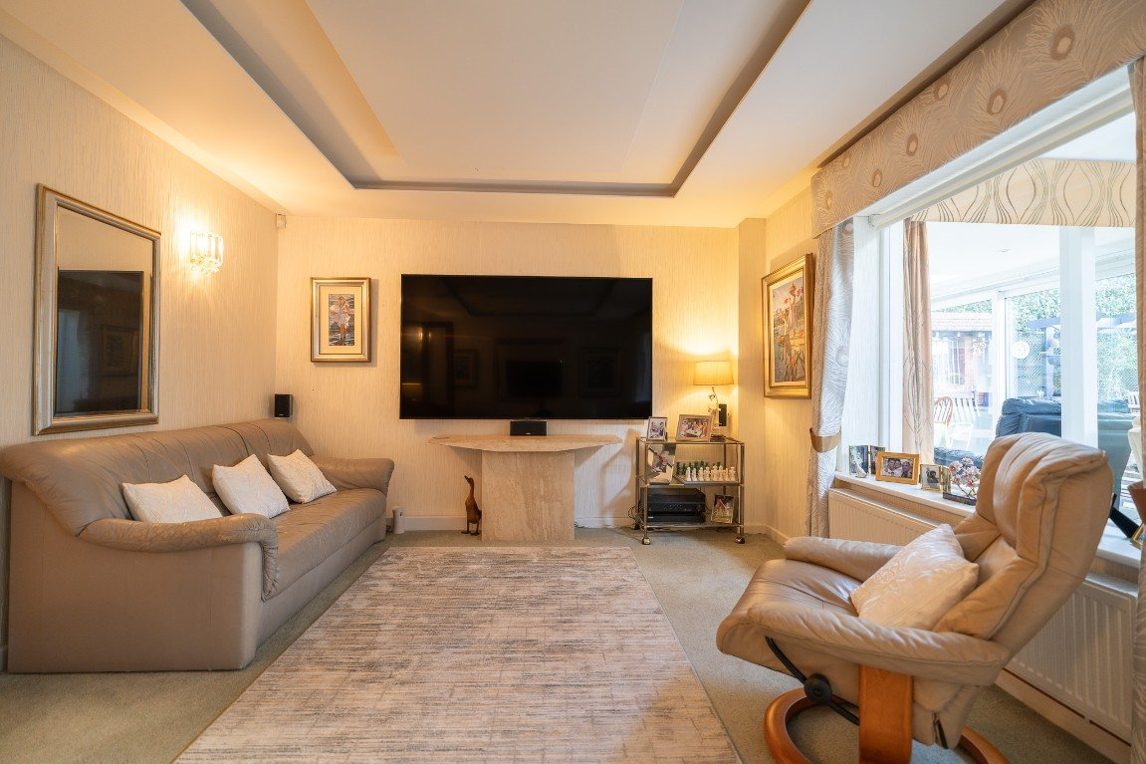
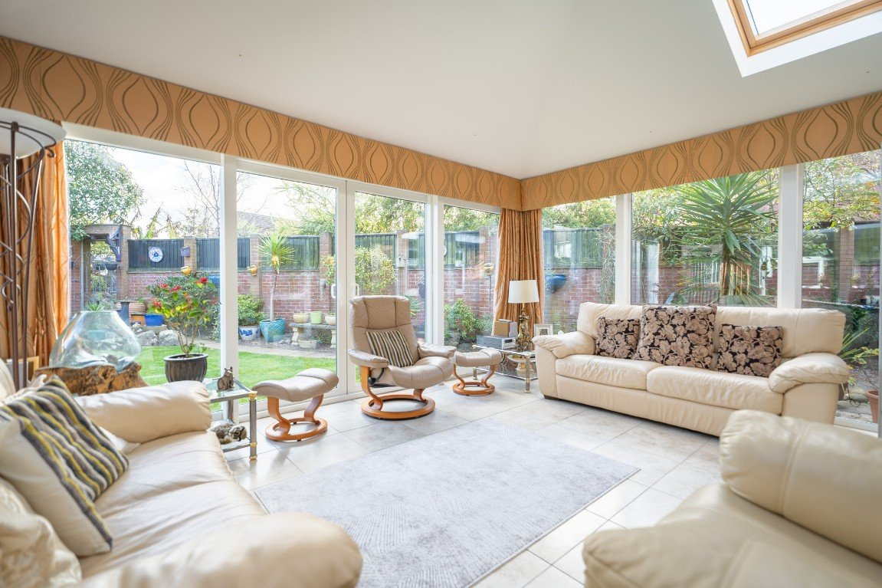
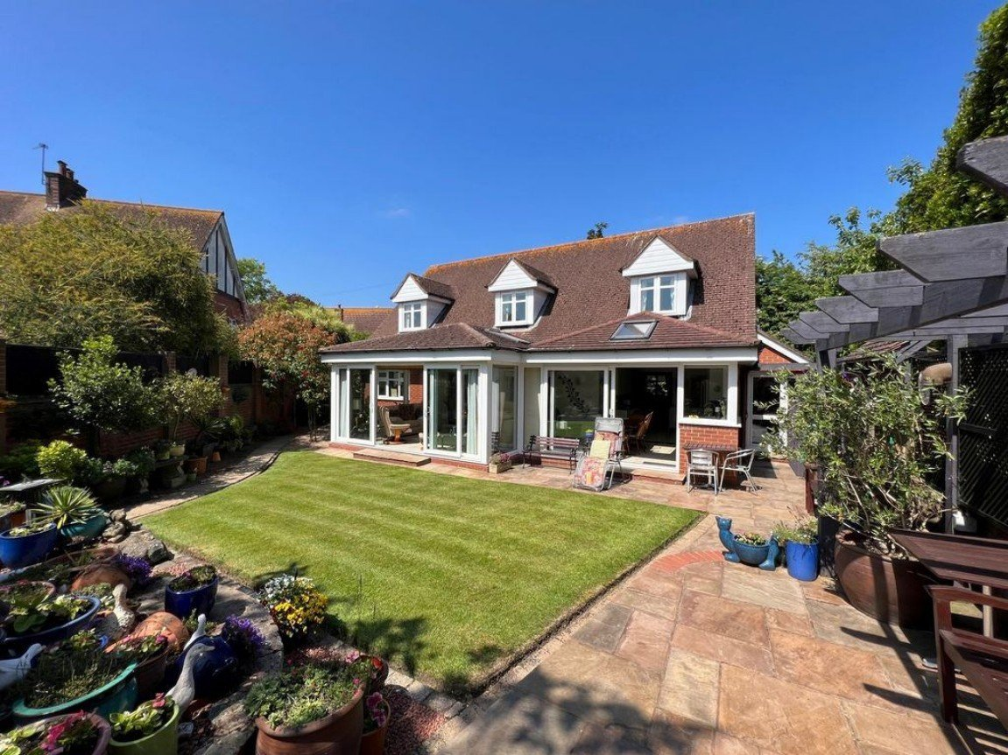
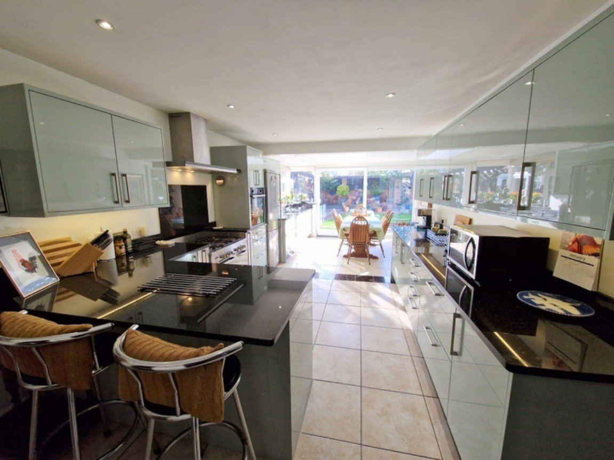
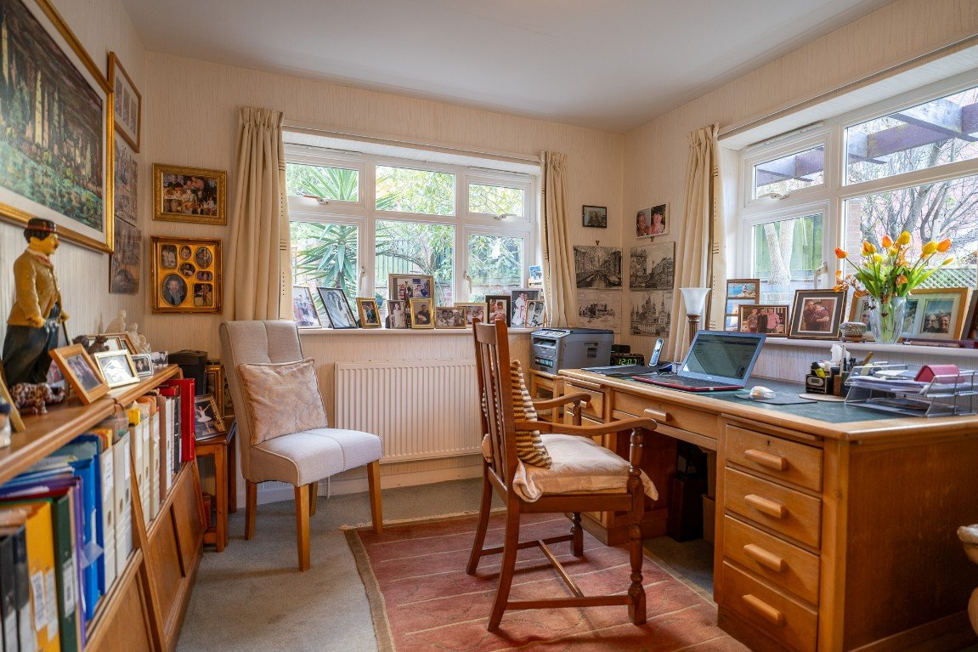
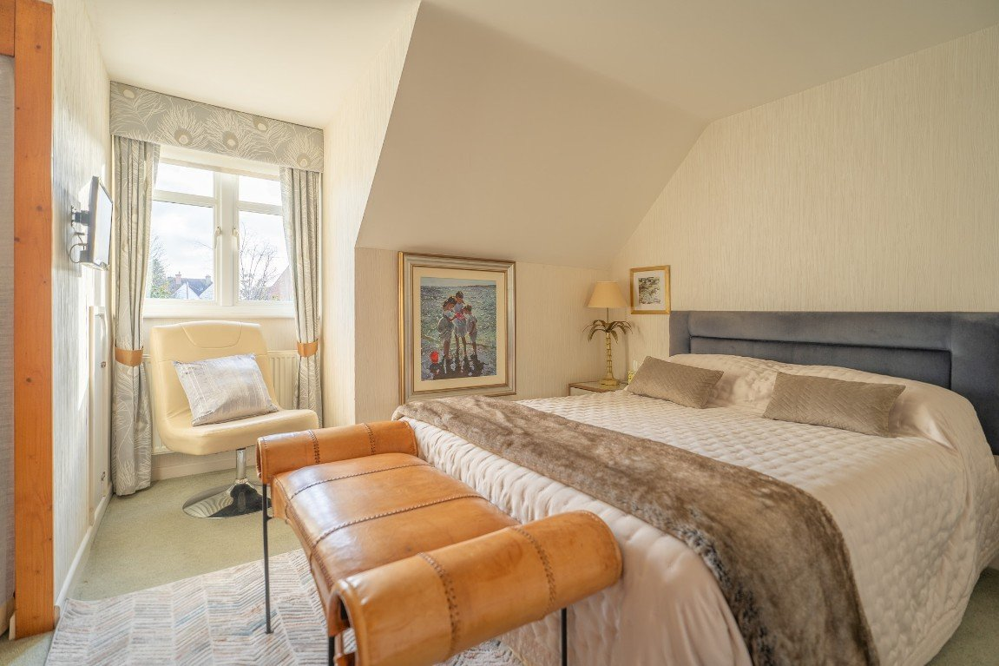
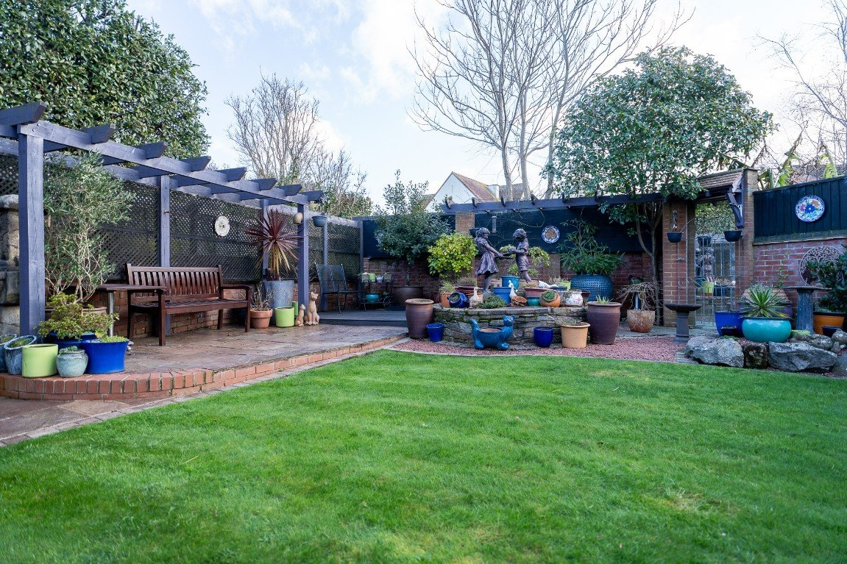
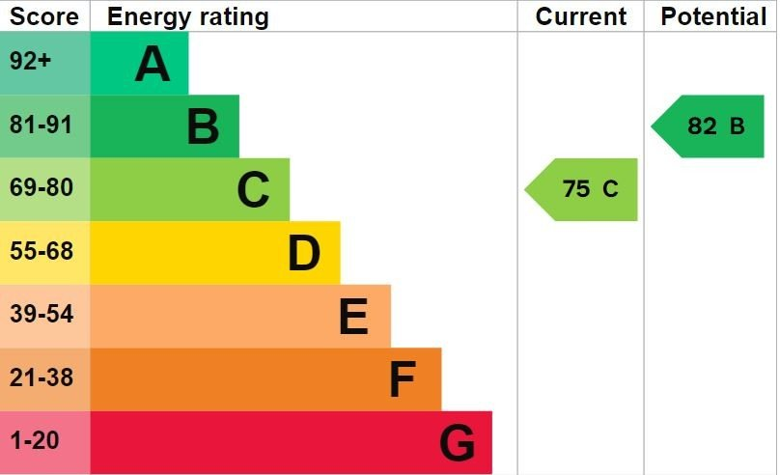
www.pennys.net
3 The Red Lodge, 11 Elwyn Road, Exmouth, EX8 2EL
PRICE £825,000
TENURE Freehold
An Individual Detached Residence Quietly Tucked Away In The Favoured 'Avenues' Area With Attractive Level Gardens And Garage
Stunning Kitchen/Breakfast Room • Lounge • Sun Room
• Study • Snug • Utility Room • Ground Floor Cloakroom/WC •
Four First Floor Bedrooms - Two With Ensuites • Main Shower Room/WC •
Gas Central Heating And Underfloor Heating • Viewing Recommended •
Pennys Estate Agents Limited for themselves and for the vendor of this property whose agents they are give notice that:- (1) These particulars do not constitute any part of an offer or a contract. (2) All statements contained in these particulars are made without responsibility on the part of Pennys Estate Agents Limited. (3) None of the statements contained in these particulars are to be relied upon as a statement or representation of fact. (4) Any intending purchaser must satisfy himself/herself by inspection or otherwise as to the correctness of each of the statements contained in these particulars. (5) The vendor does not make or give and neither do Pennys Estate Agents Limited nor any person in their employment has any authority to make or give any representation or warranty whatever in relation to this property.
PENNYS ESTATE AGENTS
2 Rolle House, Rolle Street, Exmouth, Devon, EX8 2SN
Tel: 01395 264111 EMail: help@pennys.net

Slide 2
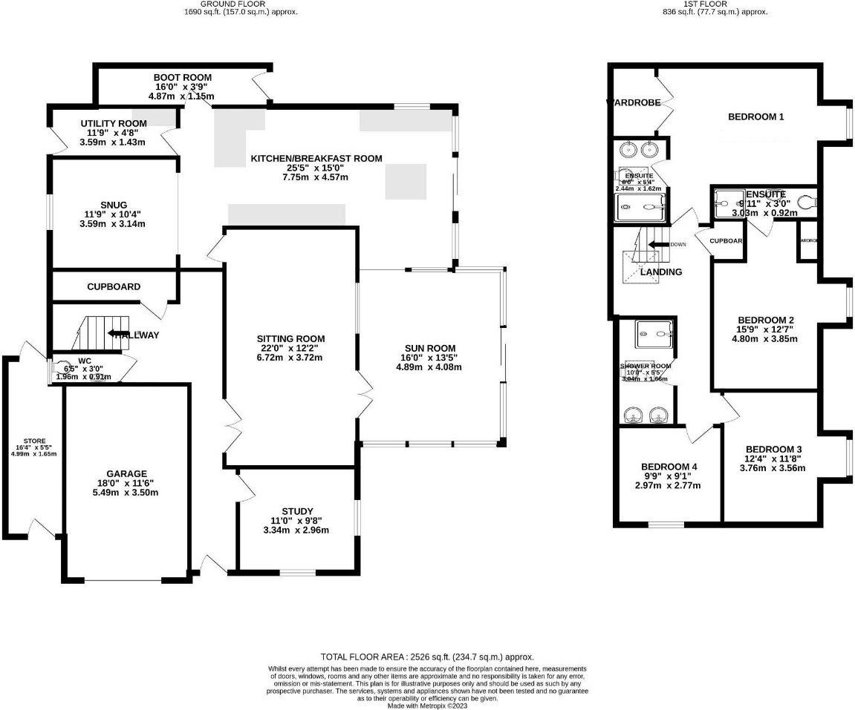
3 The Red Lodge, 11 Elwyn Road, Exmouth, EX8 2EL
Elwyn Road is located in the sought after 'Avenues' area of Exmouth, a mature & leafy area of the town. Exmouth boasts over three miles of glorious golden sands, Exmouth is renowned nationally as a regional centre for water sports activities - especially kite surfing, sailing & windsurfing. Exmouth is a bustling town with a vibrant shopping centre that also hosts a wide range of leisure and entertainment facilities, including a cinema, sports amenities, M& S food hall, a range of excellent restaurants. It is only 12 miles by road or rail from the Cathedral City of Exeter, with its Intercity railway station, international airport, connection to the M5 motorway and all major shops and facilities. THE ACCOMMODATION COMPRISES: Covered uPVC entrance door with pattern glass to: RECEPTION HALL: Radiator; tiled floor; two radiators; stairs to first floor; built-in understairs cupboard; access to GARAGE; doors to: CLOAKROOM/WC: White suite with low level WC; pedestal wash hand basin with tiled splashback; tiled floor; opaque double glazed window; radiator; WC. SITTING ROOM: 6.71m x 3.71m (22'0" x 12'2") Window and double glazed doors into SUN ROOM; LED concealed ceiling lighting with remote control; radiator; television point. SUN ROOM: 4.88m x 4.09m (16'0" x 13'5") Double glazed windows to three sides and double glazed sliding doors leading out onto the rear garden; radiator; electric underfloor heating; tiled flooring; two electric operated velux windows; opening through to the: KITCHEN/BREAKFAST ROOM: 7.75m x 4.57m (25'5" x 15'0") A bright and spacious room with granite worktop surfaces and matching upstands; inset one and a half bowl sink unit with drainer and mixer tap; cupboards and drawers under with fitted Range style cooker; built-in oven; space for fridge freezer; integrated dishwasher; matching wall mounted cupboards with under-lighting; fitted Fisher & Paykel cooker hood with down lighters; integrated fridge and freezer; down lighters; double glazed velux window; double glazed window to side and rear and double glazed sliding doors to rear; two radiators; tiled flooring; glazed door leading back to hallway' granite breakfast bar; opening through to SNUG; doors leading off to UTILITY ROOM and SIDE LOBBY. SNUG: 3.58m x 3.15m (11'9" x 10'4") Double glazed window to rear; two sun pipes providing additional natural light; tiled floor; radiator. UTILITY ROOM: 3.58m x 1.42m (11'9" x 4'8") Worktop surface with matching upstand; inset stainless steel sink with drainer and cupboards under; space for washing machine and tumble dryer; additional wall mounted cupboards; wall mounted gas fired boiler serving domestic hot water and gas central heating; tiled floor; radiator; double glazed door leading to OUTSIDE. SIDE LOBBY: 4.88m x 1.14m (16'0" x 3'9") A useful area with tiled floor; radiator; double glazed door to rear garden. FIRST FLOOR LANDING: Turning staircase with two roof void storage cupboards.
Built-in airing cupboard housing hot water cylinder and shelving; hatch to roof; double glazed velux window; doors to: BEDROOM ONE: 4.95m x 4.47m (16'3" x 14'8") Double glazed dormer style window to rear aspect; radiator; walk-in double width wardrobe with shelving and handing space; door to: ENSUITE SHOWER ROOM/WC: 2.44m x 1.63m (8'0" x 5'4") White suite comprising a large walk-in shower cubicle with built-in shower head; low level WC; twin wash hand basins with mixer tap and tiled splashbacks; tiled floor; chrome runged radiator; double glazed velux window; down lighters; extractor fan; light with shaver socket. BEDROOM TWO: 4.8m x 3.84m (15'9" x 12'7") Double glazed window to rear aspect; open fronted wardrobe; radiator; door to: ENSUITE SHOWER ROOM/WC: 3.02m x 0.91m (9'11" x 3'0") White suite comprising oversized walk-in shower with full tiled surround and built-in shower unit; pedestal wash hand basin with mixer tap; low level WC; tiled floor; walls in half height tiled surround; white runged radiator; shaver point.
BEDROOM THREE: 3.76m x 3.56m (12'4" x 11'8") Dormer style double glazed window to rear aspect and double glazed window to side aspect; radiator. BEDROOM FOUR: 2.97m x 2.77m (9'9" x 9'1") Double glazed window to side aspect; radiator; open fronted wardrobe. MAIN SHOWER ROOM/WC: 3.05m x 1.65m (10'0" x 5'5") Oversized shower cubicle with built-in shower in full tiled surround; low level WC; twin wash hand basins in tiled surrounds both with mixer taps; double glazed velux window; fitted mirror; light with shaver point; down lighters; chrome runged radiator. OUTSIDE: The property is approached via a shared private driveway which in turn leads onto the private driveway for this property via iron gates. The driveway is block paved providing parking for 2-3 cars. There is a SIDE STORE: 5.79m x 1.88m (19'0" x 6'2") with double glazed doors to front and rear. An iron gate gives access around the side of the property to the rear garden.
The rear garden is a delight and has been landscaped by the current owners to provide low maintenance. Wall and fence enclosed southerly facing garden with an area of central lawn, paved patio and decked area; pergola with covered seating area. GARAGE: 5.49m x 3.51m (18'0" x 11'6") Remote controlled roller door; opaque double glazed window to side; power and light connected.
FLOOR PLAN:

