Slide 1
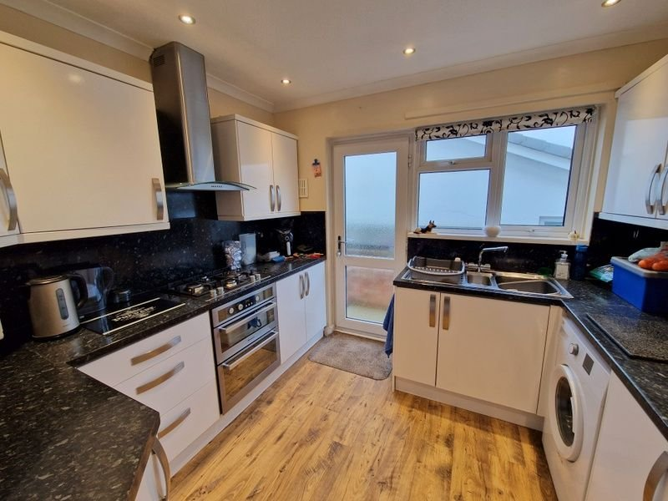
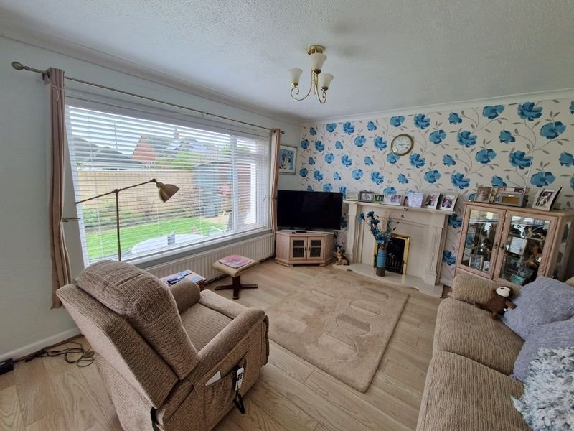
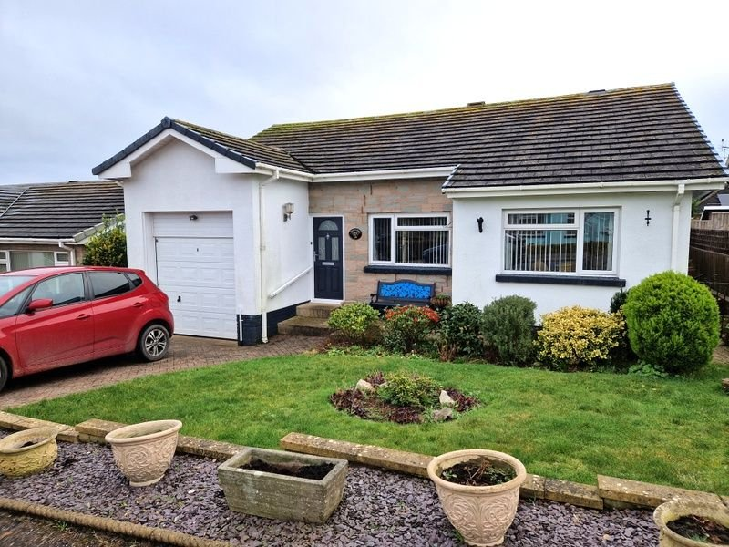
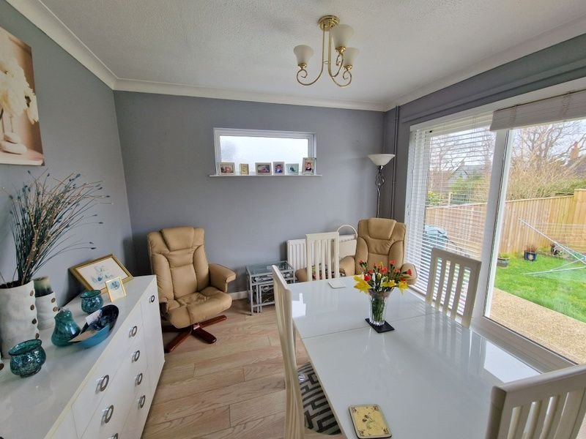
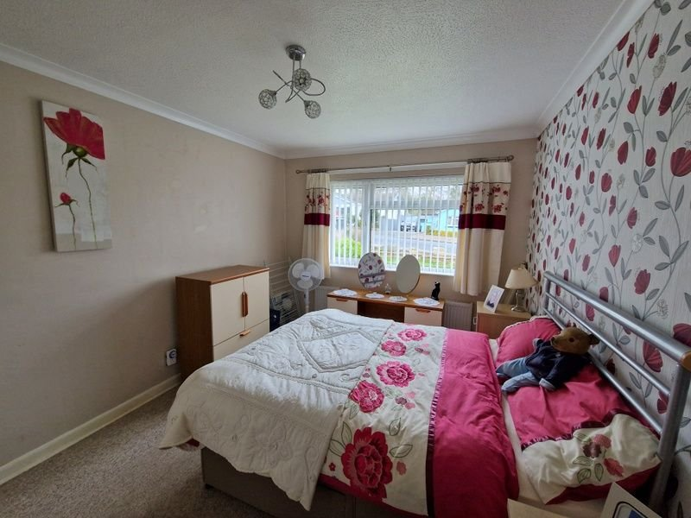
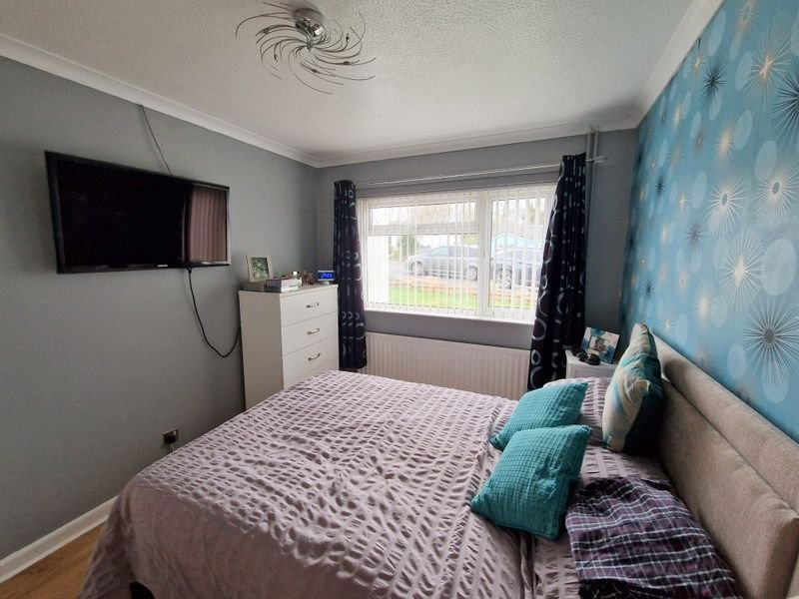
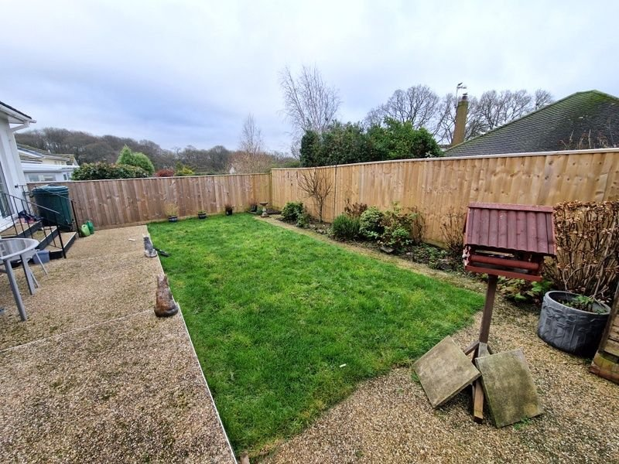
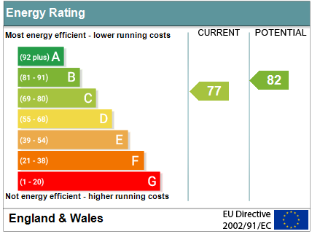
www.pennys.net
116 Parkside Drive, Exmouth, EX8 4LZ
PRICE £410,000
TENURE Freehold
A Well Presented Three Bedroom Detached Bungalow Located In A Sought After Area Enjoying A Southerly Aspect Rear Garden, Block Paved Drive And Garage
Reception Hall • Lounge And Dining Room •
Modern Kitchen • Three Bedrooms • Modern Shower Room/WC •
Gas Central Heating • Double Glazed Windows •
Viewing Recommended •
Pennys Estate Agents Limited for themselves and for the vendor of this property whose agents they are give notice that:- (1) These particulars do not constitute any part of an offer or a contract. (2) All statements contained in these particulars are made without responsibility on the part of Pennys Estate Agents Limited. (3) None of the statements contained in these particulars are to be relied upon as a statement or representation of fact. (4) Any intending purchaser must satisfy himself/herself by inspection or otherwise as to the correctness of each of the statements contained in these particulars. (5) The vendor does not make or give and neither do Pennys Estate Agents Limited nor any person in their employment has any authority to make or give any representation or warranty whatever in relation to this property.
PENNYS ESTATE AGENTS
2 Rolle House, Rolle Street, Exmouth, Devon, EX8 2SN
Tel: 01395 264111 EMail: help@pennys.net

Slide 2
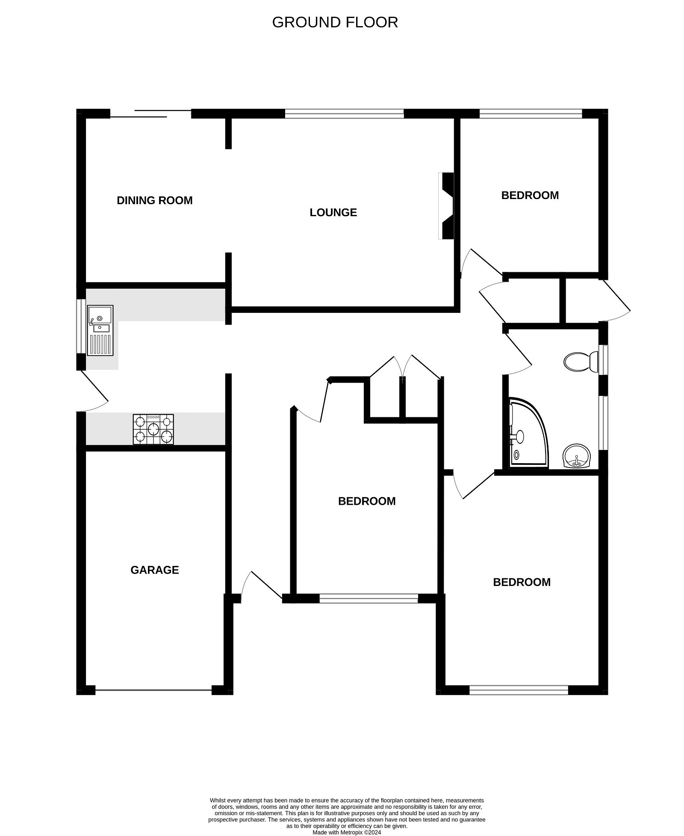
116 Parkside Drive, Exmouth, EX8 4LZ
THE ACCOMMODATION COMPRISES: Composite front door to: RECEPTION HALL: Wood effect flooring; two radiators; recess ceiling spotlighting; telephone point; two coats cupboards; linen cupboard housing modern gas boiler. KITCHEN: 3m x 2.79m (9'10" x 9'2") A modern kitchen comprising of gloss finish worktop surfaces with matching splashbacks; cupboards, drawer units and plumbing for an automatic washing machine beneath; inset one and a quarter bowl sink unit with mixer tap; inset four ring gas hob with oven below and stainless steel chimney steel extractor hood over; wall mounted cupboards; space for fridge freezer; double glazed window to side aspect; recess ceiling spotlighting; double glazed window to outside. LOUNGE: 4.22m x 3.61m (13'10" x 11'10") Enjoying a southerly aspect with double glazed window; television point; radiator; attractive fireplace housing coal living flame effect gas fire; wood effect flooring; archway to: DINING ROOM: 3.18m x 2.72m (10'5" x 8'11") A southerly aspect room; radiator; sliding double glazed patio doors to rear garden; double glazed picture window with pattern glass. BEDROOM ONE: 3.96m x 2.82m (13'0" x 9'3") Double glazed window to front aspect; radiator; wood effect flooring; television point. BEDROOM TWO: 4.14m x 3m (13'7" x 9'10") Double glazed window to front aspect; radiator. BEDROOM THREE: 3.05m x 2.72m (10'0" x 8'11") Double glazed window to rear southerly aspect; radiator. SHOWER ROOMWC: 2.84m x 1.65m (9'4" x 5'5") Large shower cubicle; vanity wash hand basin with fitted drawer and display lights over; WC with push button flush; chrome heated towel rail; fully tiled walls; color co-ordinated tiled floor; two double glazed windows with pattern glass; recess ceiling spotlighting; ceiling extractor fan. OUTSIDE: To the front of the property there is a lawn garden edged with flower beds; block paved driveway to GARAGE; outside light. The rear garden is a southerly aspect with stone raised patio and pathway; lawn garden; timber shed; outside light; side gates and pathways to each side of the bungalow leading back to the front of the property. GARAGE: 4.7m x 2.72m (15'5" x 8'11") Electric up and over door; power and light connected.
FLOOR PLAN:

