Slide 1
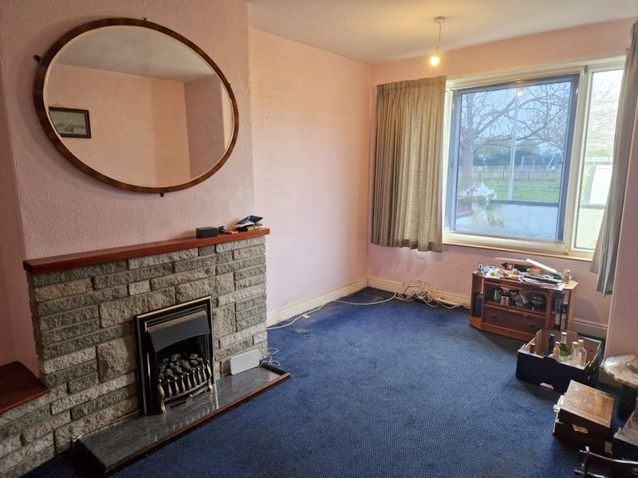
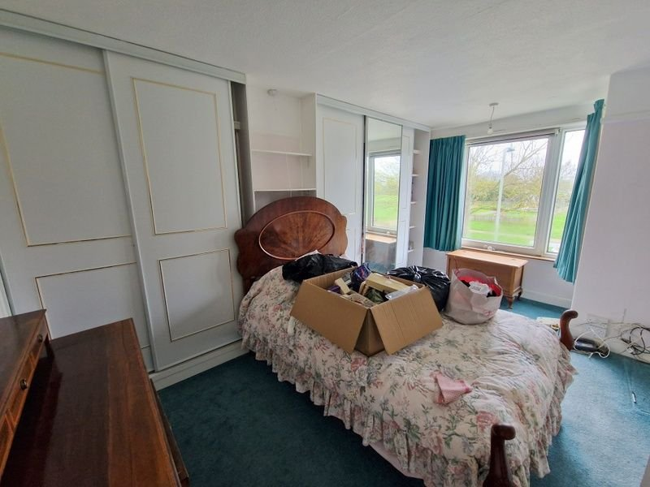
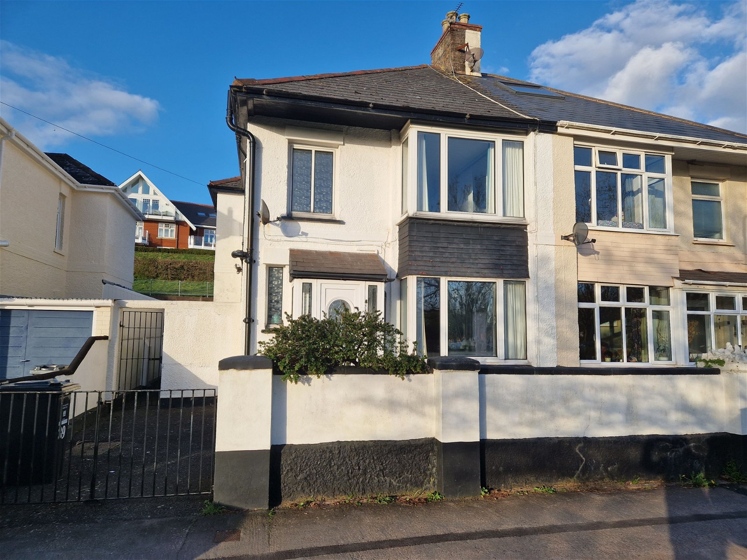
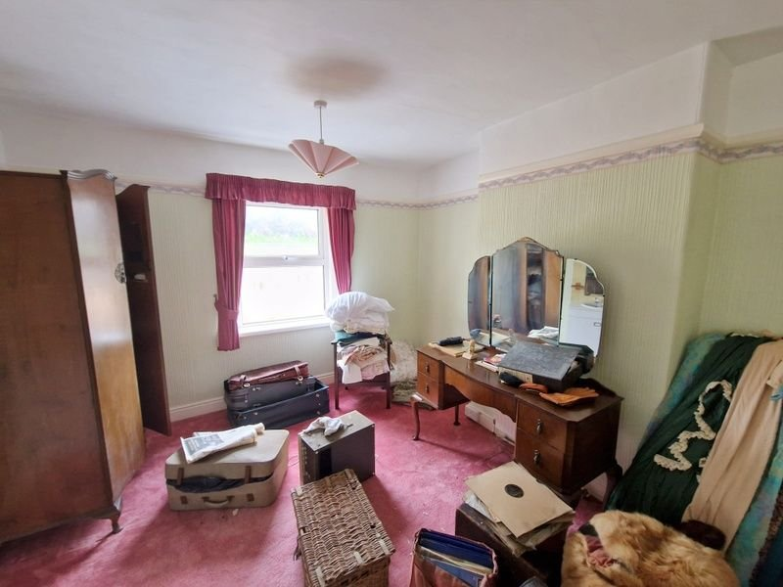
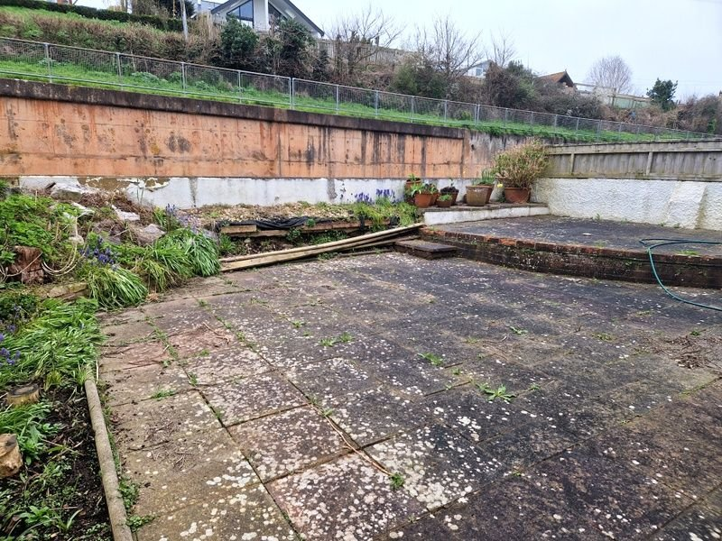
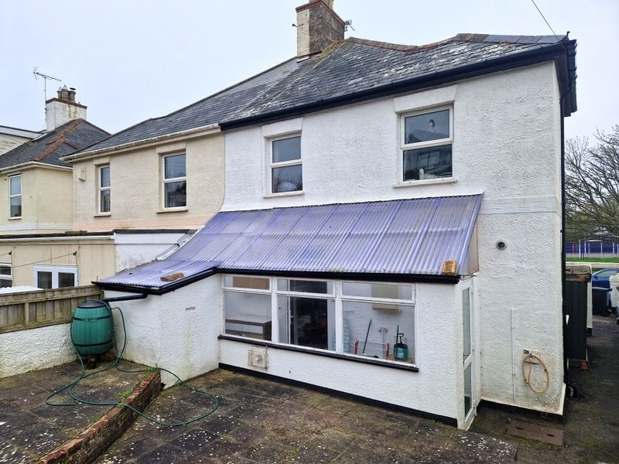
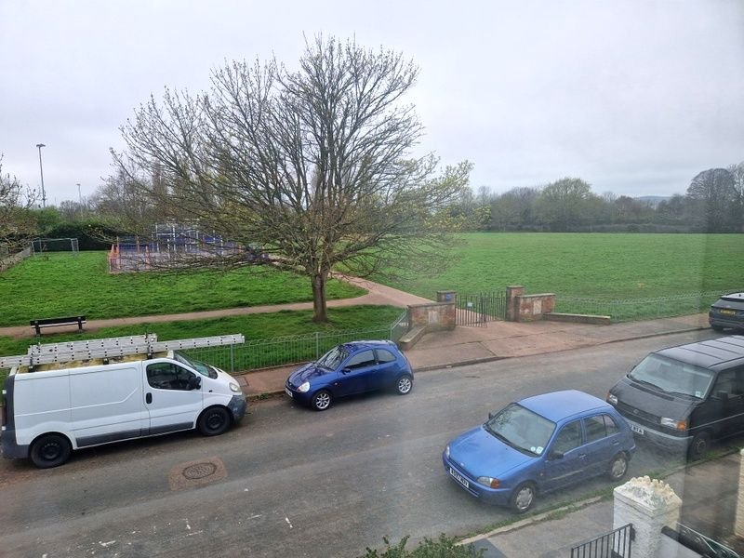
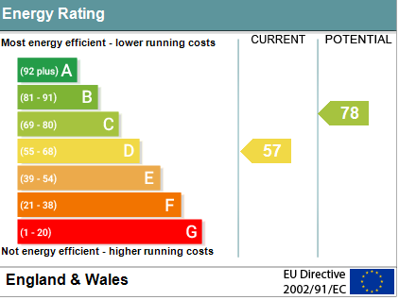
www.pennys.net
39 Carter Avenue, Exmouth, EX8 2EF
GUIDE PRICE £385,000
TENURE Freehold
A 1930's Semi Detached House Enjoying An Excellent Location Overlooking Carter Park And Offering Easy Access To Exe-Trail Cycle Path, Train Station And Town Centre
Lounge • Open Plan Kitchen/Dining Room • Cloakroom/WC •
Three Bedrooms • Bathroom/WC •
Off Road Parking Space • Gas Central Heating • Double Glazed Windows • General Programme Of Refurbishment Required • No Onward Chain •
Pennys Estate Agents Limited for themselves and for the vendor of this property whose agents they are give notice that:- (1) These particulars do not constitute any part of an offer or a contract. (2) All statements contained in these particulars are made without responsibility on the part of Pennys Estate Agents Limited. (3) None of the statements contained in these particulars are to be relied upon as a statement or representation of fact. (4) Any intending purchaser must satisfy himself/herself by inspection or otherwise as to the correctness of each of the statements contained in these particulars. (5) The vendor does not make or give and neither do Pennys Estate Agents Limited nor any person in their employment has any authority to make or give any representation or warranty whatever in relation to this property.
PENNYS ESTATE AGENTS
2 Rolle House, Rolle Street, Exmouth, Devon, EX8 2SN
Tel: 01395 264111 EMail: help@pennys.net

Slide 2
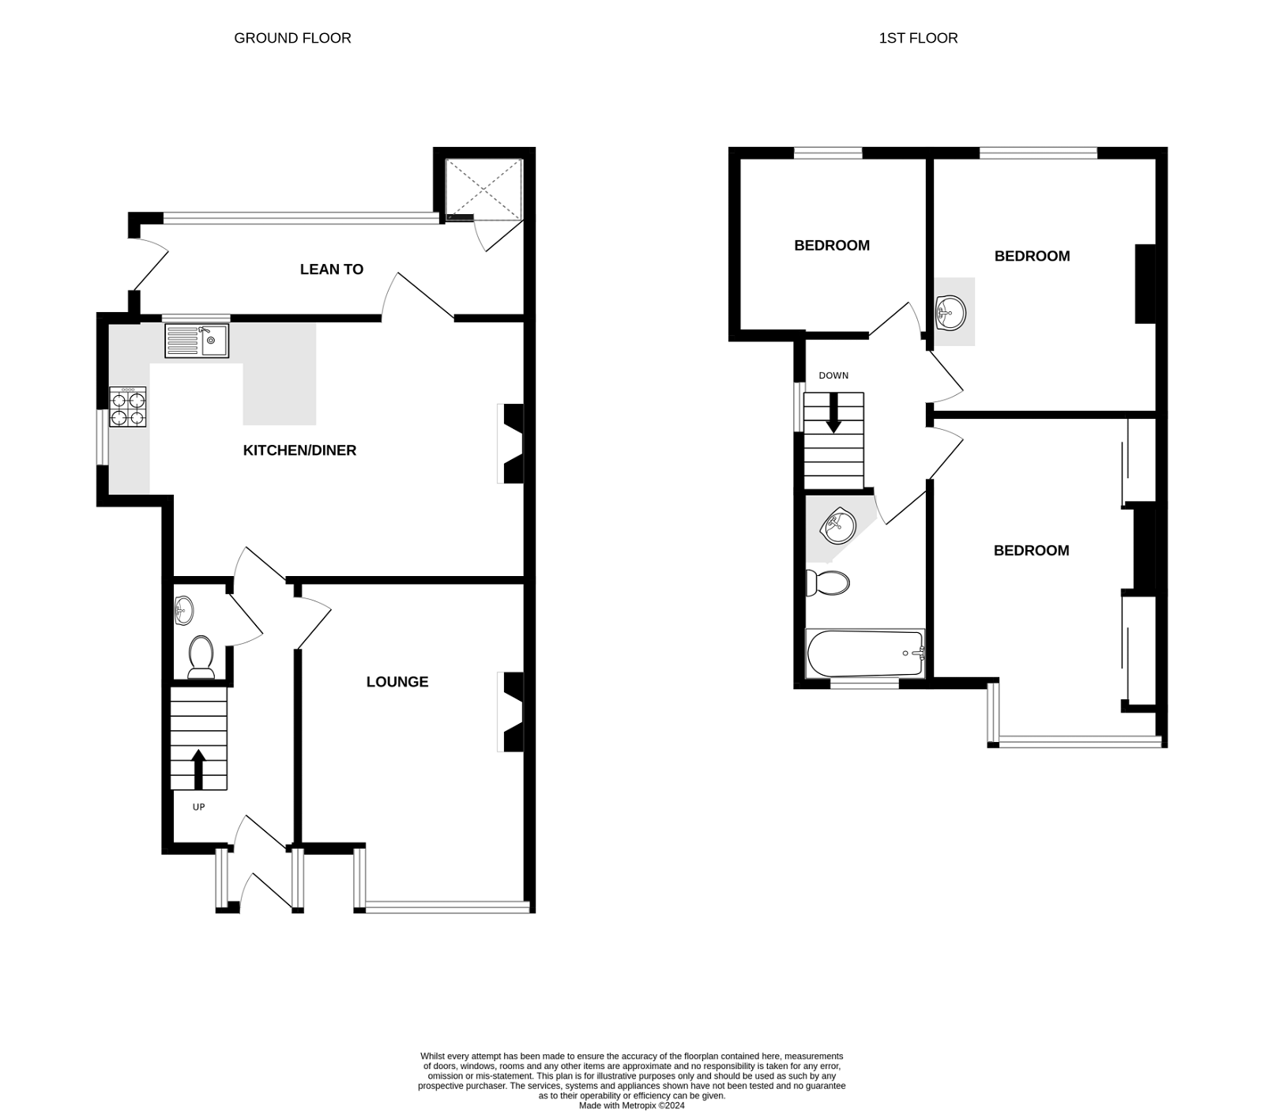
39 Carter Avenue, Exmouth, EX8 3EF
THE ACCOMMODATION COMPRISES: uPVC front door to: ENTRANCE PORCH: Tiled floor; double glazed windows; inner door with pattern glass to: RECEPTION HALL: Stairs to first floor landing with understairs cupboard beneath; cupboard housing electric consumer unit; radiator. CLOAKROOM/WC: Pedestal wash hand basin; WC with push button flush; extractor fan; part tiled walls. LOUNGE: 4.8m x 3.38m (15'9" x 11'1") into double glazed square bay window to front aspect overlooking the park; living flame coal effect gas fire housed in stone fire surround with television display area to one side and wood mantle over; radiator; television point. KITCHEN/DINING ROOM: 6.27m x 3.81m (20'7" x 12'6") An open plan room comprising of: KITCHEN AREA: Wood effect worktop surfaces extended to provide a breakfast bar area with cupboards and drawer units beneath; inset single drainer sink unit; four ring gas hob; tiled surrounds; wall mounted Glow Worm gas boiler; double glazed window to side aspect; window to rear aspect; DINING AREA: Exposed brick fireplace with display areas to either side with wood mantle over and housing coal effect gas living flame fire; television point; radiator; double glazed door to GARDEN ROOM. GARDEN ROOM: 5.49m x 1.52m (18'0" x 5'0") A useful area with windows overlooking the rear garden; fitted cupboards across to store cupboard; double glazed door to rear garden. FIRST FLOOR LANDING: Picture rails; double glazed window to side aspect; doors to: BEDROOM ONE: 4.93m x 3.05m (16'2" x 10'0") into double glazed square bay window to front aspect enjoying views over Carter Park; radiator; built-in wardrobes; television point; telephone point. BEDROOM TWO: 3.86m x 3.51m (12'8" x 11'6") Double glazed window to rear aspect; radiator; vanity wash hand basin with tiled splash back and mirror over; picture rail. BEDROOM THREE: 2.77m x 2.74m (9'1" x 9'0") Double glazed window to rear aspect; radiator; picture rail; access to loft space. BATHROOM/WC: Bath with shower attachment and shower screen; wash hand basin set in display surface; WC with concealed cistern; radiator; fully tiled walls and wall mirror; double glazed window with pattern glass.
OUTSIDE: Double wrought iron gates with dropped kerb to tarmac hard standing area providing space for a small car, raised flower bed, side gate leads to path with shed leading to rear garden which comprises of a good size patio terrace area edged with flower beds and outside tap.
FLOOR PLAN:

