Slide 1
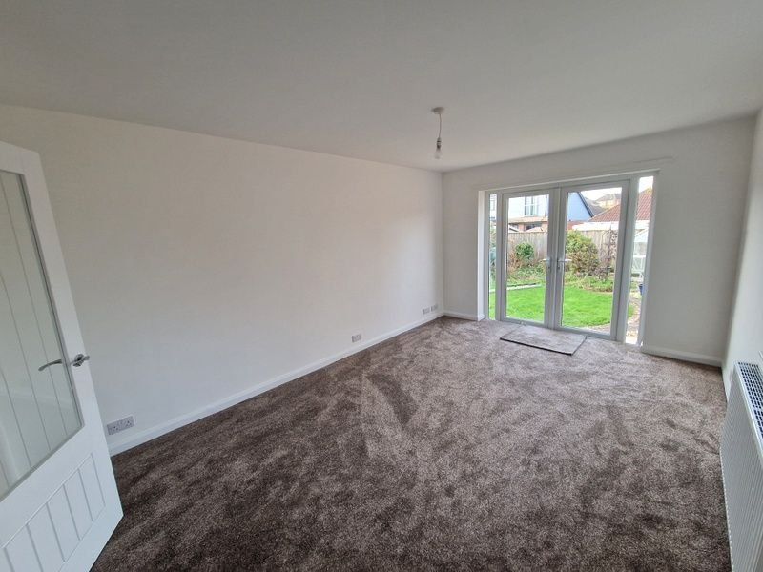
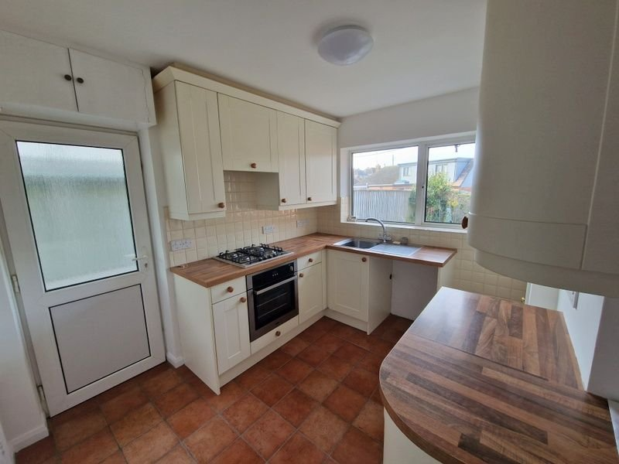
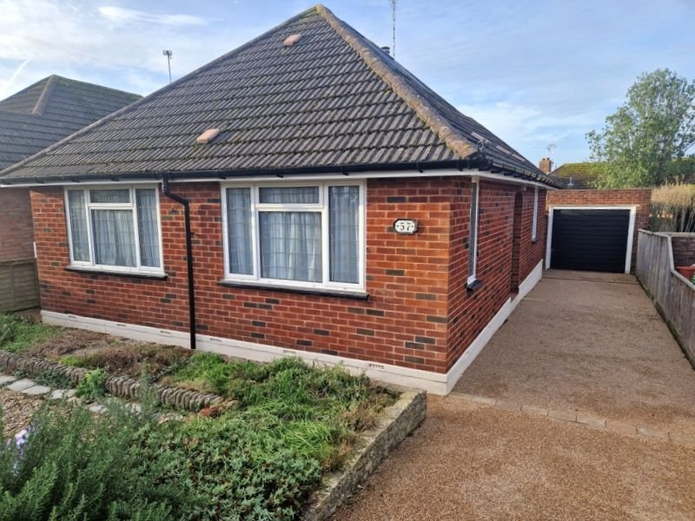
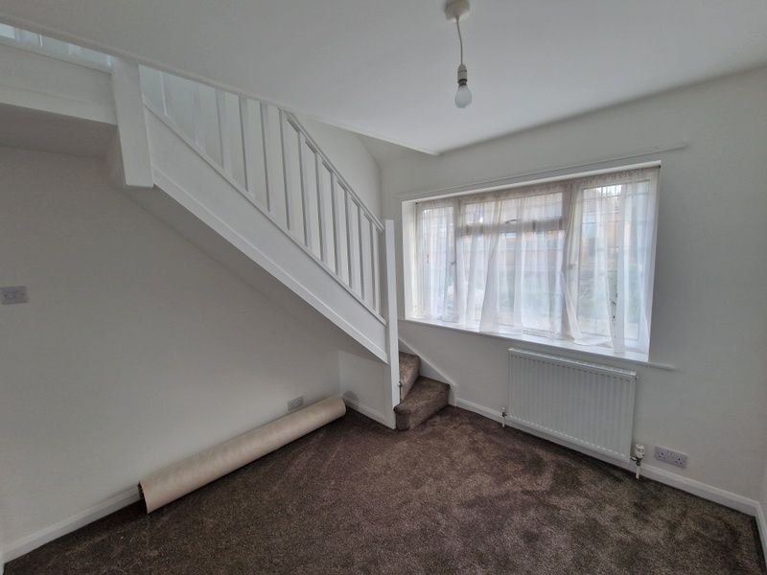
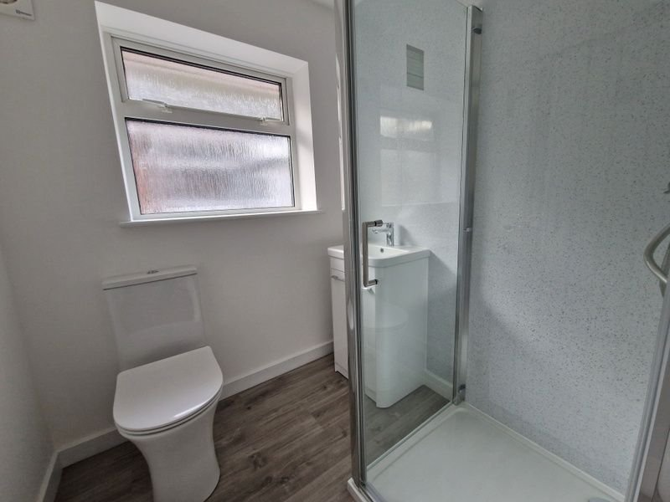
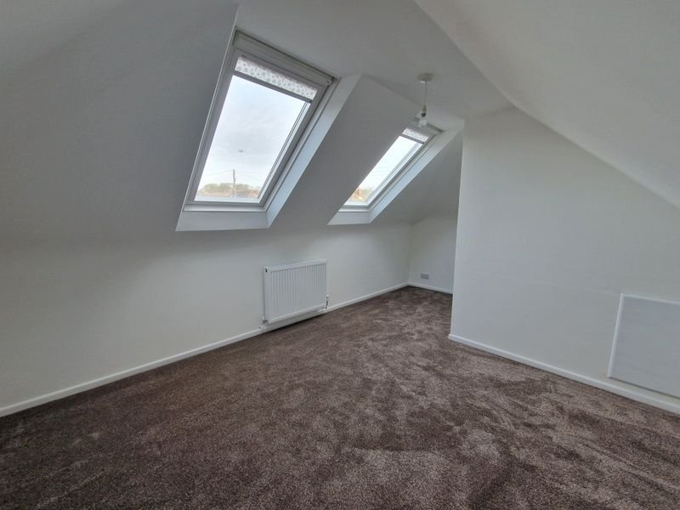
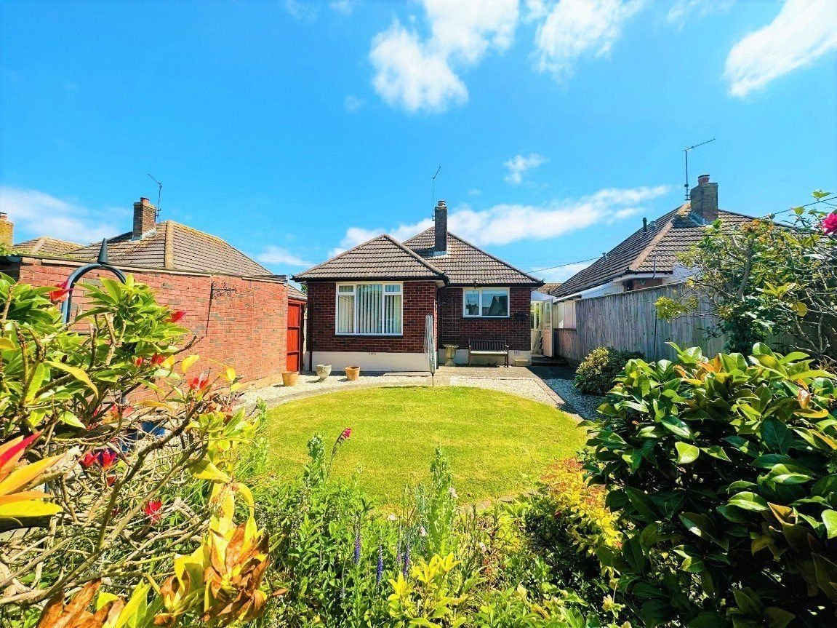
www.pennys.net
57 Elmfield Crescent, Exmouth, EX8 3BW
GUIDE PRICE £390,000
TENURE Freehold
A Beautifully Recently Modernised Detached Chalet Style Bungalow Located In A Favoured And Convenient Location
New Central Heating System, New Internal Doors & New Floor Coverings •
Rewired • Lounge With Double Glazed Doors To Garden •
Fitted Kitchen • Two Ground Floor Bedrooms •
Newly Installed Stylish Shower Room/WC • First Floor Bedroom Three •
Lovely Gardens • Stone Resin Driveway • Garage •
No Onward Chain •
EPC TO FOLLOW:
Pennys Estate Agents Limited for themselves and for the vendor of this property whose agents they are give notice that:- (1) These particulars do not constitute any part of an offer or a contract. (2) All statements contained in these particulars are made without responsibility on the part of Pennys Estate Agents Limited. (3) None of the statements contained in these particulars are to be relied upon as a statement or representation of fact. (4) Any intending purchaser must satisfy himself/herself by inspection or otherwise as to the correctness of each of the statements contained in these particulars. (5) The vendor does not make or give and neither do Pennys Estate Agents Limited nor any person in their employment has any authority to make or give any representation or warranty whatever in relation to this property.
PENNYS ESTATE AGENTS
2 Rolle House, Rolle Street, Exmouth, Devon, EX8 2SN
Tel: 01395 264111 EMail: help@pennys.net

Slide 2
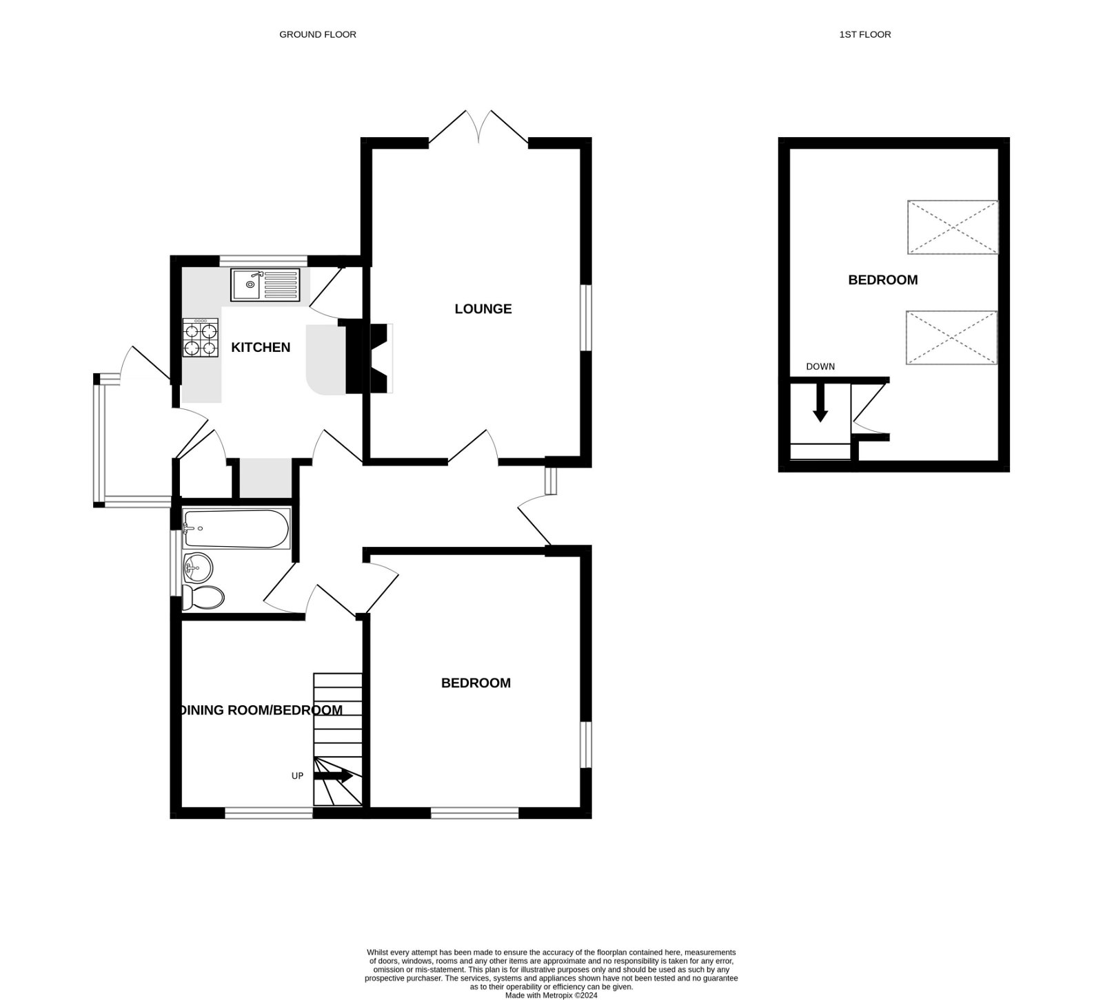
57 Elmfield Crescent, Exmouth, EX8 3BW
THE ACCOMMODATION COMPRISES: Open entrance porch with double glazed front door with leaded light window inset and matching picture window to: RECEPTION HALL: Radiator; thermostat control; smoke detector; storage cupboard over doorway recess; part glazed door to: LOUNGE/DINING ROOM: 4.85m x 3.28m (15'11" x 10'9") A bright dual aspect room with double glazed window to side aspect and double glazed double doors to rear garden; television point; radiator. KITCHEN: 3m x 2.87m (9'10" x 9'5") Maximum overall measurement into wall recess. Fitted with a range of modern cream units under wood effect work top surfaces with tiled splashback areas; wall mounted cupboards; stainless steel sink and drainer unit with mixer tap over; space and plumbing for washing machine; built-in gas oven with four ring gas hob and extractor hood above; tiled flooring; uPVC double glazed window overlooking the rear garden; built-in airing cupboard with slatted shelving and housing new Worcester gas boiler; space for fridge freezer in recess; larder style cupboard with shelving and gas meter; wall mounted cupboard housing electric meter; radiator; door giving access to: SIDE PORCH: 1.83m x 1.04m (6'0" x 3'5") uPVC window and patterned window; tiled floor; outside water tap; uPVC double glazed door giving access to the REAR GARDEN. BEDROOM ONE: 3.94m x 3.3m (12'11" x 10'10") A bright dual aspect room with double glazed windows to side and front aspects; radiator. BEDROOM TWO/DINING ROOM: 2.92m x 2.84m (9'7" x 9'4") Double glazed window to front aspect; radiator; staircase to FIRST FLOOR. SHOWER ROOM/WC: 1.78m x 1.65m (5'10" x 5'5") Fitted with a brand new stylish suite with shower cubicle with splashback walls; shower unit with rainfall shower head hose and detachable hose; vanity wash hand basin with splash back wall; WC with push button flush; radiator; double glazed window with pattern glass. FIRST FLOOR BEDROOM THREE: 4.88m x 3.33m (16'0" x 10'11") Maximum overall measurement. Two velux windows; radiator; feature sloping ceiling; television point. OUTSIDE: There are attractively planned gardens to both the front and the rear of the property which are planned with ease of maintenance. To the front there is a decorative stoned area with shrubs and borders; driveway parking providing off-road parking for ample cars and leading to the GARAGE. A wooden side gate giving access through to the REAR GARDEN which is beautifully planned and landscaped comprising of a patio area ideal for al-fresco dining/entertaining, lawned area, stoned area and a variety of shrubs and flowers; greenhouse & shed. GARAGE: 5m x 2.62m (16'5" x 8'7") Up and over door; power and light connected.
FLOOR PLAN:

