Slide 1
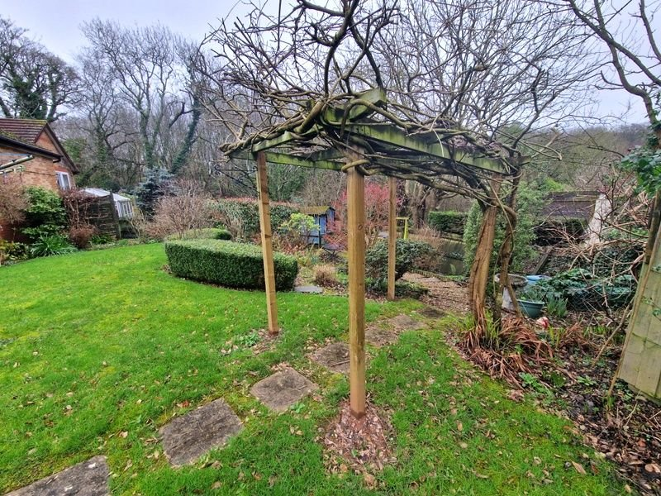
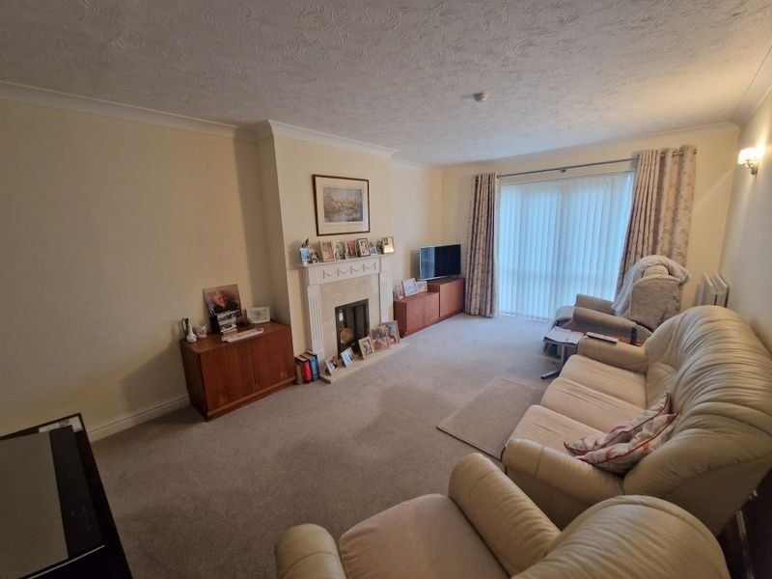
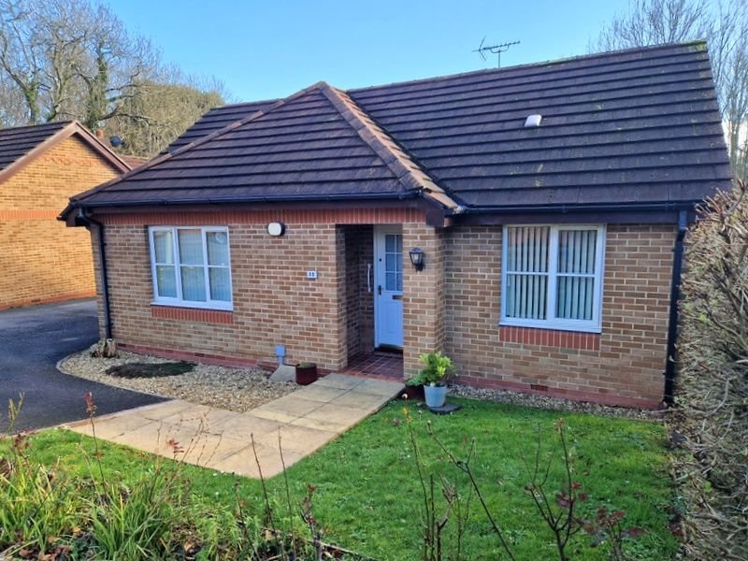
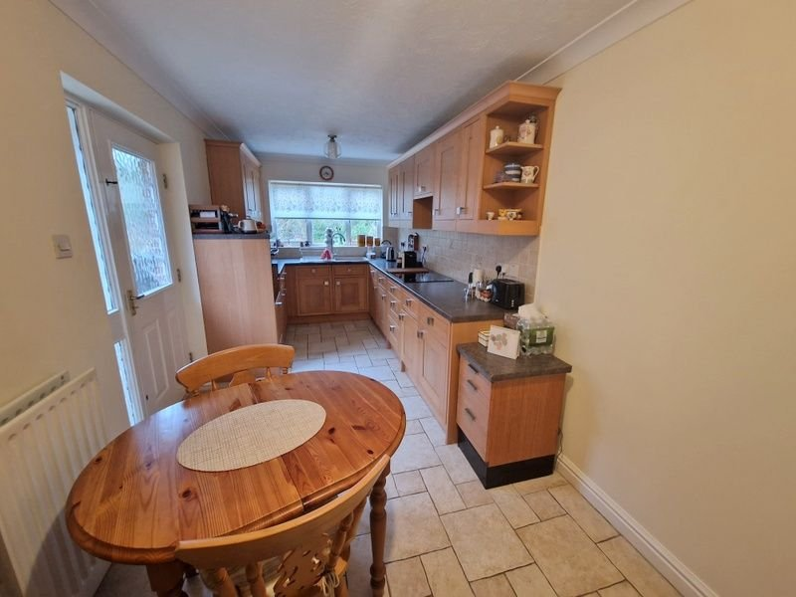
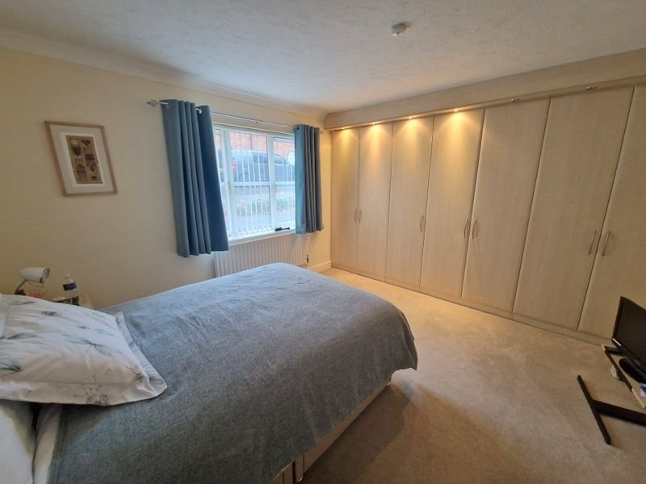
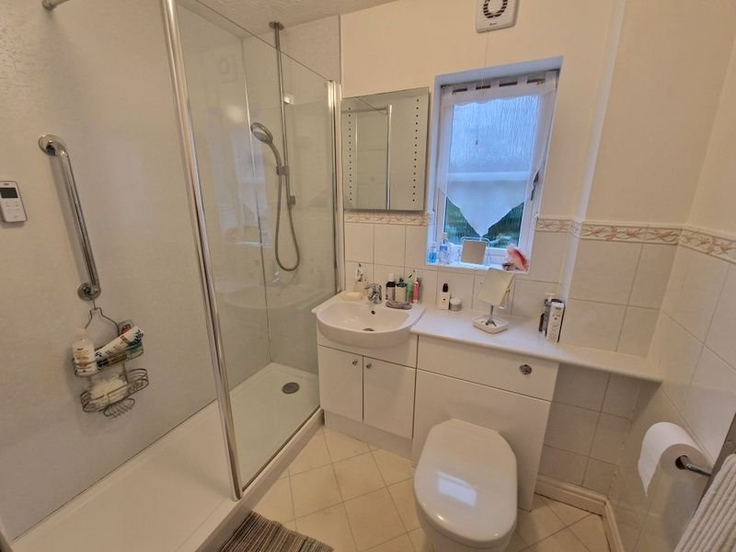
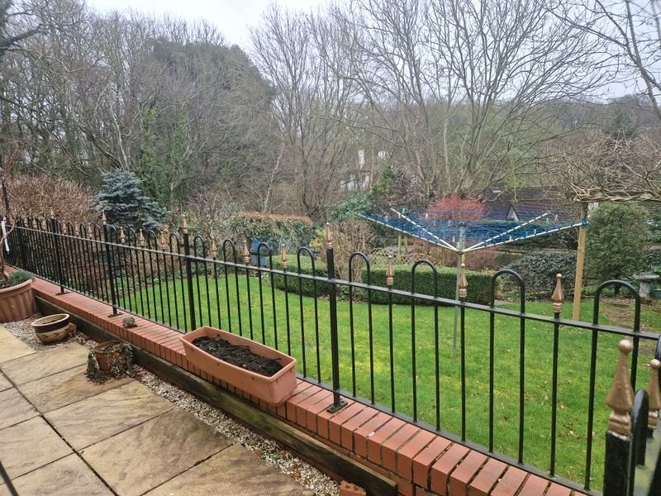
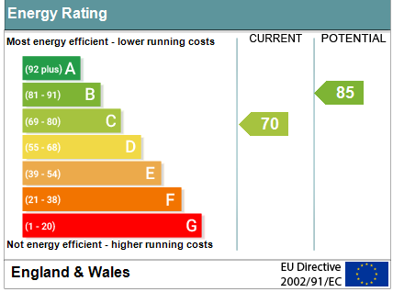
www.pennys.net
32 Port Mer Close, Exmouth, EX8 5RF
GUIDE PRICE £425,000
TENURE Freehold
A Spacious Detached Three Bedroom Bungalow Located On A Favoured Development With Lovely Rear Garden, Driveway & Garage
Lounge/Dining Room • Kitchen/Breakfast Room •
Three Bedrooms • Modern Shower Room/WC • Attractive Secluded Rear Garden •
Driveway & Garage • Gas Central Heating •
Double Glazed Windows • One Of Only 2 Bungalows In Development •
Viewing Recommended •
Pennys Estate Agents Limited for themselves and for the vendor of this property whose agents they are give notice that:- (1) These particulars do not constitute any part of an offer or a contract. (2) All statements contained in these particulars are made without responsibility on the part of Pennys Estate Agents Limited. (3) None of the statements contained in these particulars are to be relied upon as a statement or representation of fact. (4) Any intending purchaser must satisfy himself/herself by inspection or otherwise as to the correctness of each of the statements contained in these particulars. (5) The vendor does not make or give and neither do Pennys Estate Agents Limited nor any person in their employment has any authority to make or give any representation or warranty whatever in relation to this property.
PENNYS ESTATE AGENTS
2 Rolle House, Rolle Street, Exmouth, Devon, EX8 2SN
Tel: 01395 264111 EMail: help@pennys.net

Slide 2
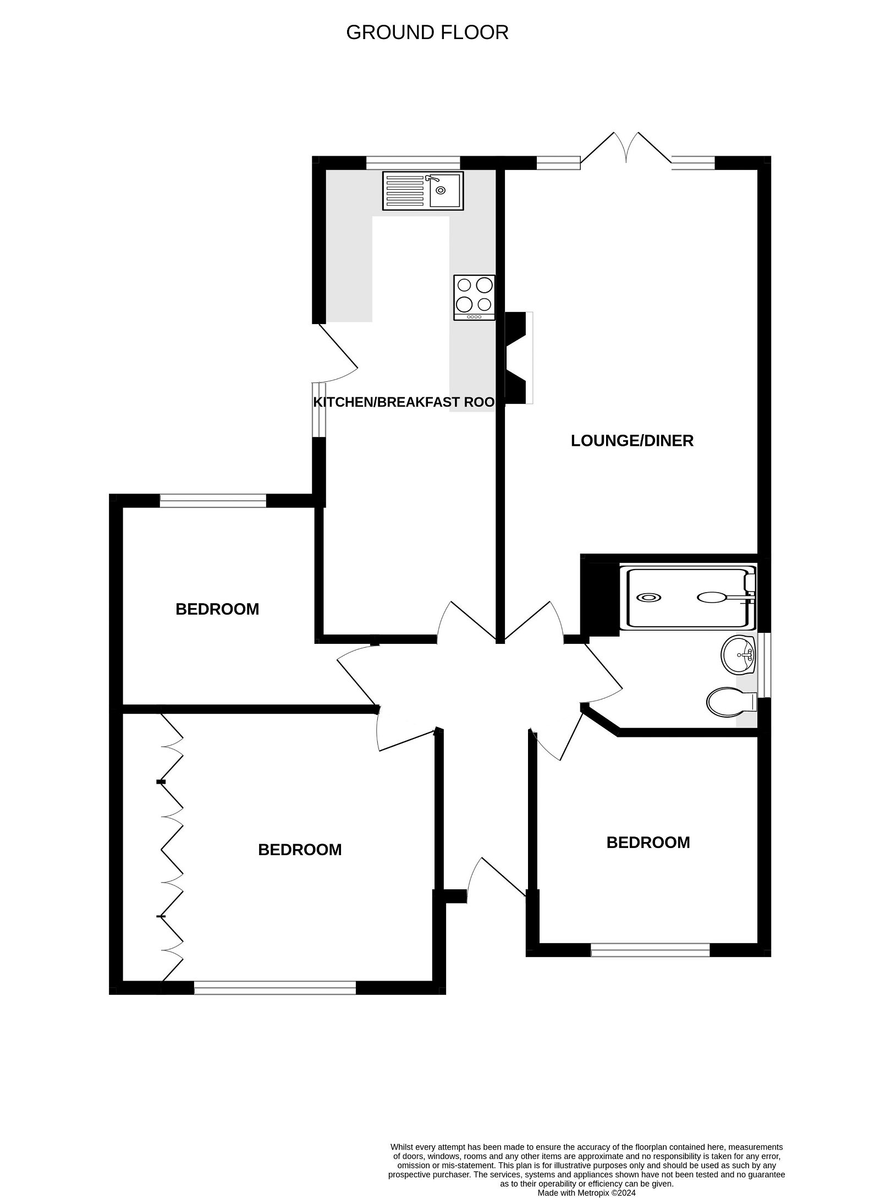
32 Port Mer Close, Exmouth, EX8 5RF
THE ACCOMMODATION COMPRISES: Open tiled entrance porch with glass panelled front door beneath to: RECEPTION HALL: Access via loft ladder to roof space; radiator; doors to all rooms: LOUNGE/DINING ROOM: 5.18m x 3.43m (17'0" x 11'3") Fire surround with marble hearth; two radiators; television point; double glazed double doors and windows to rear garden. KITCHEN/BREAKFAST ROOM: 6.1m x 2.36m (20'0" x 7'9") A most spacious room with tiled flooring; two radiators; double glazed window to rear aspect with woodland outlook; comprising of pattern worktop surfaces with cupboards, drawer units, integrated dishwasher, washing machine and fridge beneath; tiled surrounds; wall mounted cupboards with concealed lighting beneath; Worcester gas boiler housed in wall mounted kitchen unit; inset induction hob with extractor over; built-in oven with cupboard under and display surface over. BEDROOM ONE: 3.66m x 3.58m (12'0" x 11'9") Double glazed window to front aspect; radiator; full width floor to ceiling built-in quality wardrobes with dual clothes rails, shelving and display lighting. BEDROOM TWO: 2.92m x 2.79m (9'7" x 9'2") Double glazed window to front aspect; radiator. BEDROOM THREE: 2.74m x 2.64m (9'0" x 8'8") Plus door recess. Double glazed window to rear aspect; radiator. SHOWER ROOM/WC: 2.26m x 2.26m (7'5" x 7'5") Double width shower cubicle with shower screen and splash back walls; wash hand basin; WC with push button flush and display surface over; chrome heated towel rail; airing cupboard with water cylinder; part tiled walls; extractor fan; double glazed window with pattern glass. OUTSIDE: Being one of the only two bungalows on the whole development, this bungalow is approached via a driveway and turning area to GARAGE. The front garden comprises of a lawn and decorative stone front garden edged with flower and shrub beds. A wooden side gate gives access to the rear garden. The rear garden is a real feature enjoying a patio sun terrace with outside lighting and outside tap; sun canopy, lawn garden edged with well stocked flower and shrub beds, pergola, decorative stone steps to further patio area. GARAGE: 5.23m x 2.69m (17'2" x 8'10") Electric roller door; power and light connected; eaves storage space; double glazed door to rear garden.
FLOOR PLAN:

