Slide 1
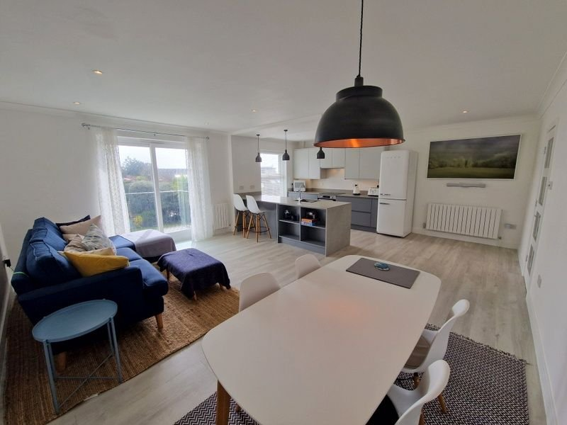
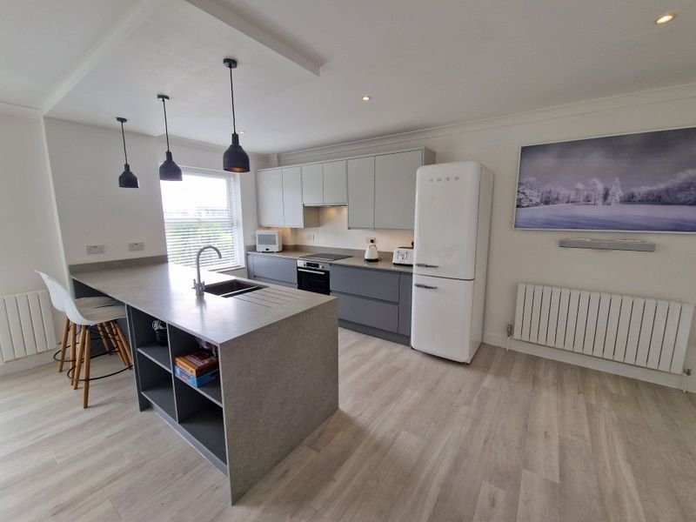
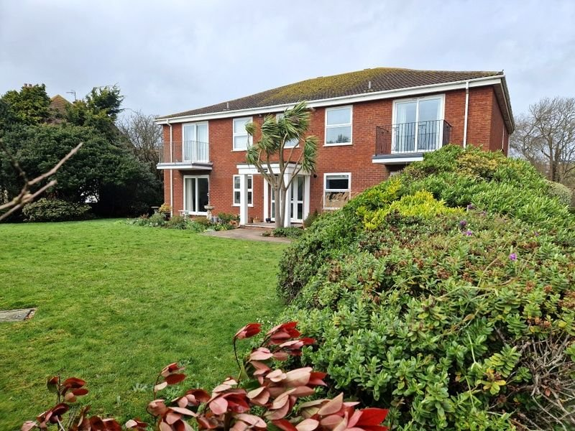
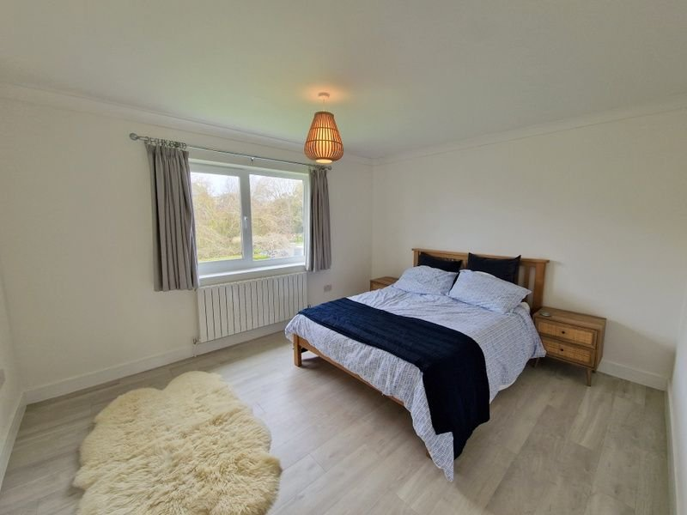
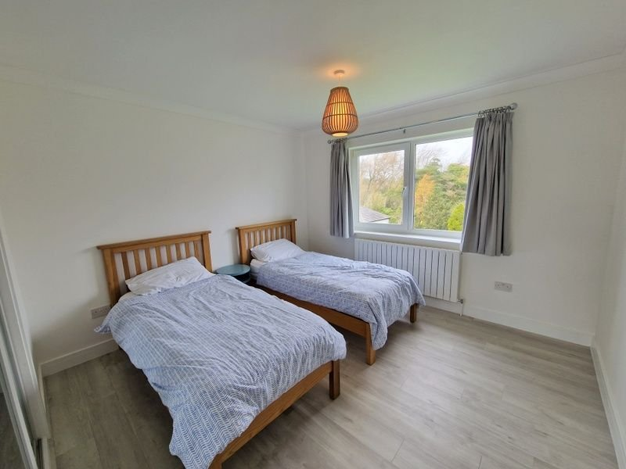
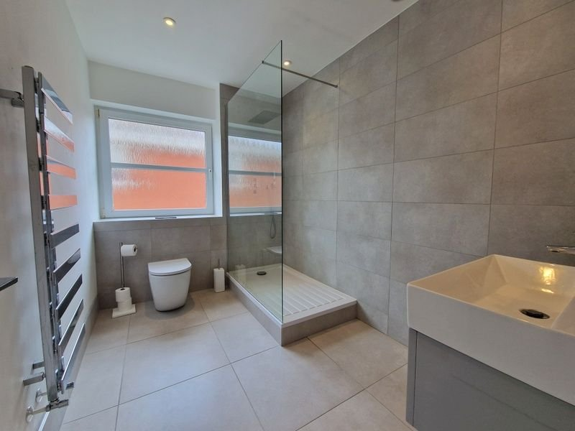
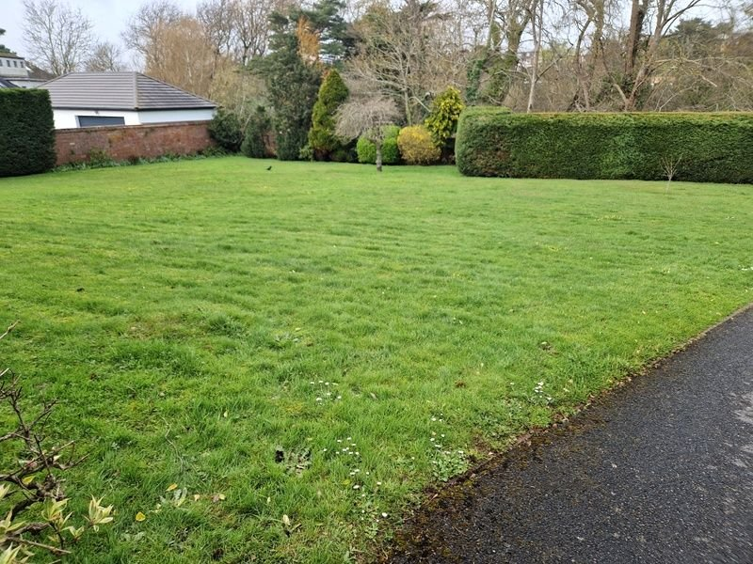
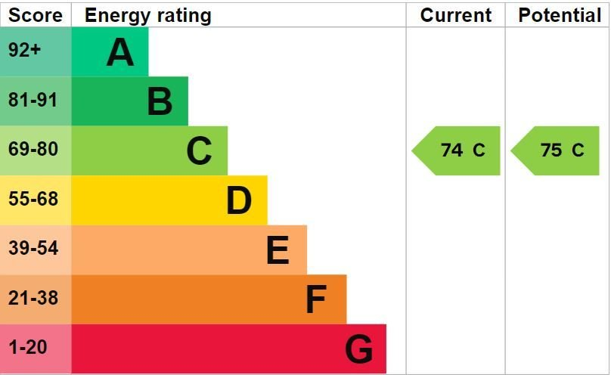
www.pennys.net
4 Applehayes, Maer Lane, Exmouth, EX8 2DD
PRICE £385,000
TENURE Share of Freehold
A Stunning Apartment Located Just Off Exmouth's Seafront With Parking, Garage And Excellent Sea Views
Recently Refurbished To Exacting Standards • High Quality Open Plan Kitchen/Breakfast/Living Room • Sun Balcony •
Two Double Bedrooms • Well Appointed Shower Room/WC •
Gas Central Heating • Double Glazed Windows • Ideal Permanent Or Holiday Retreat
• Viewing Recommended •
Pennys Estate Agents Limited for themselves and for the vendor of this property whose agents they are give notice that:- (1) These particulars do not constitute any part of an offer or a contract. (2) All statements contained in these particulars are made without responsibility on the part of Pennys Estate Agents Limited. (3) None of the statements contained in these particulars are to be relied upon as a statement or representation of fact. (4) Any intending purchaser must satisfy himself/herself by inspection or otherwise as to the correctness of each of the statements contained in these particulars. (5) The vendor does not make or give and neither do Pennys Estate Agents Limited nor any person in their employment has any authority to make or give any representation or warranty whatever in relation to this property.
PENNYS ESTATE AGENTS
2 Rolle House, Rolle Street, Exmouth, Devon, EX8 2SN
Tel: 01395 264111 EMail: help@pennys.net

Slide 2
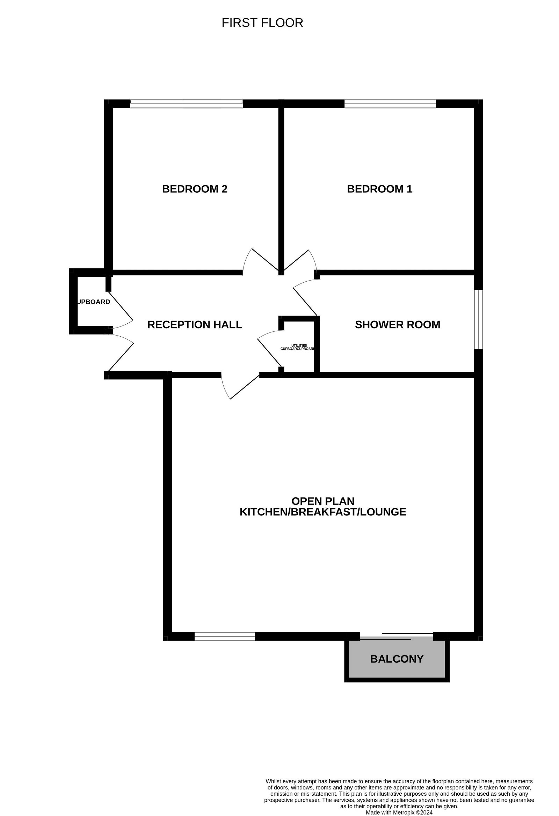
4 Applehayes, Maer Lane, Exmouth, EX8 2DD
THE ACCOMMODATION COMPRISES: Communal entrance with stairs to FIRST FLOOR LANDING. Private front door to: RECEPTION HALL: Kardean flooring; radiator; recess ceiling LED spotlighting; cupboard with plumbing for an automatic washing machine; coats cupboard with led lighting. OPEN PLAN KITCHEN/BREAKFAST/LIVING ROOM: 6.58m x 5.44m (21'7" x 17'10") A stunning high quality open plan room. KITCHEN/BREAKFAST AREA: Comprising range of quartz stone worktop surfaces incorporating breakfast bar area with down lighters over and sink unit with mixer tap; induction hob with extractor over and built-in oven below; wall mounted cupboards with concealed lighting under; radiator; space for fridge freezer; double glazed window to front aspect with sea views; recess ceiling LED spotlighting. LOUNGE/DINING AREA: Radiator; LED spotlighting and down lighters over dining area; radiator; sliding double glazed patio door to BALCONY with sea views; Kardean flooring throughout. BEDROOM ONE: 4.09m x 3.48m (13'5" x 11'5") Double glazed tilt & turn window to rear aspect; Kardean flooring; radiator. BEDROOM TWO: 3.51m x 3.35m (11'6" x 11'0") Radiator; Kardean flooring; built-in wardrobes with sliding mirror effect doors; double glazed tilt & turn window to rear aspect. SHOWER ROOM/WC: 2.84m x 2.01m (9'4" x 6'7") Stylish quality suite with shower area with splash screen; fixed rainfall shower head hose and detachable hose; wall mounted vanity wash hand basin with drawer unit beneath with mirror over in integrated light; WC with concealed cistern with push button flush; chrome heated towel rail; attractive tiling to splash prone areas; color co-ordinated tiled floor; LED ceiling spotlighting; large double glazed tilt & turn window with pattern glass; ceiling extractor fan; electric underfloor heating. OUTSIDE: Applehayes is set in beautifully tended and extensive communal gardens to both the front and rear of the building. Located to the rear of the building, apartment 4 benefits from a garage in a block. There is also a communal drying area which is well screened by Conifer hedging. TENURE AND OUTGOINGS: The property is held on a 999 year lease and benefits from an equal share of the freehold. Service charges to be confirmed. AGENTS NOTE: No holiday lets permitted.
FLOOR PLAN:

