Slide 1
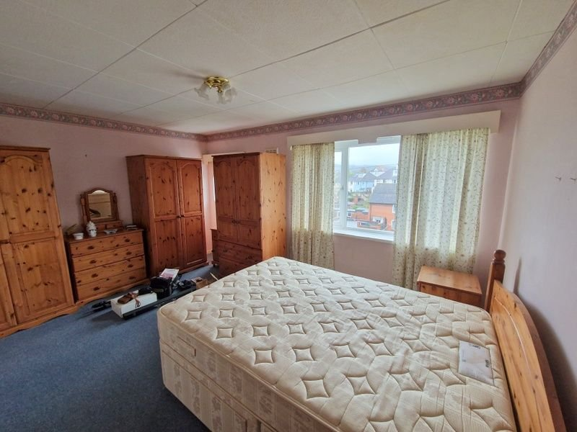
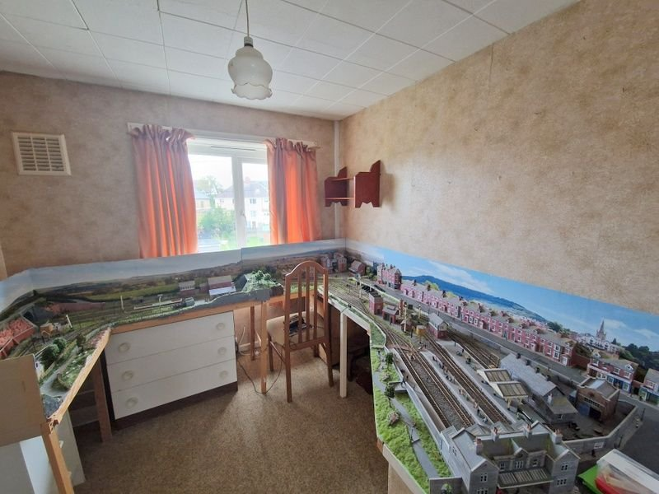
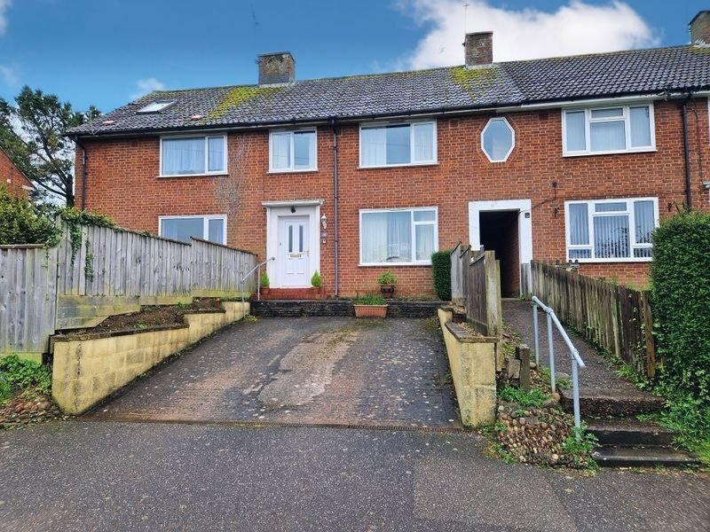
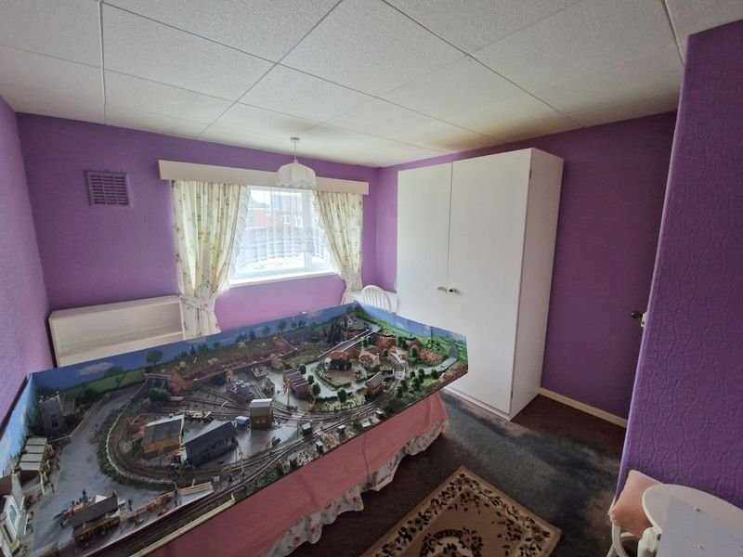
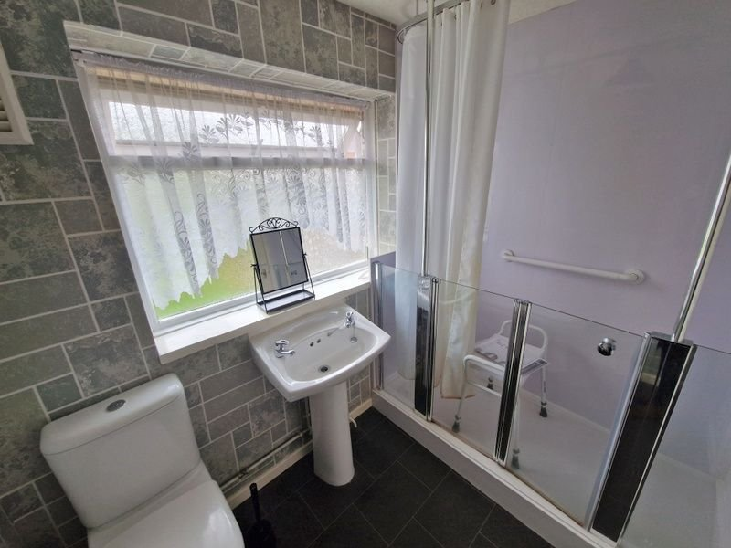
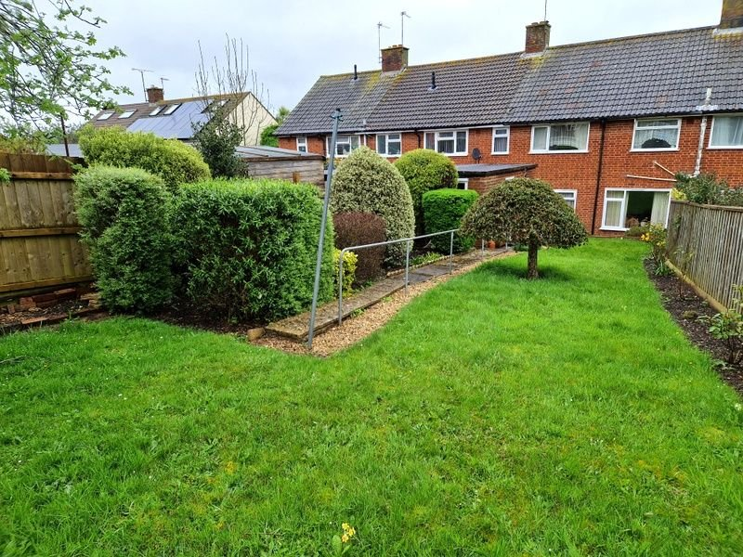
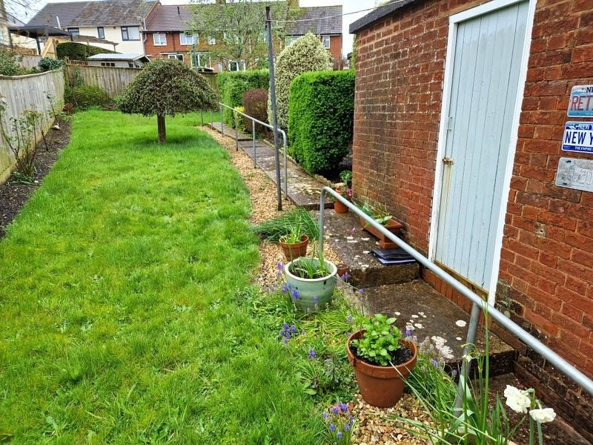
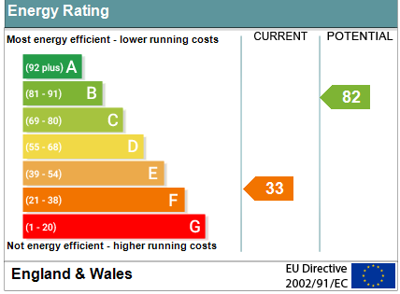
www.pennys.net
80 Moorfield Road, Exmouth, EX8 3QP
GUIDE PRICE £285,000
TENURE Freehold
A Deceptively Spacious Three Bedroom Mid Terrace House With Off-Road Parking And Good Size Rear Garden Offered For Sale With No Ongoing Chain
Lounge • Separate Dining Room • Kitchen •
Three Bedrooms • Shower Room/WC •
Double Glazed Windows • General Refurbishment Required •
Convenient Location Close To Schools•
Pennys Estate Agents Limited for themselves and for the vendor of this property whose agents they are give notice that:- (1) These particulars do not constitute any part of an offer or a contract. (2) All statements contained in these particulars are made without responsibility on the part of Pennys Estate Agents Limited. (3) None of the statements contained in these particulars are to be relied upon as a statement or representation of fact. (4) Any intending purchaser must satisfy himself/herself by inspection or otherwise as to the correctness of each of the statements contained in these particulars. (5) The vendor does not make or give and neither do Pennys Estate Agents Limited nor any person in their employment has any authority to make or give any representation or warranty whatever in relation to this property.
PENNYS ESTATE AGENTS
2 Rolle House, Rolle Street, Exmouth, Devon, EX8 2SN
Tel: 01395 264111 EMail: help@pennys.net

Slide 2
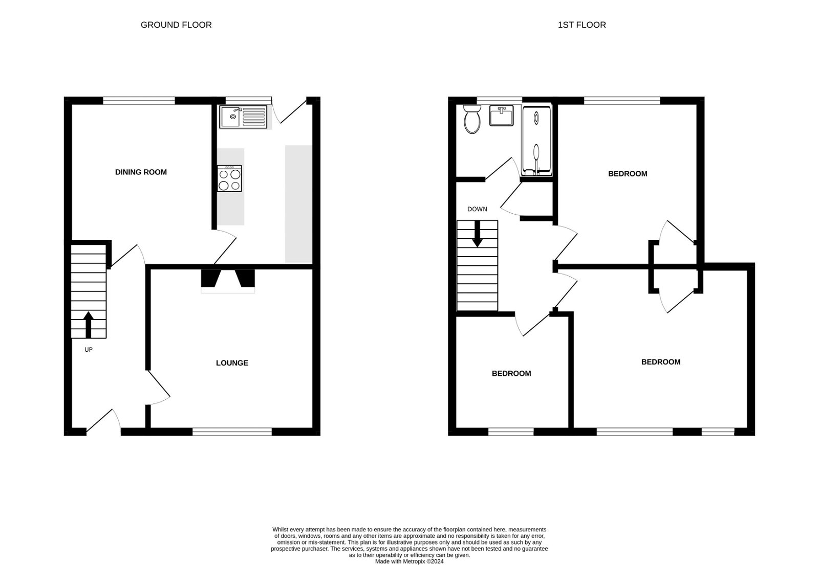
80 Moorfield Road, Exmouth, EX8 3QP
THE ACCOMMODATION COMPRISES: uPVC front door with outside courtesy light. RECEPTION HALL: Cupboard housing electric meter and consumer unit; stairs to first floor landing with understairs cupboard. LOUNGE: 3.71m x 3.68m (12'2" x 12'1") Stone fire surround with hearth and television display area with wood mantle over; picture rail; double glazed window to front aspect. DINING ROOM: 3.66m x 3.25m (12'0" x 10'8") Picture rail; double glazed window to rear aspect. KITCHEN: 3.63m x 2.24m (11'11" x 7'4") Single drainer sink unit with cupboards beneath; worktop surfaces with cupboards, drawer units and plumbing for an automatic washing machine; electric cooker point; wall mounted cupboards; upright larder style cupboard (gas point – currently capped off); double glazed window to rear aspect and double glazed door to outside. FIRST FLOOR LANDING: Access to roof space; airing cupboard with water cylinder and shelving over. BEDROOM ONE: 4.27m x 3.68m (14'0" x 12'1") A spacious main bedroom with double glazed window and diamond shaped double glazed window to front aspect; built-in wardrobe. BEDROOM TWO: 3.66m x 3.28m (12'0" x 10'9") Another good size double bedroom with double glazed window to rear aspect; built-in wardrobe. BEDROOM THREE: 2.69m x 2.59m (8'10" x 8'6") Double glazed window to front aspect. SHOWER ROOM/WC: 2.26m x 1.68m (7'5" x 5'6") Double width shower cubicle with splashback walls, shower unit, splash screen doors plus curtain and rail; WC with push button flush; pedestal wash hand basin; double glazed window with pattern glass. OUTSIDE: A good size parking bay to the front of the property. Shared covered walkway to gate giving access to the rear garden. The rear garden is a lovely size enjoying an extensive lawn garden, decorative stone rockery garden, flower beds, mature shrubs, outside tap and pathway. Access to GARDEN STORE 2.67m x 1.85m (8'9" x 6'1") with window and power and light connected. Outside WC adjoining garden store.
FLOOR PLAN:

