Slide 1
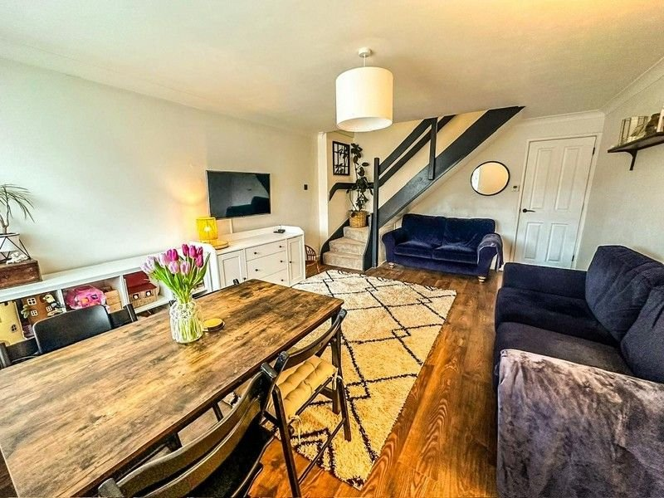
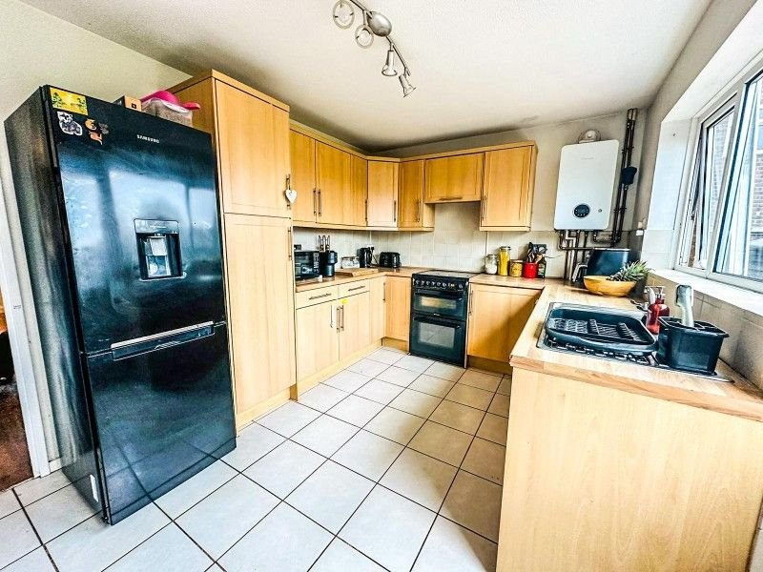
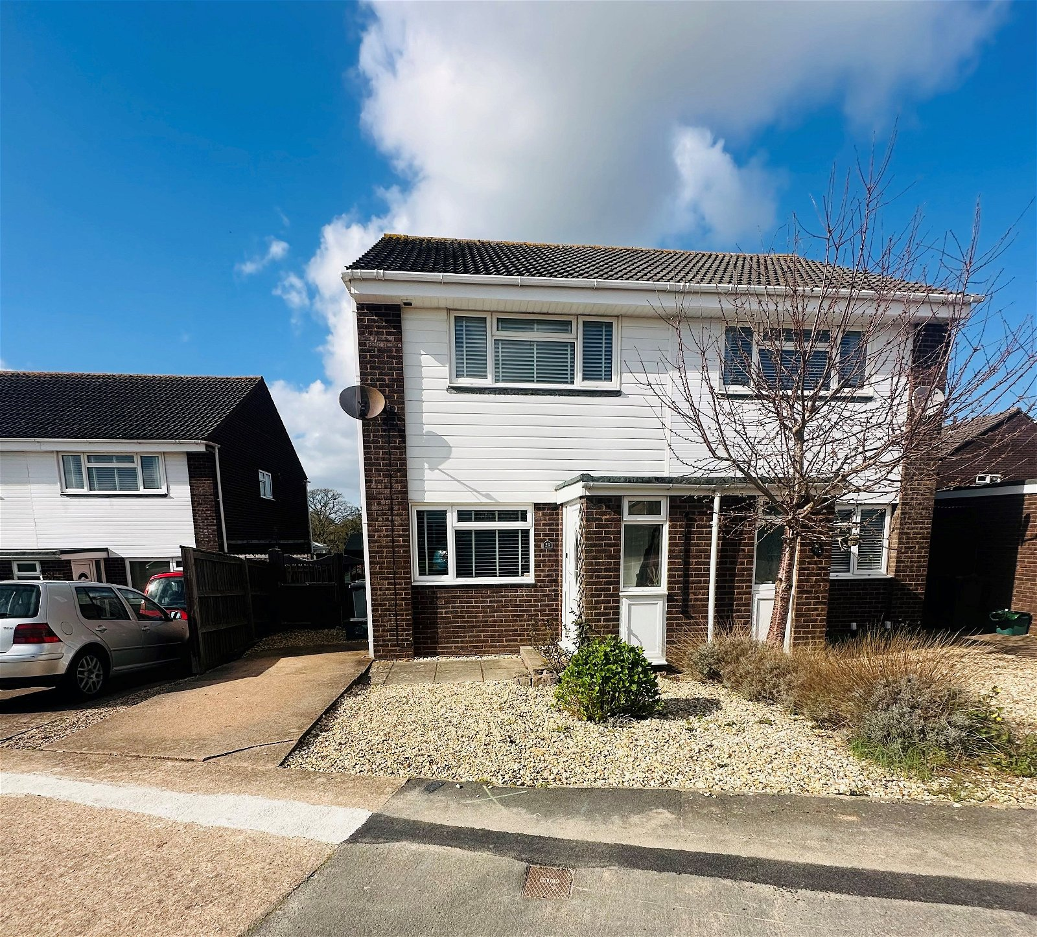
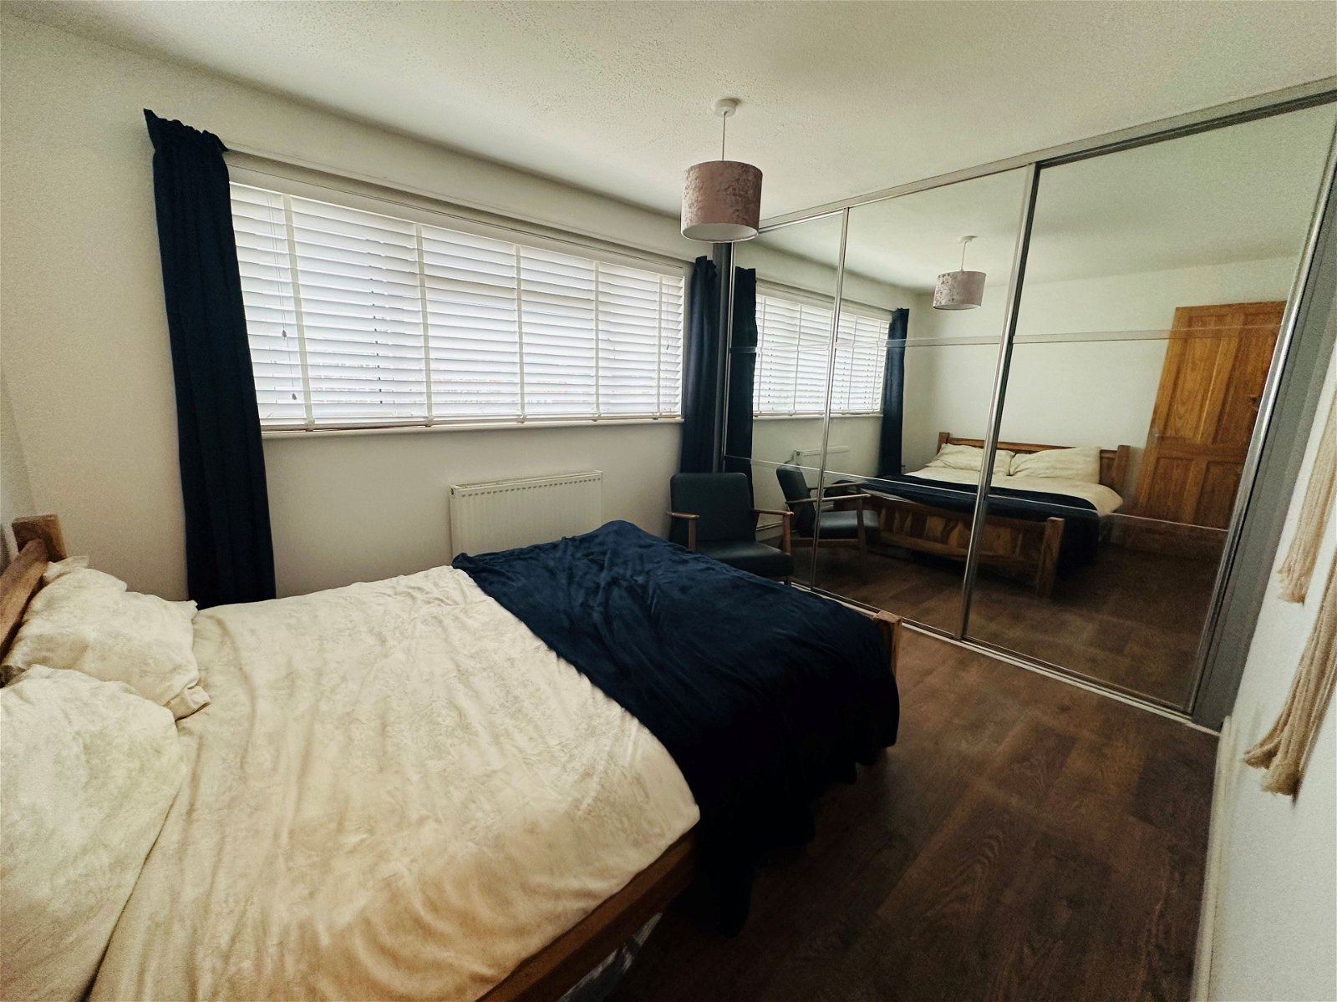
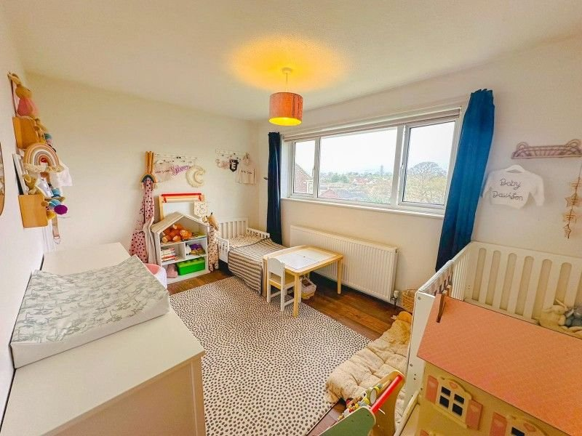
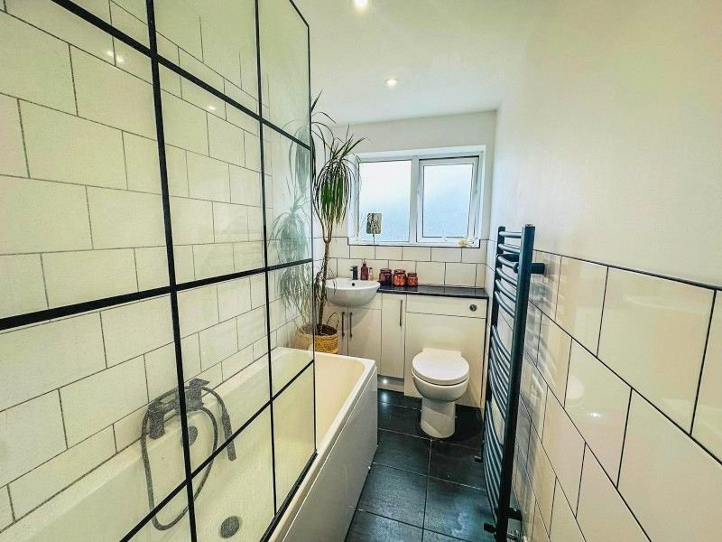
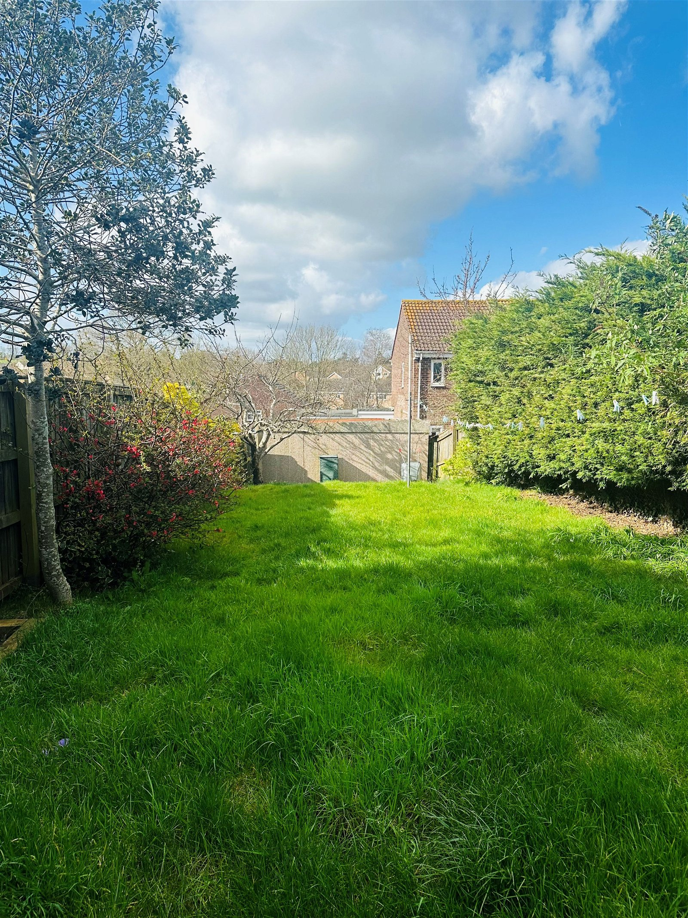
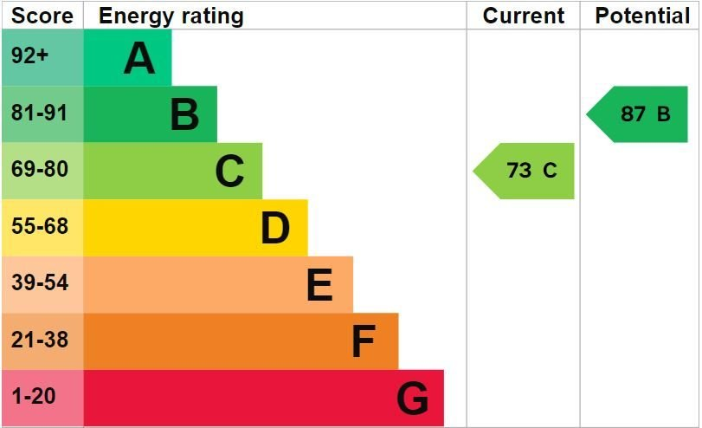
www.pennys.net
29 Vansittart Drive, Exmouth, EX8 5PD
GUIDE PRICE £279,950
TENURE Freehold
An Immaculate Two Double Bedroom Semi Detached House Situated In A Most Favoured Location Close to Amenities With Driveway Parking And Larger Than Average Rear Garden
Entrance Porch • Good Sized Lounge/Dining Room • Kitchen •
Two Double Bedrooms • Modern Stylish Bathroom/WC •
Gas Central Heating & Modern Boiler • Double Glazed Windows • Driveway Parking • Generously Sized Enclosed Rear Garden • Viewing Strongly Recommended •
Pennys Estate Agents Limited for themselves and for the vendor of this property whose agents they are give notice that:- (1) These particulars do not constitute any part of an offer or a contract. (2) All statements contained in these particulars are made without responsibility on the part of Pennys Estate Agents Limited. (3) None of the statements contained in these particulars are to be relied upon as a statement or representation of fact. (4) Any intending purchaser must satisfy himself/herself by inspection or otherwise as to the correctness of each of the statements contained in these particulars. (5) The vendor does not make or give and neither do Pennys Estate Agents Limited nor any person in their employment has any authority to make or give any representation or warranty whatever in relation to this property.
PENNYS ESTATE AGENTS
2 Rolle House, Rolle Street, Exmouth, Devon, EX8 2SN
Tel: 01395 264111 EMail: help@pennys.net

Slide 2
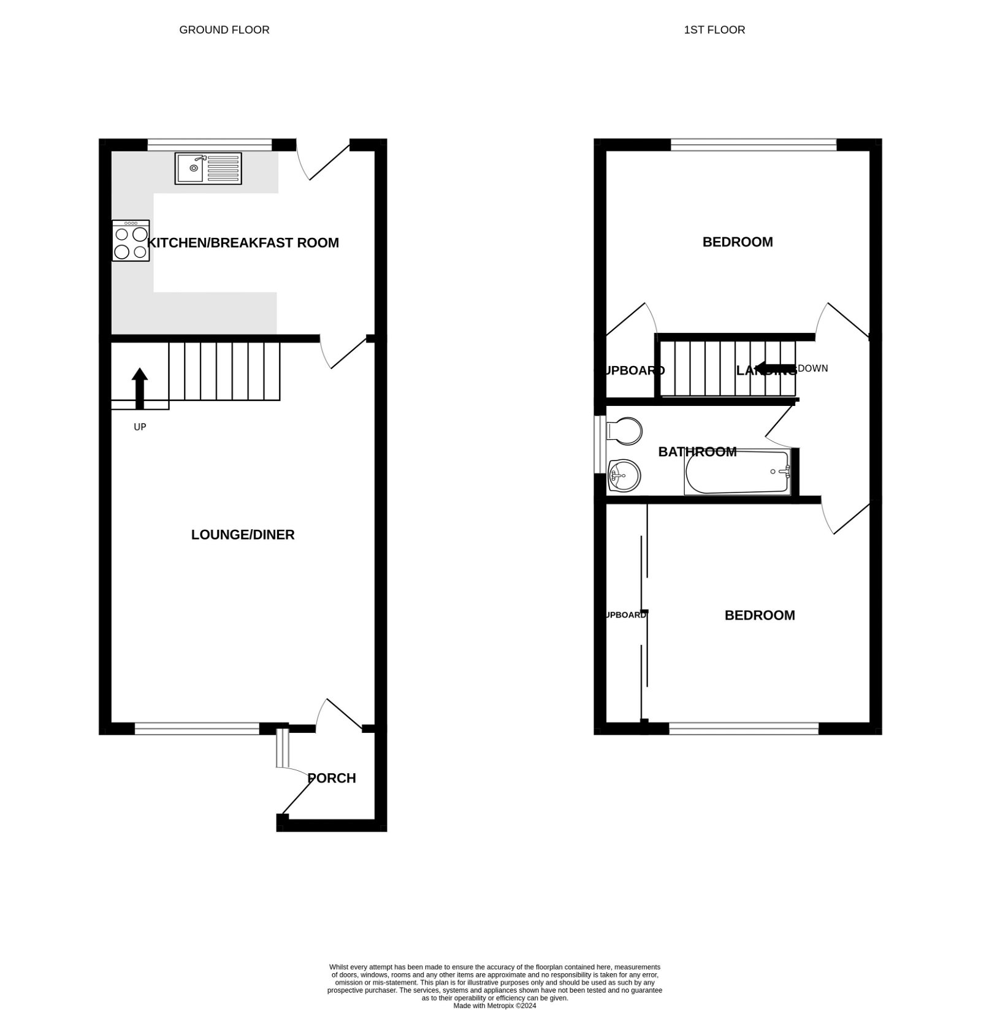
29 Vansittart Drive, Exmouth, EX8 5PD
THE ACCOMMODATION COMPRISES: uPVC front door with attractive inset panel window giving access to: ENTRANCE PORCH: 1.35m x 1.19m (4'5" x 3'11") uPVC double glazed window to front aspect; electric consumer unit; door opening to: LOUNGE/DINING ROOM: 5.33m x 3.94m (17'6" x 12'11") A lovely bright open plan room with uPVC double glazed window overlooking the front aspect and garden; radiator; television point; coved ceiling; laminate wood effect flooring; stairs rising to the first floor landing with useful under stairs recess with access to storage cupboard. KITCHEN/BREAKFAST ROOM: 3.94m x 2.74m (12'11" x 9'0") A bright and spacious room fitted with a range of wood effect work top surfaces with tiled surrounds; inset single drainer sink unit with mixer tap; base cupboards; drawer units; under counter space and plumbing for washing machine; eye level units; electric cooker point with concealed extractor hood over; upright larder style cupboard; space for upright fridge / freezer; Worcester gas combination boiler which has been replaced approximately 3 years ago including upgraded radiators throughout; useful space for a breakfast table or additional storage; uPVC double glazed window overlooking the rear garden; tiled flooring; uPVC double glazed door giving access out to the rear garden. FIRST FLOOR LANDING: With access to roof space with power and light; doors leading to: BEDROOM ONE: 3.35m x 2.9m (11'0" x 9'6") Measurement excluding built-in full length mirror fronted wardrobes with triple sliding doors; clothes rail and shelving; uPVC double glazed window to front aspect; radiator. BEDROOM TWO: 3.94m x 2.74m (12'11" x 9'0") uPVC double glazed window to rear aspect; radiator; linen cupboard with radiator built over the stairwell recess. BATHROOM/WC: Recently re fitted with a stylish modern suite comprising bath with rainfall shower unit and glass shower screen; heated towel rail; vanity storage unit with inset sink and mixer tap over; inset WC with push button flush; fully tiled walls; Italian tiled flooring; uPVC double glazed window with patterned glass. OUTSIDE: To the front of the property is an attractive decorative stone garden edged with colourful shrub beds. A driveway to one side of the house provides off-road parking; double wooden gates give access to a decorative stone side garden area which in turn leads through to the REAR GARDEN which is a lovely feature of the property being beautifully planned and presented and generous in size. It is laid extensively to lawn with decorative stone pathway; fruit tree and colourful flower beds and borders. Substantial timber garden shed. Outside water tap.
FLOOR PLAN:

