Slide 1
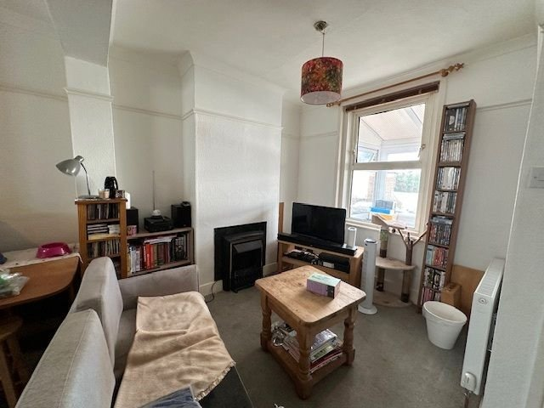
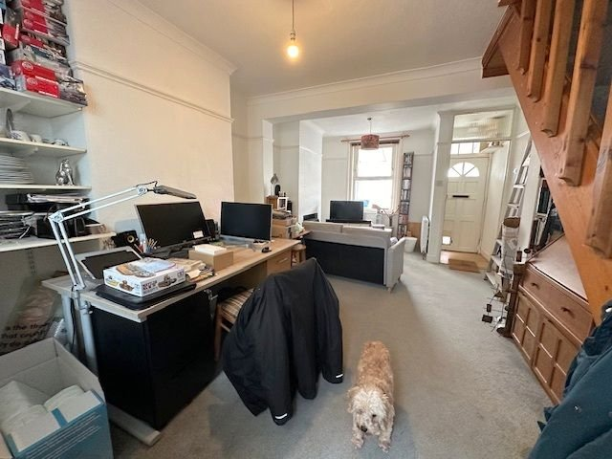
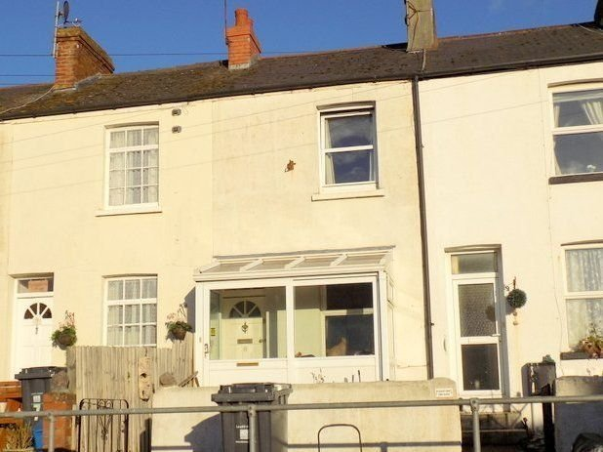
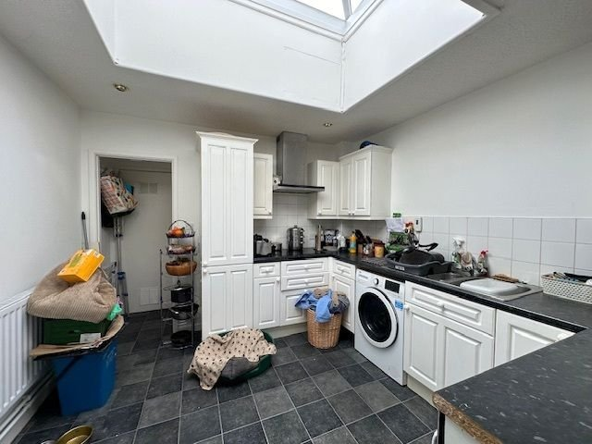
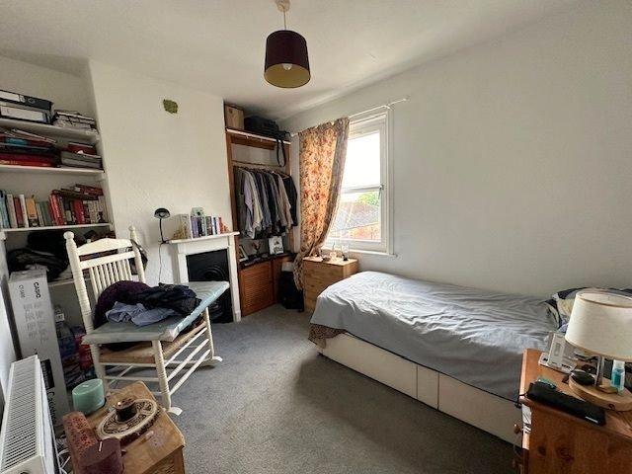
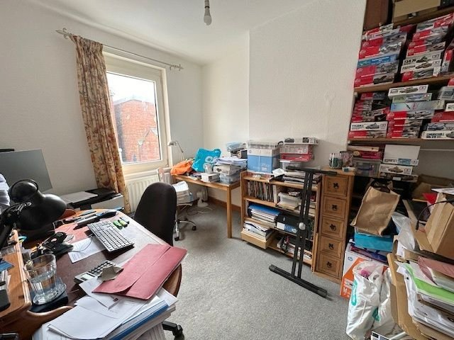
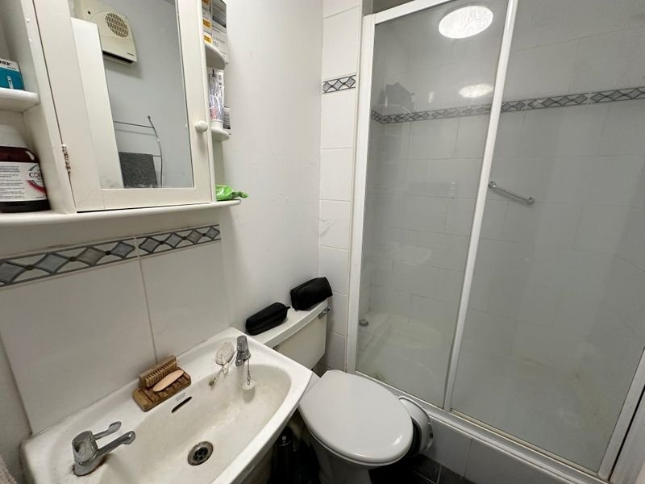
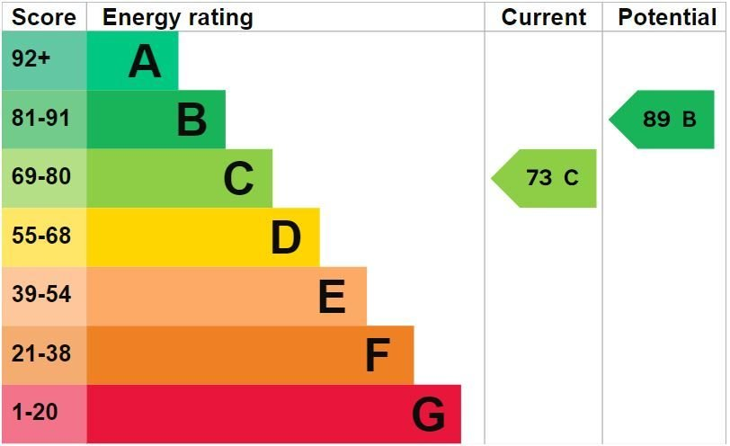
www.pennys.net
8 Helena Place, Exmouth, EX8 1JG
GUIDE PRICE £220,000
TENURE Freehold
A Two Bedroom Terraced House Enjoying A Central Yet Tucked Away Location Only A Short Distance From Exmouth Town Centre
TO BE SOLD TO INVESTORS ONLY * •
Entrance Porch/Sun Room • Lounge/Dining Room •
Kitchen/Breakfast Room • Ground Floor Shower Room/WC •
Two First Floor Bedrooms • Gas Central Heating & Double Glazed Windows •
Attractive Front Garden With Southerly Aspect•
Pennys Estate Agents Limited for themselves and for the vendor of this property whose agents they are give notice that:- (1) These particulars do not constitute any part of an offer or a contract. (2) All statements contained in these particulars are made without responsibility on the part of Pennys Estate Agents Limited. (3) None of the statements contained in these particulars are to be relied upon as a statement or representation of fact. (4) Any intending purchaser must satisfy himself/herself by inspection or otherwise as to the correctness of each of the statements contained in these particulars. (5) The vendor does not make or give and neither do Pennys Estate Agents Limited nor any person in their employment has any authority to make or give any representation or warranty whatever in relation to this property.
PENNYS ESTATE AGENTS
2 Rolle House, Rolle Street, Exmouth, Devon, EX8 2SN
Tel: 01395 264111 EMail: help@pennys.net

Slide 2
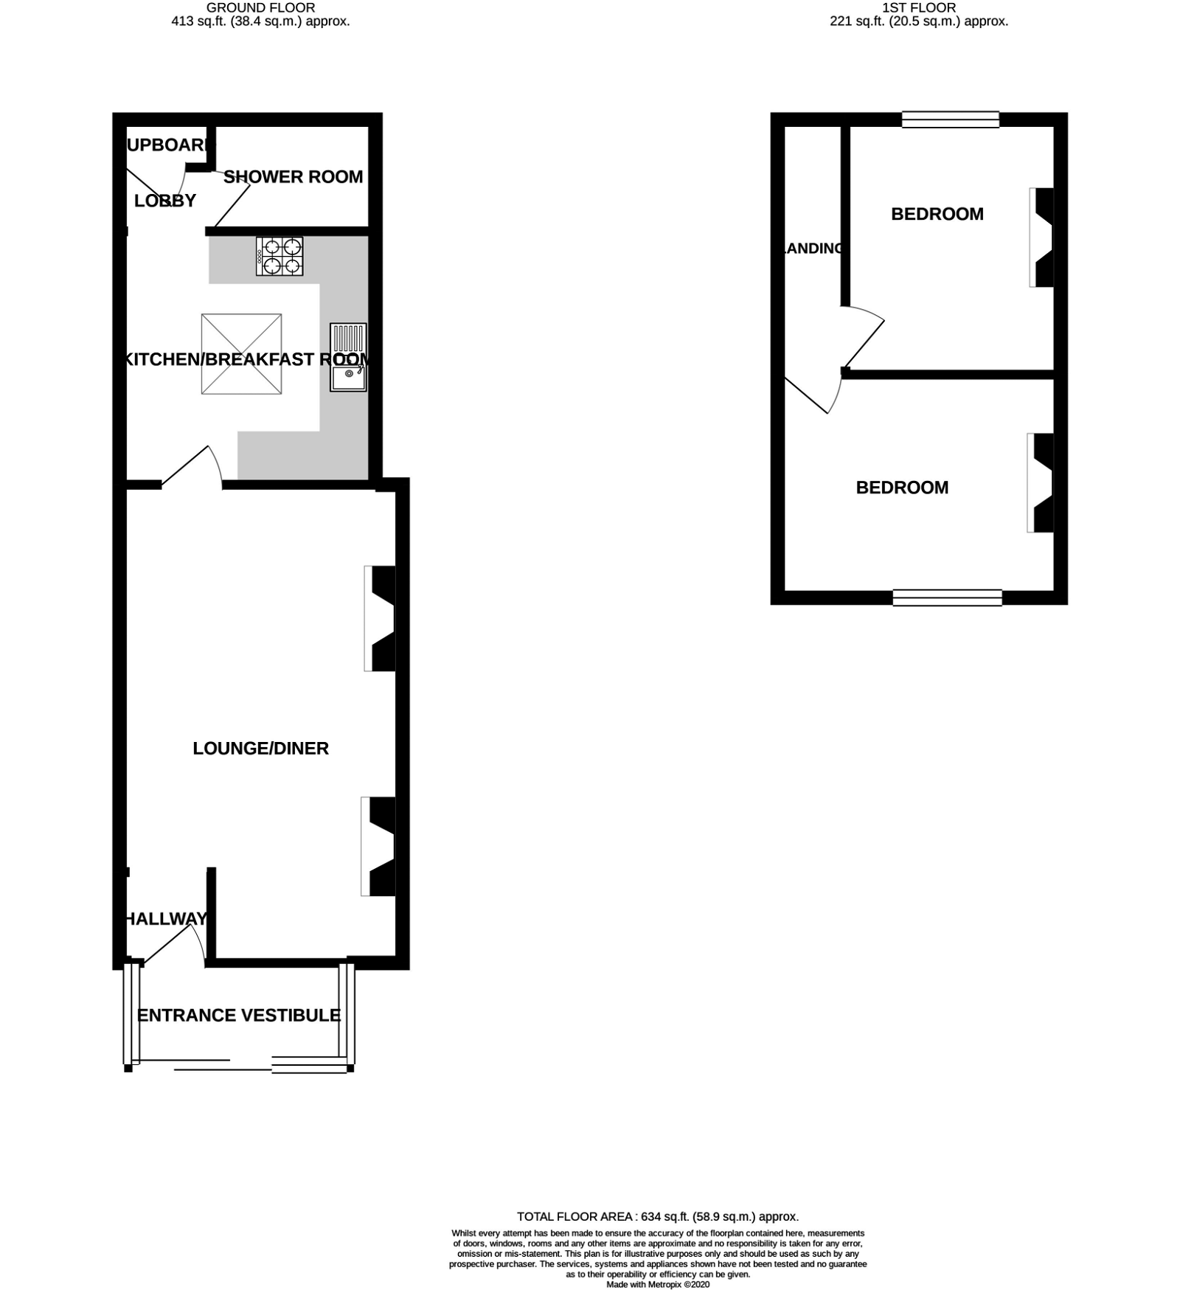
8 Helena Place, Exmouth, EX8 1JG
THE ACCOMMODATION COMPRISES: uPVC double glazed sliding door giving access to: SUN PORCH: With laminate flooring; power sockets; inner front door with glazed fan light window inset leading to: ENTRANCE VESTIBULE: Wall mounted electric consumer unit and electric meter; wood laminate flooring; opening to: LOUNGE/DINING ROOM: 5.79m x 3.53m (19'0" x 11'7") Double glazed window to front aspect; television point; picture rail; coved ceiling; stairs rising to the first floor; inner window overlooking the kitchen/breakfast room; two radiators; electric fireplace in attractive surround; smoke alarm. KITCHEN/BREAKFAST ROOM: 3.23m x 3.12m (10'7" x 10'3") Fitted with a range of patterned gloss finish worktop surfaces with tiled surrounds; inset one and a half bowl single drainer sink unit with mixer tap; range of base cupboards and drawer units; built-in electric oven; space and plumbing for an automatic washing machine beneath; inset four ring electric hob with stainless steel chimney style extractor hood over with light; wall units at eye-level incorporating a corner display unit; upright larder style cupboard; recess ceiling spotlighting; large skylight window; radiator; space for upright fridge freezer. REAR LOBBY: With coat rack; cupboard housing the boiler providing domestic hot water and gas central heating; door to: GROUND FLOOR SHOWER ROOM/WC: Comprising of a double width tiled shower cubicle with shower unit; hand rail and sliding shower splash screen doors; pedestal wash hand basin with tiled splashback; WC; wall mounted mirror fronted medicine cabinet; ceiling extractor fan; Dimplex wall heater; heated towel rail. FIRST FLOOR LANDING AREA: Smoke alarm; doors to: BEDROOM ONE: 3.56m x 2.64m (11'8" x 8'8") Double glazed tilt and turn window; feature cast iron fireplace with wooden surround; shelving and clothes rail in wall recesses; radiator. BEDROOM TWO: 3.1m x 2.69m (10'2" x 8'10") Double glazed tilt and turn window to rear aspect; cupboard over stairwell recess; radiator. OUTSIDE: To the front of the property there is a pleasant patio front garden enjoying a sunny southerly aspect with shrub borders. AGENTS NOTE: Please note this property is to be sold with a tenant in situ and achieves a rent of £866.25 per calendar month. We understand that there is a number of parking spaces available on Helena Place from East Devon District Council for £30 per month. Enquiries should be made to EDDC for any availabilities.
FLOOR PLAN:

