Slide 1
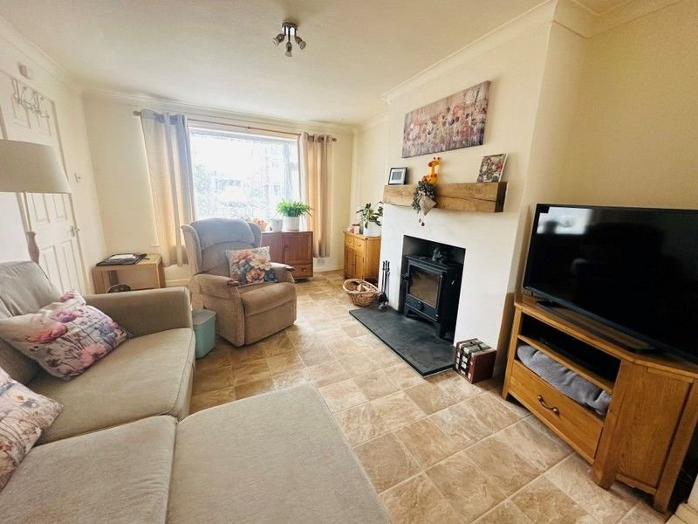
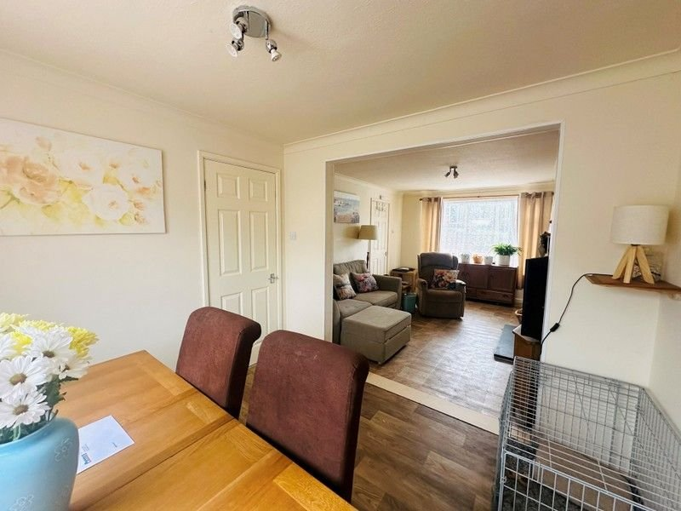
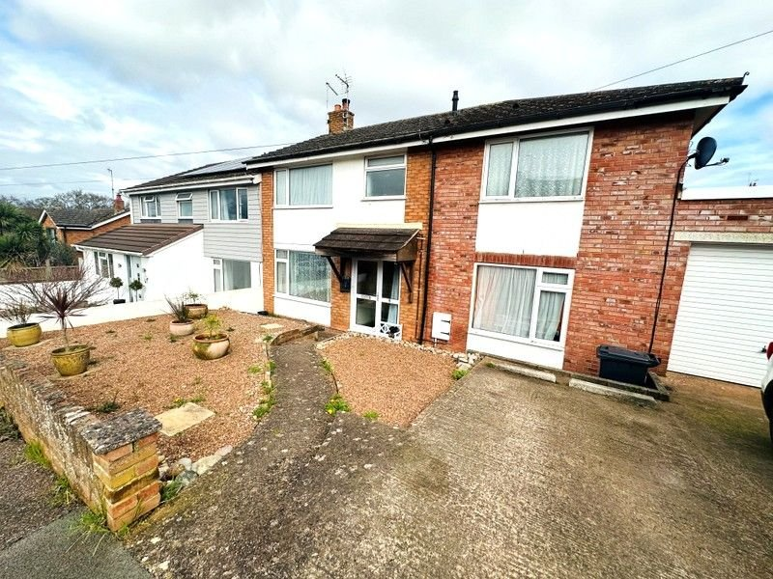
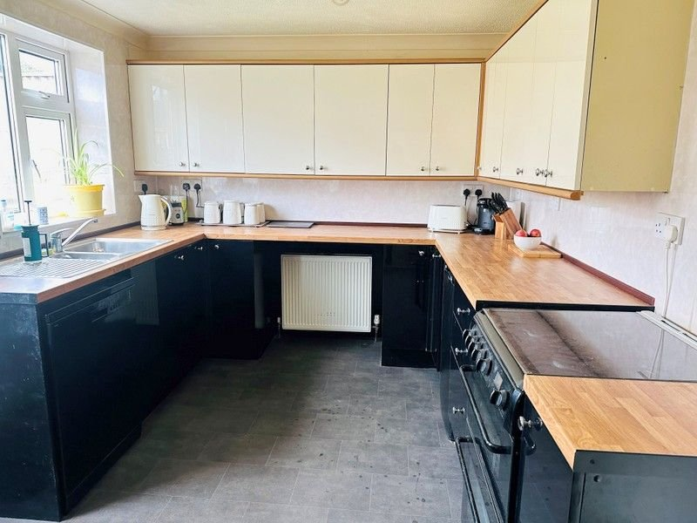
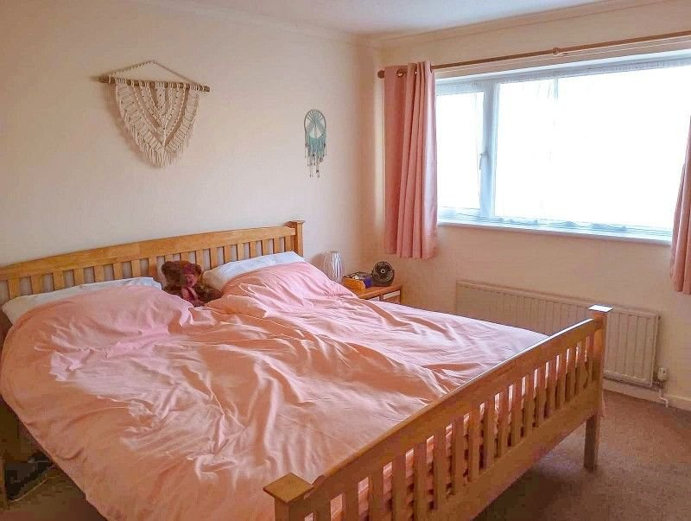
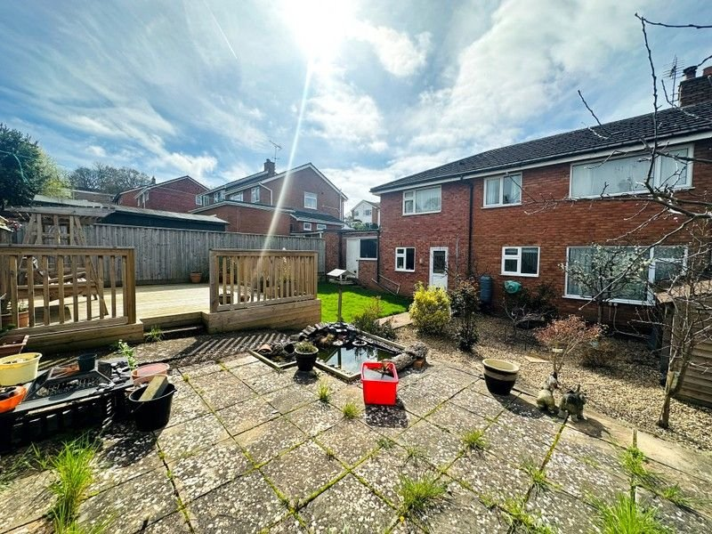
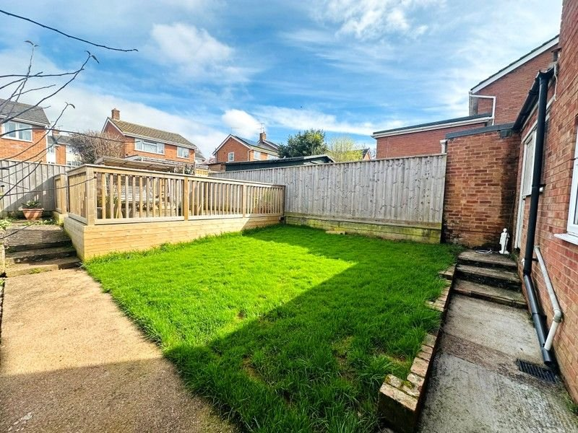
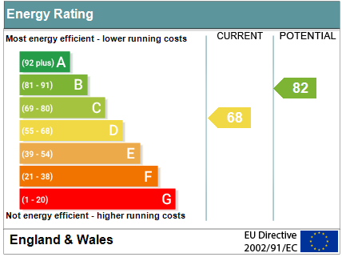
www.pennys.net
5 Caroline Close, Exmouth, EX8 4AZ
OFFERS IN THE REGION OF £425,000
TENURE Freehold
A Well Presented And Extended Semi Detached Five Bedroom House Offering Flexible Accommodation With Attractive Rear Garden And Extended Rear Garage Situated In A Popular Cul-De-Sac Location
Entrance Canopy & Reception Hall • Lounge Opening Through To Dining Room • Sitting Room • Kitchen • Ground Floor Shower Room/WC •
Five First Floor Bedrooms • First Floor Bathroom/WC •
Attractive Rear Garden & Extended Garage •
uPVC Double Glazed Window & Gas Central Heating • Super Family Home •
Pennys Estate Agents Limited for themselves and for the vendor of this property whose agents they are give notice that:- (1) These particulars do not constitute any part of an offer or a contract. (2) All statements contained in these particulars are made without responsibility on the part of Pennys Estate Agents Limited. (3) None of the statements contained in these particulars are to be relied upon as a statement or representation of fact. (4) Any intending purchaser must satisfy himself/herself by inspection or otherwise as to the correctness of each of the statements contained in these particulars. (5) The vendor does not make or give and neither do Pennys Estate Agents Limited nor any person in their employment has any authority to make or give any representation or warranty whatever in relation to this property.
PENNYS ESTATE AGENTS
2 Rolle House, Rolle Street, Exmouth, Devon, EX8 2SN
Tel: 01395 264111 EMail: help@pennys.net

Slide 2
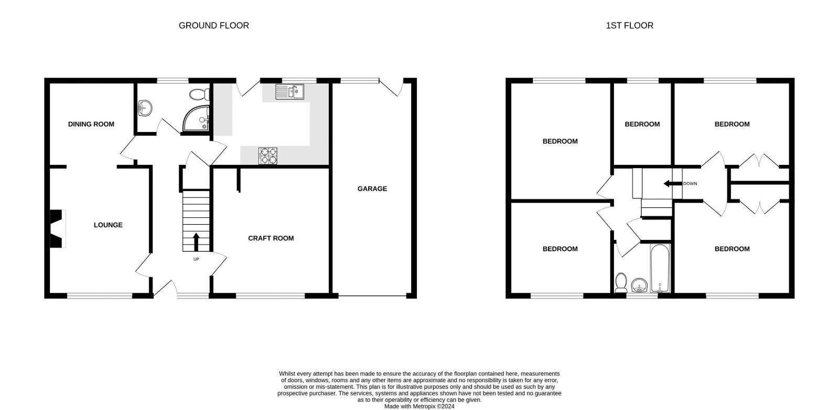
5 Caroline Close, Exmouth, EX8 4AZ
THE ACCOMMODATION COMPRISES: uPVC double glazed front door and obscure glazed side panel with wooden canopy over; outside light; giving access to: RECEPTION HALL: Radiator; tiled effect vinyl flooring; stairs rising to first floor; built-in under-stairs cupboard housing electric consumer unit; ceiling lighting; doors to : SITTING ROOM: 4.04m x 3.76m (13'3" x 12'4") uPVC double glazed window to front aspect; radiator; aerial point; ceiling lighting; tiled effect vinyl flooring. LOUNGE: 4.11m x 3.28m (13'6" x 10'9") Maximum measurement in to chimney recess; a lovely bright room with uPVC double glazed window to front aspect; radiator; tiled effect vinyl flooring; feature wood burner with stone hearth with oak mantle above; ceiling lighting; television point.
OPENING TO:
DINING ROOM: 2.82m x 2.72m (9'3" x 8'11") With uPVC double glazed window overlooking the rear garden; radiator; ceiling lighting; wood effect vinyl flooring. INNER HALLWAY: Doors to : SHOWER ROOM/WC: uPVC obscure glazed window to rear aspect; white suite comprising enclosed shower cubicle; shower with tile effect splash-back; WC with push button flush; vanity storage unit with inset wash hand basin and mixer taps; tiled splash-backs; tiled effect vinyl flooring; radiator. KITCHEN: 3.73m x 2.72m (12'3" x 8'11") A modern fitted kitchen with wood effect worktop surfaces and fully tile effect surrounds, incorporating a range of base cupboards and drawer units; inset one and a half bowl stainless steel sink unit with chrome mixer tap; space for gas cooker; appliance space for under-counter fridge/freezer; space for dishwasher; wall mounted cupboards; further worktop area with appliance space and plumbing for an automatic washing machine and tumble dryer beneath; tile effect vinyl flooring; ceiling lighting; radiator; uPVC double glazed window to rear aspect and uPVC double glazed door leading to REAR GARDEN FIRST FLOOR LANDING: With access to roof space via loft ladder with power and light connected; airing cupboard housing Worcester gas combi boiler and shelving below; split level landing to : BEDROOM ONE: 3.81m x 3.25m (12'6" x 10'8") uPVC double glazed window to rear aspect; radiator. BEDROOM TWO: 3.76m x 3.07m (12'4" x 10'1") uPVC double glazed window to front aspect; radiator; fitted wardrobes with hanging and shelving space; further display shelving. BEDROOM THREE: 3.76m x 2.62m (12'4" x 8'7") uPVC double glazed window to rear aspect; fitted wardrobes with hanging and shelving space; radiator. BEDROOM FOUR: 3.3m x 3.02m (10'10" x 9'11") uPVC double glazed window to front aspect; radiator.
BEDROOM FIVE: 2.74m x 1.96m (9'0" x 6'5") uPVC double glazed window to rear aspect; radiator. FAMILY BATHROOM/WC: uPVC obscure glazed window to rear aspect; bath with shower fitting over; mixer taps; patterned tiled surrounds; pedestal wash hand basin with mixer taps over; WC; radiator. OUTSIDE: With double width driveway parking for two cars and raised stone chipping area. The rear garden is a real feature to the property comprising of various fruit trees, a raised paved patio area with pond, level lawn area and further raised decking area ideal for outside entertaining; outside water tap, outside light and power sockets. Access to : GARAGE: 7.21m x 2.59m (23'8" x 8'6") With up and over door. Having been extended by the current owners, this larger than average garage provides ample storage with multi-purpose use (and the potential to convert if required subject to the necessary consents) power and light connected and plumbing for additional appliances.
FLOOR PLAN:

