Slide 1
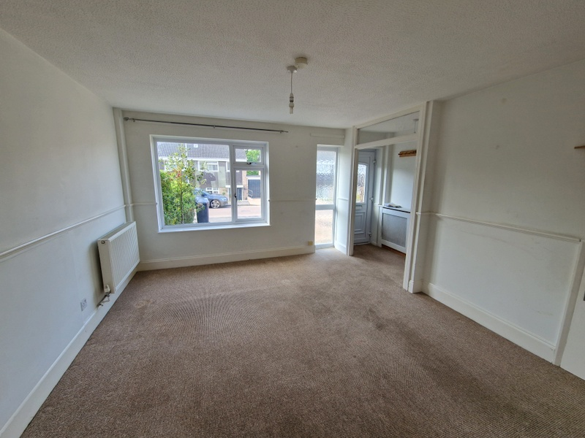
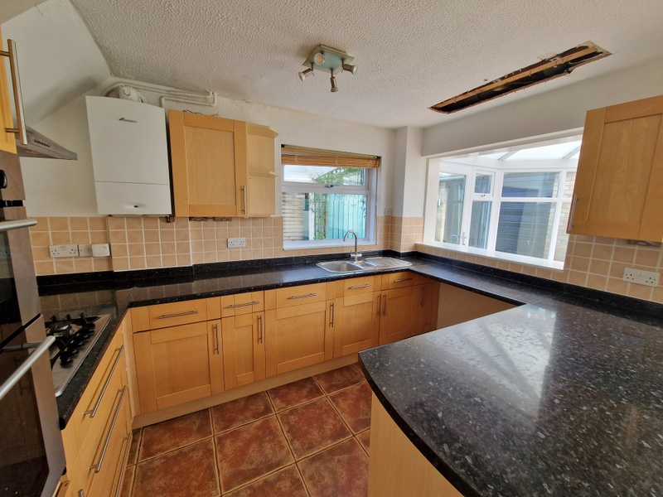
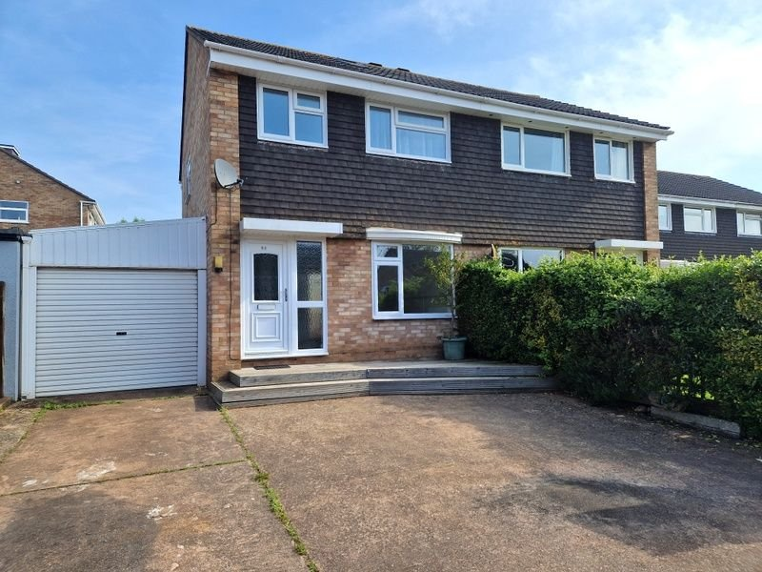
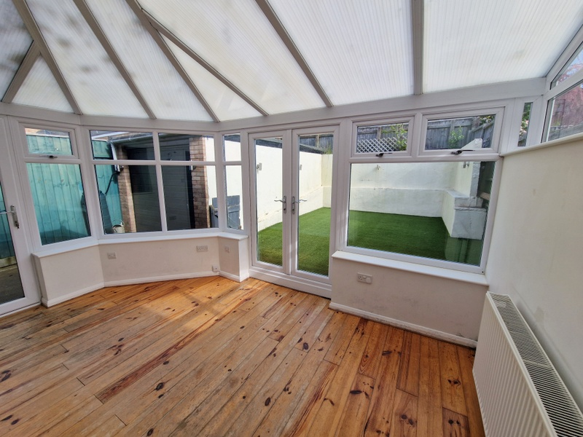
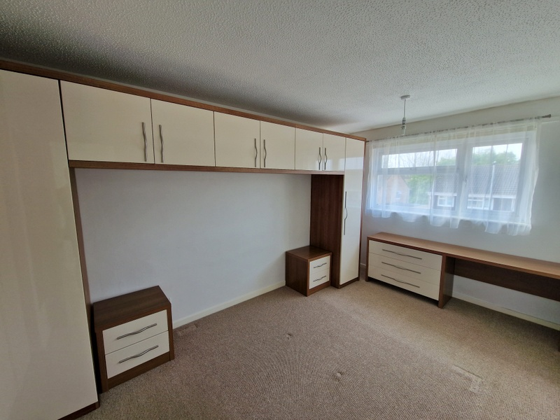
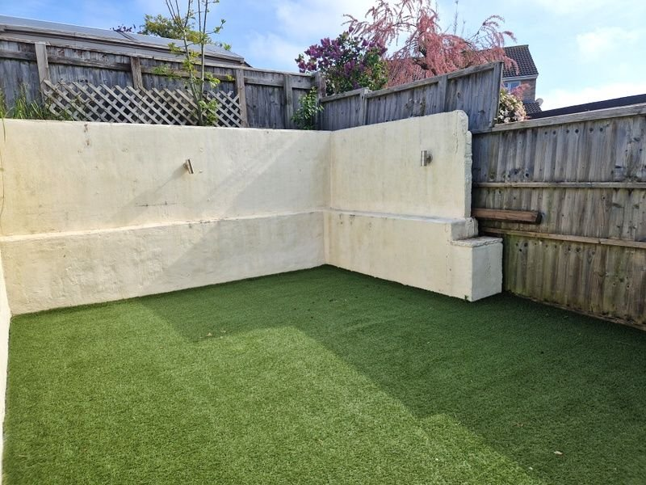
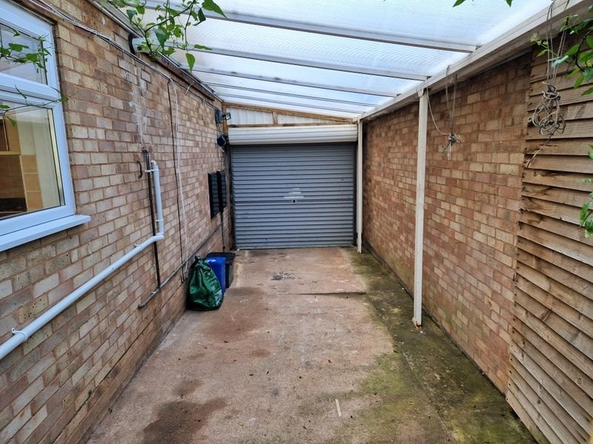
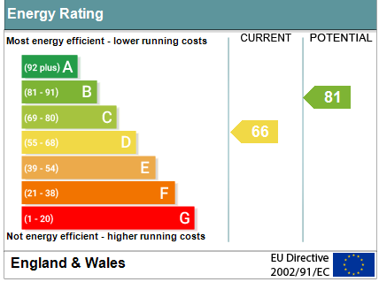
www.pennys.net
53 Hollymount Close, Exmouth, EX8 5PQ
GUIDE PRICE £309,950
TENURE Freehold
A Well Presented Three Bedroom Semi-Detached House Situated In A Popular Location Close To Amenities With Excellent Conservatory Extension And Enclosed Rear Garden
Lounge • Modern Open Plan Kitchen/Dining Room • Conservatory Extension •
Three Bedrooms • Modern Bathroom/WC • Useful Boarded Attic With Velux Window •
Gas Central Heating • Double Glazed Windows • Ample Parking •
Car Port & Garage/Store • No Onward Chain •
Pennys Estate Agents Limited for themselves and for the vendor of this property whose agents they are give notice that:- (1) These particulars do not constitute any part of an offer or a contract. (2) All statements contained in these particulars are made without responsibility on the part of Pennys Estate Agents Limited. (3) None of the statements contained in these particulars are to be relied upon as a statement or representation of fact. (4) Any intending purchaser must satisfy himself/herself by inspection or otherwise as to the correctness of each of the statements contained in these particulars. (5) The vendor does not make or give and neither do Pennys Estate Agents Limited nor any person in their employment has any authority to make or give any representation or warranty whatever in relation to this property.
PENNYS ESTATE AGENTS
2 Rolle House, Rolle Street, Exmouth, Devon, EX8 2SN
Tel: 01395 264111 EMail: help@pennys.net

Slide 2
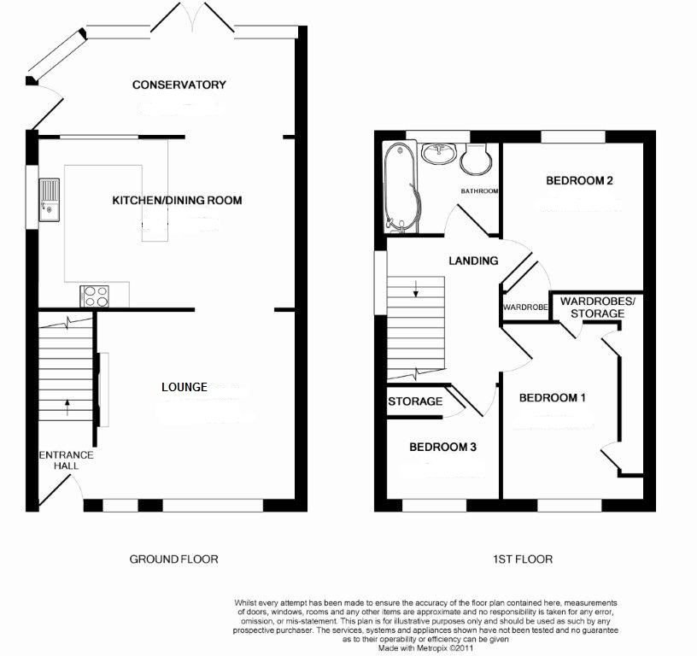
53 Hollymount Close, Exmouth, EX8 5PQ
THE ACCOMMODATION COMPRISES: uPVC double glazed front door with patterned glass window inset giving access to the: ENTRANCE HALLWAY: With stairs rising to the first floor; radiator housed in feature radiator cover; opening to: LOUNGE: 4.01m x 3.73m (13'2" x 12'3") uPVC double glazed window to front aspect; uPVC double glazed picture window with patterned glass; radiator; dado rail; television point; access to understairs storage cupboard; part glazed double doors opening to: KITCHEN/DINING ROOM: 4.78m x 3.3m (15'8" x 10'10") A spacious open plan room fitted with a range of gloss finished patterned worktop surfaces incorporating a breakfast bar area with matching splashbacks and tiled surrounds; single drainer sink unit with chrome mixer tap over; range of base cupboards, drawer units, integrated dishwasher, fridge and freezer beneath; inset five ring gas hob with stainless steel chimney style extractor hood over with light; built-in oven with cupboards above and below; two wall units at eye-level with concealed lighting beneath and adjoining display shelving; radiator; wall mounted gas boiler providing domestic hot water and gas central heating; good size serving hatch opening to the conservatory; uPVC double glazed window to side aspect. From the dining area there is an opening which gives access to the conservatory extension. CONSERVATORY: 4.27m x 2.39m (14'0" x 7'10") A fine addition to the accommodation with stripped wood flooring; radiator; range of power sockets; wall lighting; uPVC double glazed window overlooking the rear garden; uPVC double glazed double doors opening onto the rear garden; additional uPVC double glazed doors to side aspect. FIRST FLOOR LANDING: With access via wooden foldaway loft ladder to boarded roof space with velux window; uPVC double glazed window to side aspect; dado rail. BEDROOM ONE: 4.14m x 2.67m (13'7" x 8'9") uPVC double glazed window to front aspect; radiator; television point; fitted range of built-in furniture which includes chest of drawers, range of wardrobes, storage cupboards and dressing table area. BEDROOM TWO: 2.77m x 2.77m (9'1" x 9'1") uPVC double glaze window to rear aspect; radiator; built-in single wardrobe with clothes rail and shelving. BEDROOM THREE: 3.1m x 1.96m (10'2" x 6'5") maximum overall measurement. uPVC double glazed window to front aspect; radiator; fitted wardrobe over stairwell recess with clothes rail and shelving. BATHROOM/WC: Comprising of a modern suite with bath with over shower and shower splash screen; pedestal wash hand basin; WC with dual push button flush; attractive tiling to splash prone areas; chrome heated towel rail; light/shaver socket; uPVC double glazed window with patterned glass.
OUTSIDE: To the front of the property the garden is adapted to provide ample additional off-road parking with a raised decked area directly to the front of the property. A driveway provides further off-road parking with electric roller up and over door leading to a CARPORT/DRYING AREA with outside cold water tap. This area in turn leads through a GARAGE/STORE. The rear garden is fully enclosed with an area laid to artificial lawn. GARAGE/STORE: 5.59m x 2.72m (18'4" x 8'11") With up and over door; power and light connected.
FLOOR PLAN:

