Slide 1
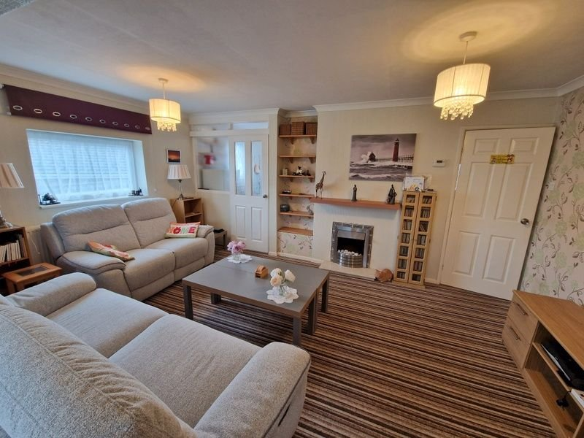
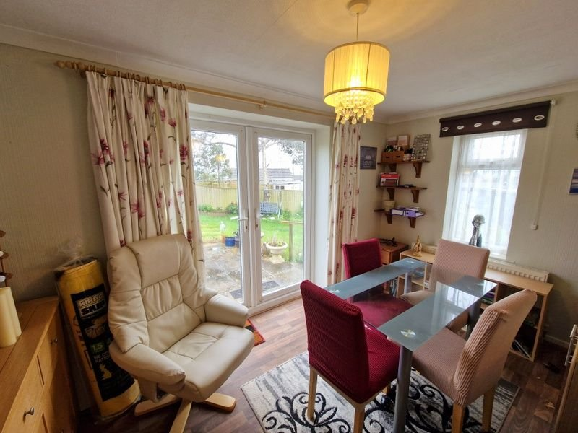
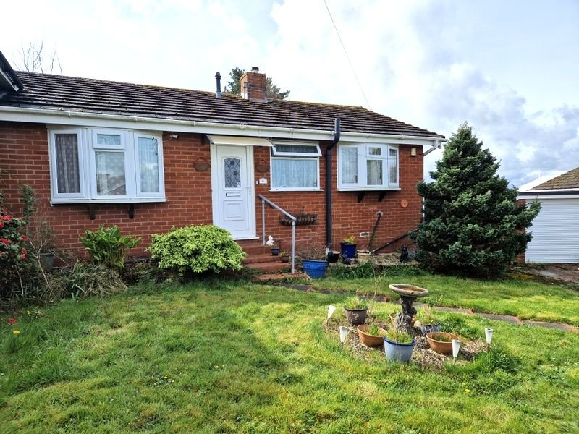
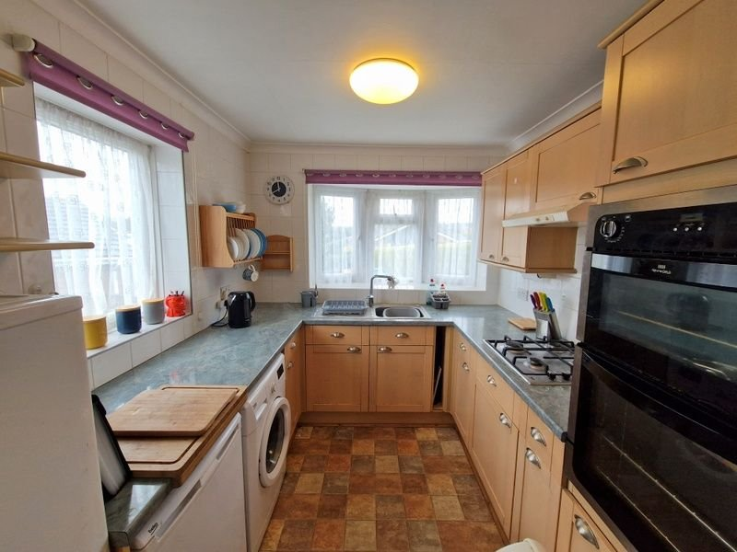
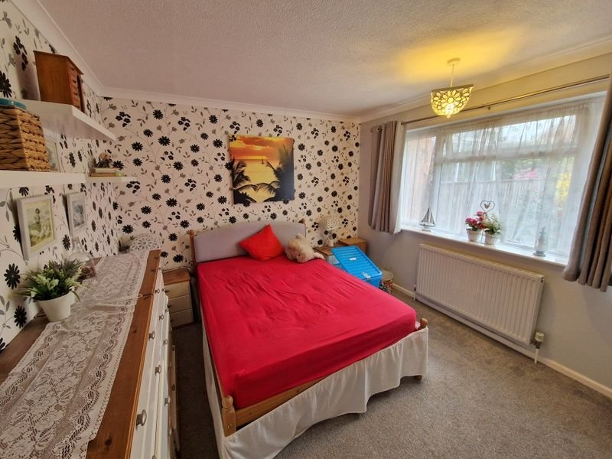
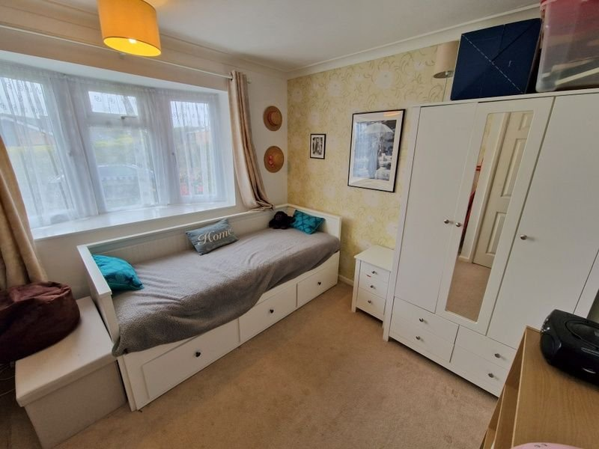
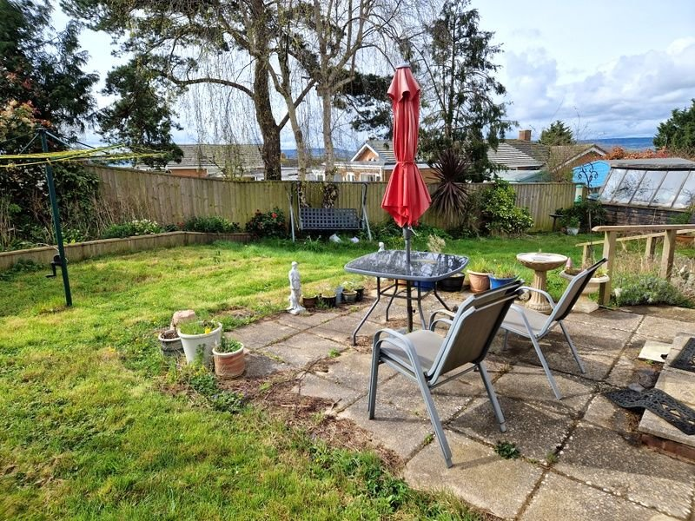
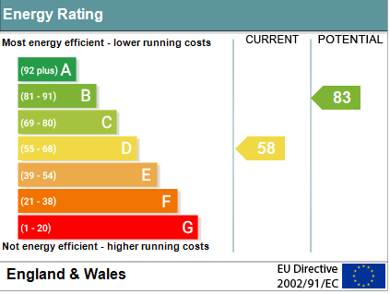
www.pennys.net
6 Elizabeth Road, Exmouth, EX8 4NT
PRICE £315,000
TENURE Freehold
A Significantly Extended Semi Detached Bungalow Located In A Favoured Location Close To Amenities And Park Offered For Sale With No Onward Chain
Generously Sized Southerly Facing Rear Garden • Ample Parking & Garage •
Spacious Open Plan Lounge & Dining Area •
Kitchen • Two Bedrooms • Shower Room/WC • Gas Central Heating •
Double Glazed Windows • Viewing Recommended • No Onward Chain •
Pennys Estate Agents Limited for themselves and for the vendor of this property whose agents they are give notice that:- (1) These particulars do not constitute any part of an offer or a contract. (2) All statements contained in these particulars are made without responsibility on the part of Pennys Estate Agents Limited. (3) None of the statements contained in these particulars are to be relied upon as a statement or representation of fact. (4) Any intending purchaser must satisfy himself/herself by inspection or otherwise as to the correctness of each of the statements contained in these particulars. (5) The vendor does not make or give and neither do Pennys Estate Agents Limited nor any person in their employment has any authority to make or give any representation or warranty whatever in relation to this property.
PENNYS ESTATE AGENTS
2 Rolle House, Rolle Street, Exmouth, Devon, EX8 2SN
Tel: 01395 264111 EMail: help@pennys.net

Slide 2
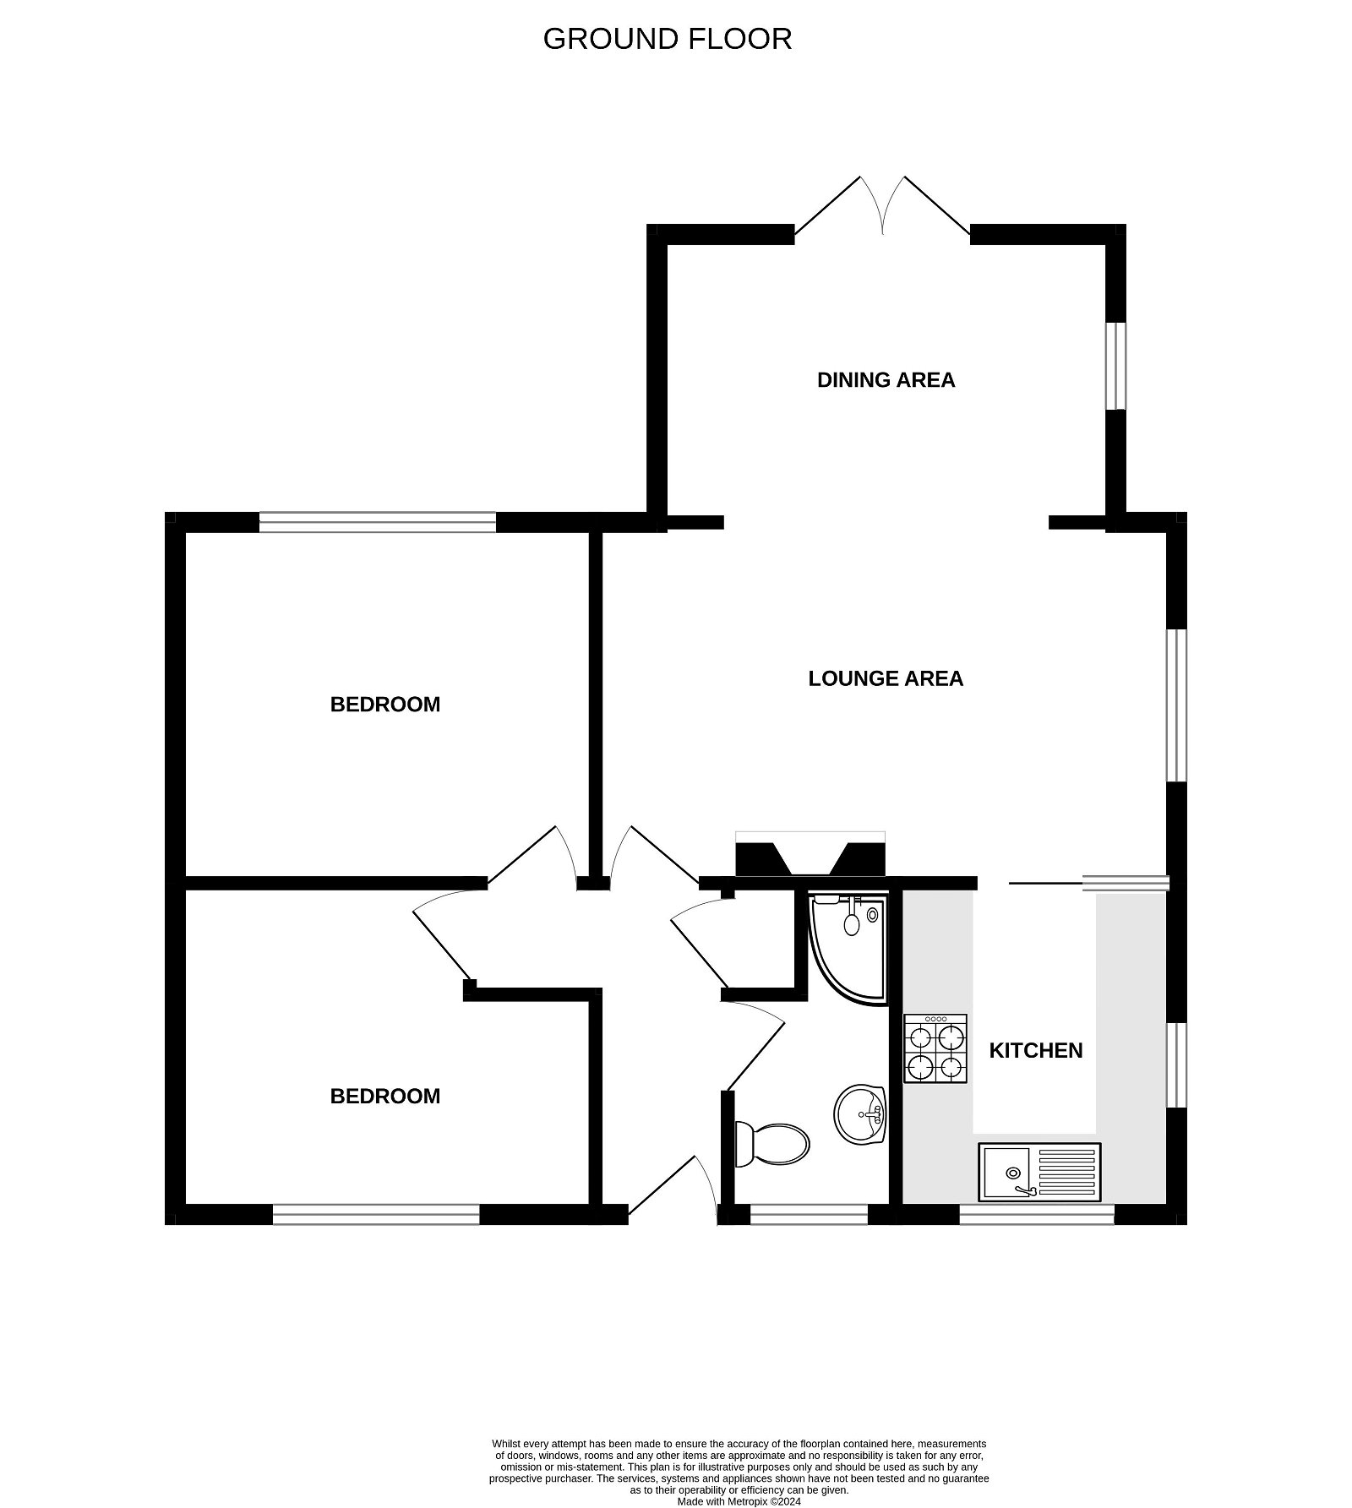
6 Elizabeth Road, Exmouth, EX8 4NT
THE ACCOMMODATION COMPRISES: uPVC front door to: RECEPTION HALL: Radiator with shelf over; access to roof space; cupboard housing gas boiler; electric consumer unit. LOUNGE/DINING ROOM: A lovely spacious and extended open plan living space comprising: LOUNGE AREA: 5.05m x 3.07m (16'7" x 10'1") Living flame electric pebble effect fire with wood mantle over and marble hearth; radiator; double glazed window to side aspect; wall recess with fitted shelving. DINING AREA: 3.94m x 2.46m (12'11" x 8'1") Wood effect flooring; radiator; double glazed to side aspect and double glazed double doors to rear garden. KITCHEN: 2.59m x 2.46m (8'6" x 8'1") Comprising range of pattern worktop surfaces with cupboards, drawer units, plumbing for an automatic washing machine and appliance space beneath; tiled surrounds; inset single drainer sink unit with mixer tap; four ring gas hob with extractor hood over; built-in oven and grill; wall mounted cupboards and plate rack; space for fridge freezer; double glazed windows to side aspect; 'Oriel' style double glazed window to front aspect. BEDROOM ONE: 3.66m x 3.07m (12'0" x 10'1") Double glazed window to rear aspect; radiator. BEDROOM TWO: 3.33m x 2.84m (10'11" x 9'4") Double glazed 'Oriel' style window to front aspect; radiator. SHOWER ROOM/WC: 2.39m x 1.73m (7'10" x 5'8") Shower cubicle; pedestal wash hand basin; WC with push button flush; radiator; mirror fronted medicine cabinet; fully tiled walls; double glazed window with frosted glass; shaver socket. OUTSIDE: Lawn front garden with pathway to the bungalow. Decorative stone flower and shrub beds, double wrought iron gates to driveway providing ample parking to GARAGE with outside tap. Side gate to rear garden. The rear garden enjoys a southerly aspect and is of generous size comprising lawn garden, patio sun terrace, flower and shrub beds, timber garden store, concrete hard standing area. GARAGE: Electrically operated up and over door, window, power and light connected and replaced roof.
FLOOR PLAN:

