Slide 1
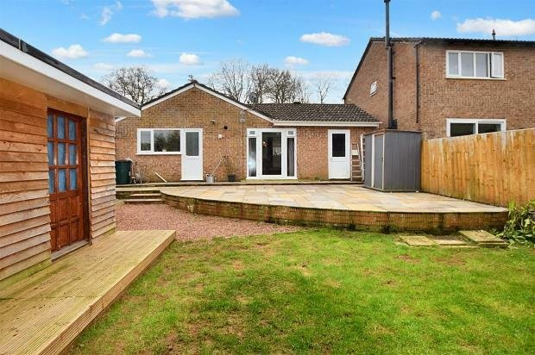
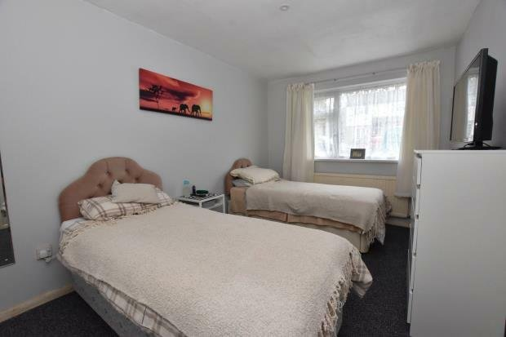
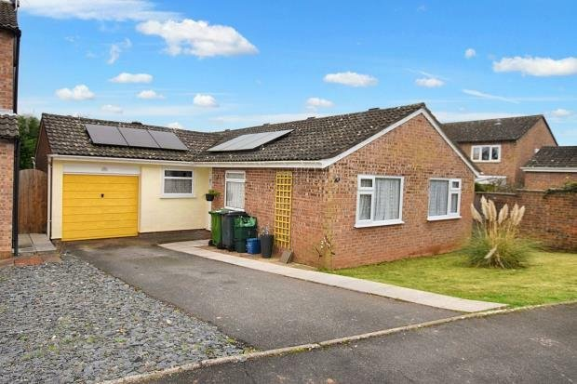
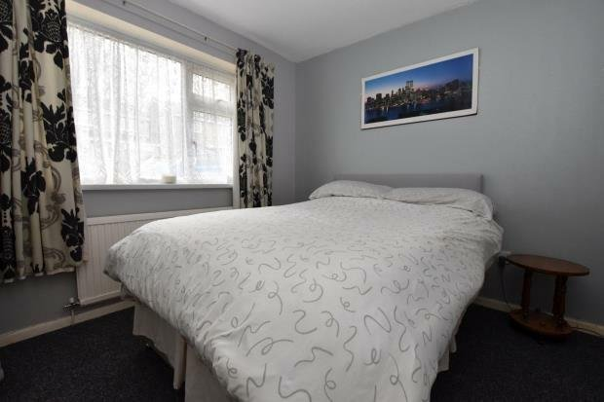
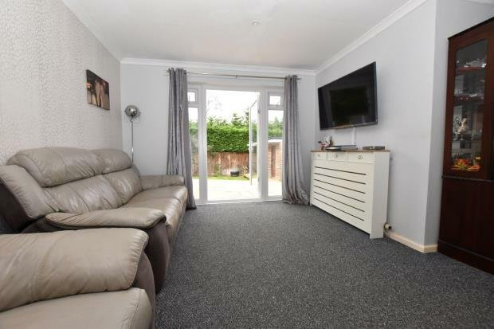
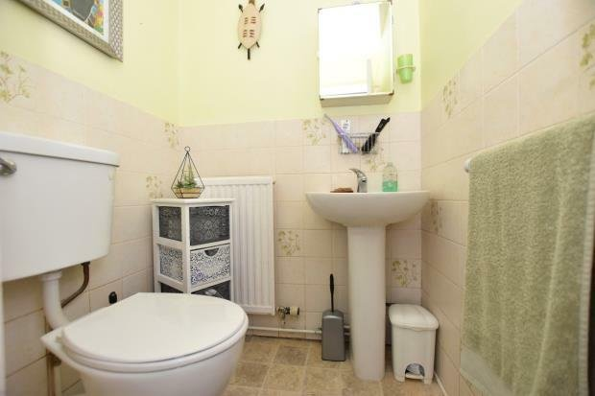
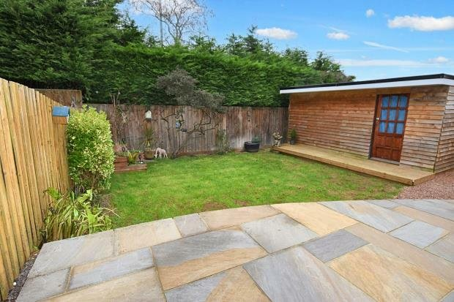
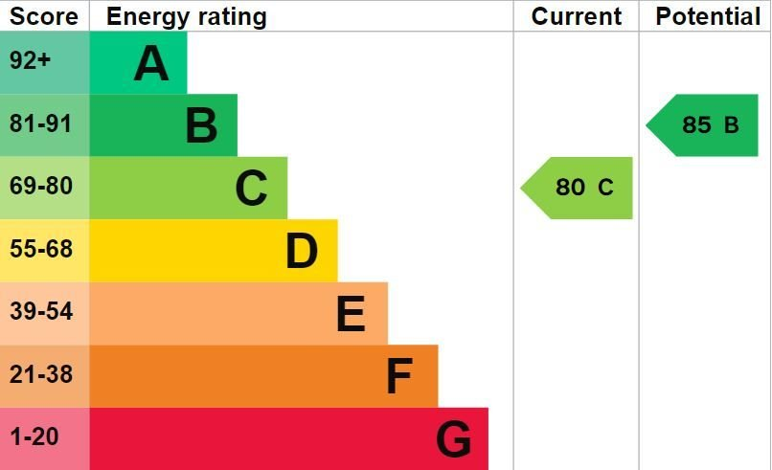
www.pennys.net
26 Evergreen Close, Exmouth, EX8 4RR
GUIDE PRICE £369,950
TENURE Freehold
A Well Presented Three Bedroom Detached Bungalow With Level Garden, Driveway & Garage
Reception Hall • Lounge/Dining Room • Modern Kitchen/Breakfast Room •
Three Bedrooms • En-Suite Cloakroom/WC • Some Newly Laid Floor Coverings •Shower Room/WC • Insulated Studio/Summerhouse • Gas Central Heating & Double Glazed Windows • No Onward Chain •
Pennys Estate Agents Limited for themselves and for the vendor of this property whose agents they are give notice that:- (1) These particulars do not constitute any part of an offer or a contract. (2) All statements contained in these particulars are made without responsibility on the part of Pennys Estate Agents Limited. (3) None of the statements contained in these particulars are to be relied upon as a statement or representation of fact. (4) Any intending purchaser must satisfy himself/herself by inspection or otherwise as to the correctness of each of the statements contained in these particulars. (5) The vendor does not make or give and neither do Pennys Estate Agents Limited nor any person in their employment has any authority to make or give any representation or warranty whatever in relation to this property.
PENNYS ESTATE AGENTS
2 Rolle House, Rolle Street, Exmouth, Devon, EX8 2SN
Tel: 01395 264111 EMail: help@pennys.net

Slide 2
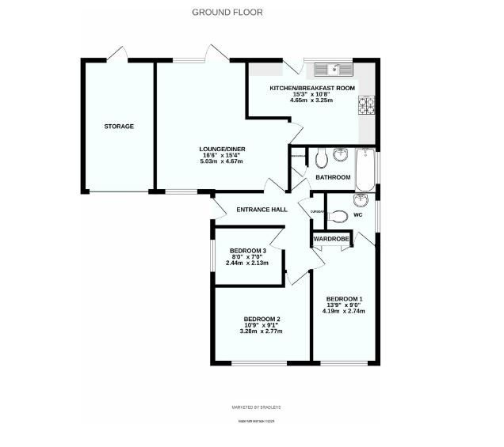
26 Evergreen Close, Exmouth, EX8 4RR
THE ACCOMMODATION COMPRISES: uPVC double glazed front door with three pattern window inset giving access to: RECEPTION HALL: With access to roof space; wall mounted radiator; coats cupboard; doors leading to: LOUNGE: 5.08m x 4.67m (16'8" x 15'4") An 'L' shaped room with double glazed windows to front and rear aspects and large double glazed door giving access to rear patio/sun terrace; two radiators; television point; telephone point; coved ceiling; newly laid carpets; door leading to: KITCHEN: 4.65m x 3.25m (15'3" x 10'8") A modern stylish kitchen fitted with a range of pattern worktop surfaces with matching splashbacks; cupboards and drawer units; gas hob with stainless steel back and matching chimney style extractor hood over; built-in oven and grill; ceramic one and a quarter bowl sink unit; space for slimline dishwasher; plumbing for an automatic washing machine and tumble dryer space; radiator; recess ceiling spotlighting; Worcester gas boiler; electric consumer unit; uPVC double glazed window to rear garden and double glazed door to outside. BEDROOM ONE: 4.19m x 2.74m (13'9" x 9'0") uPVC double glazed window to front aspect; radiator; built-in double wardrobe; new carpets; door leading to: EN-SUITE/WC: 1.88m x 1.36m (6'2" x 4'5") Comprising of a wash hand basin; WC; radiator; part tiled walls; uPVC double glazed window with pattern glass. BEDROOM TWO: 3.28m x 2.77m (10'9" x 9'1") uPVC double glazed window to front aspect; radiator. BEDROOM THREE: 2.44m x 2.13m (8'0" x 7'0") uPVC double glazed window to side aspect; radiator. BATHROOM/WC: Comprising of fitted walk-in shower; high level WC; wash hand basin with mixer tap with cupboard beneath; built-in airing cupboard housing hot water tank and timer controls; window with pattern glass to side aspect; radiator. OUTSIDE: To the front of the property is a lawn area of garden, a driveway provides off-road parking for two cars and leads to the garage. The rear garden is fully enclosed and has a large curved patio/sun terrace ideal for outside entertaining, level area of lawned garden with a WOODEN SUMMERHOUSE/STUDIO: 4.67m x 3.48m (15'4" x 11'5") which has electric power and double glazed windows and decking providing an ideal space for an office. A side gate and patio pathway gives access back round to the front of the property. GARAGE: 4.93m x 2.39m (16'2" x 7'10") With up and over door; power and light connected; door giving direct access to REAR GARDEN; solar power system..
FLOOR PLAN:

