Slide 1
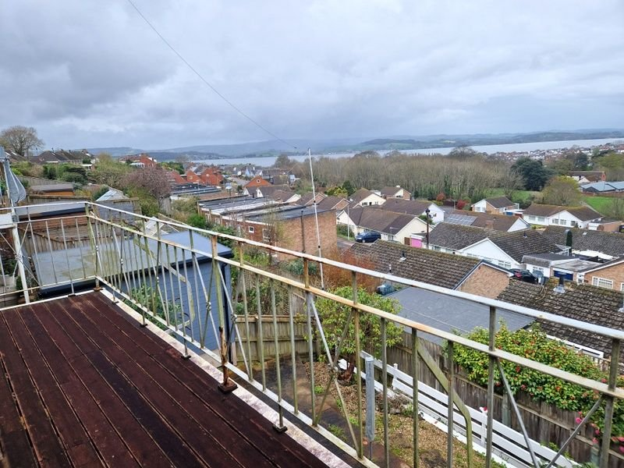
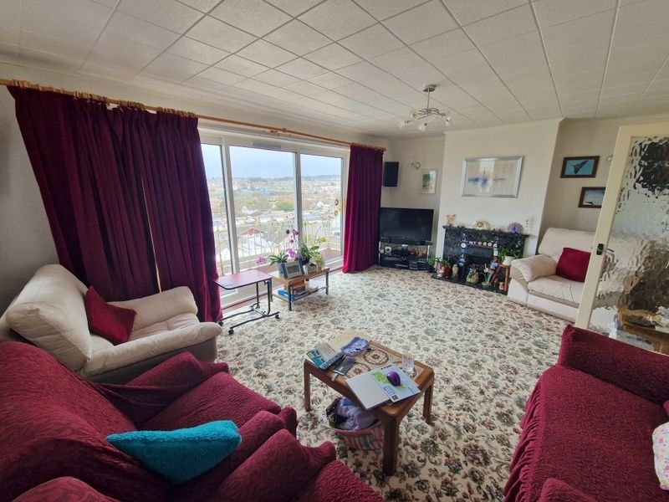
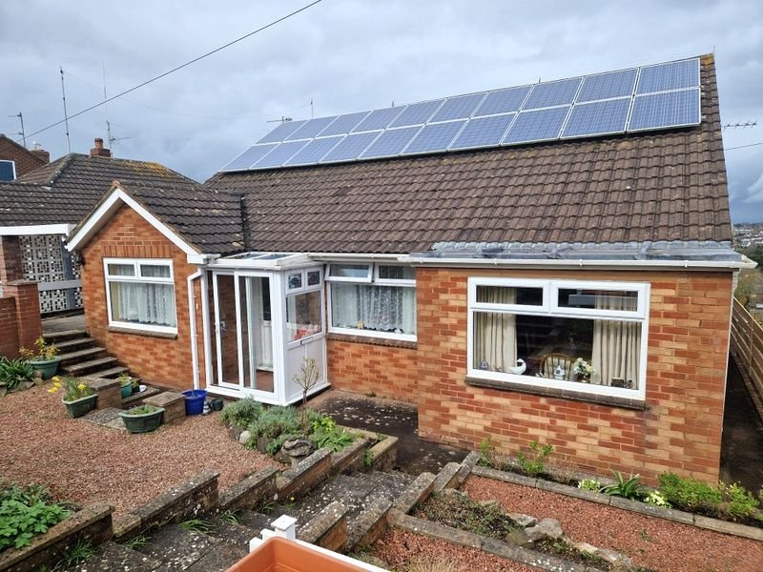
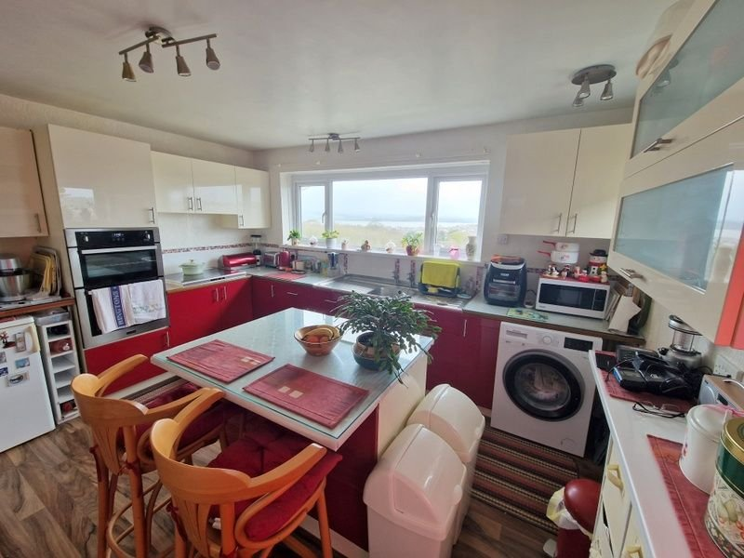
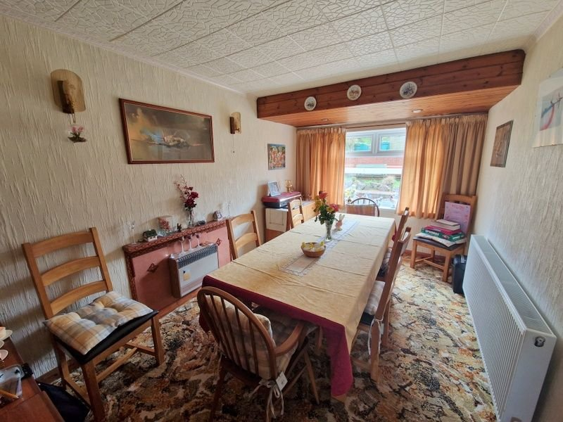
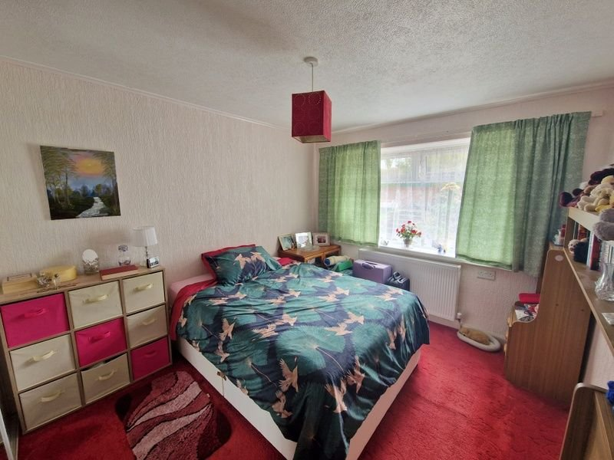
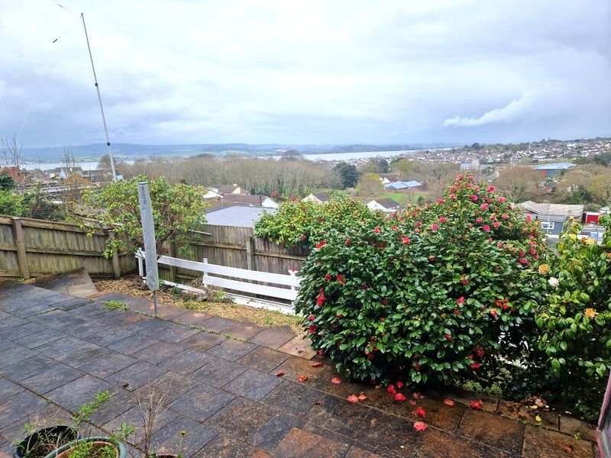
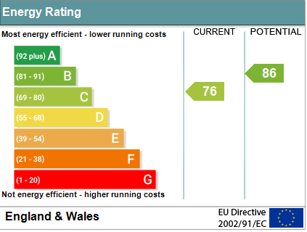
www.pennys.net
33 Hamilton Lane, Exmouth, EX8 2JT
GUIDE PRICE £650,000
TENURE Freehold
A Deceptively Spacious Detached Residence With Stunning Views Across The Town To The Estuary
Lounge With Sun Balcony Off • Dining Room/Bedroom Three • Kitchen/Breakfast Room •
Two Ground Floor Bedrooms • Office/Hobbies Room •
Modern Bathroom/WC • First Floor Bedroom Four & Shower Room/WC •
Large Basement Area Offering Huge Potential • Front & Rear Gardens •
Car Port & Garage • Double Glazed Windows & Air Heat Source Pump For Central Heating & Hot Water •
Pennys Estate Agents Limited for themselves and for the vendor of this property whose agents they are give notice that:- (1) These particulars do not constitute any part of an offer or a contract. (2) All statements contained in these particulars are made without responsibility on the part of Pennys Estate Agents Limited. (3) None of the statements contained in these particulars are to be relied upon as a statement or representation of fact. (4) Any intending purchaser must satisfy himself/herself by inspection or otherwise as to the correctness of each of the statements contained in these particulars. (5) The vendor does not make or give and neither do Pennys Estate Agents Limited nor any person in their employment has any authority to make or give any representation or warranty whatever in relation to this property.
PENNYS ESTATE AGENTS
2 Rolle House, Rolle Street, Exmouth, Devon, EX8 2SN
Tel: 01395 264111 EMail: help@pennys.net

Slide 2
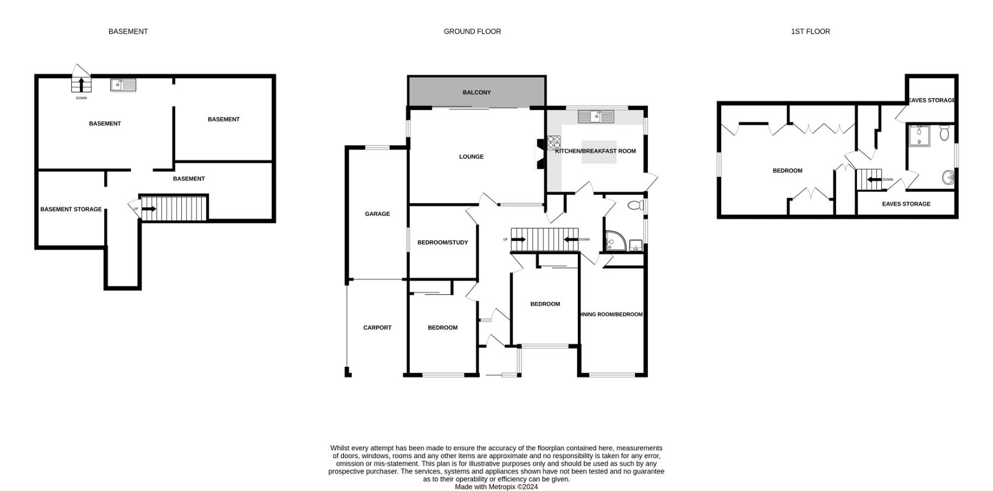
33 Hamilton Lane, Exmouth, EX8 2JT
THE ACCOMMODATION COMPRISES: ENTRANCE PORCH: With sliding double glazed door and window; courtesy light; tiled floor; inner double glazed door to ENTRANCE LOBBY; glass panelled door to: RECEPTION HALL: Radiator; stairs to FIRST FLOOR LANDING and stairs to LOWER GROUND FLOOR; telephone point; shelved storage cupboard. LOUNGE: 5.69m x 3.96m (18'8" x 13'0") With triple sliding double glazed doors opening to SUN BALCONY gaining stunning views over the town to the estuary and coastline beyond; feature marble fire surround and hearth housing coal effect living flame gas fire; television point; three radiatiors; further double glazed window to side aspect. KITCHEN/BREAKFAST ROOM: 4.11m x 3.53m (13'6" x 11'7") With double glazed windows again gaining wonderful views across the town to the estuary; range of worktop surfaces with double drainer sink unit with cupboards, drawer units and plumbing for an automatic washing machine beneath; gas hob; built-in oven and grill; island unit providing breakfast bar area with cupboards and drawer units beneath; wall mounted cupboards; two radiators; further double glazed window to side aspect; double glazed double doors to OUTSIDE; television point. DINING ROOM/BEDROOM THREE: 5.05m x 2.72m (16'7" x 8'11") Including door way recess; radiator; double glazed window to front aspect; recess ceiling spotlighting; cupboard housing electric meters. BEDROOM ONE: 3.71m x 2.97m (12'2" x 9'9") Double glazed window to front aspect; radiator; built-in wardrobes. BEDROOM TWO: 3.94m x 2.64m (12'11" x 8'8") Double glazed window to front aspect; radiator; built-in wardrobes. OFFICE/HOBBIES ROOM: 3.05m x 2.69m (10'0" x 8'10") Radiator. SHOWER ROOM/WC: 2.44m x 1.68m (8'0" x 5'6") Corner shower cubicle with splash back walls; vanity wash hand basin; light shaver socket; WC with push button flush; two double glazed windows; radiator; mirror fronted medicine cabinet; ceiling extractor fan; towel radiator. FIRST FLOOR LANDING: Access to eaves storage spaces. BEDROOM FOUR: 5.49m x 3.51m (18'0" x 11'6") Double glazed window to side aspect; built-in wardrobes with access to eaves space; radiator; tongue and groove high vaulted style ceiling. SHOWER ROOM/WC: Shower cubicle; pedestal wash hand basin; WC; double glazed window with views; light shaver socket; radiator; fitted mirror cupboard with light shaver socket over; tiled walls; tongue and groove vaulted style ceiling. LOWER GROUND FLOOR BASEMENT AREAS: A useful area offering huge potential arranged in 4 areas.
AREA ONE: 5.64m x 4.06m (18'6" x 13'4") Door to rear garden; sink unit. AREA TWO: 4.14m x 3.51m (13'7" x 11'6") With water cylinder and boiler tank; solar panel controls. AREA THREE: 2.54m x 2.44m (8'4" x 8'0") Access to cupboard. AREA FOUR: 3.05m x 2.67m (10'0" x 8'9") With access to storage areas underneath front of the property. OUTSIDE: Driveway leading to CARPORT and SINGLE GARAGE. Decorative stone front garden with patio areas and steps, outside lighting, side pathways to either side of the property and outside tap. The rear garden comprises of tier patio areas and decorative stone garden, shrub beds, summer house and lovely views towards the estuary. Air source heat pump.
FLOOR PLAN:

