Slide 1
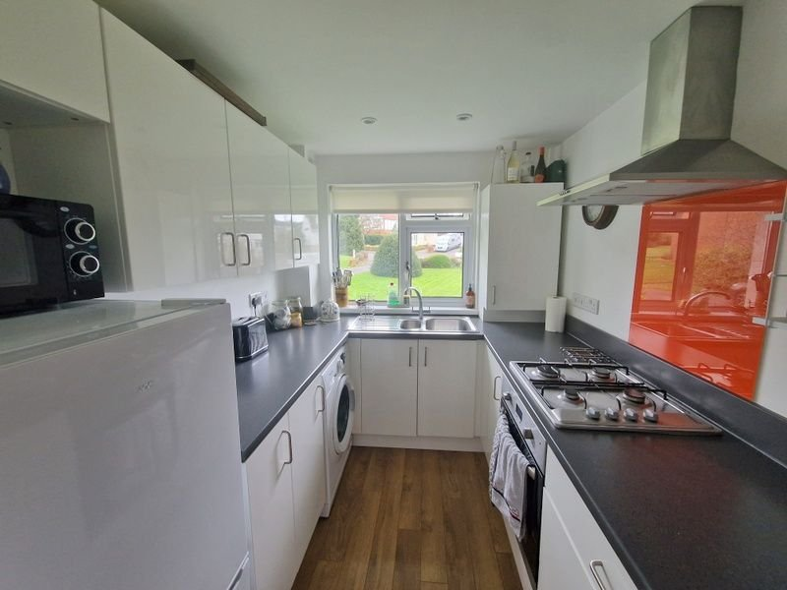
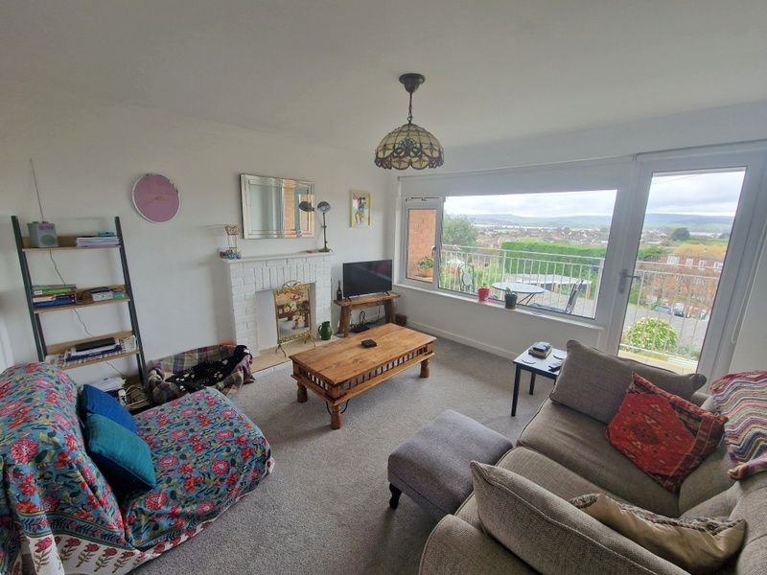
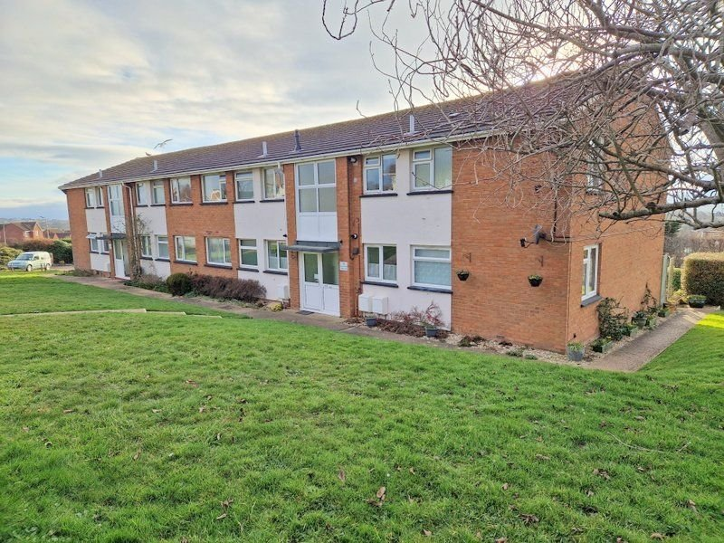
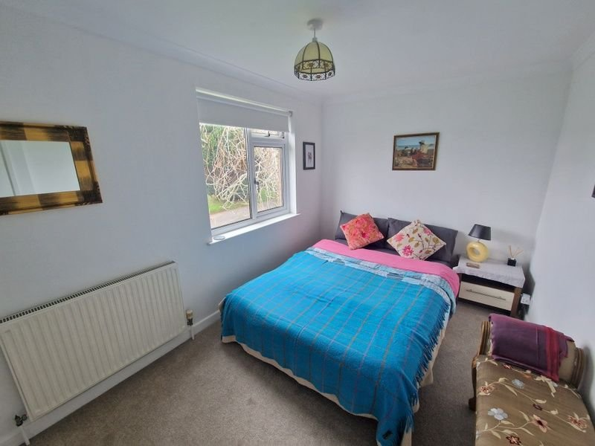
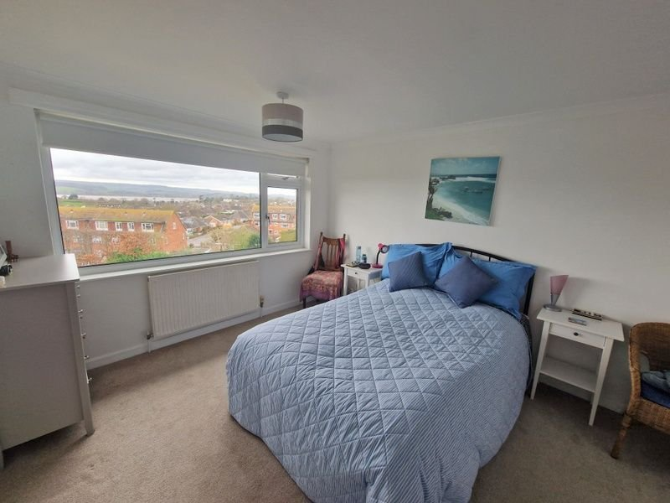
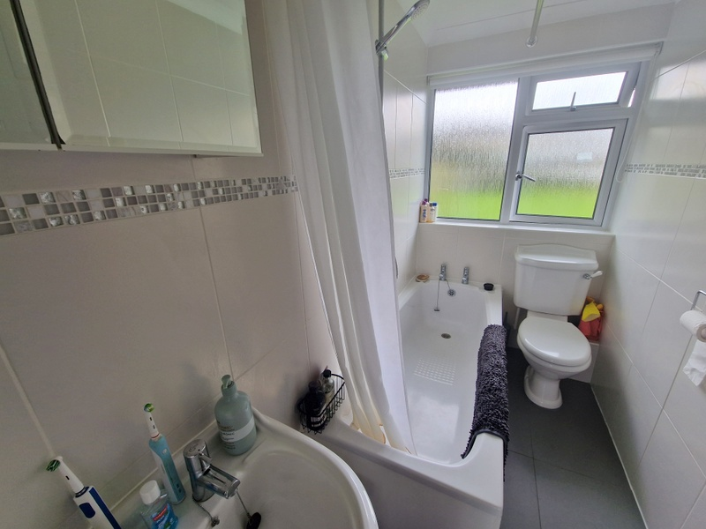
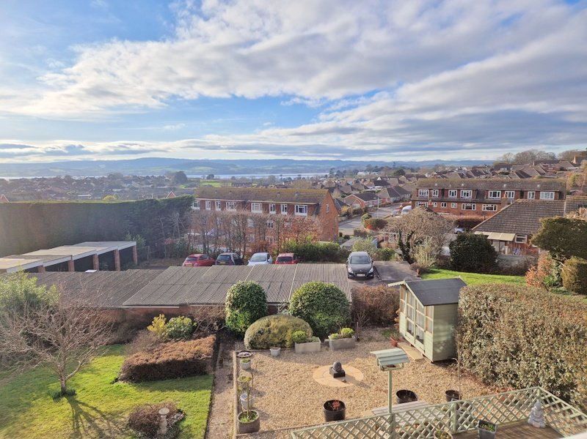
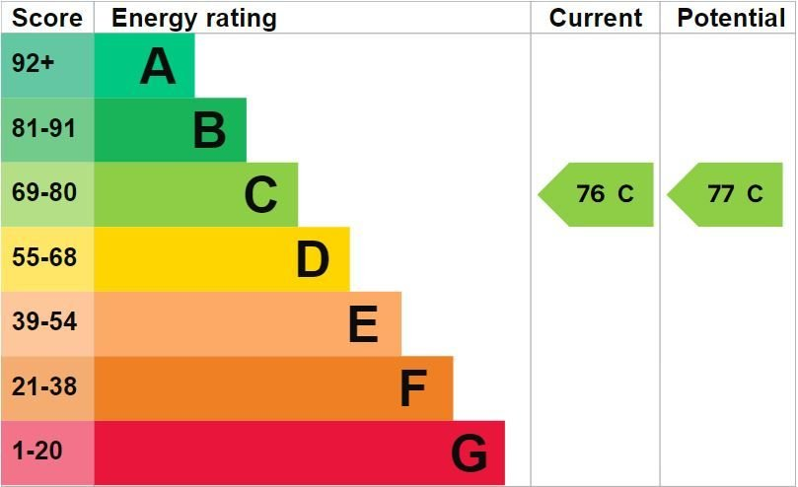
www.pennys.net
Flat 8 West View, 125 Hulham Road, Exmouth, EX8 4QZ
GUIDE PRICE £225,000
TENURE Share of Freehold
A Beautifully Presented First Floor Purpose Built Apartment With Wonderful Estuary And Coastline Views
Reception Hall • Lounge With Access To Sun Balcony • Two Double Bedrooms •
Modern Stylish Kitchen • Well Appointed Bathroom/WC •
Double Glazed Windows • Gas Central Heating •
Communal Grounds To The Front Of The Development • Garage •
NO ONWARD CHAIN •
Pennys Estate Agents Limited for themselves and for the vendor of this property whose agents they are give notice that:- (1) These particulars do not constitute any part of an offer or a contract. (2) All statements contained in these particulars are made without responsibility on the part of Pennys Estate Agents Limited. (3) None of the statements contained in these particulars are to be relied upon as a statement or representation of fact. (4) Any intending purchaser must satisfy himself/herself by inspection or otherwise as to the correctness of each of the statements contained in these particulars. (5) The vendor does not make or give and neither do Pennys Estate Agents Limited nor any person in their employment has any authority to make or give any representation or warranty whatever in relation to this property.
PENNYS ESTATE AGENTS
2 Rolle House, Rolle Street, Exmouth, Devon, EX8 2SN
Tel: 01395 264111 EMail: help@pennys.net

Slide 2
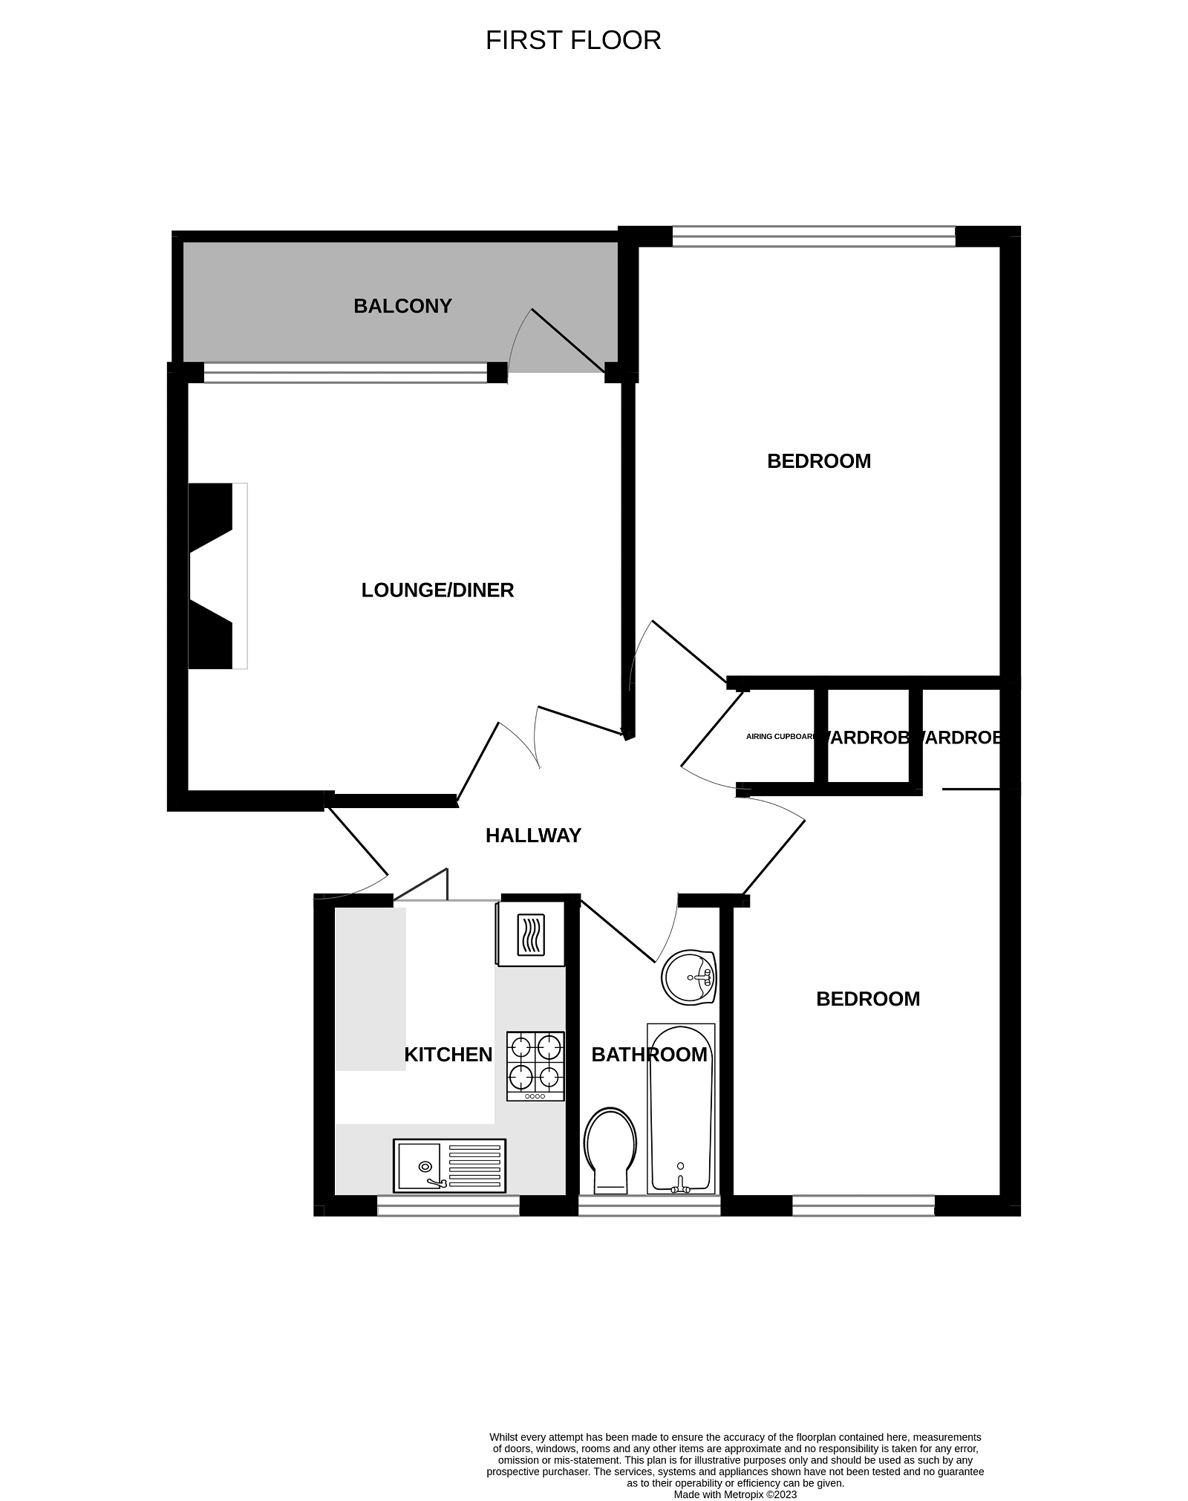
Flat 8 West View, 125 Hulham Road, Exmouth, EX8 4QZ
THE ACCOMMODATION COMPRISES: Communal Entrance with stairs to the FIRST FLOOR. The FD30 rated wooden door with spyhole to: RECEPTION HALL: Radiator; wood effect flooring; smoke detector; coved ceiling; thermostat control for central heating; good size linen cupboard with slatted shelving; glazed double doors with patterned glass leading to: LOUNGE: 3.78m x 3.23m (12'5" x 10'7") A lovely bright room with uPVC double glazed window and uPVC double glazed door giving access to tiled COVERED SUN BALCONY with both enjoying stunning views towards the estuary and coastline beyond; feature fireplace with raised tiled hearth; television point; radiator; coved ceiling. KITCHEN: 2.59m x 2.11m (8'6" x 6'11") Stylishly fitted with modern white units and range of patterned worktop surfaces with matching splashbacks; inset stainless steel single drainer one and a half bowl sink unit with mixer tap; range of base cupboard and drawer units, space and plumbing for washing machine beneath work tops; inset four ring gas hob with coloured glass splashback and stainless steel chimney style extractor hood over with light, built-in oven below; range of matching wall units at eye-level; space for upright fridge/freezer; combi gas boiler serving domestic hot water and central heating housed in matching unit cover; electric consumer unit; recess ceiling spotlighting; uPVC double glazed window overlooking the front elevation. BEDROOM ONE: 3.86m x 3.23m (12'8" x 10'7") uPVC double glazed window to rear elevation again enjoying lovely estuary and coastline views; radiator; coved ceiling; television point; built-in wardrobe with clothes rail and shelf. BEDROOM TWO: 3.53m x 2.39m (11'7" x 7'10") A good size second bedroom with uPVC double glazed window to side elevation enjoying an open aspect; radiator; built-in wardrobe with clothes rail and shelving. BATHROOM/WC: Comprising bath with shower unit over, shower curtain and rail; pedestal wash hand basin with wall mounted mirror fronted medicine cabinet over; WC; chrome heated towel rail; recess ceiling spotlighting; coved ceiling; attractive fully tiled walls; uPVC double glazed window with patterned glass. OUTSIDE: West View enjoys good size communal gardens to the front of the development which are mainly laid to lawn with colourful flower and shrub beds. To the rear of the development the property benefits from a GARAGE in a block with up and over door. TENURE AND OUTGOINGS: We understand that the property is held on a 999 year lease, we also understand that the flat owns an equal share of the freehold. The service charge is approximately £95 per month.
FLOOR PLAN:

