Slide 1
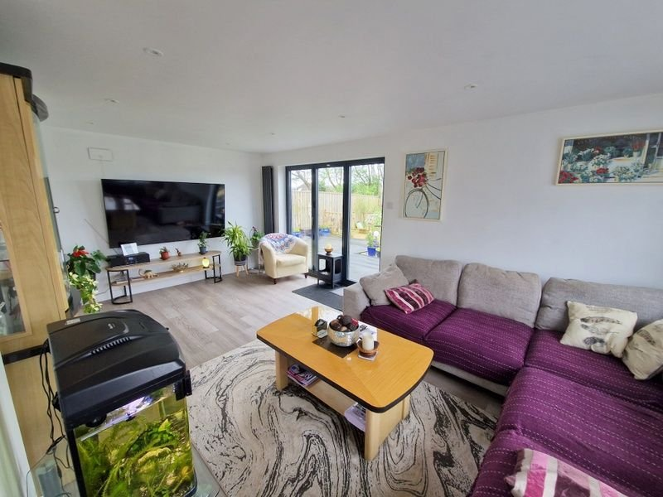
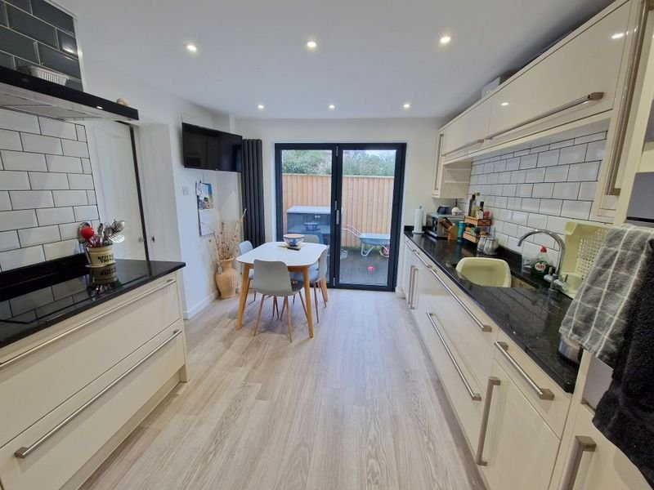
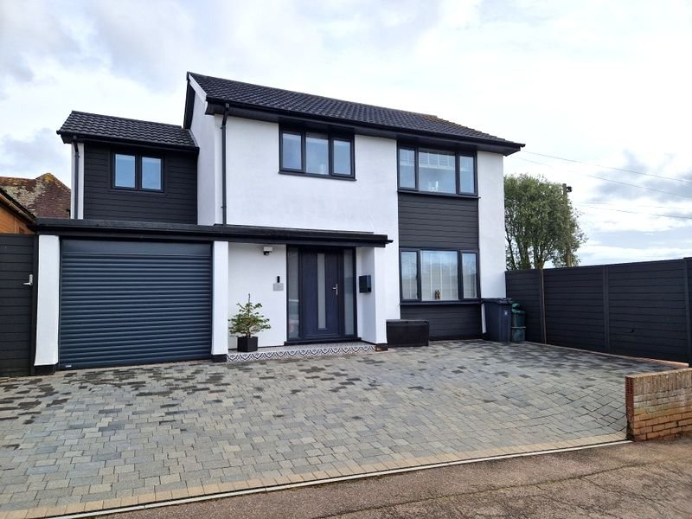
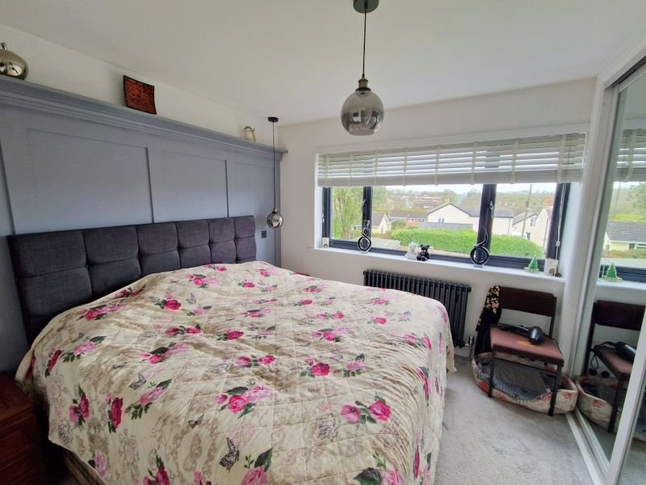
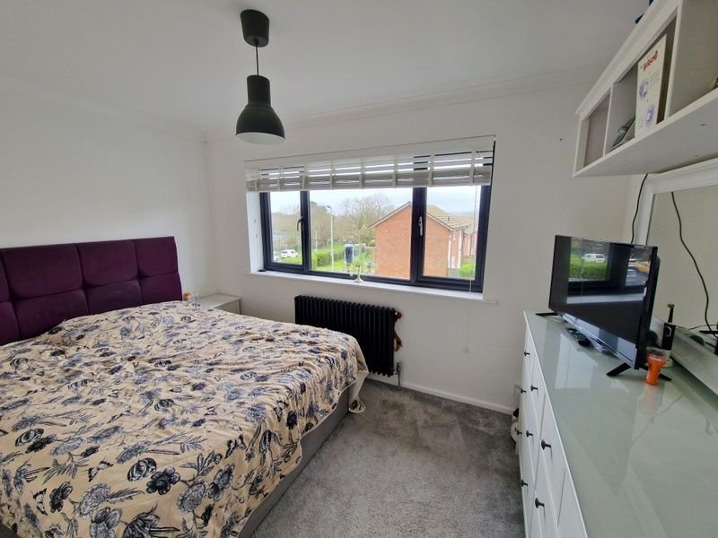
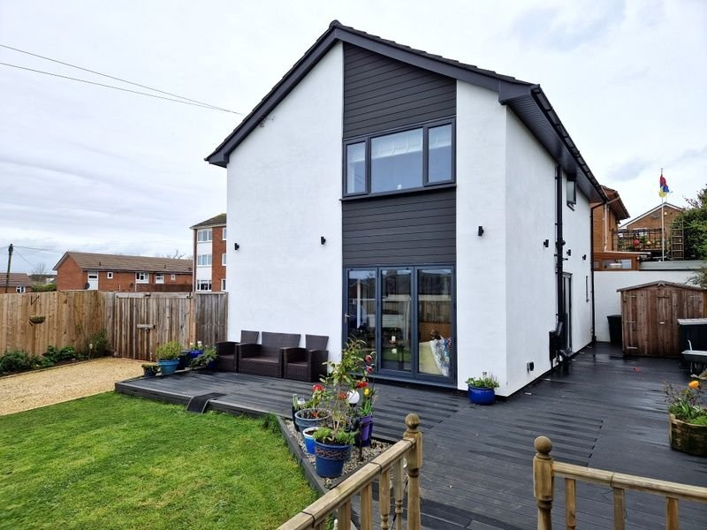
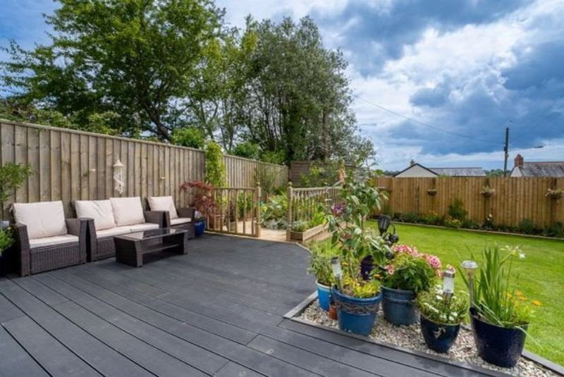
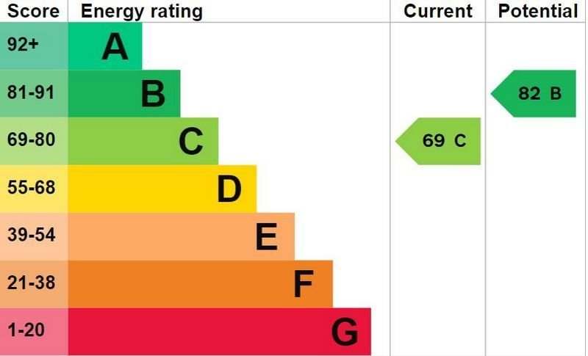
www.pennys.net
30 York Close, Exmouth, EX8 4EQ
GUIDE PRICE £500,000
TENURE Freehold
A Beautifully Presented Four Bedroom Detached House Benefiting From A Delightful Corner Plot And Situated In A Popular Location Close To A Range Of Amenities
Reception Hall • Sitting Room With Bi-Folding Doors • Quality Fitted Kitchen/Breakfast Room •
Ground Floor Cloakroom/WC & Separate Utility Room •
Four First Floor Bedrooms - Main With En-Suite Shower Room/WC • First Floor Wet Room/WC • Attractive Landscaped Southerly Facing Gardens With Decked Area •
Gas Central Heating & Double Glazed Windows • Block Paved Driveway • Garage •
Further Gated Area Ideal For Caravan/Boat • Recently Modernised • Viewing Highly Recommended •
Pennys Estate Agents Limited for themselves and for the vendor of this property whose agents they are give notice that:- (1) These particulars do not constitute any part of an offer or a contract. (2) All statements contained in these particulars are made without responsibility on the part of Pennys Estate Agents Limited. (3) None of the statements contained in these particulars are to be relied upon as a statement or representation of fact. (4) Any intending purchaser must satisfy himself/herself by inspection or otherwise as to the correctness of each of the statements contained in these particulars. (5) The vendor does not make or give and neither do Pennys Estate Agents Limited nor any person in their employment has any authority to make or give any representation or warranty whatever in relation to this property.
PENNYS ESTATE AGENTS
2 Rolle House, Rolle Street, Exmouth, Devon, EX8 2SN
Tel: 01395 264111 EMail: help@pennys.net

Slide 2
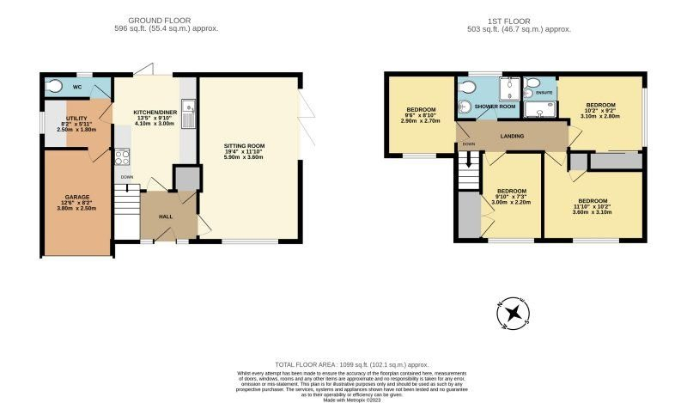
30 York Close, Exmouth, EX8 4EQ
THE ACCOMMODATION COMPRISES: Composite front door to: RECEPTION HALL: Antique style radiator; stairs to first floor landing. SITTING ROOM: 5.89m x 3.61m (19'4" x 11'10") A bright room with bi-folding doors opening onto the gardens; television point; upright radiator. KITCHEN/BREAKFAST ROOM: 4.09m x 3m (13'5" x 9'10") A well appointed quality kitchen with granite worktop surfaces with integrated sink unit and drainer; range of cupboards, drawer units and built in fridge freezer under worktops; induction hob with extractor over; Smeg oven and microwave; wall mounted cupboards; bi-folding doors to rear decked area; upright radiator. UTILITY ROOM: 2.49m x 1.8m (8'2" x 5'11") Worktop surfaces with built in dishwasher and plumbing for an automatic washing machine; cupboards beneath worktops; double glazed window and door to GARAGE. GROUND FLOOR CLOAKROOM/WC: Stylishly fitted with space saver wash hand basin with fitted mirror and light over; WC with push button flush; heated towel rail; radiator; extractor fan; attractive tiling; double glazed window. FIRST FLOOR LANDING: With access to roof space; radiator. BEDROOM ONE: 3.1m x 2.79m (10'2" x 9'2") Built-in mirror fronted wardrobes; antique style radiator; double glazed window. EN-SUITE SHOWER ROOM/WC: Stylishly fitted with shower cubicle; wash hand basin with cabinet beneath and WC; tube funnell light; chrome heated towel rail; radiator. BEDROOM TWO: 3.61m x 3.1m (11'10" x 10'2") Double glazed window to front aspect; built-in wardrobe; television point; antique style radiator. BEDROOM THREE: 3m x 2.21m (9'10" x 7'3") Double glazed window to front aspect; antique style radiator. BEDROOM FOUR: 2.9m x 2.69m (9'6" x 8'10") Double glazed window to front aspect; built-in wardrobe; antique style radiator. WETROOM/WC: Stylishly fitted with shower area and shower screen; wash hand basin with display surface, cupboard and WC with push button flush beneath; large touch sensitive mirror with light; fully tiled walls; double glazed window. OUTSIDE: Commanding an impressive corner position with block paved parking leading to the garage, gate gives access to further decorative stone parking area ideal for a small boat/caravan. Stunning southerly facing landscaped gardens comprising of composite decking, raised vegetable plot, timber store, extensive lawn gardens and rear decked terrace area.
FLOOR PLAN:

