Slide 1
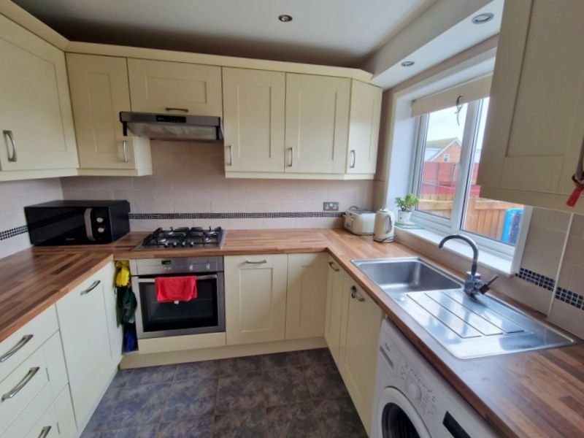
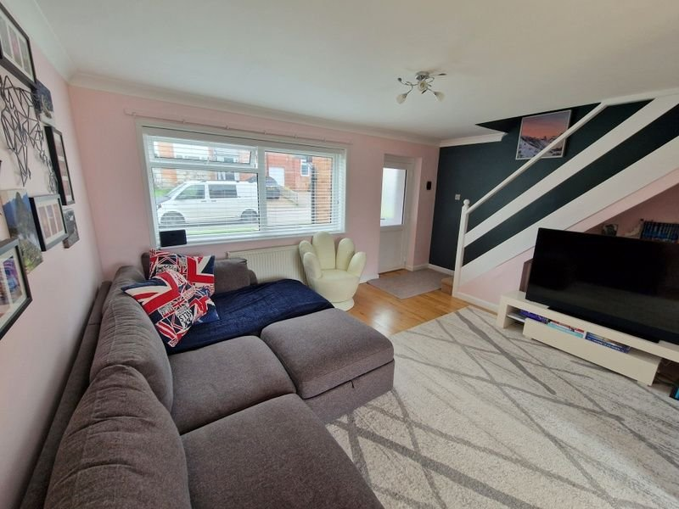
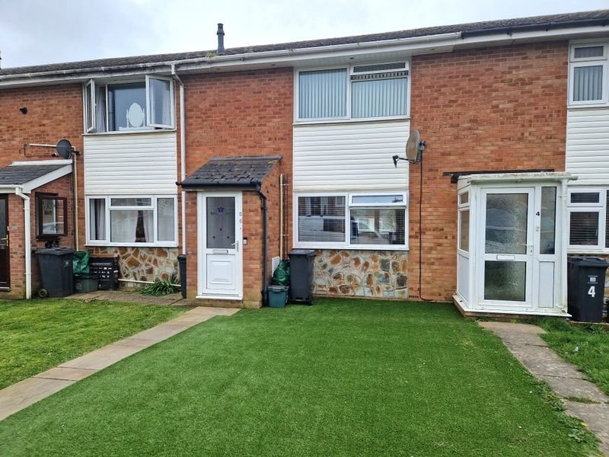
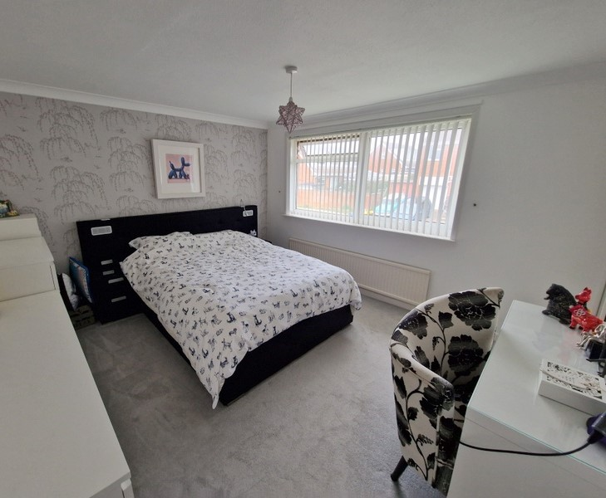
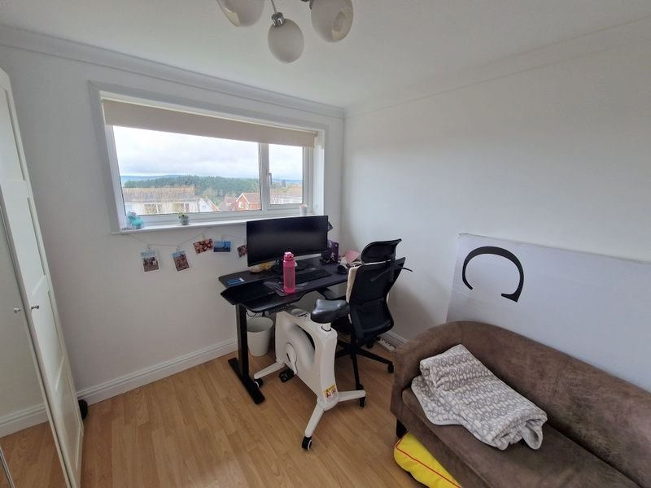
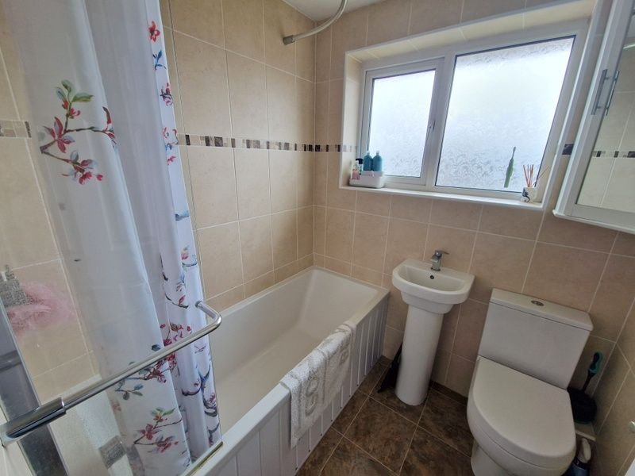
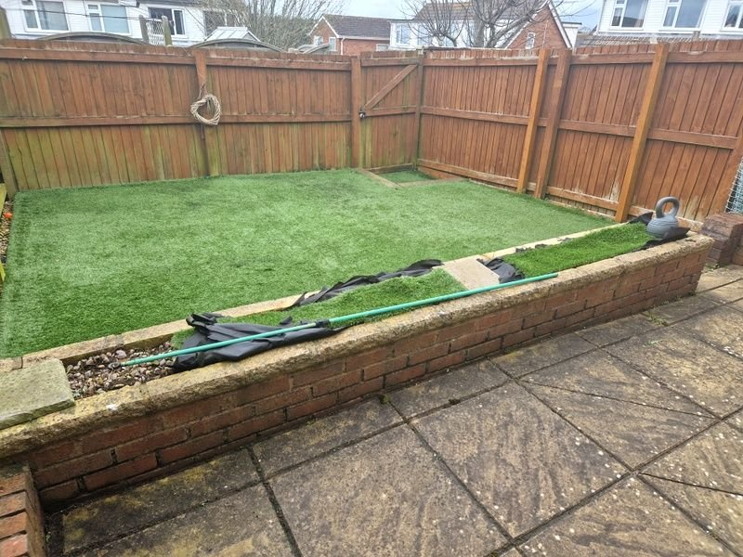
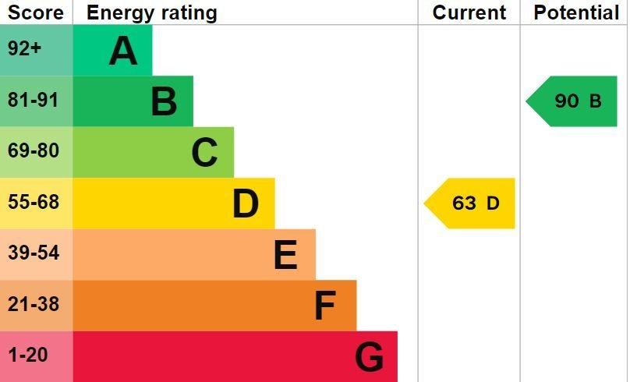
www.pennys.net
6 Yew Tree Close, Exmouth, EX8 5NF
GUIDE PRICE £250,000
TENURE Freehold
A Well Presented Mid Terraced House Located In A Favoured Location Close To Amenities With Views To The Estuary & Coastline Beyond
Porch • Lounge/Dining Room • Modern Kitchen •
Two Bedrooms • Modern Bathroom/WC •
Gas Central Heating • Double Glazed Windows •
Well Planned South Facing Rear Garden • Garage In A Block •
Pennys Estate Agents Limited for themselves and for the vendor of this property whose agents they are give notice that:- (1) These particulars do not constitute any part of an offer or a contract. (2) All statements contained in these particulars are made without responsibility on the part of Pennys Estate Agents Limited. (3) None of the statements contained in these particulars are to be relied upon as a statement or representation of fact. (4) Any intending purchaser must satisfy himself/herself by inspection or otherwise as to the correctness of each of the statements contained in these particulars. (5) The vendor does not make or give and neither do Pennys Estate Agents Limited nor any person in their employment has any authority to make or give any representation or warranty whatever in relation to this property.
PENNYS ESTATE AGENTS
2 Rolle House, Rolle Street, Exmouth, Devon, EX8 2SN
Tel: 01395 264111 EMail: help@pennys.net

Slide 2
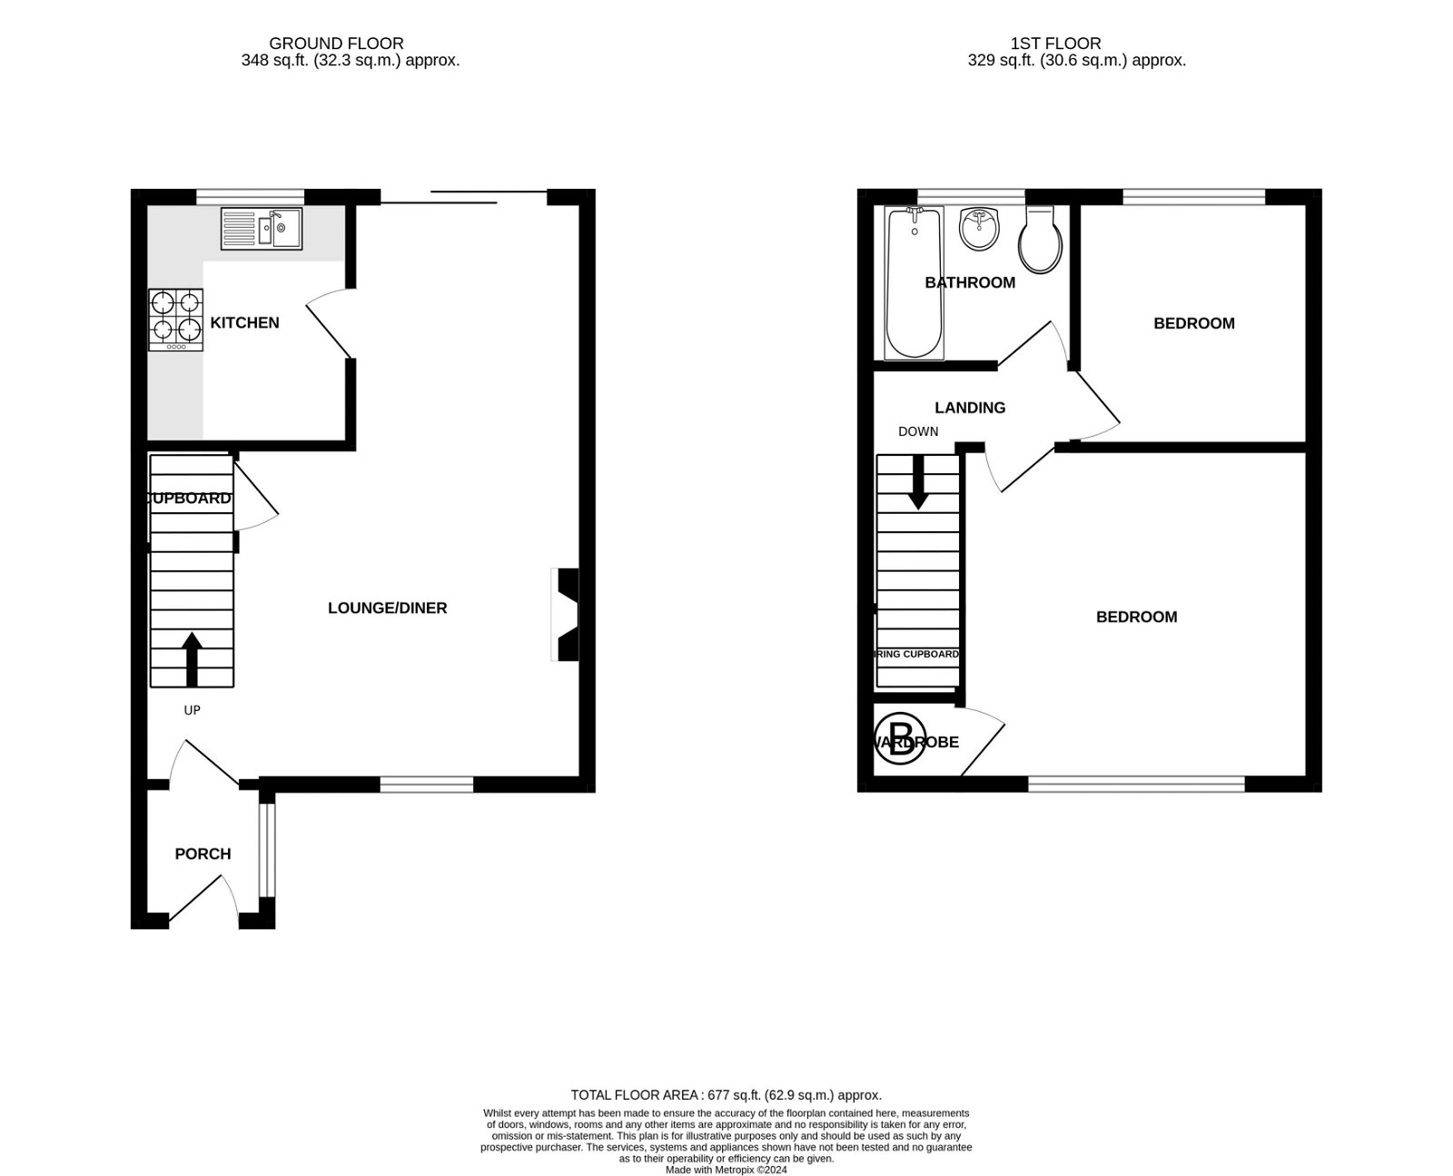
6 Yew Tree Close, Exmouth, EX8 5NF
THE ACCOMMODATION COMPRISES: uPVC front door to: PORCH: Double glazed window and inner double glazed door to: LOUNGE/DINING ROOM: 6.4m x 4.83m (21'0" x 15'10") Narrowing to 8'0". Solid wood flooring throughout; two radiators; television point; stairs to first floor landing with useful understairs recess with shelving; sliding double glazed patio doors to rear garden, KITCHEN: 2.64m x 2.21m (8'8" x 7'3") With wood effect worktop surfaces with cupboards, drawer units and plumbing for an automatic washing machine beneath; tiled surrounds; stainless steel single drainer sink unit; wall mounted cupboards; space for upright fridge freezer; gas cooker point; built-in oven with extractor hood over; recess ceiling spotlighting; double glazed window to rear aspect. FIRST FLOOR LANDING: Access to roof space. BEDROOM ONE: 3.81m x 3.51m (12'6" x 11'6") Double glazed window to front aspect; radiator; built-in cupboard housing gas boiler; television point. BEDROOM TWO: 2.92m x 2.72m (9'7" x 8'11") Wood laminate flooring; radiator; double glazed window to rear aspect with estuary and coastline views. BATHROOM/WC: 1.78m x 1.68m (5'10" x 5'6") Modern suite with fully tiled walls; chrome heated towel rail and medicine cabinet; bath with shower over; pedestal wash hand basin; WC with push button flush; uPVC double glazed window with pattern glass; recess ceiling spotlighting. OUTSIDE: Artificial lawn front garden with path to front door. South facing enclosed rear garden planned with ease of maintenance in mind with patio sun terrace and artificial lawn area, rear pedestrian gate and garage in a block close by.
FLOOR PLAN:

