Slide 1
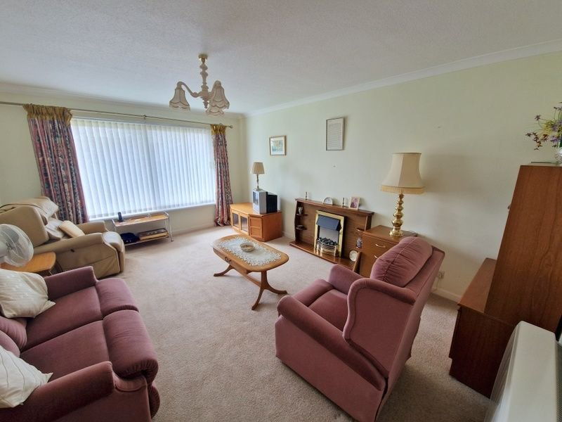
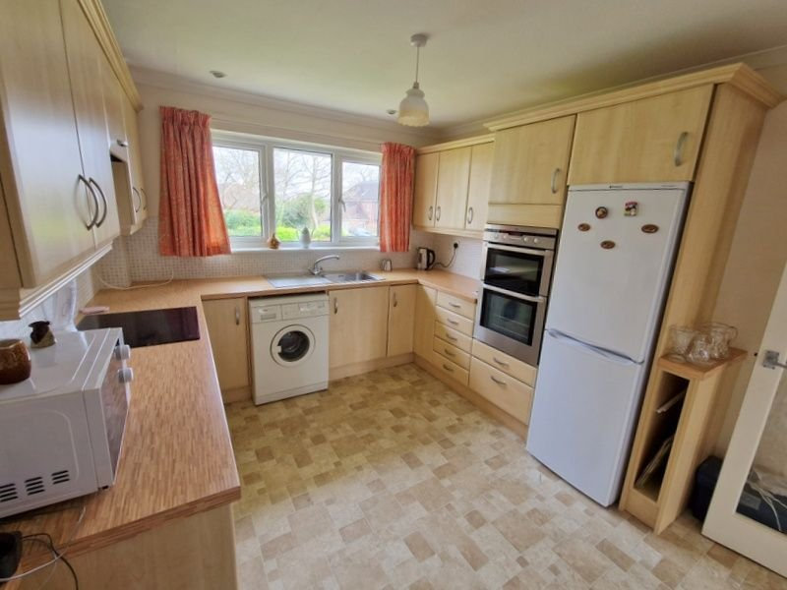
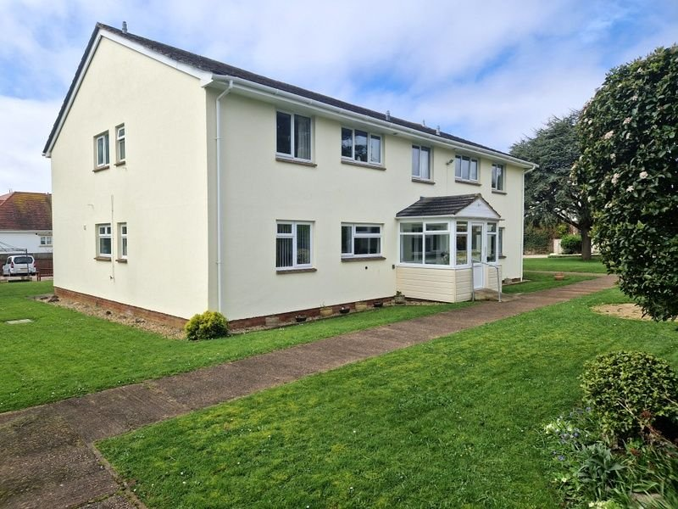
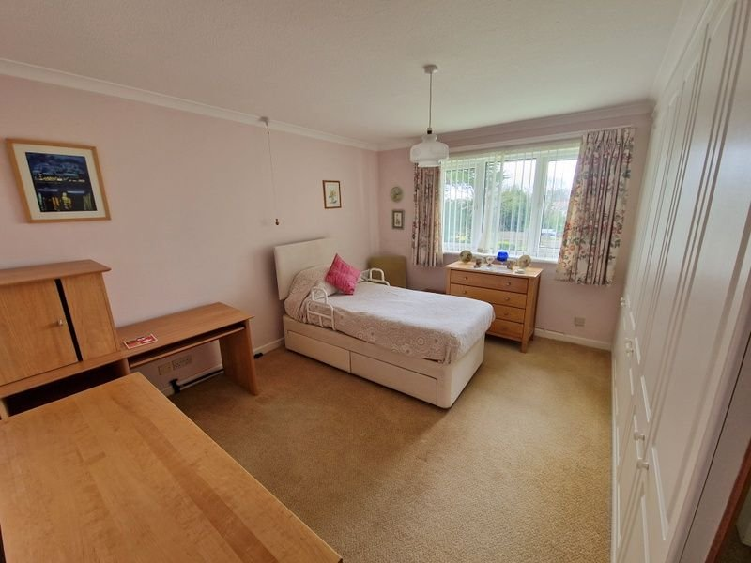
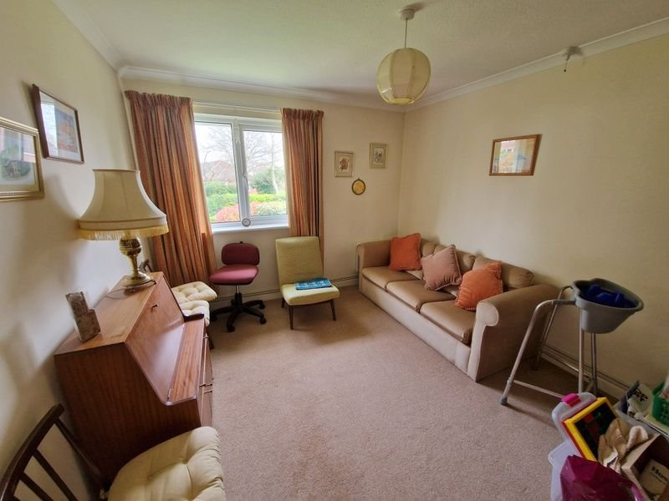
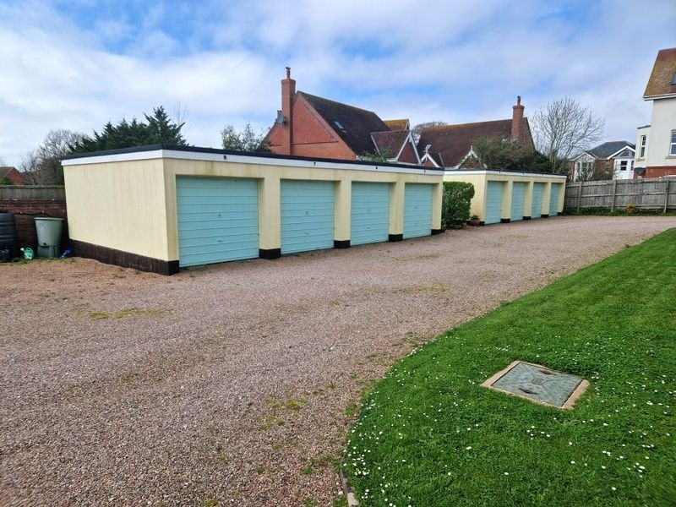
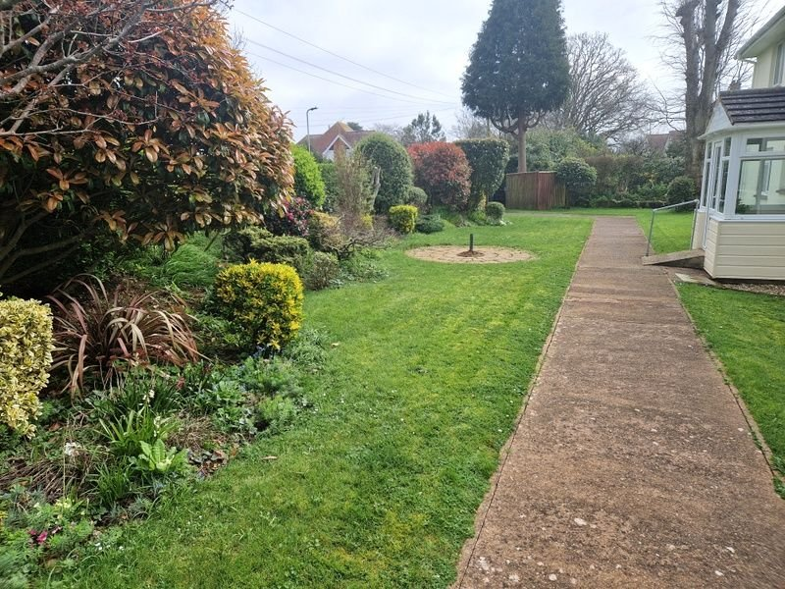
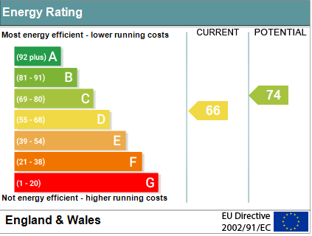
www.pennys.net
Flat 7 Pentgrove Court, Stevenstone Road, Exmouth, EX8 2EP
GUIDE PRICE £215,000
TENURE Share of Freehold
A Well Presented First Floor Purpose Built Apartment Set In Well Tended Communal Gardens With Ample Parking And Garage
Sought After Avenues Locations • Lounge/Dining Room • Kitchen/Breakfast Room •
Two Double Bedrooms • Bathroom •
Separate WC • Double Glazed Windows • No Ongoing Chain •
Pennys Estate Agents Limited for themselves and for the vendor of this property whose agents they are give notice that:- (1) These particulars do not constitute any part of an offer or a contract. (2) All statements contained in these particulars are made without responsibility on the part of Pennys Estate Agents Limited. (3) None of the statements contained in these particulars are to be relied upon as a statement or representation of fact. (4) Any intending purchaser must satisfy himself/herself by inspection or otherwise as to the correctness of each of the statements contained in these particulars. (5) The vendor does not make or give and neither do Pennys Estate Agents Limited nor any person in their employment has any authority to make or give any representation or warranty whatever in relation to this property.
PENNYS ESTATE AGENTS
2 Rolle House, Rolle Street, Exmouth, Devon, EX8 2SN
Tel: 01395 264111 EMail: help@pennys.net

Slide 2
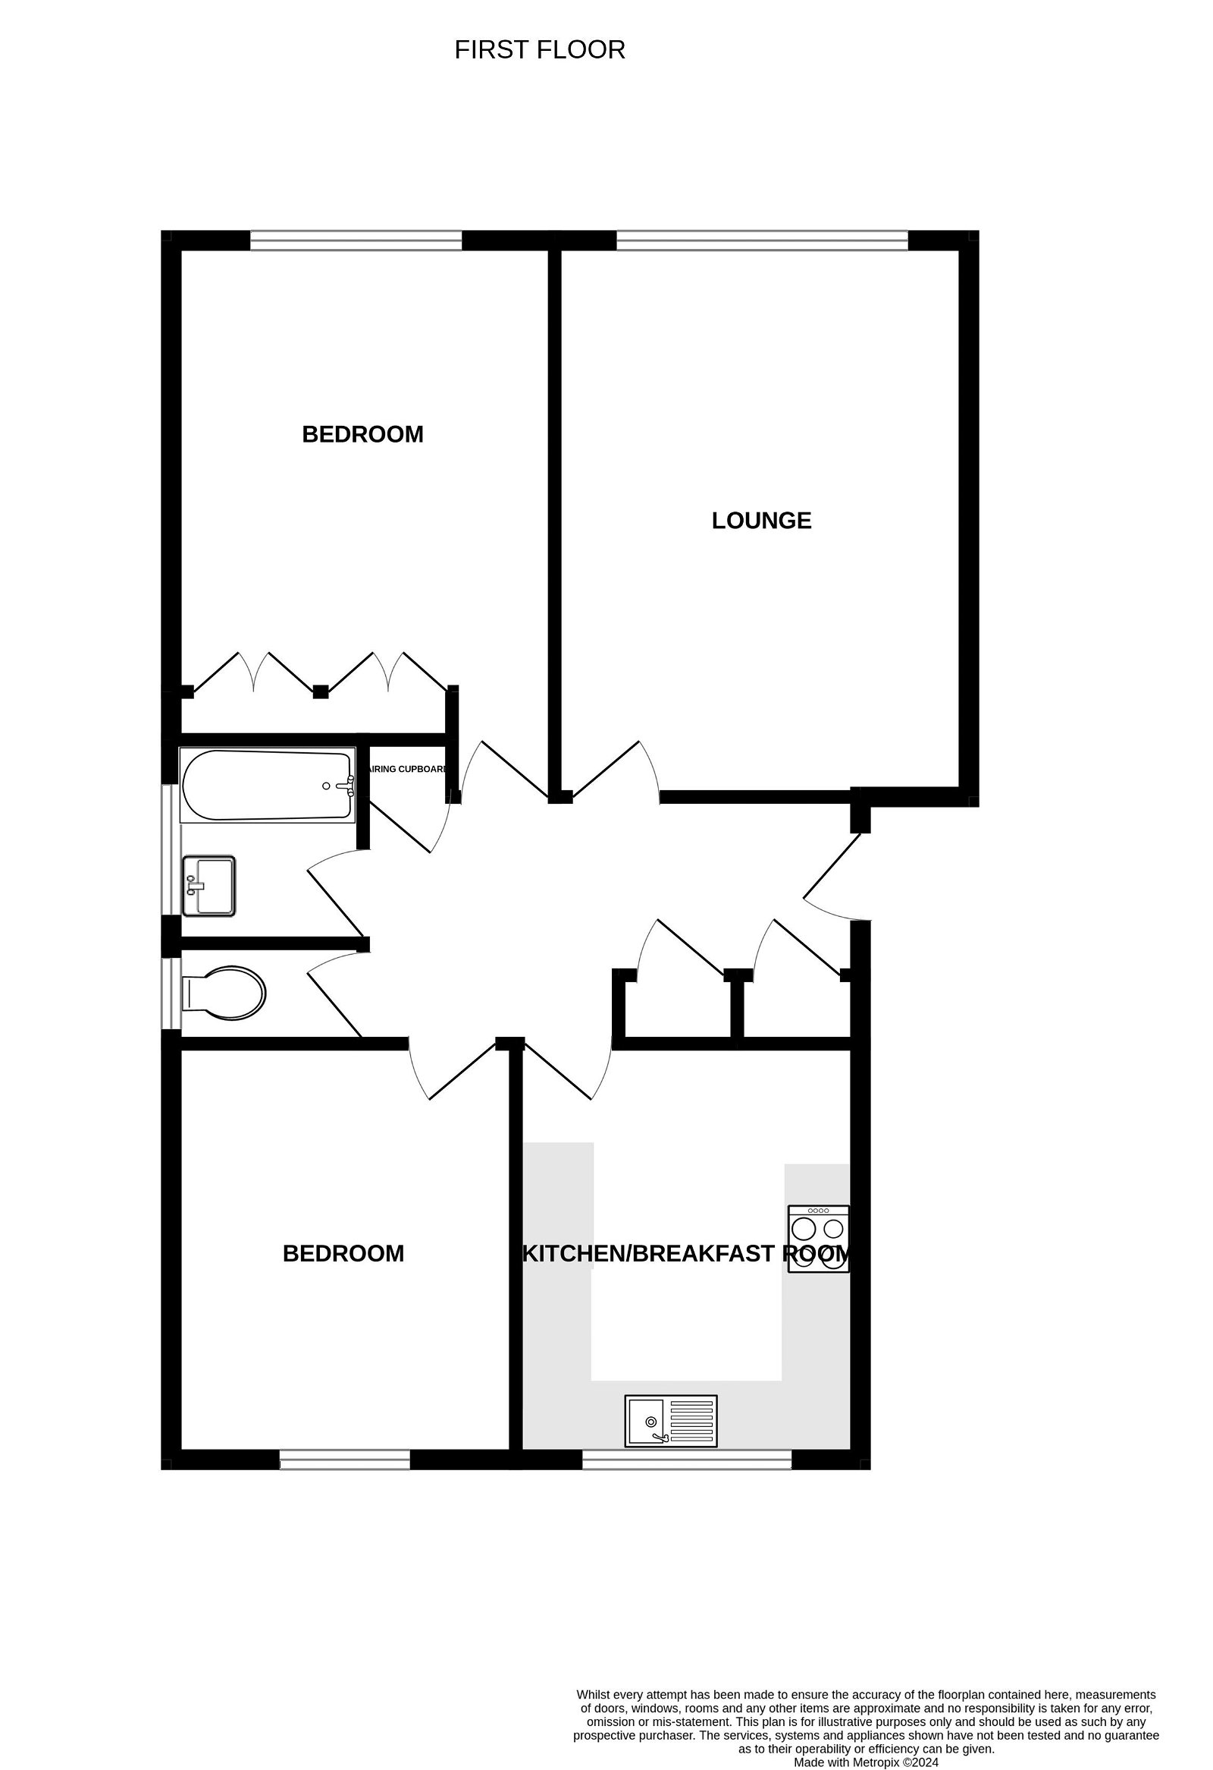
Flat 7 Pentgrove Court, Stevenstone Road, Exmouth, EX8 2EP
THE ACCOMMODATION COMPRISES: Communal entrance with staircase to first floor landing (stair lift available if required) with private front door to: RECEPTION HALL: Two cupboards - one housing electric meters; airing cupboard with water tank and shelving; doors to: LOUNGE/DINING ROOM: 4.88m x 3.63m (16'0" x 11'11") Double glazed window overlooking communal gardens to the rear of the development; Dimplex Quantrum heater; television point. KITCHEN/BREAKFAST ROOM: 3.61m x 3.05m (11'10" x 10'0") With wood effect worktop surfaces with tiled surrounds; cupboards, drawer units and plumbing for an automatic washing machine beneath; inset single drainer sink unit; four ring electric hob; built-in oven with drawer unit beneath and cupboard over; wall mounted cupboards; space for upright fridge freezer; Dimplex Quantum heater; double glazed window overlooking front communal gardens; television point. BEDROOM ONE: 4.88m x 3.63m (16'0" x 11'11") including doorway recess. Double glazed window overlooking rear communal gardens; built-in range of floor to ceiling wardrobes; Airmaster electric heater; television point. BEDROOM TWO: 3.81m x 3.02m (12'6" x 9'11") Double glazed window overlooking communal gardens to the front aspect; Airmaster wall heater. BATHROOM: Bath; pedestal wash hand basin; attractively tiled walls with fitted mirror; chrome heated towel rail; double glazed window with pattern glass; mirror fronted medicine cabinet. SEPARATE WC: WC; double glazed window with pattern glass. OUTSIDE: Pentgrove Court enjoys well tendered communal gardens, ample parking and communal bin store area. The flat benefits from a SINGLE GARAGE in a block. TENURE AND OUTGOINGS: Lease information and Service charges to be confirmed.
FLOOR PLAN:

