Slide 1
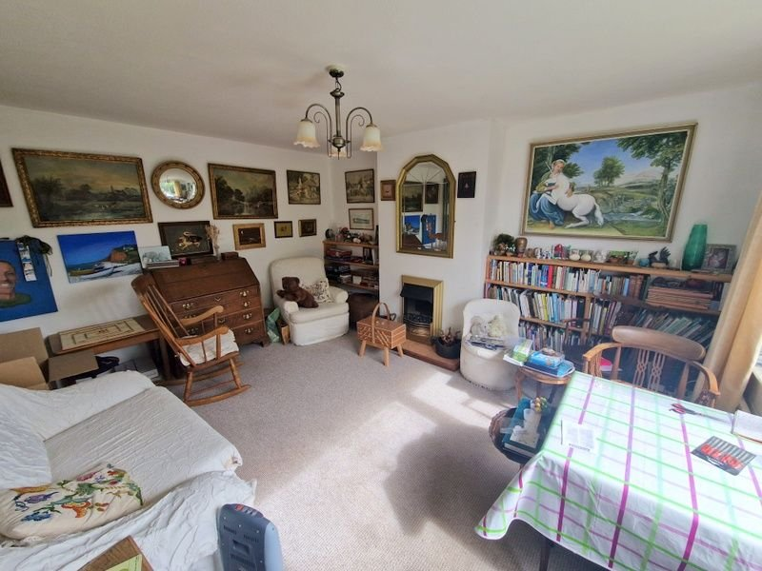
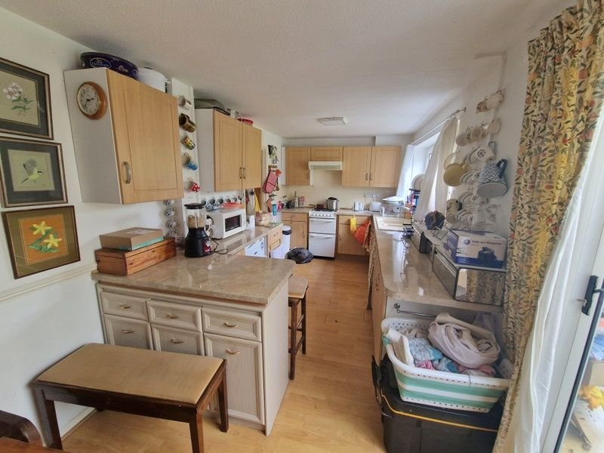
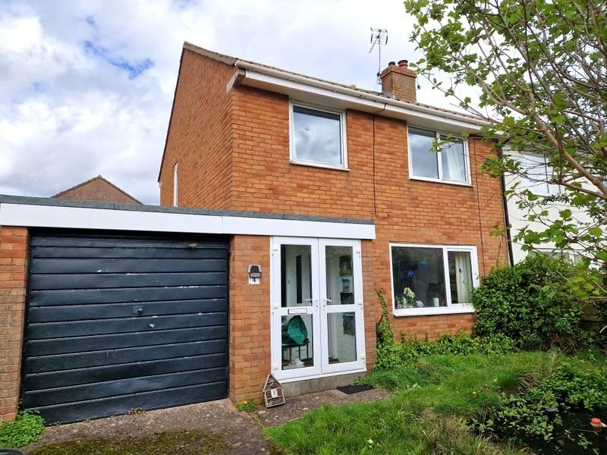
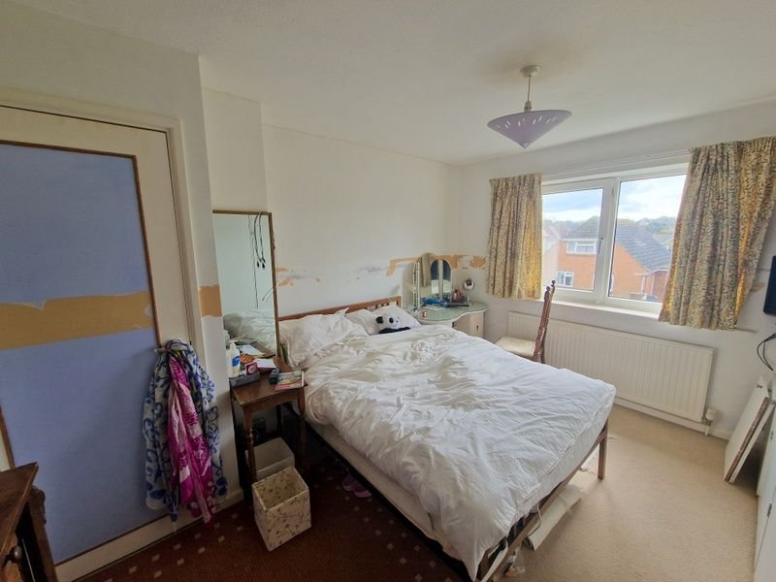
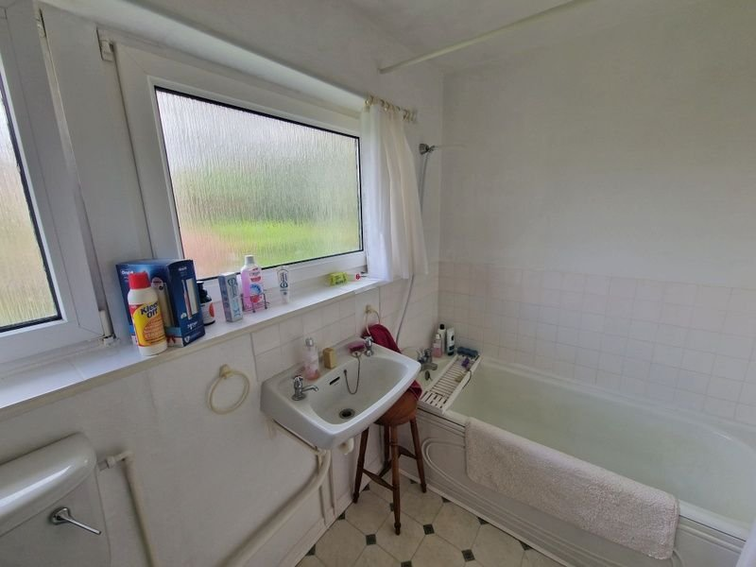
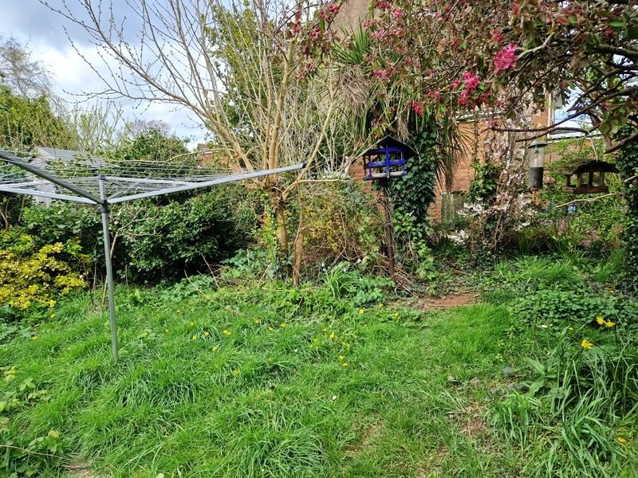
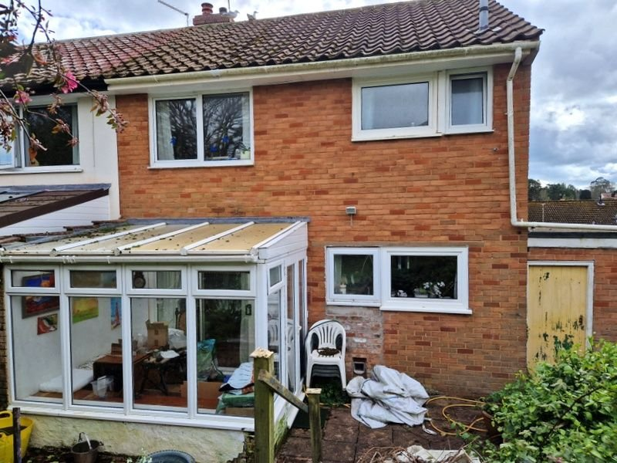
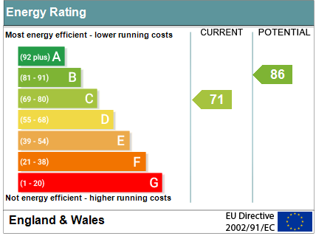
www.pennys.net
4 Clinton Close, Budleigh Salterton, EX9 6QD
GUIDE PRICE £360,000
TENURE Freehold
A Semi Detached House Enjoying An Enviable Location In The Sought After Area Of Budleigh Salterton
Lounge • Open Plan Kitchen/Dining Room • Conservatory •
Three Bedrooms • Bathroom/WC •
Large Garage • Front & Rear Gardens • Gas Central Heating • Double Glazed Windows • Some General Refurbishment Required • No Onward Chain •
Pennys Estate Agents Limited for themselves and for the vendor of this property whose agents they are give notice that:- (1) These particulars do not constitute any part of an offer or a contract. (2) All statements contained in these particulars are made without responsibility on the part of Pennys Estate Agents Limited. (3) None of the statements contained in these particulars are to be relied upon as a statement or representation of fact. (4) Any intending purchaser must satisfy himself/herself by inspection or otherwise as to the correctness of each of the statements contained in these particulars. (5) The vendor does not make or give and neither do Pennys Estate Agents Limited nor any person in their employment has any authority to make or give any representation or warranty whatever in relation to this property.
PENNYS ESTATE AGENTS
2 Rolle House, Rolle Street, Exmouth, Devon, EX8 2SN
Tel: 01395 264111 EMail: help@pennys.net

Slide 2
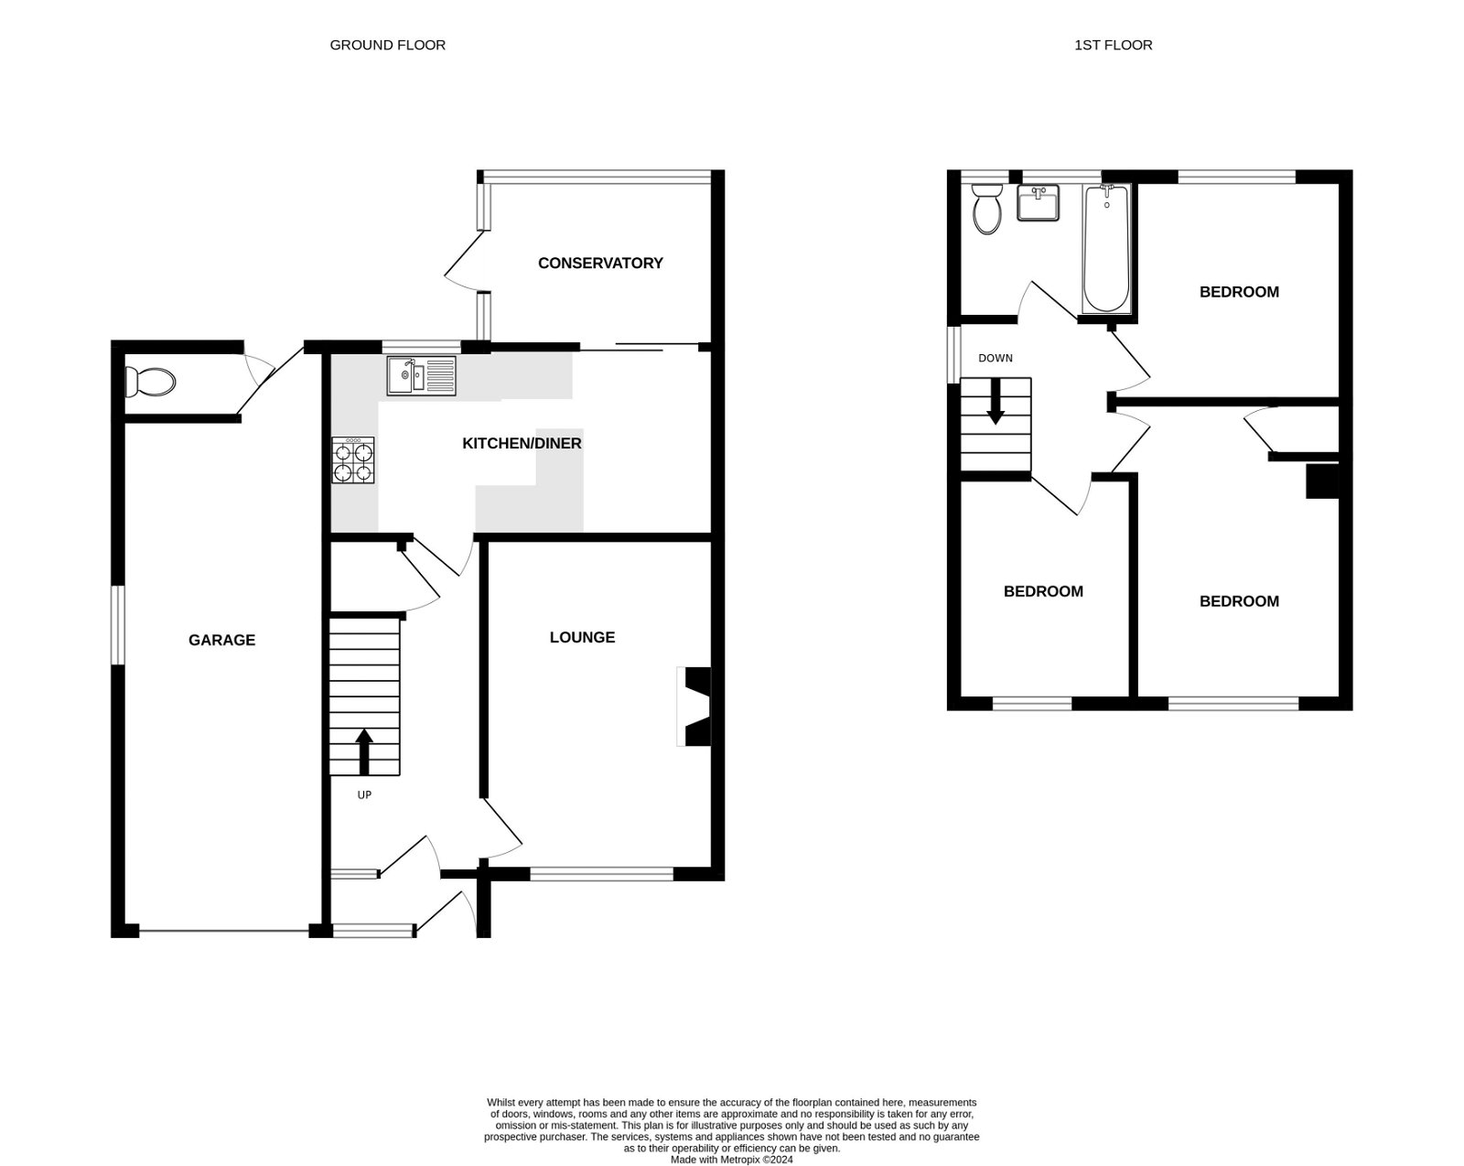
4 Clinton Close, Budleigh Salterton, EX9 6QD
THE ACCOMMODATION COMPRISES: Double glazed double doors to: ENTRANCE PORCH: Inner door to: RECEPTION HALL: Radiator; stairs to first floor landing; access to understairs cupboard. LOUNGE: 4.27m x 3.76m (14'0" x 12'4") Double glazed window to front aspect; electric coal effect fire; radiator. KITCHEN/DINING ROOM: 5.79m x 2.49m (19'0" x 8'2") An open plan room with pattern worktop surfaces with tiled surrounds; inset one and a quarter bowl sink unit with cupboards, drawer units, and appliance space beneath; gas cooker point; extractor hood over; wall mounted cupboards; radiator; sliding door to: CONSERVATORY: 3m x 2.26m (9'10" x 7'5") Double glazed windows and door to rear garden. FIRST FLOOR LANDING: Access to roof space via ladder; double glazed window to side aspect; doors to; BEDROOM ONE: 3.45m x 3.73m (11'4" x 12'3") Maximum overall measurement. Double glazed window to front aspect; built-in wardrobes; radiator. BEDROOM TWO: 4.04m x 2.87m (13'3" x 9'5") Double glazed window to rear aspect; radiator; pedestal wash hand basin with tiled splash back; fitted wardrobes and cupboard. BEDROOM THREE: 2.82m x 2.46m (9'3" x 8'1") Double glazed window to front aspect; cupboard over stairwell; radiator. BATHROOM/WC: 1.7m x 1.63m (5'7" x 5'4") Bath; wash hand basin; WC; radiator; tiling to splash prone areas; two double glazed windows with pattern glass; radiator. OUTSIDE: Gates to driveway and GARAGE. The front garden is laid to lawn with a fish pond. Side path to rear garden. The rear garden is an abundance of wildlife with patio steps up to lawn garden.
FLOOR PLAN:

