Slide 1
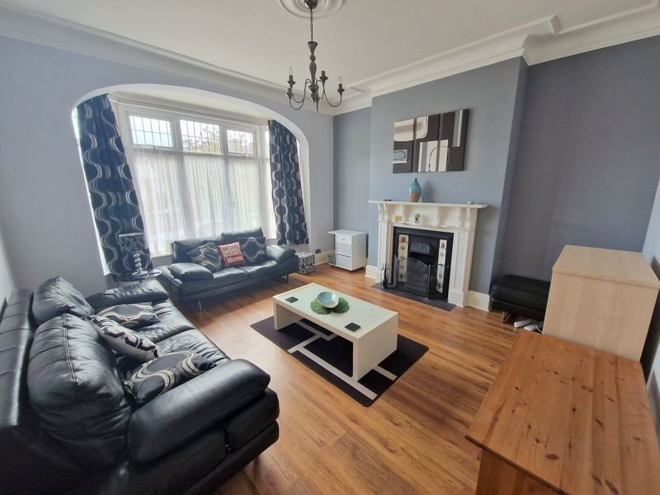
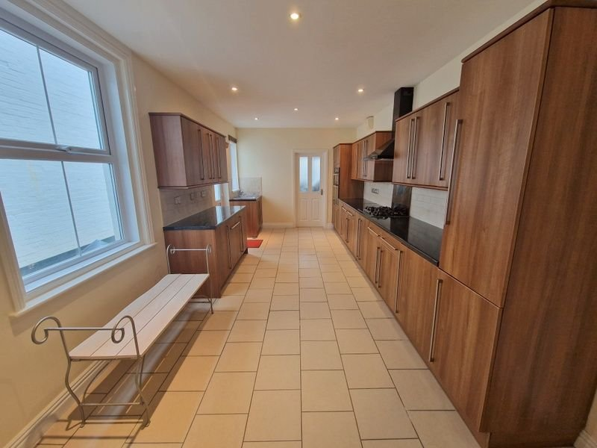
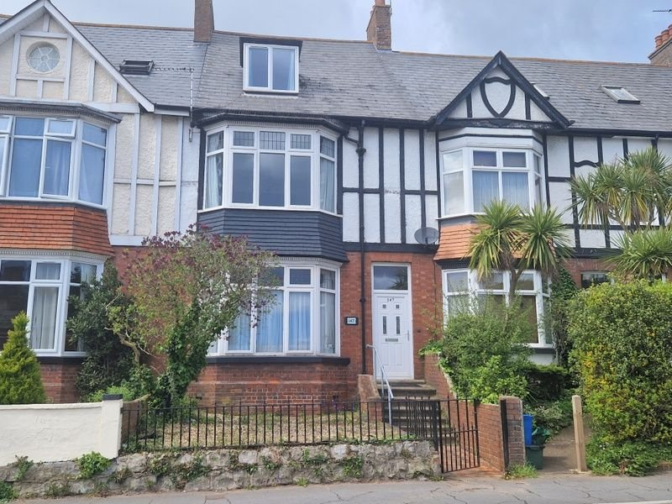
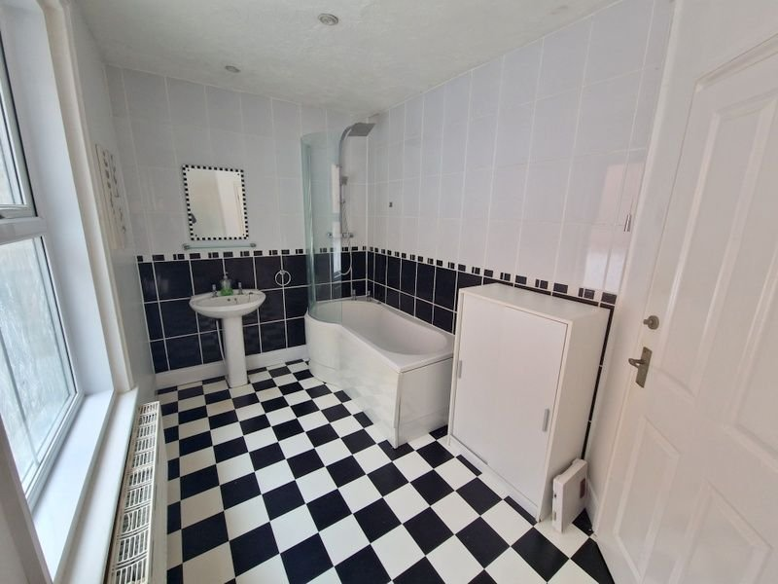
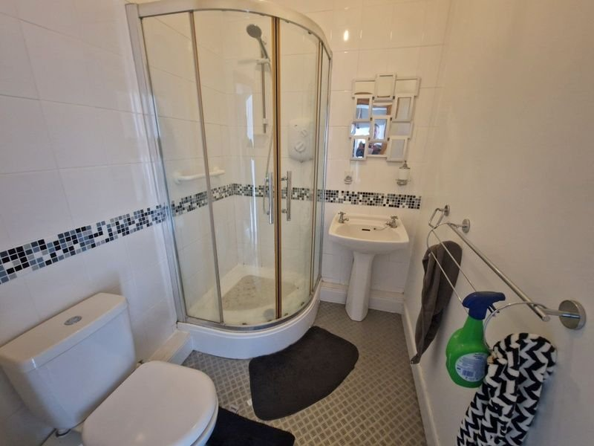
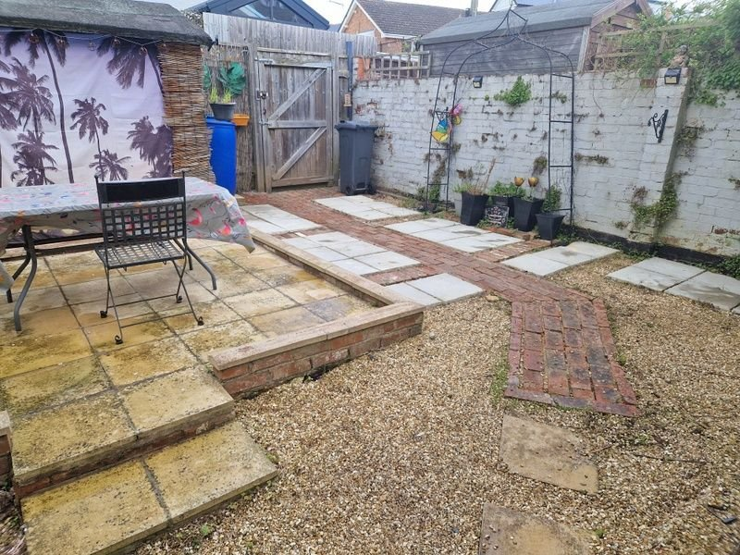
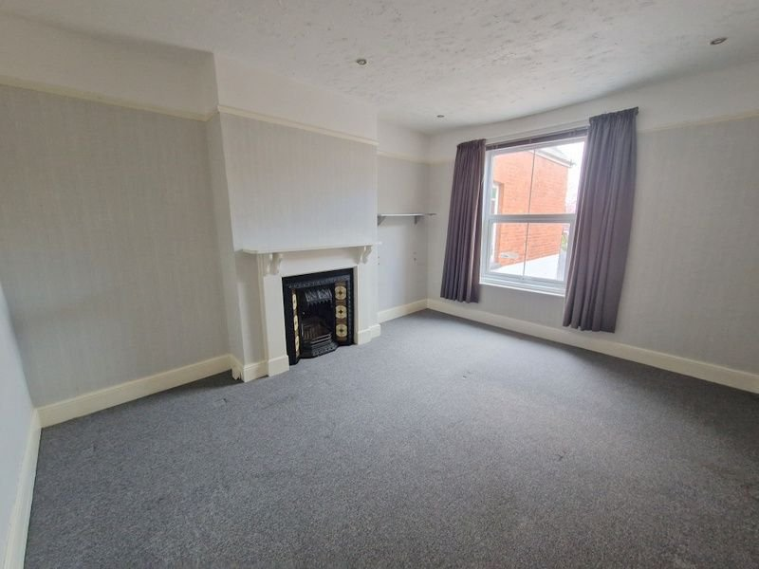
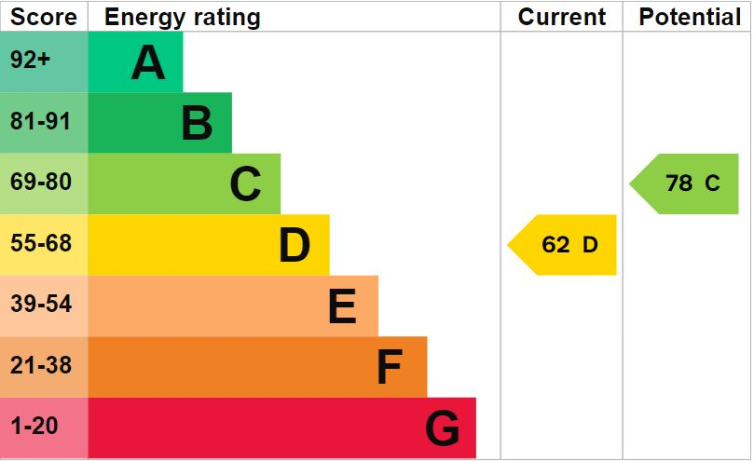
www.pennys.net
147 Exeter Road, Exmouth, EX8 3DX
GUIDE PRICE £440,000
TENURE Freehold
A Substantial Three Storey Five Bedroom Period House Found In Excellent Order With Attractive Rear Garden
Entrance Vestibule & Reception Hall • Lounge • Dining Room•
Modern Spacious Kitchen/Breakfast Room • Utility Room & WC •
Three First Floor Bedrooms - Main With En-Suite Shower Room/WC •
Spacious Bathroom Suite • Two Second Floor Bedrooms • No Onward Chain •
Viewing Recommended •
Pennys Estate Agents Limited for themselves and for the vendor of this property whose agents they are give notice that:- (1) These particulars do not constitute any part of an offer or a contract. (2) All statements contained in these particulars are made without responsibility on the part of Pennys Estate Agents Limited. (3) None of the statements contained in these particulars are to be relied upon as a statement or representation of fact. (4) Any intending purchaser must satisfy himself/herself by inspection or otherwise as to the correctness of each of the statements contained in these particulars. (5) The vendor does not make or give and neither do Pennys Estate Agents Limited nor any person in their employment has any authority to make or give any representation or warranty whatever in relation to this property.
PENNYS ESTATE AGENTS
2 Rolle House, Rolle Street, Exmouth, Devon, EX8 2SN
Tel: 01395 264111 EMail: help@pennys.net

Slide 2
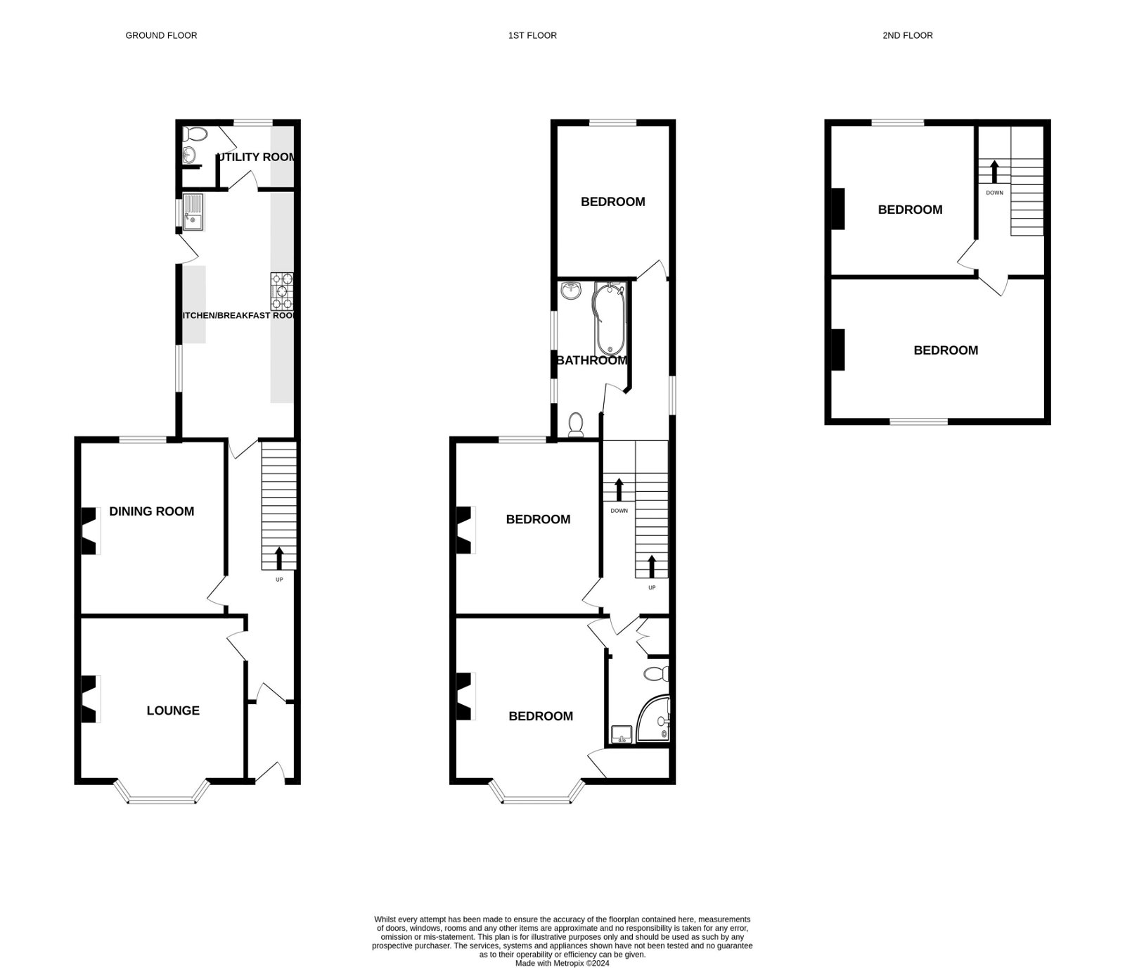
147 Exeter Road Exmouth EX8 3DX
THE ACCOMMODATION COMPRISES: uPVC front door to: ENTRANCE VESTIBULE: Mosaic tiled floor; inner door with pattern glass to: RECEPTION HALL: Wood effect flooring; radiator; recess ceiling spotlighting; stairs to FIRST FLOOR LANDING with understairs cupboard beneath; telephone point; cupboard housing electric consumer unit. LOUNGE: 5.05m x 4.42m (16'7" x 14'6") A bright room with double glazed bay window to front aspect; attractive fireplace with open grate and hearth; wood effect flooring; radiator; television point. DINING ROOM: 4.5m x 3.76m (14'9" x 12'4") Double glazed window to rear aspect; wood effect flooring; chimney recess with exposed brick and wood surround housing log burner stove; TV point; radiator. KITCHEN/BREAKFAST ROOM: 6.4m x 3.02m (21'0" x 9'11") A spacious room with a range of gloss finish worktop surfaces with tiled surrounds; cupboards, drawer units and integrated dishwasher beneath; inset five ring gas hob with chimney style extractor hood over; built-in double oven and grill; single drainer sink unit with hose style mixer tap; two double glazed windows and double glazed door to outside; tiled floor; radiator; recess ceiling spotlighting; space for large fridge freezer; door to: UTILITY ROOM: 1.75m x 1.73m (5'9" x 5'8") Plumbing for an automatic washing machine with worktop over; tiled surround; double glazed window; ceiling spotlighting; clothes rail; door to: CLOAKROOM: Wash hand basin; WC with push button flush; tiled floor; cupboard recess housing gas boiler; recess ceiling spotlighting. FIRST FLOOR LANDING: Double glazed window with pattern glass; radiator; stairs to SECOND FLOOR LANDING. Lobby area with built-in cupboard and access to BEDROOM & EN-SUITE. BEDROOM ONE: 5.13m x 4.11m (16'10" x 13'6") Double glazed bay window to front aspect; feature fireplace with grate; radiator; range of wardrobes plus built-in wardrobe; television point. EN-SUITE SHOWER ROOM/WC: 2.03m x 1.65m (6'8" x 5'5") Shower cubicle; pedestal wash hand basin; WC with push button flush; tiling to splash prone areas. BEDROOM TWO: 4.57m x 3.78m (15'0" x 12'5") Double glazed window to rear aspect; fireplace; radiator. BEDROOM THREE: 4.06m x 3.12m (13'4" x 10'3") Double glazed window to rear aspect; radiator; access to loft space.
BATHROOM/WC: 4.17m x 2.06m (13'8" x 6'9") Spacious bathroom with bath, shower over and shower screen; pedestal wash hand basin; WC with push button flush; radiator; two double glazed windows with pattern glass; recess ceiling spotlighting. SECOND FLOOR LANDING: Velux window. BEDROOM FOUR: 5.79m x 3.76m (19'0" x 12'4") Double glazed dormer style window to front aspect with pleasant open views; TV point; radiator; access to loft space via loft ladder which is fully insulated, partially boarded and with velux window.
BEDROOM FIVE: 3.96m x 3.78m (13'0" x 12'5") Double glazed dormer style window to rear aspect; access to roof eaves space; radiator; recess ceiling spotlighting. OUTSIDE: A decorative stone front garden enclosed with pedestrian gate and path to front door. Enclosed rear garden with decorative block paved path and stone garden and patio terrace ideal for outside entertaining, garden shed and rear pedestrian gate to service lane with potential parking Outside lighting.

