Slide 1
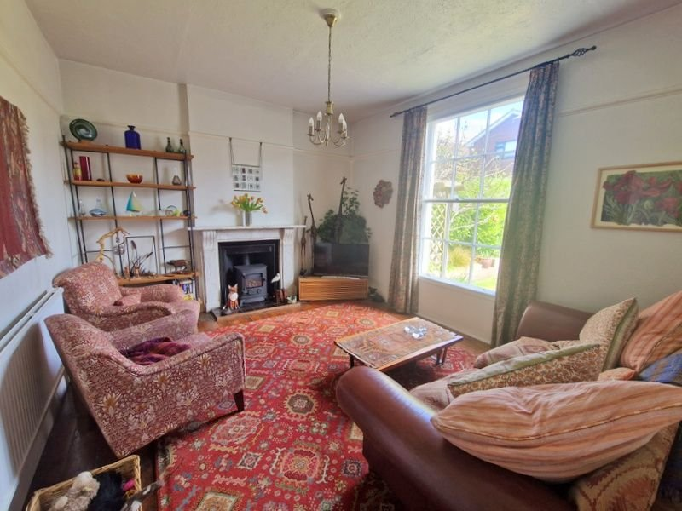
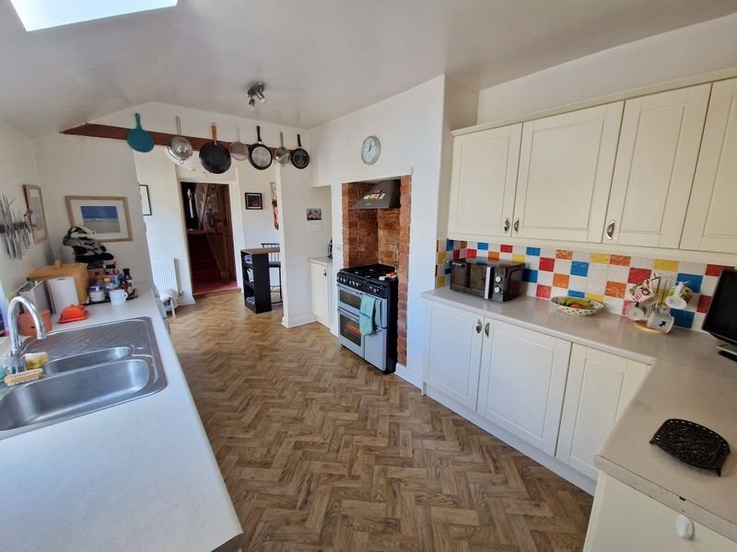
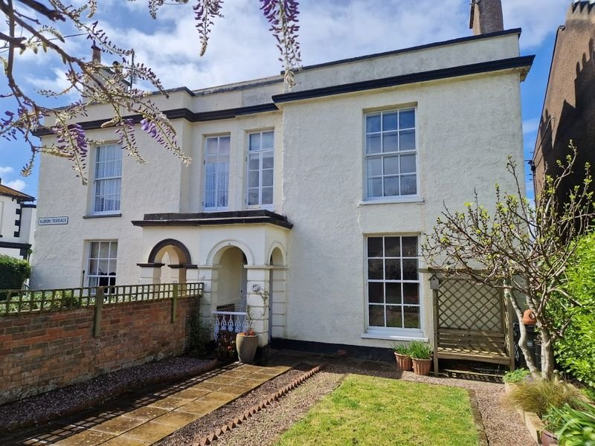
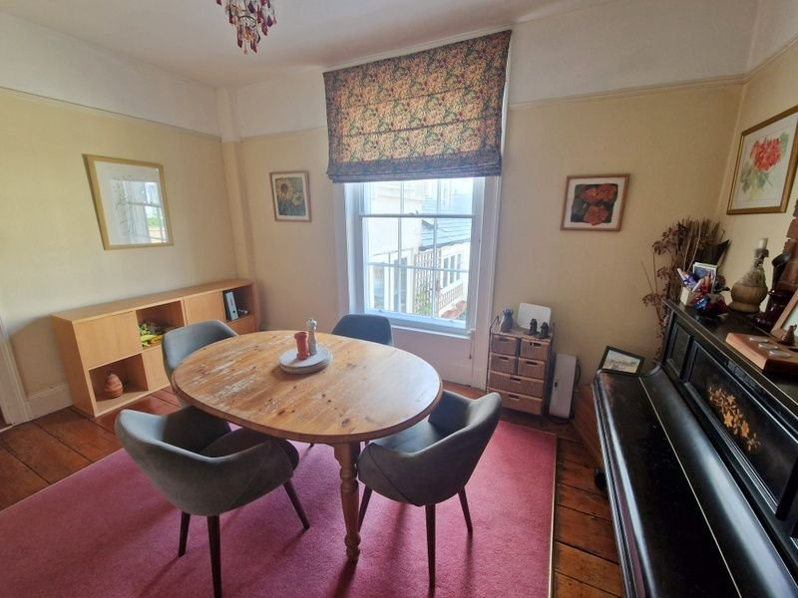
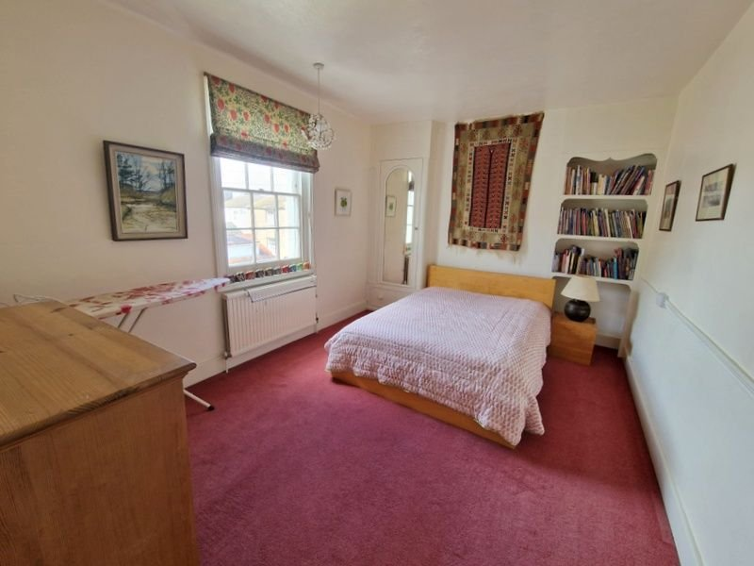
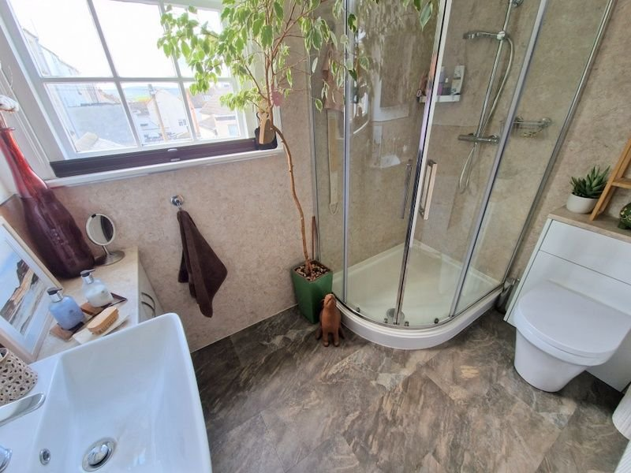
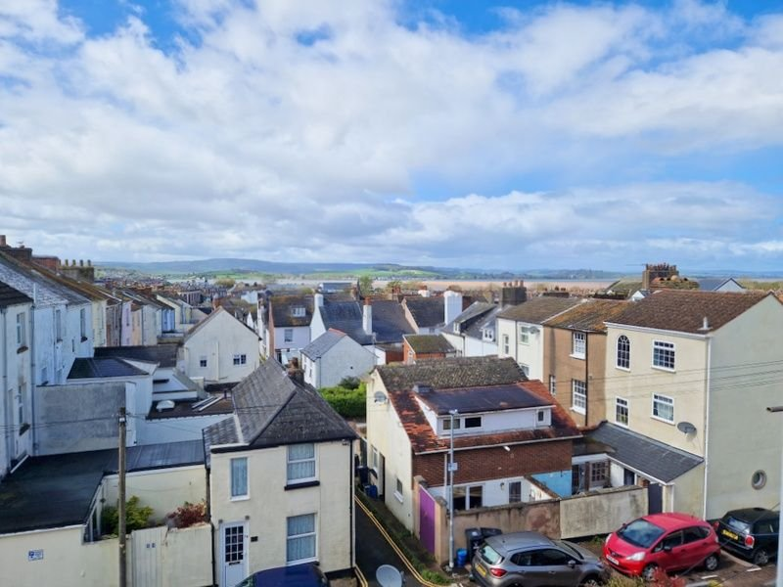
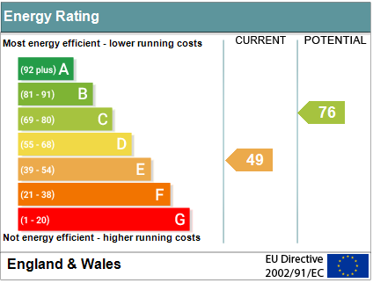
www.pennys.net
2 Albion Terrace, Exmouth, EX8 1JT
GUIDE PRICE £460,000
TENURE Freehold
A Beautifully Presented Grade II Listed Period Semi Detached House Enjoying A Tucked Away Yet Central Location With Attractive Gardens.
Bright And Well Maintained Accommodation • Entrance Vestibule And Reception Hallway • Lounge And Separate Dining Room • Kitchen/Breakfast Room •
Cloakroom/WC • Modern Shower Room/WC •
Basement Area • Four Bedrooms • Study • Lovely Gardens •
Potential To Create Off Road Parking (Previously Had An Off Road•
Parking Space) • Gas Central Heating Via Modern Boiler • Pleasant Estuary Views •
Pennys Estate Agents Limited for themselves and for the vendor of this property whose agents they are give notice that:- (1) These particulars do not constitute any part of an offer or a contract. (2) All statements contained in these particulars are made without responsibility on the part of Pennys Estate Agents Limited. (3) None of the statements contained in these particulars are to be relied upon as a statement or representation of fact. (4) Any intending purchaser must satisfy himself/herself by inspection or otherwise as to the correctness of each of the statements contained in these particulars. (5) The vendor does not make or give and neither do Pennys Estate Agents Limited nor any person in their employment has any authority to make or give any representation or warranty whatever in relation to this property.
PENNYS ESTATE AGENTS
2 Rolle House, Rolle Street, Exmouth, Devon, EX8 2SN
Tel: 01395 264111 EMail: help@pennys.net

Slide 2
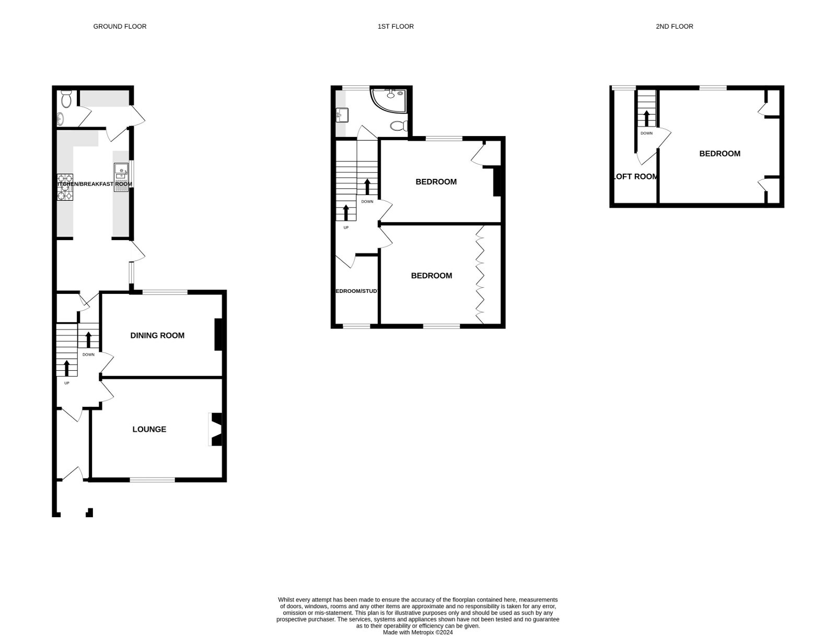
2 Albion Terrace, Exmouth, EX8 1JT
THE ACCOMMODATION COMPRISES: Arched open entrance porch and mosaic tiled floor: courtesy light; solid wood front door to: ENTRANCE VESTIBULE: Electric meters; inner part glazed door to: RECEPTION HALL: Radiator; stairs to first floor landing; door to:
BASEMENT/CELLAR AREA: A useful storage area. LOUNGE: 4.95m x 3.73m (16'3" x 12’3”) Secondary glazed sash style panelled window to front aspect; part stripped wood flooring; living flame effect gas burner stove housed in marble fireplace with tiled hearth; TV point;; radiator; and picture rail. DINING ROOM: 4.52m x 3.12m (14'10" x 10’3”) Secondary glazed panelled sash style window to rear aspect; part stripped wood stripped; exposed brick chimney breast; radiator; picture rail. KITCHEN/BREAKFAST: 5.99m x 2.84m (19'8" x 9'4") widening to 9’10 Comprising a range of worktops and cupboards and drawers and appliance space under; inset one and a quarter bowl single drainer sink unit; wall mounted cupboards; exposed brick chimney; gas cooker point with extractor hood over; patterned tiled surround; sealed unit double glazed window overlooking rear garden and sealed unit double doors to rear garden; sky light window; radiator. UTILITY ROOM: 2.03m x 1.42m (6'8" x 4’8”) Plumbing for automatic washing machine and tumble dryer space beneath work top; modern gas boiler; wall mounted cupboards; window and part glazed door to garden; door to: CLOAKROOM/WC: Wash hand basin; tiled splash back; WC; cupboard housing gas meter and water meter Turning staircase leads to : FIRST FLOOR LANDING: Stairs leading to second floor landing; radiator. BEDROOM ONE: 3.84m x 3.78m (12'7" x 12’5”) Secondary glazed panelled sash window to front aspect; full length floor to ceiling built in wardrobes with cupboards over. BEDROOM TWO: 4.32m x 3.2m (14'2" x 10’6”) Glass panelled sash window to rear aspect with some Estuary views; built in wardrobe and shelving units in wall recesses; radiator. STUDY: 2.36m x 1.8m (7'9" x 5'11") Glass panelled window to front aspect; radiator.
SHOWER ROOM: 2.59m x 1.8m (8'6" x 5'11")Modern stylish suite and large shower cubicle with curved shower screen doors and splash back walls; wash hand basin set in display surface with cupboard under; matching splash back walls and mirror over with integrated light; WC with push button flush; radiator; extractor fan; recessed ceiling spotlighting; single glazed window.
SECOND FLOOR LANDING:
BEDROOM THREE; 4.44m x 4.65m (14'7" x 15’3”) Double glazed dormer style windows to rear aspect affording views to the Estuary and Coastline beyond; built in cupboard and drawer unit; part tiled sloping ceilings.
BEDROOM FOUR: 2.31m x 1.7m (7'7" x 5'7") plus recess area of 6'x 2’7 Double glazed window to rear; splendid Estuary views. OUTSIDE: A pedestrian gate gives access to a charming front garden with lawn; decorative stone areas; patio pathway and raised colourful shrub borders; summer house. There is a side gateway and pathway to the rear garden. The enclosed rear garden has decked and block paved patio area. An outside tap and pedestrian gate to service lane. With re-modelling of the garden, there is scope to create parking if required.
FLOORPLAN:

