Slide 1
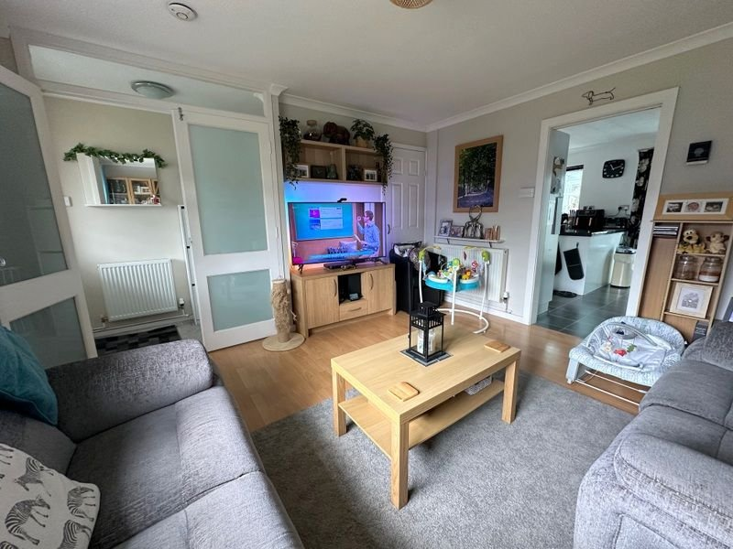
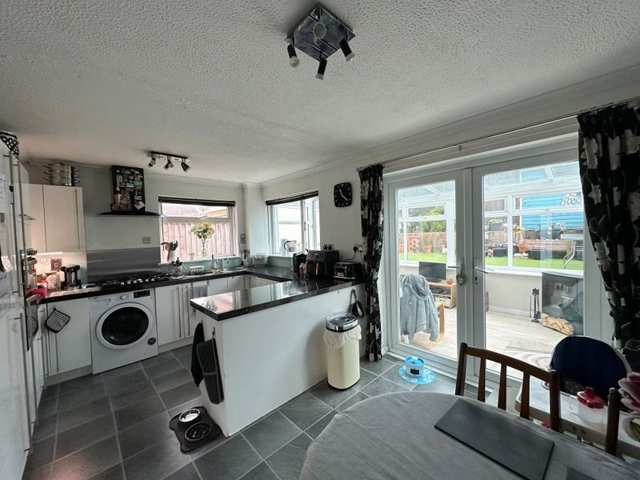
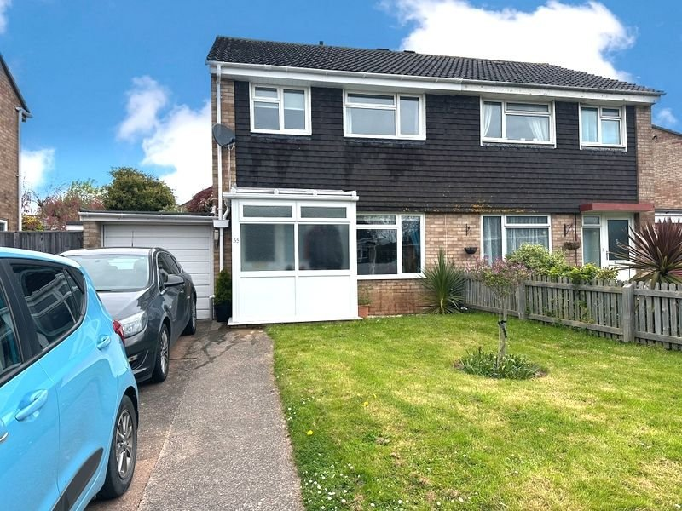
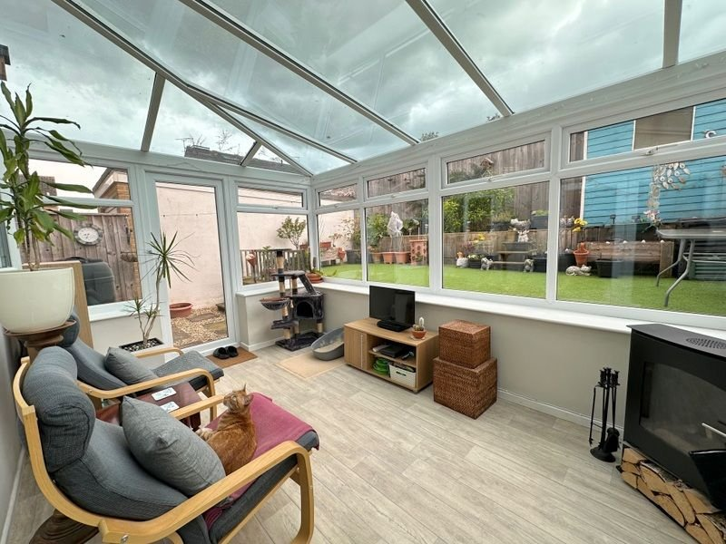
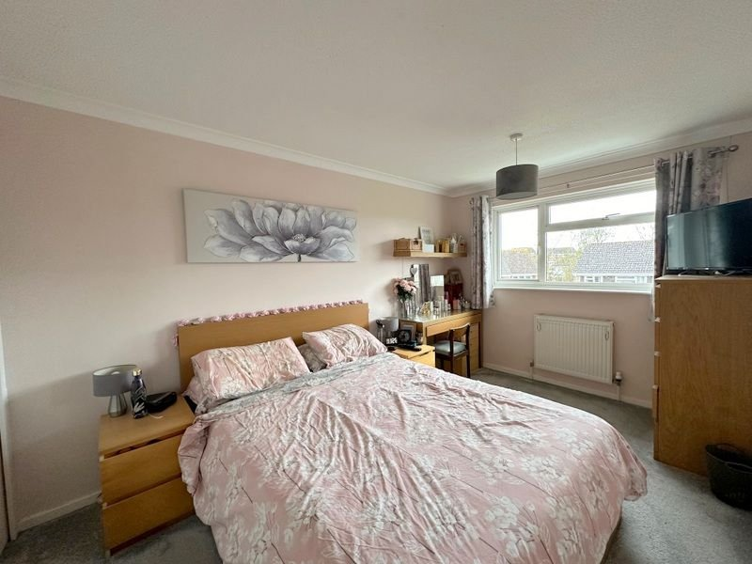
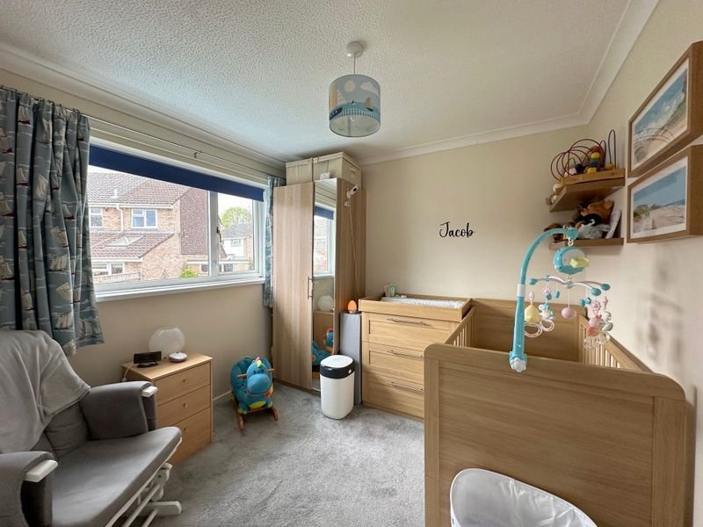
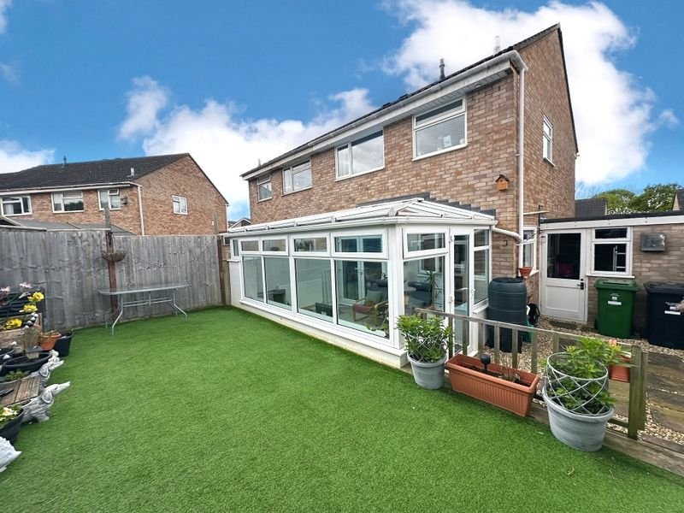
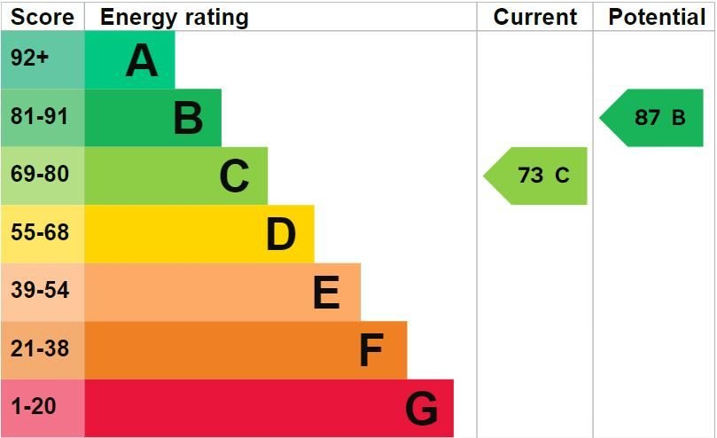
www.pennys.net
55 Hollymount Close, Exmouth, EX8 5PQ
GUIDE PRICE £307,500
TENURE Freehold
A Well Presented Three Bedroom Semi Detached House Situated In A Popular Location Close To Amenities With Off-Road Parking, Attractive Front And Rear Gardens And Garage.
Lounge • Kitchen/Dining Room • Conservatory • Three First Floor Bedrooms • Modern Bathroom/WC • Gas Central Heating & Double Glazed Windows • Driveway & Garage * Attractive Front and Rear Gardens • Viewing Highly Recommended •
Pennys Estate Agents Limited for themselves and for the vendor of this property whose agents they are give notice that:- (1) These particulars do not constitute any part of an offer or a contract. (2) All statements contained in these particulars are made without responsibility on the part of Pennys Estate Agents Limited. (3) None of the statements contained in these particulars are to be relied upon as a statement or representation of fact. (4) Any intending purchaser must satisfy himself/herself by inspection or otherwise as to the correctness of each of the statements contained in these particulars. (5) The vendor does not make or give and neither do Pennys Estate Agents Limited nor any person in their employment has any authority to make or give any representation or warranty whatever in relation to this property.
PENNYS ESTATE AGENTS
2 Rolle House, Rolle Street, Exmouth, Devon, EX8 2SN
Tel: 01395 264111 EMail: help@pennys.net

Slide 2
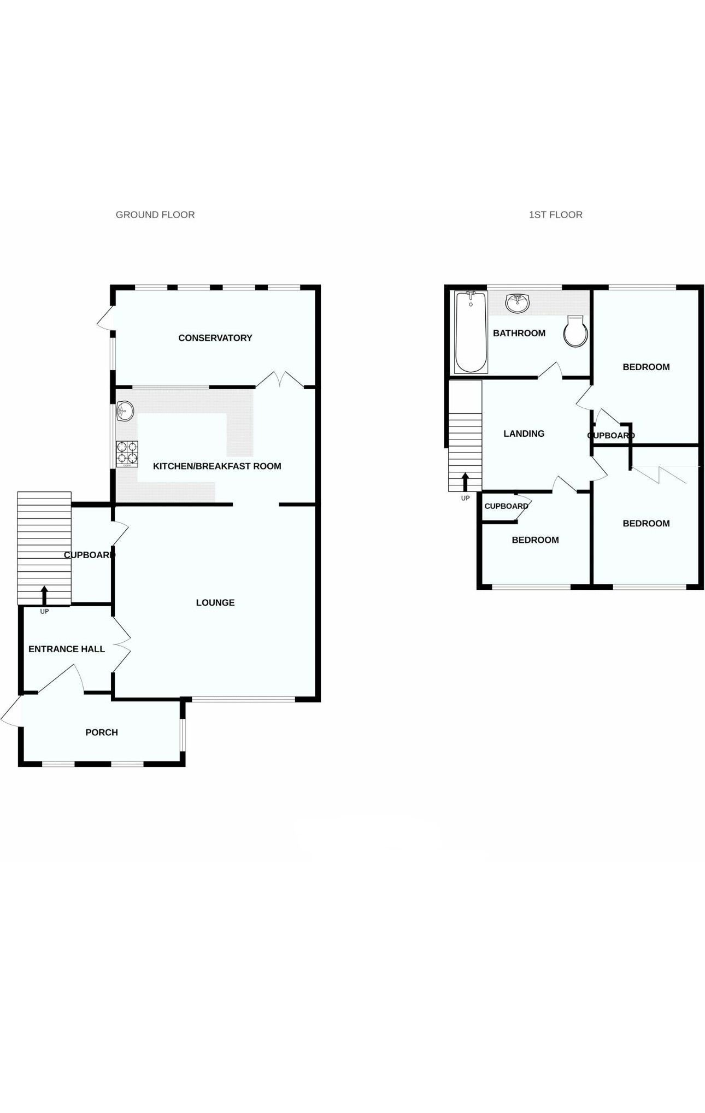
55 Hollymount Close, Exmouth, EX8 5PQ
THE ACCOMMODATION COMPRISES: uPVC double glazed front door with pattern inset giving access to:
ENTRANCE PORCH: uPVC double glazed windows with pattern glass coat rack, inner uPVC door with pattern window inset to:
RECEPTION HALL: Radiator, stairs to first floor landing, coved ceiling double wooden doors with pattern inset to:
LOUNGE: 4.04m x 3.73m (13'3" x 12'3") uPVC double glazed window to front aspect, wood effect flooring, coved ceiling, radiator, TV point, useful understairs cupboard housing electric consumer unit, wall lights.
Kitchen/Breakfast Room: 4.75m x 3.3m (15'7" x 10'10") Fitted with pattern worktop surfaces with cupboards, drawer units, plumbing for an automatic washing machine underneath with attractive tile surround, integrated dishwasher, integral fridge freezer, larder style cupboard. Built-in electric cooker and grill above, 6-ring gas hob with chimney style extractor hood over, circular sink with mixer tap and circular drainer. Wall mounted cupboards. Radiator, Coved ceiling, Tile effect flooring. uPVC double glazed side aspect window, uPVC window to rear aspect, uPVC double glazed door to:
Conservatory: 4.32m x 2.67m (14'2" x 8'9") uPVC double glazed window overlooking rear garden and uPVC door to outside. Radiator.
First Floor Landing: Access to partially boarded roof space. uPVC double glazed window to side aspect, Doors to:
Bedroom 1: 4.09m x 2.97m (13'5" x 9'9") uPVC double glazed window to front aspect. TV point. Radiator. Coved ceiling.
Bedroom 2: 2.77m x 2.74m (9'1" x 9'0") uPVC double glazed rear aspect. Radiator. Built-in wardrobe with slatted shelving and housing gas boiler servicing domestic hot water and gas central heating.
Bedroom 3: 3.02m x 1.98m (9'11" x 6'6") uPVC double glazed window to front aspect. Radiator. Built-in cupboard with shelving.
Bathroom/WC: 1.88m x 1.83m (6'2" x 6'0") Modern white suite comprising of; bath with rainfall and detachable shower head hose, glass shower screen, attractive tiled walls, extractor fan. Vanity unit with set in display surface with cupboard beneath and adjoining WC with push button flush and shelf over. LED spotlights. Chrome heated towel rail, mirror, uPVC double glazed window to rear aspect with obscure glass.
Outside: To the front there is a concrete driveway providing off-road parking, lawned garden edged with mature plants and trees. The rear garden is a feature to the property with patio and stone areas, steps to an artificial lawn are edged with mature shrubs and flower beds. Timber shed, outside tap.
Garage: 5.64m x 2.16m (18'6" x 7'1") Up and over door. Power and lighting connected, gas & electric meters, door to garden & window overlooking the garden.
FLOOR PLAN:

